Slide 1
YANGON TECHNOLOGICAL UNIVERSITY DEPARTMENT OF COMPUTER ENGINEERING AND INFORMATION TECHNOLOGY
Development of Children Gender Classification System Using Speech
(Weekly Seminar - 2)
Presented By
Ma Khin Aye Chan
M.E CEIT -2
Supervised By
Dr. Su Su Maung
February 13, 2019

Slide 2
Outlines
Introduction
Dataset Preparation
Data Preprocessing
Conclusion
References

Slide 3
Introduction
When developing a gender classification system by speech, high quality speech data is needed to ensure that the system can understand and respond to human speech with exact classification rate.
Preprocessing of data (speech signals) is considered a crucial step in the development of a robust and efficient speech recognition system.

Slide 4
Dataset Preparation
Firstly, I prepared 10 Myanmar sentences:
မဂင်္လာပါ
ေကျးဇူးတင်ပါတယ်
နာမည်ဘယ်လိုေခါ်လဲ
ဘယ ်သွားမလို့လဲ
ေနေကာင်းလား
စာေမးပွဲေြဖနိုင်လား
အေမကိုေခါ်လာခဲ့ပါ
ဘာြဖစ်လို့လဲ
ဘယ်မှာေနသလဲ
ဘာ၀ါသနာပါလဲ

Slide 5
Dataset Preparation (Cont’d)
I will collect audio files from children of KG to Grade V (age range 6 to 11 years).
For each year, a boy and a girl are selected and speak the above mentioned sentences repeatedly about 15 times and record their voice.
Right now, I have 750 audio files for the first five sentences.
Grade | Male | Female
KG | 2 | 2
1 | 2 | 2
2 | - | 2
Table 1

Slide 6
Dataset Preparation (Cont’d)
File Type | .wav format
Duration | 2 or 3 second
Numbers of Channel | Mono (1 Channel)
Sampling Frequency | 44.1 kHz
Number of Bits | 16 bits
Table 2: Recording Specification

Slide 7
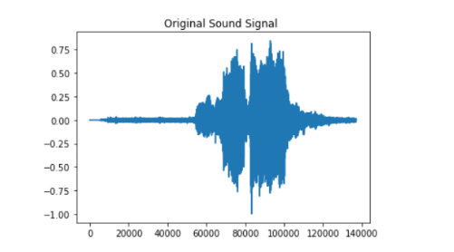
Data Preprocessing
At first, silence and unvoiced speech are cut out from collected wave files by using amplitude values and a threshold value.
Fig 1: Original Sound Signal

Slide 8
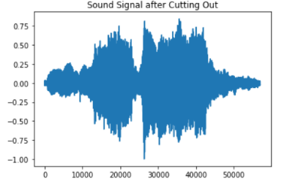
Data Preprocessing (Cont’d)
Fig 2: Sound Signal after Cutting out

Slide 9
Data Preprocessing (Cont’d)
Noise problems affect the interpretation of the final voice data, as they affect classification algorithms and can mask the real data.
Data processing methods are used for noise removal.
In this system, high-pass filter and low-pass filter are used for noise removal.
A high-pass filter (HPF) is an electronic filter that passes signals with a frequency higher than a certain cutoff frequency and attenuates signals with frequencies lower than the cutoff frequency.
A low-pass filter (LPF) is a filter that passes signals with a frequency lower than a selected cutoff frequency and attenuates signals with frequencies higher than the cutoff frequency.

Slide 10
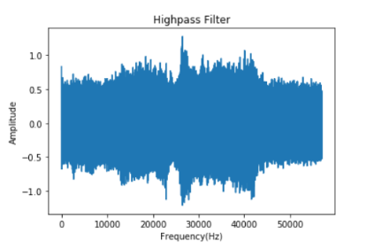
Data Preprocessing (Cont’d)
Fig 3: Sound Signal after Applying High-pass Filter

Slide 11
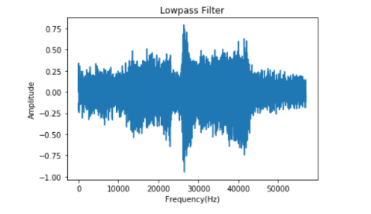
Data Preprocessing (Cont’d)
Fig 3: Sound Signal after Applying Low-pass Filter

Slide 12
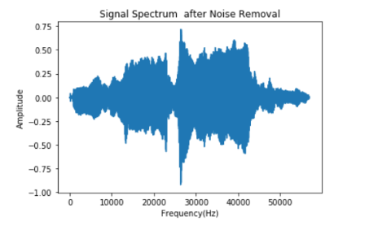
Data Preprocessing (Cont’d)
Fig 3: Sound Signal after Noise Removal

Slide 13
Conclusion
The goal is to implement a gender classifier that can automatically predict the gender of the speaker.
After preprocessing step, feature extraction continued to work using MFCC algorithm.

Slide 14
References
https://github.com/davidpraise45/Audio-Signal-Processing
https://en.wikipedia.org/wiki/High-pass_filter
https://en.wikipedia.org/wiki/Low-pass_filter

Slide 15
Thank you for your attention!!!

