Slide 1

YANGON TECHNOLOGICAL UNIVERSITY
DEPARTMENT OF COMPUTER ENGINEERING AND INFORMATION TECHNOLOGY
Development of Children Gender Classification System Using Speech
(First Seminar)
Presented By
Ma Khin Aye Chan
M.E CEIT -2
Supervised By
Dr. Su Su Maung
March 21, 2019

Slide 2
Outlines
Objectives
Introduction
Applied Research Area
Problem Statement
System Flow Diagram for the Proposed System
Dataset Preparation
Data Preprocessing
Feature Extraction Using MFCC Algorithm
Conclusion and Future Work
References

Slide 3
Objectives
To study the algorithms of feature extraction (MFCC) and classification
To understand the speech recognition operations in details
To implement a gender classifier that can automatically predict the gender of the speaker

Slide 4
Introduction
Gender classification is to determine a person’s gender, e.g., male or female, based on his or her biometric cues.
There are a number of biometrics which may be used to classify gender such as the face, eyes, fingerprint and hand shape, speech etc.
This system aims at analyzing speech signals to predict the gender of the speaker.

Slide 5
Applied Research Area
In today’s increasingly mobile connected world, having hands free interface options is critical.
Speech recognition technology, also called voice command, allows users to interact with and control technologies by speaking to them.
Gender classification is widely used in automatic speech recognition systems to recognize a speaker speaking continuously in any language.
The need for gender classification from speech also arises in several situations such as speech synthesis, speaker recognition, acoustic data analysis (heart beat, pulse) and sorting telephone calls by gender for gender sensitive surveys.

Slide 6
Problem Statement
Gender identiﬁcation of children is difﬁcult than adults, it is confusing to identify whether the speaking child is male or female.
Due to underdeveloped vocal tract and thin vocal folds in both male and female child, there is no signiﬁcant difference in their acoustic-phonetic properties.

Slide 7
Start
Children Speech (6 to 11 age range)
Preprocessing
Feature Extraction
(MFCCs)
Classification
(Random Forest)
Predicted Output
(Male/Female)
End
Fig. 1: System Flow Diagram

Slide 8
Dataset Preparation
Firstly, I prepared 10 Myanmar sentences:
မဂင်္လာပါ
ေကျးဇူးတင်ပါတယ်
နာမည်ဘယ်လိုေခါ်လဲ
ဘယ ်သွားမလို့လဲ
ေနေကာင်းလား
စာေမးပွဲေြဖနိုင်လား
အေမကိုေခါ်လာခဲ့ပါ
ဘာြဖစ်လို့လဲ
ဘယ်မှာေနသလဲ
ဘာ၀ါသနာပါလဲ

Slide 9
Dataset Preparation (Cont.)
I will collect audio files from children of KG to Grade V (age range 6 to 11 years).
For each year, a boy and a girl are selected and speak the above mentioned sentences repeatedly about 15 times and record their voice in quiet classrooms.
Right now, I have 750 audio files for the first five sentences.
Grade | Male | Female
KG | 2 | 2
1 | 2 | 2
2 | - | 2
Table 1

Slide 10
Dataset Preparation (Cont.)
File Type | .wav format
Duration | 2 or 3 second
Numbers of Channel | Mono (1 Channel)
Sampling Frequency | 44.1 kHz
Number of Bits | 16 bits
Table 2: Recording Specification

Slide 11
Data Preprocessing
When developing a gender classification system by speech, high quality speech data is needed to ensure that the system can understand and respond to human speech with exact classification rate.
Preprocessing of data (speech signals) is considered a crucial step in the development of a robust and efficient speech recognition system.
In this system, preprocessing has two steps: noise reduction and silence removal.

Slide 12
Data Preprocessing (Cont.)
Noise Reduction
Noise problems affect the interpretation of the final voice data, as they affect classification algorithms and can mask the real data.
If the signal occupies low frequencies and the main noise occupies high frequencies, then by using a low pass filter most of the noise can be removed.
In this system, low-pass filter with cutoff frequency 500Hz is used for noise reduction.
A low-pass filter (LPF) is a filter that passes signals with a frequency lower than a selected cutoff frequency and attenuates signals with frequencies higher than the cutoff frequency.

Slide 13
Data Preprocessing(Cont.)
Silence and Unvoiced Speech Removal
The speech recordings of children consists of many silence and unvoiced regions.
Leading/trailing silence in the audio may not contain much information and thus not useful for the classification.
Hence, next preprocessing step is to remove this silence.
librosa.effects.trim function was used to achieve this.

Slide 14


Data Preprocessing (Cont.)
Original Audio File
Audio File after Noise Removal
Audio File after Silence Removal

Slide 15
Feature Extraction using MFCC Algorithm
Mel-frequency Cepstral Coefﬁcients (MFCCs)
In sound processing, the mel-frequency cepstrum (MFC) is a representation of the short-term power spectrum of a sound.
The power spectrum describes the distribution of power into frequency components composing that signal.
MFCCs are coefficients that collectively make up an MFC.

Slide 16
Input Speech Signal
Pre-emphasis
Framing
Windowing
Fast Fourier Transform
MFCC Features
DCT
Mel-frequency Warping
Fig. 2: Steps for Computing MFCCs

Slide 17
Pre-emphasis
Due to the structure of human speech production system, damping occurs in high-frequency regions.
Especially, higher frequencies will have less energy compared to the lower ones, thus, getting poor results with the linear prediction model.
To cope with this, a high pass filter is applied on the signal in order to enhance these components.
The filter increases the energy of higher frequency signal and decrease the energy of lower frequency signal and obtain a much evenly distributed spectrum.
So it can remove some noise signal.
This is called the pre-emphasizing step.

Slide 18
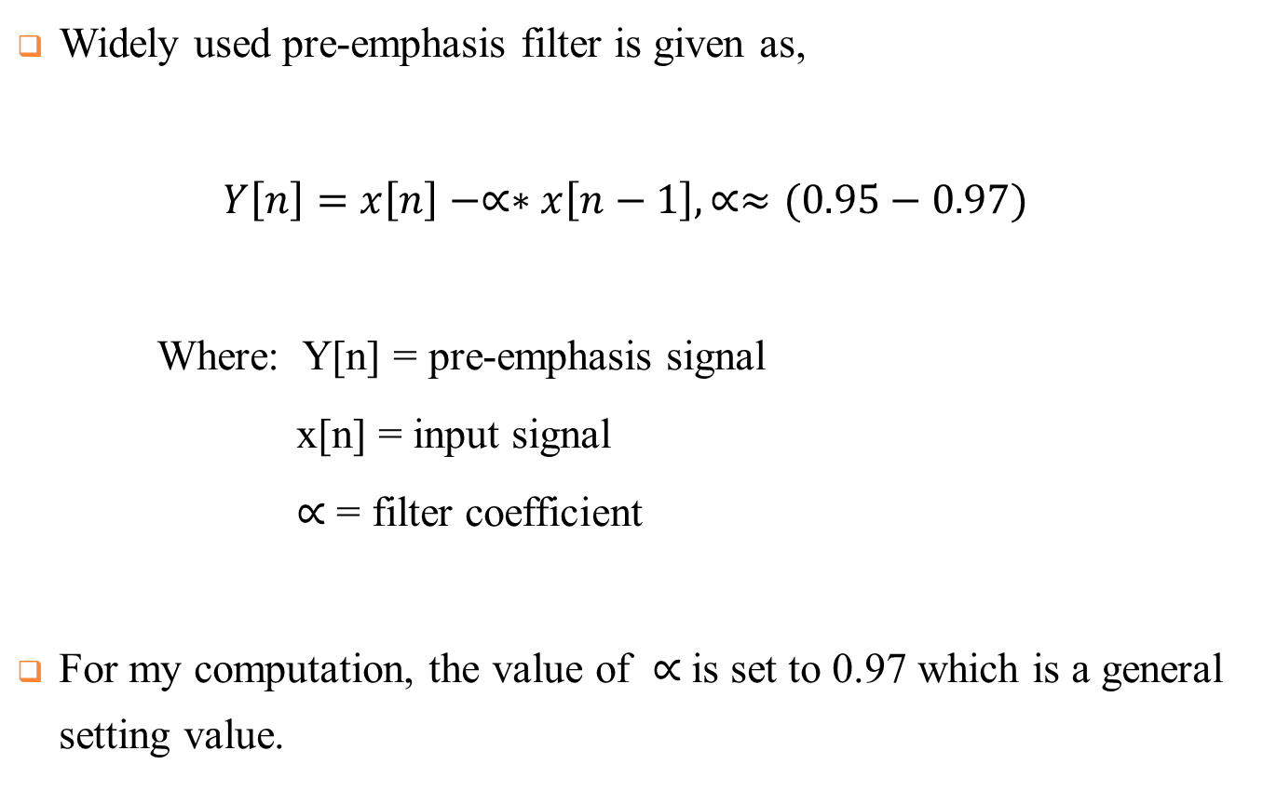
Pre-emphasis (Cont.)
Widely used pre-emphasis filter is given as,
$Y\left[n\right]=x\left[n\right]−∝∗x\left[n−1\right], ∝≈(0.95−0.97)$
Where: Y[n] = pre-emphasis signal
x[n] = input signal
$∝$ = filter coefficient
For my computation, the value of $∝$is set to 0.97 which is a general setting value.

Slide 19
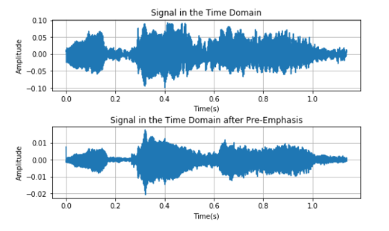
Pre-emphasis (Cont.)
Fig. 3: Pre-emphasizing an Audio Signal

Slide 20
Framing
Like in all voice analysis methods, also MFCC method is applied along the short portions where voice has stationary acoustic features.
Framing is the process of blocking the speech signal into short portion of n samples known as frames in the time domain.
These frames are generally selected as 20-30 milliseconds a shift of 10-15 milliseconds along the signal.
If the signal is framed into 25ms, the frame length for a 16kHz signal is 0.025*16000 = 400 samples.
If the frame step is 10ms (160 samples), which allows some overlap to the frames, the first 400 sample frame starts at sample 0, the next 400 sample frame starts at sample 160 etc. until the end of the speech file is reached.

Slide 21

Windowing
After framing step, each individual frame is windowed using window function.
Each of the above frames is multiplied with a window function to minimize signal discontinuities at the beginning and at the end of each frame .
This step makes the end of each frame connects smoothly with the beginning of the next.
MFCC uses hamming window and the equation is as follows:
Where: n = number of samples in each frame
Y(n) = Output Signal
x(n) = Input Signal
W(n) = Hamming window
$$Y\left(n\right)=x\left(n\right). W(n)$$

Slide 22
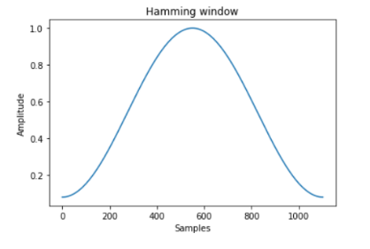

Windowing (Cont.)
A Hamming window has the following form:
where: 0 ≤ n ≤ N−1, N = the window length
$W\left(n\right)=0.54−0.46\cos{(\frac{2πn}{N−1}}$)
Fig. 4: Hamming Window with 1000 samples

Slide 23
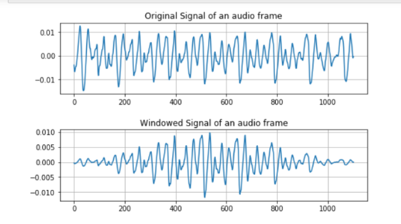
Windowing (Cont.)
Fig. 5: Windowing of an Audio Frame

Slide 24
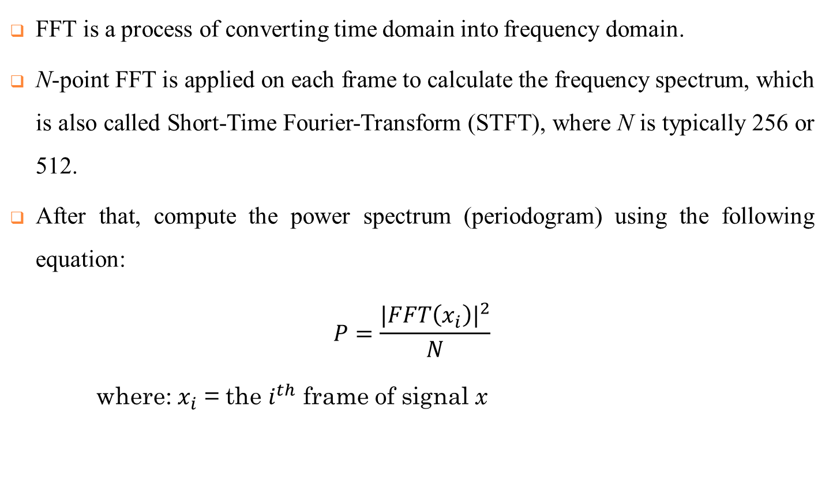
Fast Fourier Transform
FFT is a process of converting time domain into frequency domain.
N-point FFT is applied on each frame to calculate the frequency spectrum, which is also called Short-Time Fourier-Transform (STFT), where N is typically 256 or 512.
After that, compute the power spectrum (periodogram) using the following equation:
$$P=\frac{{|FFT\left(x_{i}\right)|}^{2}}{N}$$
where: $x_{i}$ = the $i^{th}$ frame of signal x

Slide 25
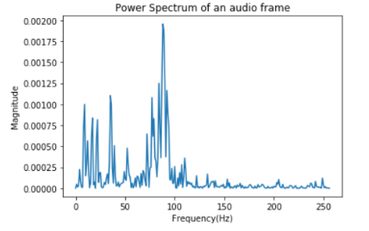
Fast Fourier Transform (Cont.)
Fig. 6: Power Spectrum using FFT=512

Slide 26
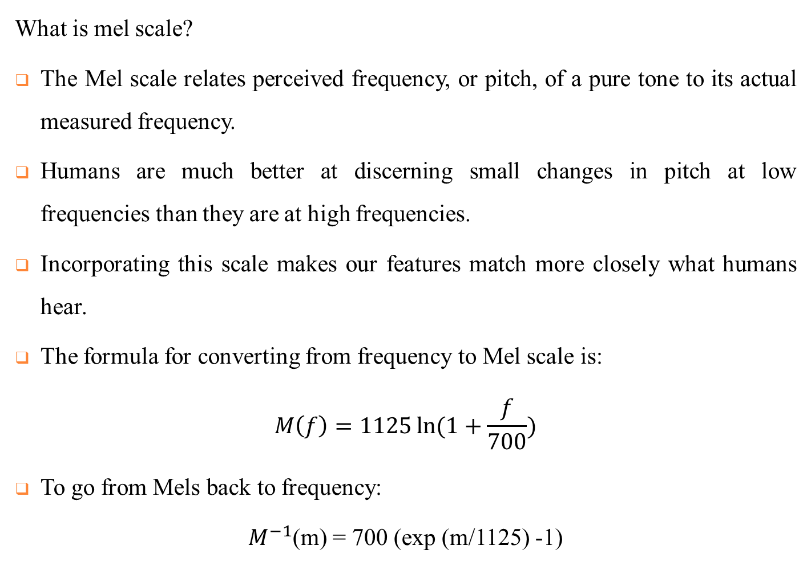
Mel-frequency Warping
What is mel scale?
The Mel scale relates perceived frequency, or pitch, of a pure tone to its actual measured frequency.
Humans are much better at discerning small changes in pitch at low frequencies than they are at high frequencies.
Incorporating this scale makes our features match more closely what humans hear.
The formula for converting from frequency to Mel scale is:
$$M\left(f\right)=1125\ln{(1+\frac{f}{700})}$$
To go from Mels back to frequency:
$M^{−1}$(m) = 700 (exp (m/1125) -1)

Slide 27
Mel-frequency Warping (Cont.)
To convert the obtained amplitude spectrum into mel-scale, a filter set placed linearly with respect to mel-scale is used.
This set consists of triangle band pass filters that are overlapping 50% and generally, filter coefficient is selected between 20 and 40.
Each filter in the filter set is triangular starting at the first point, reach its peak at the second point, then return to zero at the 3rd point.
The second filter will start at the 2nd point, reach its max at the 3rd, then be zero at the 4th etc.

Slide 28
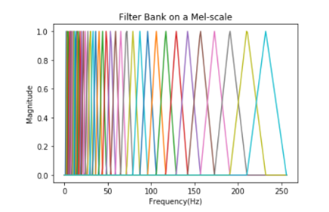
Mel-frequency Warping (Cont.)
At this stage, mel filterbank energies is obtained by multiplying power spectrum of the signal with mel filter bank.
Take the log of each of the energies from the above step and get log filterbank energies.
Fig. 7: Mel Filter Bank

Slide 29
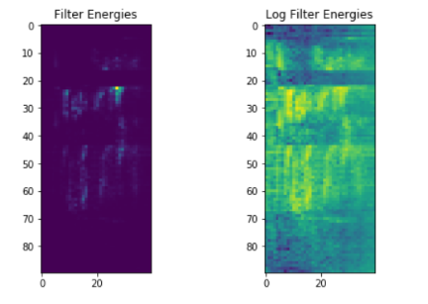
Mel-frequency Warping (Cont.)
Fig. 8: Plot of Filter Bank Energies

Slide 30
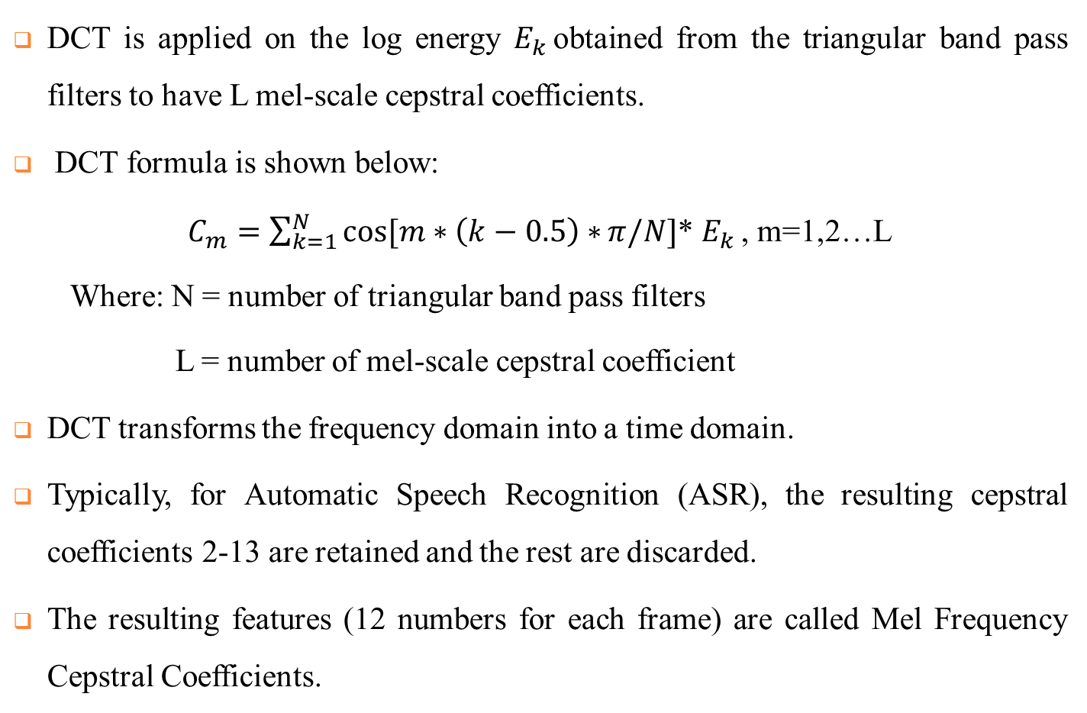
Discrete Cosine Transform
DCT is applied on the log energy $E_{k }$obtained from the triangular band pass filters to have L mel-scale cepstral coefficients.
DCT formula is shown below:
$C_{m}=\sum_{k=1}^{N}{\cos{[m∗\left(k−0.5\right)∗}π/N]}$* $E_{k }$, m=1,2…L
Where: N = number of triangular band pass filters
L = number of mel-scale cepstral coefficient
DCT transforms the frequency domain into a time domain.
Typically, for Automatic Speech Recognition (ASR), the resulting cepstral coefficients 2-13 are retained and the rest are discarded.
The resulting features (12 numbers for each frame) are called Mel Frequency Cepstral Coefficients.

Slide 31
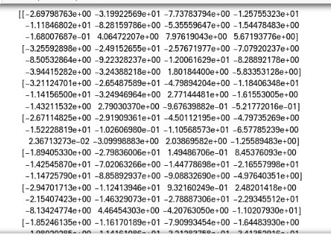
Discrete Cosine Transform (Cont.)
Fig. 9: The Numeric Representation of MFCC Matrix
It is a numpy array of size (numbers of frames by number of coefficients) containing features.
Each row holds one feature vector.

Slide 32
Conclusion and future work
Now I finished part of data collection, continued to record voice from children of each grade.
The audio records are preprocessed, do feature extraction with MFCC algorithm and voice feature dataset will be created.
When feature dataset is completely established ,the next step is gender classification by Random Forest Classifier.

Slide 33
References
Pravin Bhaskar Ramteke , Amulya A. Dixit , Sujata Supanekar , Nagraj V. Dharwadkar , and Shashidhar G. Koolagudi , “ Gender Identiﬁcation From Children’s Speech ”, Published in: Proceedings of 2018 Eleventh International Conference on Contemporary Computing (IC3), 2-4 August, 2018, Noida, India.
A Raahul, R Sapthagiri, K Pankaj and V Vijayarajan, “Voice based gender classification using machine learning” ,Published in: IOP Conf. Series: Materials Science and Engineering, 14th ICSET-2017.
https://github.com/davidpraise45/Audio-Signal-Processing

Slide 34
References (Cont.)
https://en.wikipedia.org/wiki/High-pass_filter
https://en.wikipedia.org/wiki/Low-pass_filter
https://www.researchgate.net/publication/261423419_Gender_identification_of_a_speaker_using_MFCC_and_GMM
https://www.kaggle.com/ybonde/log-spectrogram-and-mfcc-filter-bank-example
https://haythamfayek.com/2016/04/21/speech-processing-for-machine-learning.html
https://waset.org/publications/10008047/the-capacity-of-mel-frequency-cepstral-coefficients-for-speech-recognition

Slide 35
References (Cont.)
http://practicalcryptography.com/miscellaneous/machine-learning/guide-mel-frequency-cepstral-coefficients-mfccs/#computing-the-mel-filterbank
https://www.researchgate.net/publication/271250372_An_Approach_to_Extract_Feature_using_MFCC

Slide 36
Thank you for your attention!!!

