Slide 1
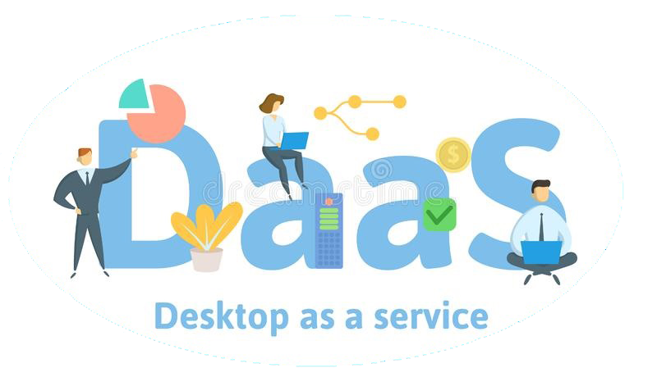
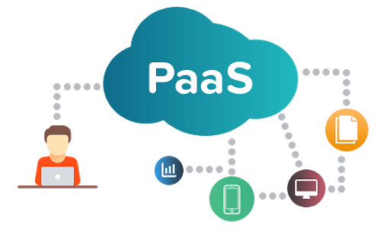
&
Platform as a service
Platform as a Service & Desktop as a Service
Presented by :
Group-B
7.8.2020

Slide 2
Group Members
Ma Khin Nyein Chan
Ma May Wah Wah Kyaw
Mg Thu Htoo Aung
Mg Htet Arkar Linn

Slide 3
What is a cloud service?
Four categories of cloud service:
Cloud services can include software, data storage, databases, servers, networks, computing and other services that are accessible on-demand though internet.
As these services are externally located they are referred to as a cloud, thus the term "cloud services".
Infrastructure as a Service(IaaS)
Platform as a Service(PaaS)
Software as a Service(SaaS)
Desktop as a Service(DaaS)

Slide 4
Platform as a Service (PaaS)
Cloud computing model.
Support soft/hardware tools to users by third-party provider on the internet.
Hosts on its own infrastructure.
PaaS tools tend to be touted as simple to use and convenient.

Slide 5
How PaaS works
Platform as a Service allows users to create software applications using tools supplied by the provider.
PaaS services can consist of preconfigured features that customers can subscribe to; they can choose to include the features that meet their requirements while discarding those that do not.
The infrastructure and applications are managed for customers and support is available.
Services are constantly updated, with existing features upgraded and additional features added.

Slide 6
Types of PaaS
PaaS
Public PaaS
Hybrid PaaS
Mobile PaaS
Private PaaS
Commni-cations PaaS
Open PaaS

Slide 7
Examples of PaaS
Google
Microsoft
Google App Engine supports distributed web applications using Java, Python, PHP, and Go.
PaaS
AWS Elastic Beanstalk allows users to create, deploy and scale web applications and services developed with Java, .NET, PHP, Node.js, Python, Ruby, Go and Docker on common servers, such as Apache, Nginx, Passenger and IIS.
Amazon Web Services

Slide 8
Three ways to send PaaS
As a cloud service from a provider.
As a private service behind a firewall.
As software deployed.

Slide 9
Advantages of PaaS
Flexibility
Simplicity and Convenience
Faster coding
Scalability
Lower cost
Less staff required

Slide 10

Disadvantages of PaaS
Security
Infrastructure
Compatibility issue

Slide 11

Why do Enterprises want to Consider a PaaS?
Faster Time to Market
Lower Cost
Lower Capital Commitment
Manage many application easier
More Responsive
Best Practices
Increase Reuse
PaaS
Others

Slide 12
What is DaaS?

Slide 13
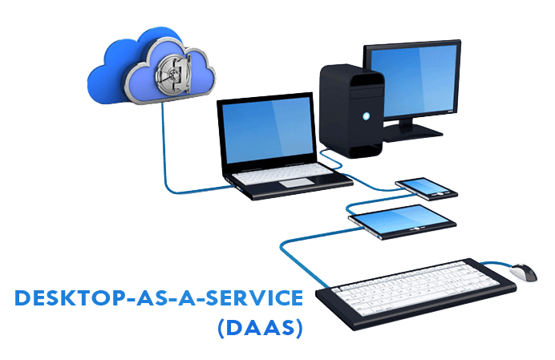
Desktop as a Service (DaaS)
cloud-based desktop virtualization service hosted by a third party enterprise.

Slide 14
Data as a Service ( DaaS) Desktop as a Service ( DaaS )
Database as a Service ( DaaS )

Slide 15
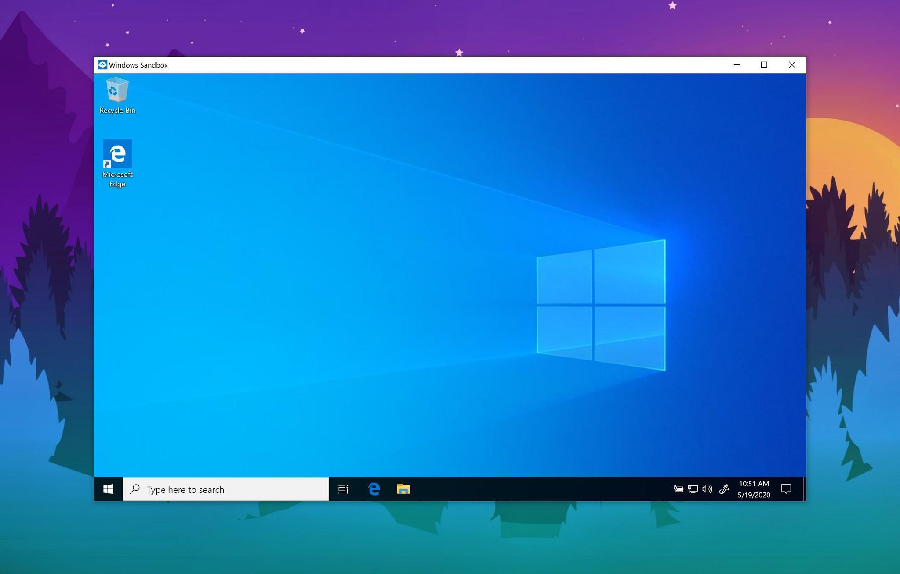
Desktop
Desktop

Slide 16
Infrastructure as a Service ( IaaS )
Software as a Service ( SaaS)
Platform as a Service ( PaaS )
Desktop as a Service ( DaaS )
...
etc.
Service Models

Slide 17
Interact via network
Desktop
As a
service
Desktop

Slide 18
DaaS is a form of Virtual Desktop Infrastructure ( VDI )
VID
DaaS

Slide 19
Virtualization
Virtualization = Simulation = Emulation
Window Operating System Desktop
Virtual OS
Example:
Mac OS (or)
Linux OS

Slide 20
Locally Virtualization
Operating System Image File + VMWare or VirtualBox = Local Virtualization
Main operating system (Host OS)
Main(Flashed/Host) OS load
Virtualization Software
Virtualization Software load
Virtualized OS(Guest OS)
VirtualBox(Virtualization Software)
Guest OS

Slide 21
DaaS Virtualization ( Cloud based Virtualization )
Client’s Desktop ( Main OS)
Guest OS
Interact via
internet
Client’s Desktop ( Main OS)
DaaS or Hosted
Guest OS
Guest OS
Cloud Computing

Slide 22
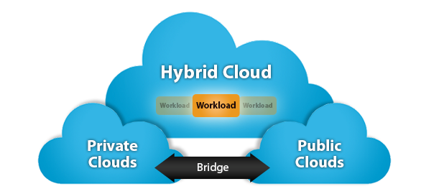
Three Types of DaaS
Private Cloud DaaS
Virtual Private Cloud DaaS(Hybrid)
Public Cloud DaaS

Slide 23
Benefits of migrating to DaaS
Availability
Reduced IT Costs
Centralized Data
Collaborative Work Environment
Reduce hardware expenses
Data Safety
Disaster Relief and Prevention : Business Continuity

Slide 24


Disadvantages of DaaS
Resources
Single Point of Failure
Multiple Use Cases Require Multiple Images
Long-term ROI

Slide 25
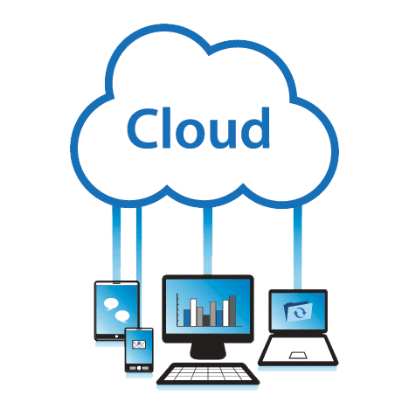
DaaS Providers
dinCloud - dinWorkspace
Amazon - Web Services
DA
AS
VMware - Horizon Cloud
Microsoft - Windows Virtual Desktop
MTM Technologies - AnywhereApp

Slide 26
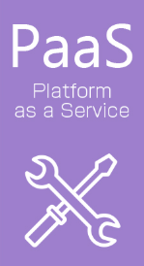
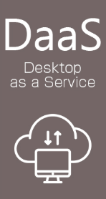

Key difference between PaaS & DaaS
PaaS provides a platform in addition to IaaS.
DaaS provides a virtual desktop environment.

Slide 27
