Slide 1
TECHNOLOGICAL UNIVERSITY(THANLYIN) DEPARTMENT OF INFORMATION TECHNOLOGY Comparison of MQTT and HTTP based on IoT
Supervised By:
Daw Aye Kyi Pyar Shwe
Presented By:
Ma Khine Zar Thwe ( VI IT - 6 )

Slide 2
Outlines of presentation
Abstract
Introduction
Aim and Objectives
System Requirements
Flow Chart
Architecture
Block Diagram
System Overview
Scope of Thesis
Conclusion

Slide 3
Abstract
MQTT is a publish-subscribe-based messaging protocol used in the internet of Things.
It works on top of the TCP/IP protocol, and is designed for connections with remote locations or the network bandwidth is limited.
The goal is to provide a protocol, which is bandwidth-efficient and uses little battery power.
The Hypertext Transfer Protocol is an application protocol for distributed, collaborative, hypermedia information systems that allows users to communicate data on the World Wide Web.
HTTP uses a request/response paradigm where each device connects directly to the IoT Agent.
MQTT is different in that publish-subscribe is event-driven and pushes messages to clients.
It requires an additional central communication point (known as the MQTT broker) which it is in charge of dispatching all messages between the senders and the rightful receivers.
Each client that publishes a message to the broker, includes a topic into the message. The topic is the routing information for the broker.

Slide 4
Abstract
Each client that wants to receive messages subscribes to a certain topic and the broker delivers all messages with the matching topic to the client. Therefore the clients don’t have to know each other, they only communicate over the topic.
This architecture enables highly scalable solutions without dependencies between the data producers and the data consumers.
The system will compare and use MQTT and HTTP on IOT and show differences among them. HTTP has been widely applied for data transfer.
However, in networks for IoT, this protocol causes a large overhead. To solve this problem, named based transfer protocols have been discussed.
This system compares the performance of HTTP with that of MQTT, a type of named based transfer protocol.
Additionally, the system proposes enhancements to MQTT for better performance.
Main solid benefits of MQTT are lightweightness and publish/subscribe model, which makes it perfect for resource-constrained devices and help to save battery.
The system will present the broad comparison among HTTP and MQTT to introduce their characteristics comparatively. Afterwards, it presents their strengths and limitations.
Thus, based on this detailed evaluation, the user can decide their appropriate usage in various IoT systems according to their requirements and suitability.

Slide 5
Introduction
The system demonstrates the basic functionality of reading and visualizing sensor data using a Circuit Python board.
It starts demonstrating reading sensor data in only a few lines or Python, following a simple workflow.
It progresses from zero to hero to show how user can send data over a network using MQTT and HTTP, liberating user’s data and persisting it to a database for long term storage and visualization.

Slide 6
Aim and Objectives
To compare MQTT and HTTP to know which one is the best for IoT
To familiarize with the world of hardware and build a full-stack IoT(Internet-of-Things) solution
To publish data from a sensor over MQTT and HTTP, persist the data and visualize it in real time
To demonstrate a beginner friendly workflow that is not too complicated using Circuit Python
To demonstrates a solution that has real world applications - logging sensor data over a network, storing it in a database and displaying the data on a dashboard

Slide 7
System Requirements
Hardware
No | Devices | Price | Qty | Total
1 | Raspberry Pi 3 B+ | 70,000 Kyats | 1 | 70,000 Kyats
2 | ESP8266 NodeMCU | 7,000 Kyats | 1 | 7,000 Kyats
3 | Breadboard | 2,500 Kyats | 1 | 2,500 Kyats
4 | M-M Jumper Wires | 1,000 Kyats | 1 | 1,000 Kyats
5 | Push button | 30 Kyats | 1 | 30 Kyats
6 | 10K resistor | 10 Kyats | 1 | 10 Kyats
7 | Push Button | 60 Kyats | 1 | 60 Kyats
 | Total |  |  | 80600 Kyats

Slide 8
System Requirements
Software
Python
Text Editor
Putty
Mosquito Broker
Adafruit IO MQTT Api

Slide 9
Flow Chart(MQTT)
Start
Attached temp and humidity sensor
Raspberry pi 3b+
Publish data to broker
Broker
Humidity data
Temperature data
Humidity data ?
Humidity data and Temperature data ?
Temperature data ?
Yes
Yes
Yes
User who subscribe Humidity data only
User who subscribe Temperature data and Humidity data.
User who subscribe Temperature data only
End

Slide 10
Flow Chart(HTTP)
Start
Attached temp and humidity sensor
Raspberry pi 3b+
Send temperature and humidity data
User
End

Slide 11
Architecture (MQTT)
Publisher
Broker
Subcriber
Connect
Connect ACK
Connect
Connect ACK
Subscribe(Topic)
Subscribe ACK
Publish(Topic , Data)
Publish(Topic , Data)
Broker Based MQTT protocol

Slide 12
MQTT
MQTT was originally invented and developed by IBM in the late 1990s. Its original purpose was to link sensors on oil pipelines with satellites.
As the name suggests, it is a messaging protocol that supports asynchronous communication between parties.
The asynchronous message protocol separates the message sender from the receiver in space and time, so it can be expanded in an unreliable network environment.
Although it is called message queue telemetry transmission, it has nothing to do with message queue, but uses a publish and subscribe model.

Slide 13
Architecture (HTTP)
User
Server
HTTP Request
HTTP Response
HTTP protocol

Slide 14
HTTP
Internet network is built to communicate via HTTP (Hyper Text Transfer Protocol). Various data, from images to texts, are sent over internet every day. HTTP is as a primary protocol interface to move a wide range of data quickly, easily, and stable from server to user devices such as browser.
HTTP is built on TCP.
HTTP ensures that data transmitted from one device to another will not corrupt so that the integrity of data transmitted is assured.
HTTP is an open communication protocol that can be read by any devices that have been developed for HTTP protocol as browser or smartphone through browser application.
An HTTP transaction consists of two parts: request command (request) sent from client to server, and response command (response) sent from server to client.
The process of response and request is submitted using a data block with specific format known as HTTP Message.
The messages are sent by HTTP which moves in one direction.

Slide 15
Block Diagram(MQTT)
Subscribe
Client
MQTT
Broker
Publish
Publish
Client
Subscribe
Client
Publish

Slide 16
Block Diagram(HTTP)
Client
HTTP Request
Server
HTTP Response

Slide 17
System Overview
MQTT is data centric whereas HTTP is document-centric. HTTP is request-response protocol for client-server computing and not always optimized for mobile devices.
Besides, publish/subscribe model provides clients with independent existence from one another and enhance the reliability of the whole system.

Slide 18
Scope of Thesis
The scope of the system is to improve the operational efficiency of the handling MQTT and HTTP data and information and to easily examine the effect of MQTT and HTTP on IoT platform.
The purpose of this system will make it easy for the users by a wide range of comparison among MQTT and HTTP.
A typical use case of IoT systems is many sensors publishing data to a broker. In this thesis, the majority of the system is to emulate the comparison facts of MQTT and HTTP on a Raspberry Pi and ESP8266(WiFi-Module).

Slide 19
Comparative Analysis of Messaging Protocals for IoT Systems:MQTT and HTTP
Criteria | MQTT | HTTP
1.Years | 1999 | 1997
2.Architecture | Client/Broker | Client/Server
3.Abstraction | Publish/Subscribe | Request/Response
4.Header Size | 2Byte | Undefined
5.Message Size | Small and Undefined(up to 256 MB maximum size) | Large and Undefined(Depends on the programming)
6.Semanties/Methods | Connect,Disconnect,Publish,Subscribe,Unsubscribe,close | Get, Post, Head, Put, Patch, Options, Connect, Delete
7. Cache and Proxy Support | Partial | Yes
8. Quality of Service (QoS)/ Reliability | QoS 0 - At most once (Fire-and-Forget), QoS 1 - At least once, QoS 2 - Exactly once | Limited (via Transport Protocol - TCP)
9. Standards | OASIS, Eclipse Foundations | IETF and W3C
10. Transport Protocol | TCP (MQTT-SN can use UDP) | TCP
11. Security | TLS/SSL | TLS/SSL
12. Default Port | 1883/ 8883 (TLS/SSL) | 80/ 443 (TLS/SSL)
13. Encoding Format | Binary | Text
14. Licensing Model | Open Source | Free
15. Organisational Support | IBM, Facebook, Eurotech, Cisco, Red Hat, Software AG, Tibco, ITSO, M2Mi, Amazon Web Services (AWS), InduSoft, Fiorano | Global Web Protocol Standard

Slide 20
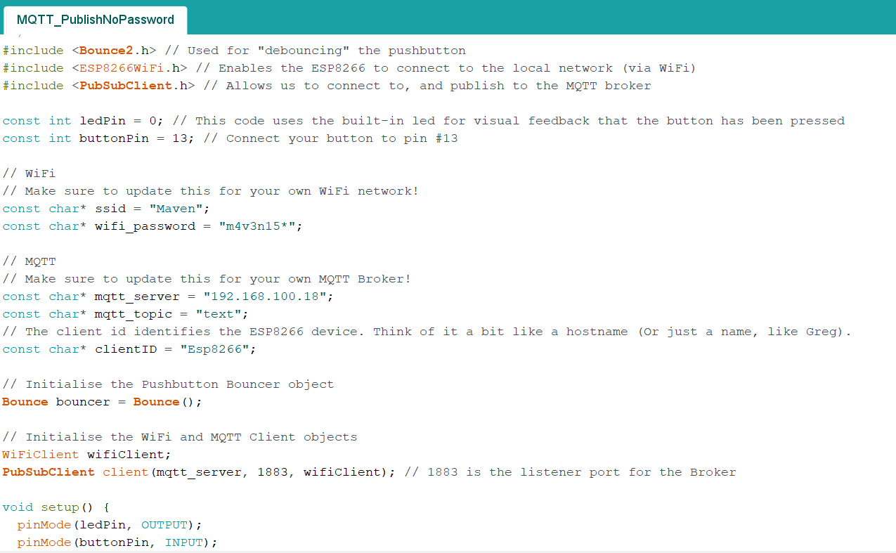
Code in Thesis

Slide 21
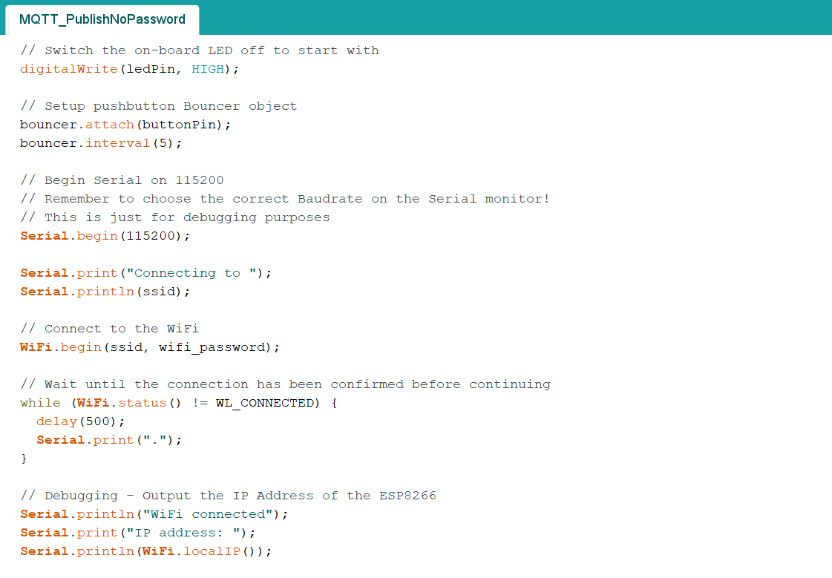

Slide 22
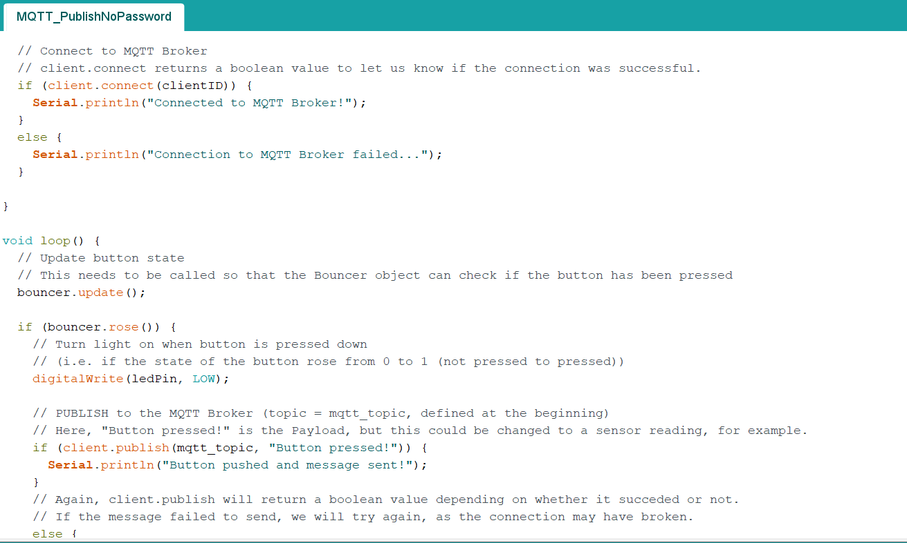

Slide 23
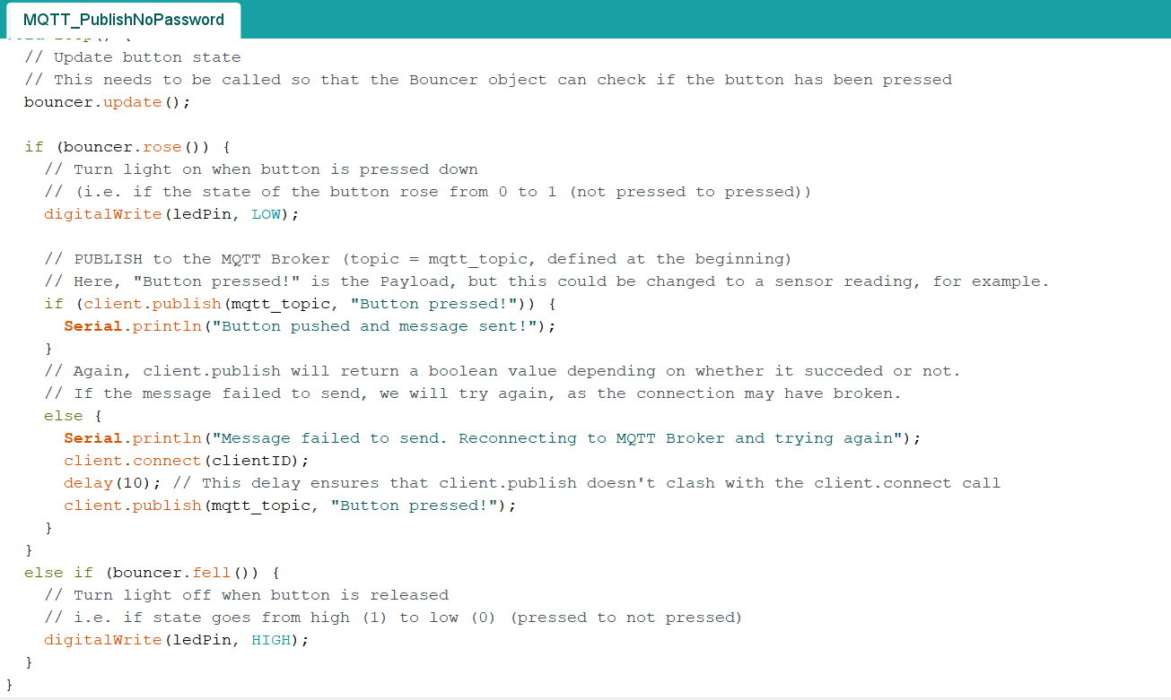

Slide 24
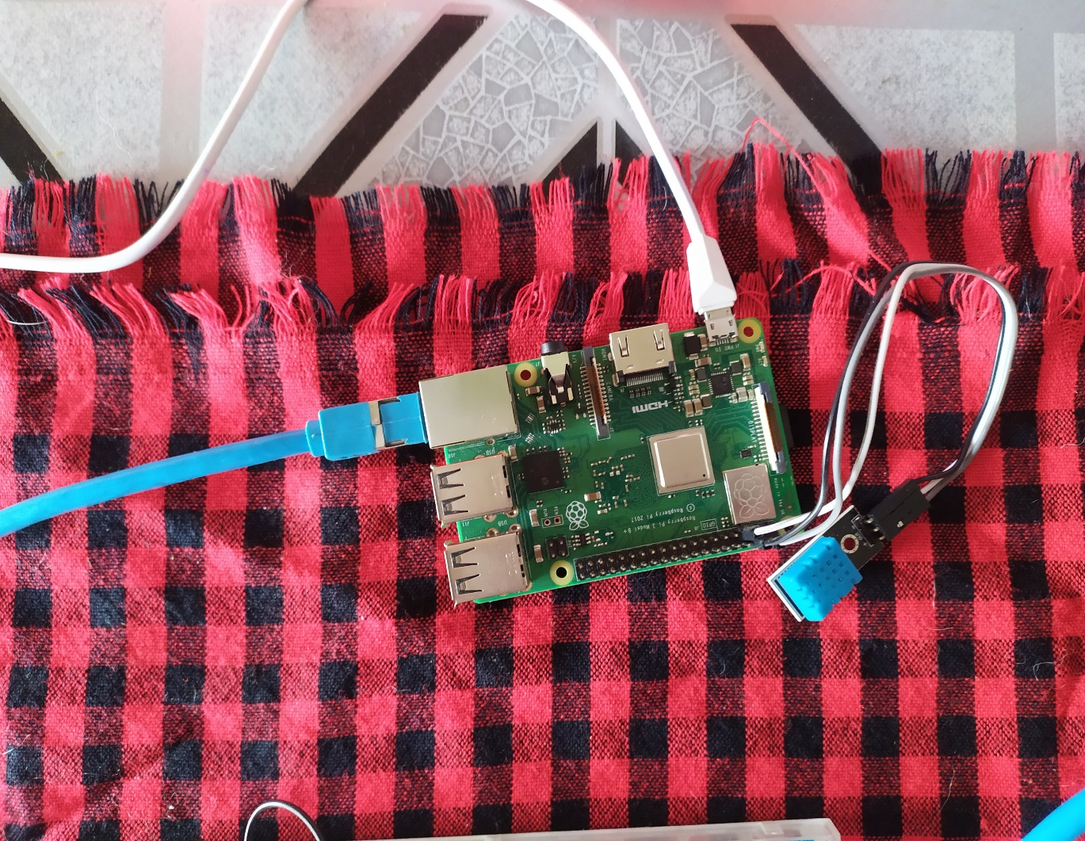
Diagram of Thesis

Slide 25
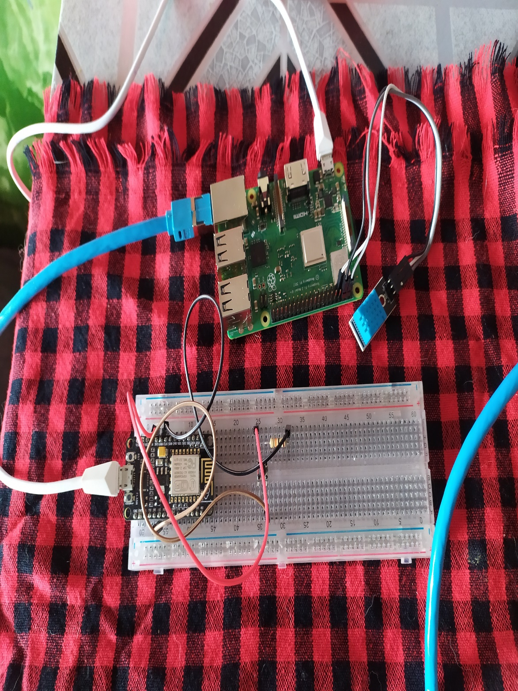

Slide 26
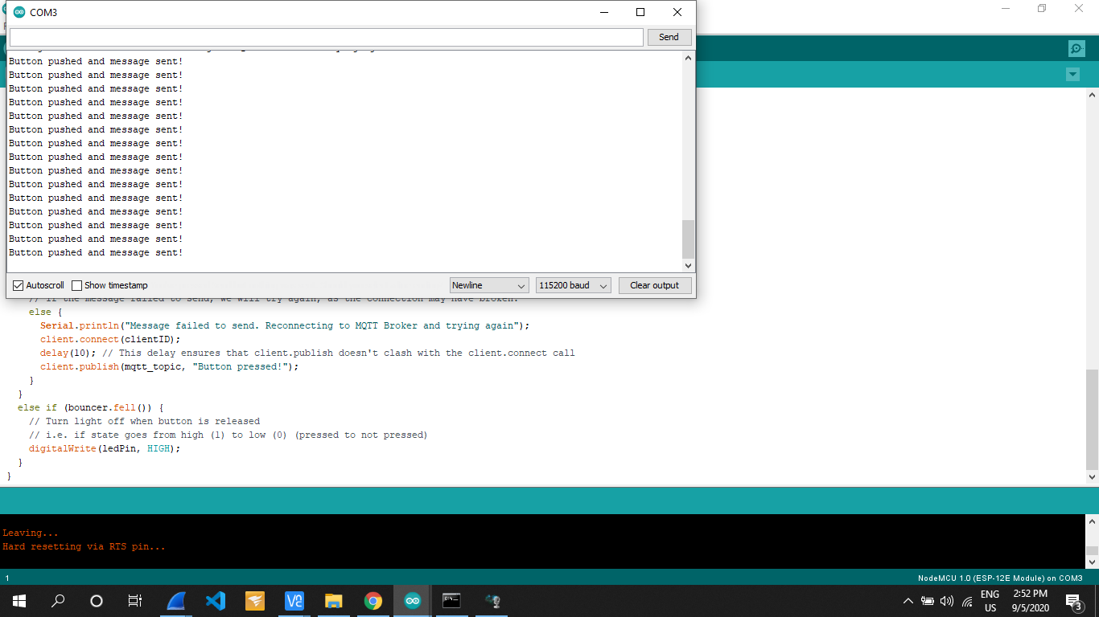

Slide 27
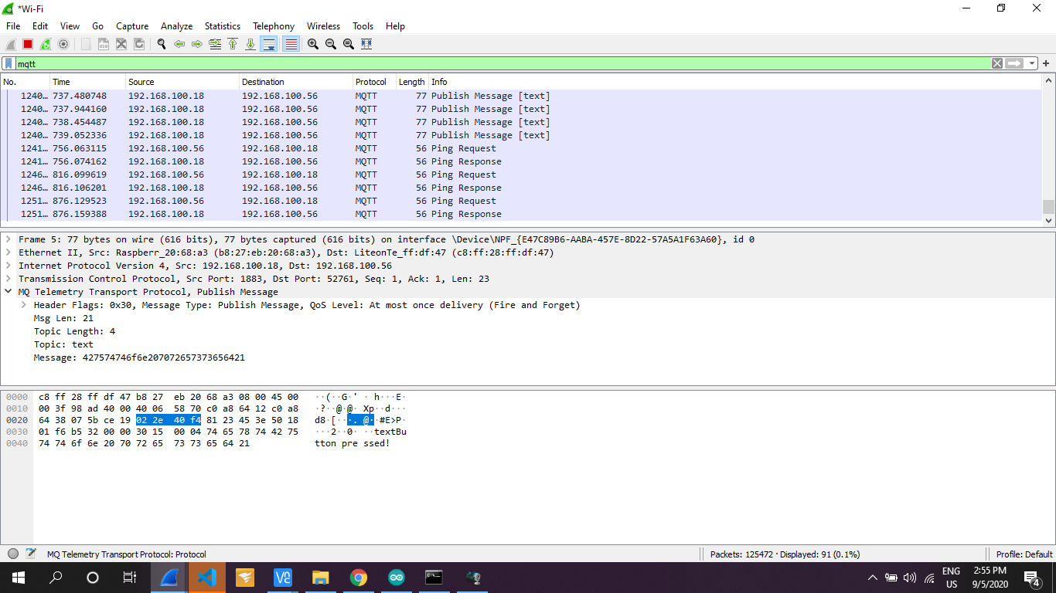

Slide 28
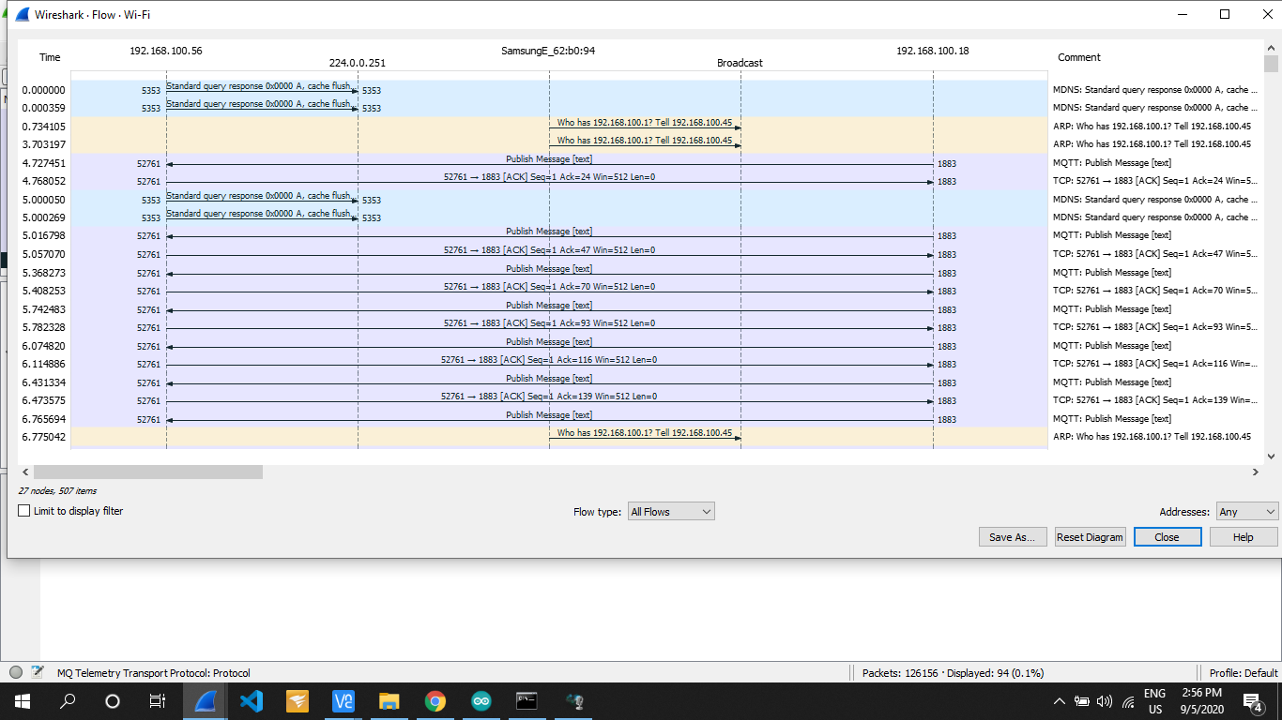

Slide 29
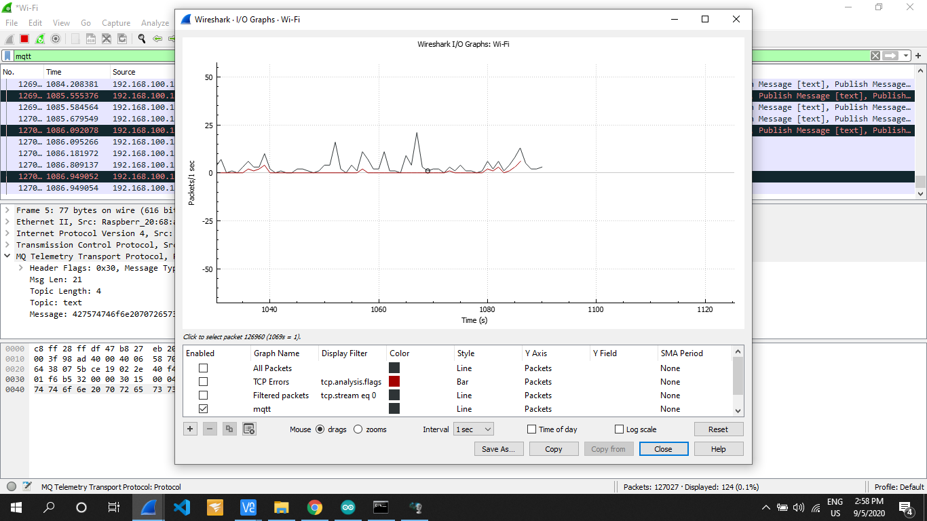

Slide 30
Conclusion
MQTT Protocol is easy of use. It is essential when response time, throughput, lower battery and bandwidth usage are on the first place for future solutions. It’s also perfect in case of intermittent connectivity.
HTTP is worthy and extendable. But MQTT is more suitable when it is referred to IoT development.

