Slide 1
Khiops 10.2 Khiops SCENARIOS for easy integration
Orange Labs
April 2024

Slide 2

Khiops scenarios
A Khiops session can be registered in a scenario file, which can be replayed by Khiops in batch mode.
This allows to automatize data preparation, modeling and deployment in a Data Mining project and to easily integrate the process in any information system.

Slide 3
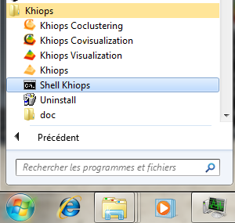
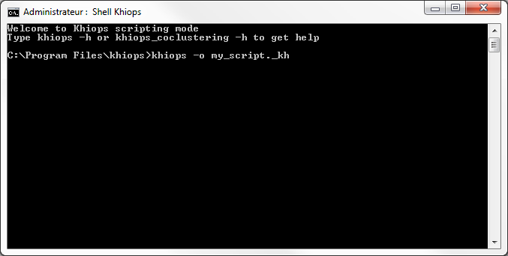
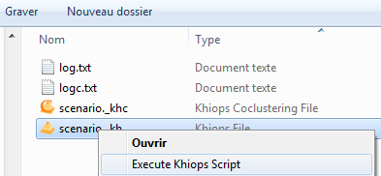
Recording and replaying a scenario
Start a Shell Khiops
Record a script « automatically» using Khiops user interface
khiops –o my_script._kh
o = output
Replay a script from the shell
khiops –i my_script._kh
i = input
Replay a script from Windows Explorer
right click on script file

Slide 4
Recording
When Khiops is used with option “-o”, a scenario is recorded.
Khiops –o my_scenario._kh
Each action on the Khiops user interface is stored in the scenario.

Slide 5
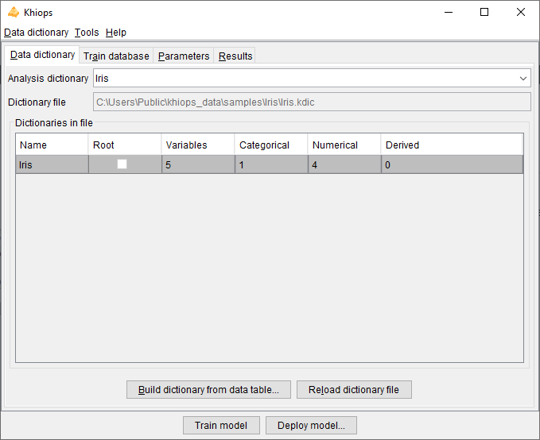
Recording : Example with Iris Dataset
Open dictionary
// -> Khiops
ClassManagement.OpenFile // Open...
// -> Open
ClassFileName C:\Users\Public\khiops_data\samples\Iris\Iris.kdic
// Dictionary file
OK // Open
// <- Open

Slide 6
Recording : Example with Iris Dataset
Choose dictionary
// -> Khiops
ClassManagement.OpenFile // Open...
// -> Open
ClassFileName C:\Users\Public\khiops_data\samples\Iris\Iris.kdic
// Dictionary file
OK // Open
// <- Open

Slide 7
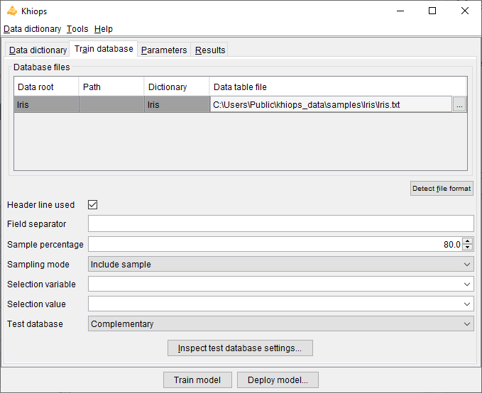
Recording : Example with Iris Dataset
Select data file and split ratio
// -> Khiops
ClassManagement.OpenFile // Open...
// -> Open
ClassFileName C:\Users\Public\khiops_data\samples\Iris\Iris.kdic
// Dictionary file
OK // Open
// <- Open
TrainDatabase.DatabaseFiles.List.Key Iris // List item selection
TrainDatabase.DatabaseFiles.DataTableName
C:\Users\Public\khiops_data\samples\Iris\Iris.txt // Data table file
TrainDatabase.SampleNumberPercentage 80 // Sample percentage

Slide 8
Recording : Example with Iris Dataset
Select data file and split ratio
// -> Khiops
ClassManagement.OpenFile // Open...
// -> Open
ClassFileName C:\Users\Public\khiops_data\samples\Iris\Iris.kdic
// Dictionary file
OK // Open
// <- Open
TrainDatabase.DatabaseFiles.List.Key Iris // List item selection
TrainDatabase.DatabaseFiles.DataTableName
C:\Users\Public\khiops_data\samples\Iris\Iris.txt // Data table file
TrainDatabase.SampleNumberPercentage 80 // Sample percentage

Slide 9
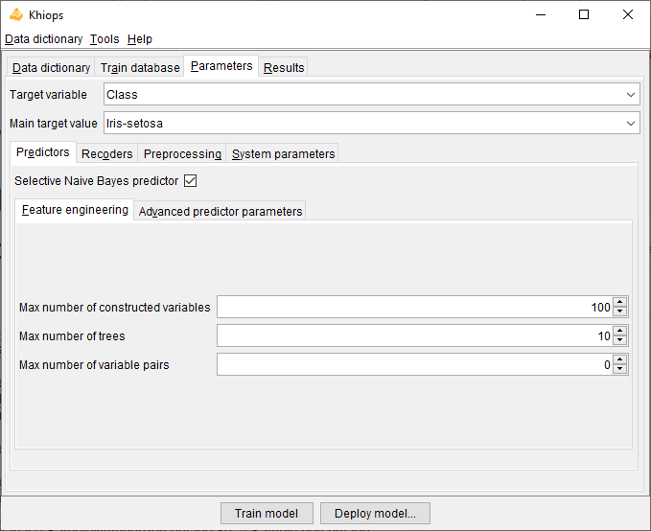
Recording : Example with Iris Dataset
Select data file and split ratio
// -> Khiops
ClassManagement.OpenFile // Open...
// -> Open
ClassFileName C:\Users\Public\khiops_data\samples\Iris\Iris.kdic
// Dictionary file
OK // Open
// <- Open
TrainDatabase.DatabaseFiles.List.Key Iris // List item selection
TrainDatabase.DatabaseFiles.DataTableName C:\Users\Public\khiops_data\samples\Iris\Iris.txt // Data table file
TrainDatabase.SampleNumberPercentage 80 // Sample percentage
AnalysisSpec.TargetAttributeName Class // Target variable
AnalysisSpec.MainTargetModality Iris-setosa // Main target value
ComputeStats // Train model
Exit // Close
// <- Khiops
// -> Khiops
OK // Yes
// <- Khiops

Slide 10
Recording : Example with Iris Dataset
Select data file and split ratio
// -> Khiops
ClassManagement.OpenFile // Open...
// -> Open
ClassFileName C:\Users\Public\khiops_data\samples\Iris\Iris.kdic
// Dictionary file
OK // Open
// <- Open
TrainDatabase.DatabaseFiles.List.Key Iris // List item selection
TrainDatabase.DatabaseFiles.DataTableName C:\Users\Public\khiops_data\samples\Iris\Iris.txt // Data table file
TrainDatabase.SampleNumberPercentage 80 // Sample percentage
AnalysisSpec.TargetAttributeName Class // Target variable
AnalysisSpec.MainTargetModality Iris-setosa // Main target value
ComputeStats // Train model
Exit // Close
// <- Khiops
// -> Khiops
OK // Yes
// <- Khiops

Slide 11
Playing a scenario
When Khiops is used with option “-i”, the scenario is replayed.
khiops –i my_scenario._kh

Slide 12
Dealing with scenarios
You can edit scenarios in a text editor to apply it on another dataset.

Slide 13
Dealing with scenarios
You can edit scenarios in a text editor to apply it on another dataset.
// -> Khiops
ClassManagement.OpenFile // Open...
// -> Open
ClassFileName C:\Users\Public\khiops_data\samples\Iris\Iris.kdic
// Dictionary file
OK // Open
// <- Open
TrainDatabase.DatabaseFiles.List.Key Iris TrainDatabase.DatabaseFiles.DataTableName C:\Users\Public\khiops_data\samples\Iris\Iris.txt TrainDatabase.SampleNumberPercentage 80 // Sample percentage
AnalysisSpec.TargetAttributeName Class // Target variable
AnalysisSpec.MainTargetModality Iris-setosa // Main target value
ComputeStats // Train model
Exit // Close
// <- Khiops
// -> Khiops
OK // Yes
// <- Khiops
// -> Khiops
ClassManagement.OpenFile // Open...
// -> Open
ClassFileName C:\Users\Public\khiops_data\samples\Adult\Adult.kdic
// Dictionary file
OK // Open
// <- Open
TrainDatabase.DatabaseFiles.List.Key Adult TrainDatabase.DatabaseFiles.DataTableName C:\Users\Public\khiops_data\samples\Adult\Adult.txt TrainDatabase.SampleNumberPercentage 80 // Sample percentage
AnalysisSpec.TargetAttributeName class // Target variable
AnalysisSpec.MainTargetModality more // Main target value
ComputeStats // Train model
Exit // Close
// <- Khiops
// -> Khiops
OK // Yes
// <- Khiops

Slide 14
Dealing with scenarios
You can replace any element of a scenario with the « -r » option
khiops –i my_scenario._kh –r to_replace:new
To run analysis with 90% of instances in train instead of 80%
khiops –i my_scenario._kh –r 80:90

Slide 15
Dealing with scenarios
We can easily make the scenario more generic
// -> Khiops
ClassManagement.OpenFile // Open...
// -> Open
ClassFileName $DICTIONARY_FILE$ // Dictionary file
OK // Open
// <- Open
TrainDatabase.DatabaseFiles.List.Key $DICTIONARY_NAME$
TrainDatabase.DatabaseFiles.DataTableName $DATA$
TrainDatabase.SampleNumberPercentage $TRAIN_PERCENTAGE$
AnalysisSpec.TargetAttributeName $TARGET_NAME$
AnalysisSpec.MainTargetModality $TARGET_MODALITY$
ComputeStats // Analyse database
Exit // Close
// <- Khiops
// -> Khiops
OK // Close
// <- Khiops

Slide 16
Dealing with scenarios
Beware of ambiguities :
replace DATA
replace DATA_PATH
Recommendations :
$DATA$
$DATA_PATH$

Slide 17
Tips and tricks
A scenario is automatically generated by khiops in the directory C:\Users\<username>\khiops_data\lastrun
You don't know the syntax and you want to add features to your scenario ?
Just click on the khiops buttons and open the scenario in the lastrun directory
Use the « -b » option in conjunction with « -i » and « -r » to replay scenarios silently (without a user interface)
Use the « -e <file> » to store the results logs in a file

Slide 18
Integration with other programming languages
If you need to start a Khiops process from your favorite programing language: C++, Java, Java script, MATLAB, R…
Record a scenario using Khiops application
Make the scenario more generic
Prepare a Khiops command line with options -i, -r, -b, -e
Call Khiops with this command line and the generic scenario from your favorite language
Example
C++: system(command)
Java: Process process = Runtime.getRuntime().exec(command);
…

Slide 19
Note on backwards compatibility
Khiops scenario are not backwards compatible
In the event of a new version of Khiops
Simply re-register a scenario and make it generic
Reuse the same integration process by just updating the scenario files

