Slide 1

Prediction of COVID cases

Slide 2
Team Members
Akash Sharma(0785748)
Brajabijayini Acharya(0788387)
Khirabdhi Tanaya Acharya(0788278)
Jay Patel(0789561)
Sukhjeet Kaur(0774458)

Slide 3
AGENDA
Why COVID
Problem Statement
Project Objective
About Dataset
Data Exploration and Visualization
Why Machine Learning
Model Outputs
Challenges
References
Conclusion

Slide 4
Why COVID?
The Coronavirus Disease Pandemic of 2019 (COVID-19) serves as a timely reminder of the nature and consequences of Public Health Emergencies of International Concern. More than 314 million cases and more than 5.5 million fatalities had been reported since the epidemic began as of January 12, 2022. In terms of cases and fatalities, the COVID-19 pandemic manifests itself in various ways in various parts of the world. This project’s goal is to examine the COVID-19 pandemic's varying expression so that lessons can be learnt for an effective public health emergency response.

Slide 5
Problem Statement
To identify the top 3 nations where COVID cases have been reported to be most prevalent and Build a machine learning model that is fully based on the idea of time series prediction to determine which countries will still have an impact on COVID in the year 2023. so that the relevant nation can take preventative measures in advance.

Slide 6
Project Objectives
We have thoroughly examined and contrasted the underlying temporal patterns from sequential historical observations regarding the COVID-19 pandemic in 3 countries, India, Brazil, and the US. We have concentrated particularly on the following feature: NEW CASES.
The main objective of this project is to develop a model that takes into account all available data in order to forecast behavior in "future days," enabling the prospect of supporting our decisions or next actions in the duty to keep our community safe.
We have used Time series modelling to forecast future days.

Slide 7
Data Set
The data set made available to the public by the group "Our World in Data," which in partnership with The University of Oxford has created a reliable repository of datasets about dozens of topics with a focus on major global issues.
Therefore, since the start of the COVID-19 outbreak, several researchers have been gathering data from every nation in the world about a variety of indicators that can help us make better decisions.
Data Source : Kaggle
COVID-19 Data
https://www.kaggle.com/datasets/georgesaavedra/covid19-dataset

Slide 8

Analysis

Slide 9
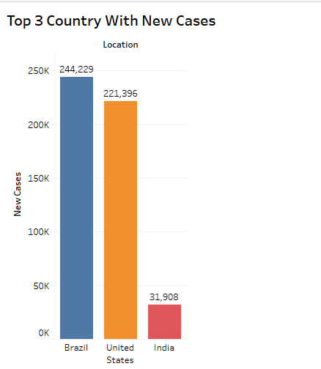
TOP 3 COUNTRIES WITH MAXIMUM NUMBER OF NEW CASES
The visualization depicts top 3 countries with the maximum number of New confirmed cases which has been reported according to the data.
Brazil has the maximum number of cases which are 244,229K whereas United States has the second most maximum number of new cases which are 221,396K and India has the 3rd most maximum number of cases with a figure of 31,908K cases respectively.

Slide 10
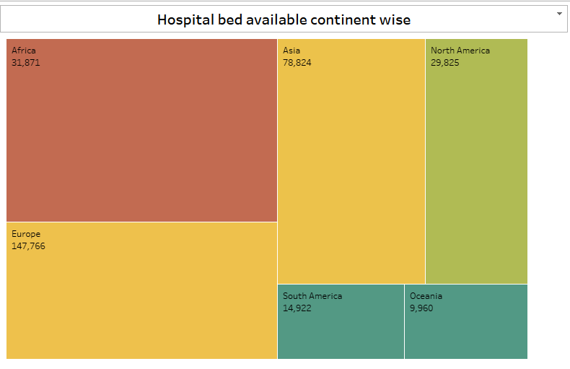
HOSPITAL BEDS AVAILABILITY CONTINENT WISE
The visualization depicts total number of hospital beds available with respect to its continent.
Africa has 31,871 beds available, Asia with 78,824, North America having 29,825 beds, Europe with 147,766 beds, South America having 14,922 beds and Ocenia having 9960 beds.
Higher the number of beds available having higher probability of patients survival as they can get better treatment and equipments in order to get COVID treated as early as possible.

Slide 11
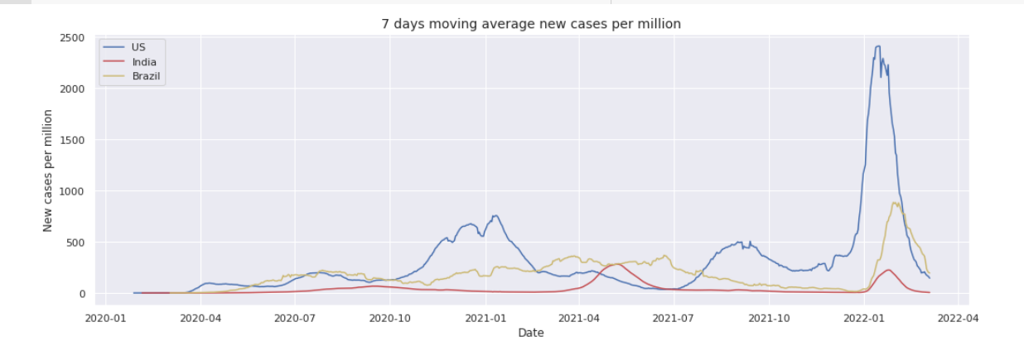
GROWTH OF NEW CASES PER MILLION WITHIN 7 DAYS MOVING AVERAGE

Slide 12
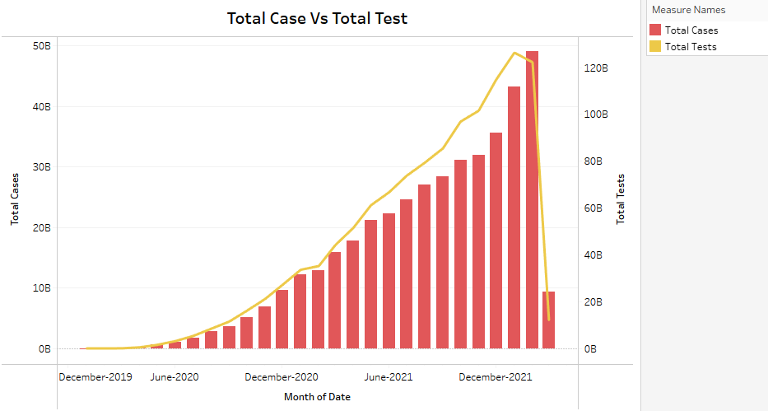
TOTAL CASES VS TOTAL TESTS CONDUCTED IN 6 Months
As per the visualization total tests conducted and total cases were similar till the year june 2021 in all the continents
Afterwards ratio of total tests conducted got boomed after the year June 2021 till December 2021 with respect to the total cases average for all the continents.
Higher the number of tests per patient conducted, greater will be the possibility for life expectancy.

Slide 13
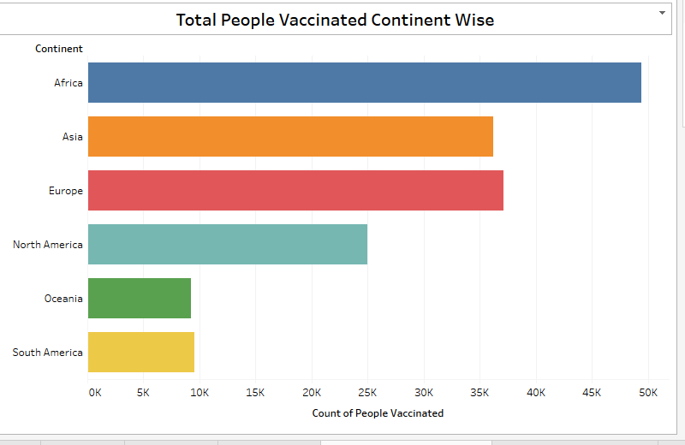
TOTAL NO. OF PEOPLE VACCINATED IN EACH CONTINENT
The visualization depicts total number of people who got vaccinated in each continent.
Africa is the country where people had maximum number of Vaccination rate which is nearly about 50,000 vaccinations
Whereas Asia and Europe conducted vaccinations nearly at a same pace.
Oceania is a country which has lowest number of Vaccinations among all the continents which is about 9,000 respectively.

Slide 14
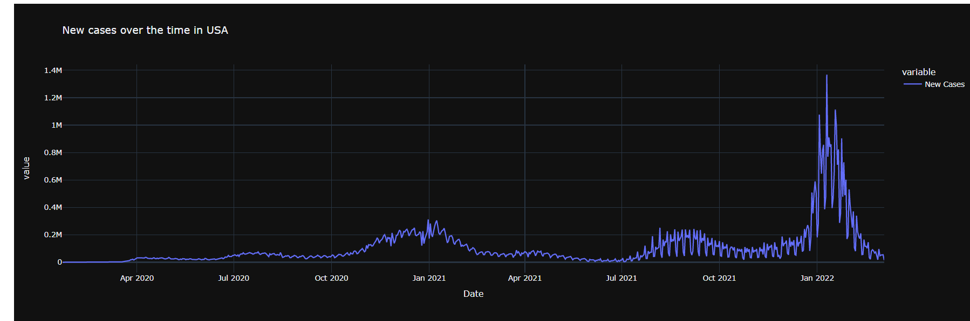
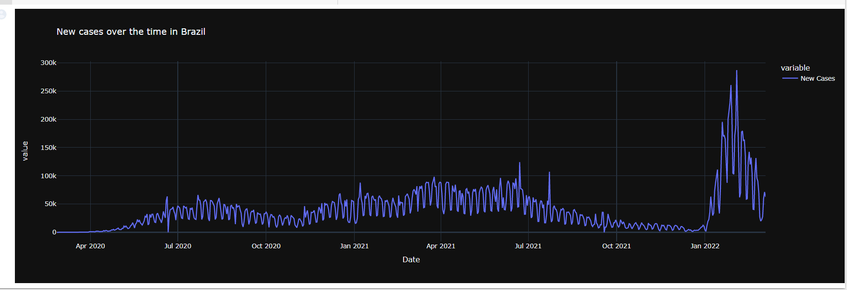
NEW CASES IN BRAZIL, USA & INDIA OVER THE TIME

Slide 15
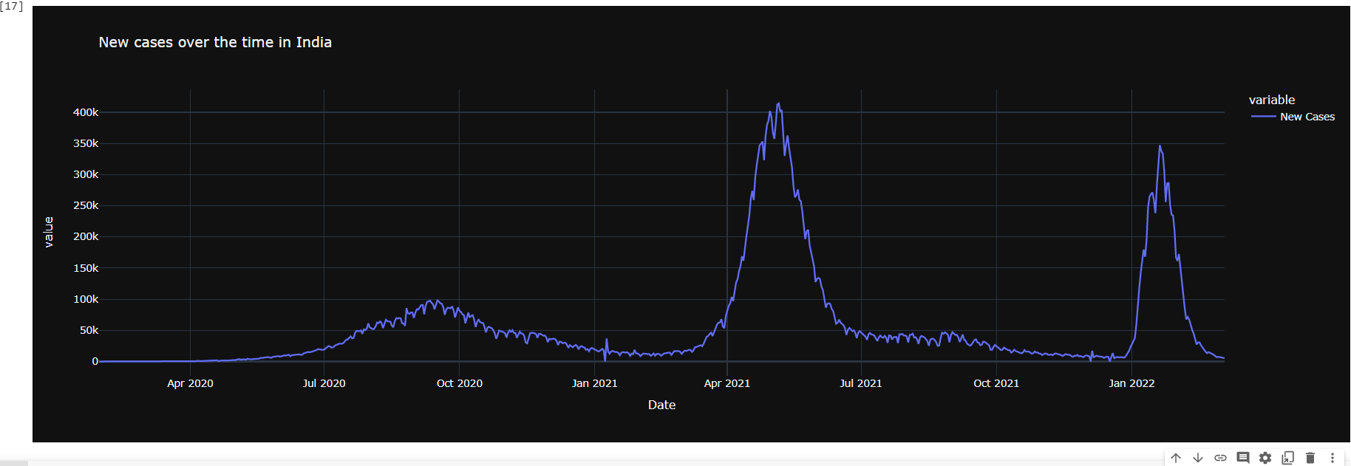
NEW CASES IN BRAZIL, USA & INDIA OVER THE TIME

Slide 16
Why Machine Learning?
In order to forecast the spread of COVID-19 in the upcoming year which would serve as an early warning system for upcoming pandemics and identify the top vulnerable country.
With the help of Machine learning we can develop a model that takes into account all available data in order to forecast behavior in "future days," enabling the prospect of supporting our decisions or next actions in the duty to keep our community safe.
We have used Time series modelling to forecast future days.

Slide 17

TIME SERIES FORCASTING PREDICTION USING PYCARET
Python-based machine learning workflows can be automated with PyCaret, a low-code machine learning library and end-to-end model management system. It is much-liked because of how simple and easy it is to use, as well as how fast and effectively end-to-end machine learning prototypes can be built and deployed.
PyCaret automates everything from missing values through one-hot encoding, categorical data transformation, feature engineering, and hyperparameter tuning.
After EDA and analysis, we found out that "India" is most prone to the new cases and the prediction is increasing exponentially for next 365 days, so we are going ahead to analyse different time series forecasting for the country "India"

Slide 18
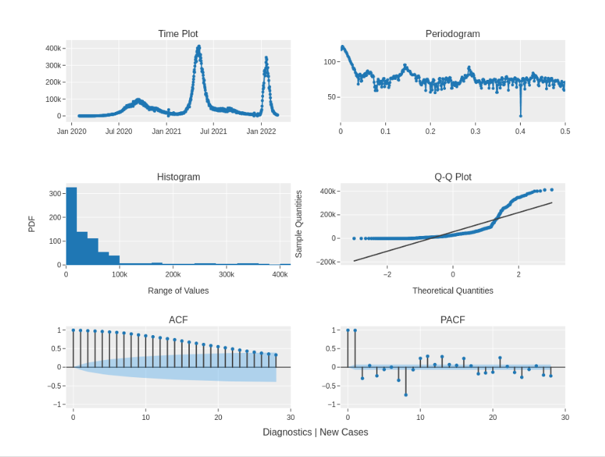
Diagnostic plot
PyCaret also offers a very useful method for plotting all graphs in a single multi-plot
The periodogram can provide insight regarding possible cyclical behavior in a series
The ACF (Auto-Correlation Function)is a time domain measure of the correlation between two datapoints and how that changes as the distance between them increases

Slide 19
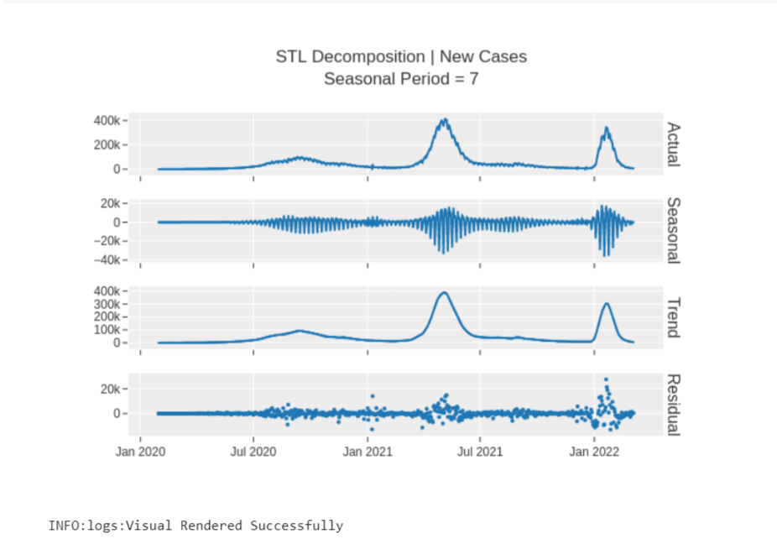
Time Series Decomposition
The process of breaking down a time series into structural components is known as time series decomposition.
Trend: The time series' overall direction of movement. Seasonality is the time series' repeated signal cycles. Level: The time series' average value. Noise: Unpredictable elements inside the series.

Slide 20
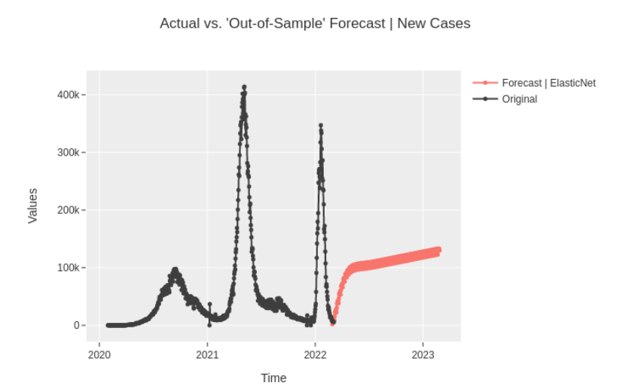
365 days Prediction Of new cases In India by best model 'ElasticNet'

Slide 21
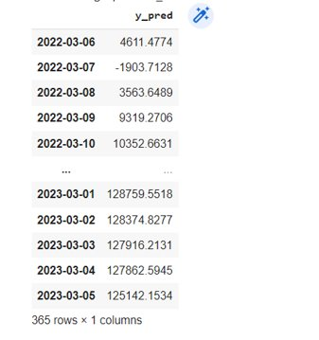
Predictions generated for future 365 days

Slide 22
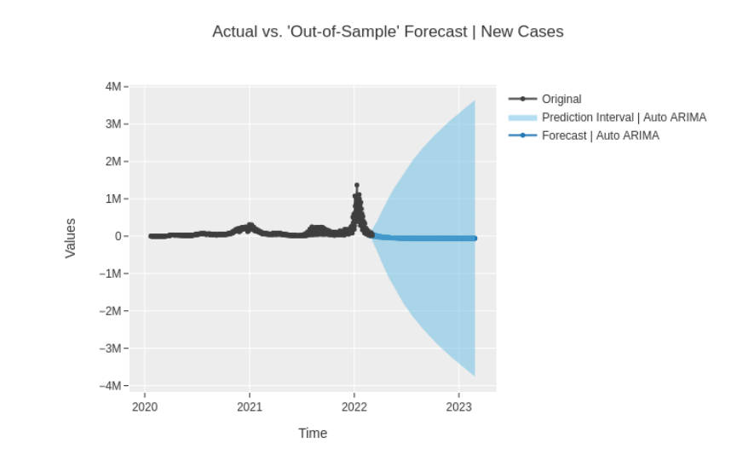
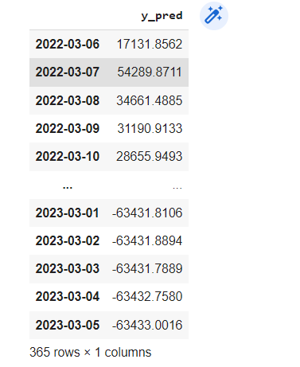
365 days Prediction Of new cases In USA by best model 'Auto ARIMA(AutoRegressive Moving Average)'

Slide 23
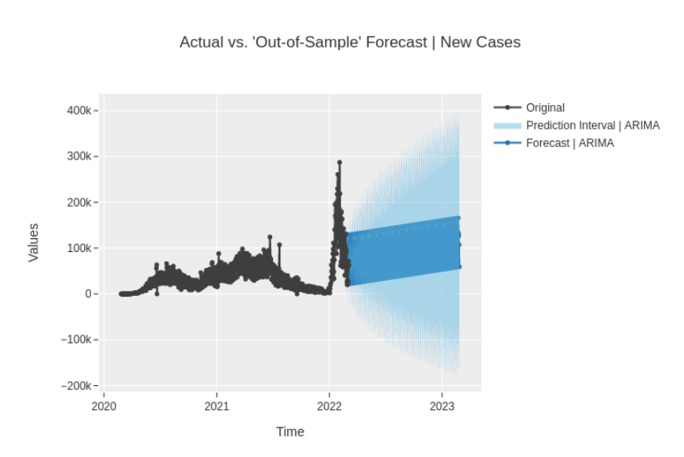
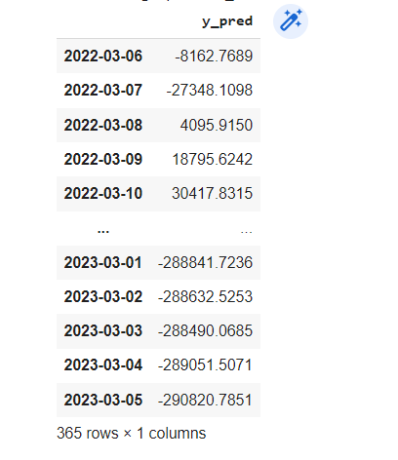
365 days Prediction Of new cases In Brazil by best model ' ARIMA(AutoRegressive Moving Average)'

Slide 24
Challenges
COMPLEX DATA CLEANING
As our dataset is huge with lots of variables and data in it, It got complex to clean the Data and perform Exploratory data analysis on it.
LOADING THE VISUALIZATIONS
As our dataset is massive so while analyzing it sometimes system took a lot of time to load the visualizations due to the data complexity.
DATA QUALITY
As data was gathered from various sources so data quality was compromised and hence data quality was distorted.
SETTING UP PYCARET
We faced lots of dependency issues while setting up Pycaret Module. We had to create separate python environment on system in order to set up Pycaret. Even though it was best module for time series prediction, model was using 100% CPU and still results were time taking

Slide 25
Conclusion
Considering forecasts from many time series forecast models, we could observe that "India" will be the nation affected in "future days."
Our modelling revealed that India would have the most number of "New cases" in 2023 if such a pandemic or emergency situation occurred.
This prediction is just based on a few variables, experience, and empirical data from the past few years; by no means should one assume that it will actually occur exactly as the models predicted.

Slide 26
REFERENCES
Kaggle:
https://www.kaggle.com/datasets/georgesaavedra/covid19-dataset
Live COVID dashboard:
https://www.worldometers.info/coronavirus/
PyCaret Reference:
https://towardsdatascience.com/deploy-pycaret-and-streamlit-app-using-aws-fargate-serverless-infrastructure-8b7d7c0584c2

Slide 27


