Slide 1



Dashbord_absenteisme
View in Power BI
Last data refresh:
03/07/2020 21:34:49 UTC
Downloaded at:
03/07/2020 21:43:44 UTC

Slide 2
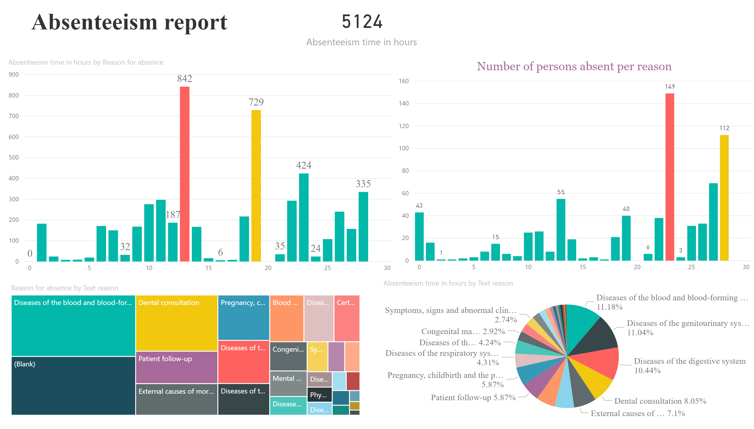

Slide 3
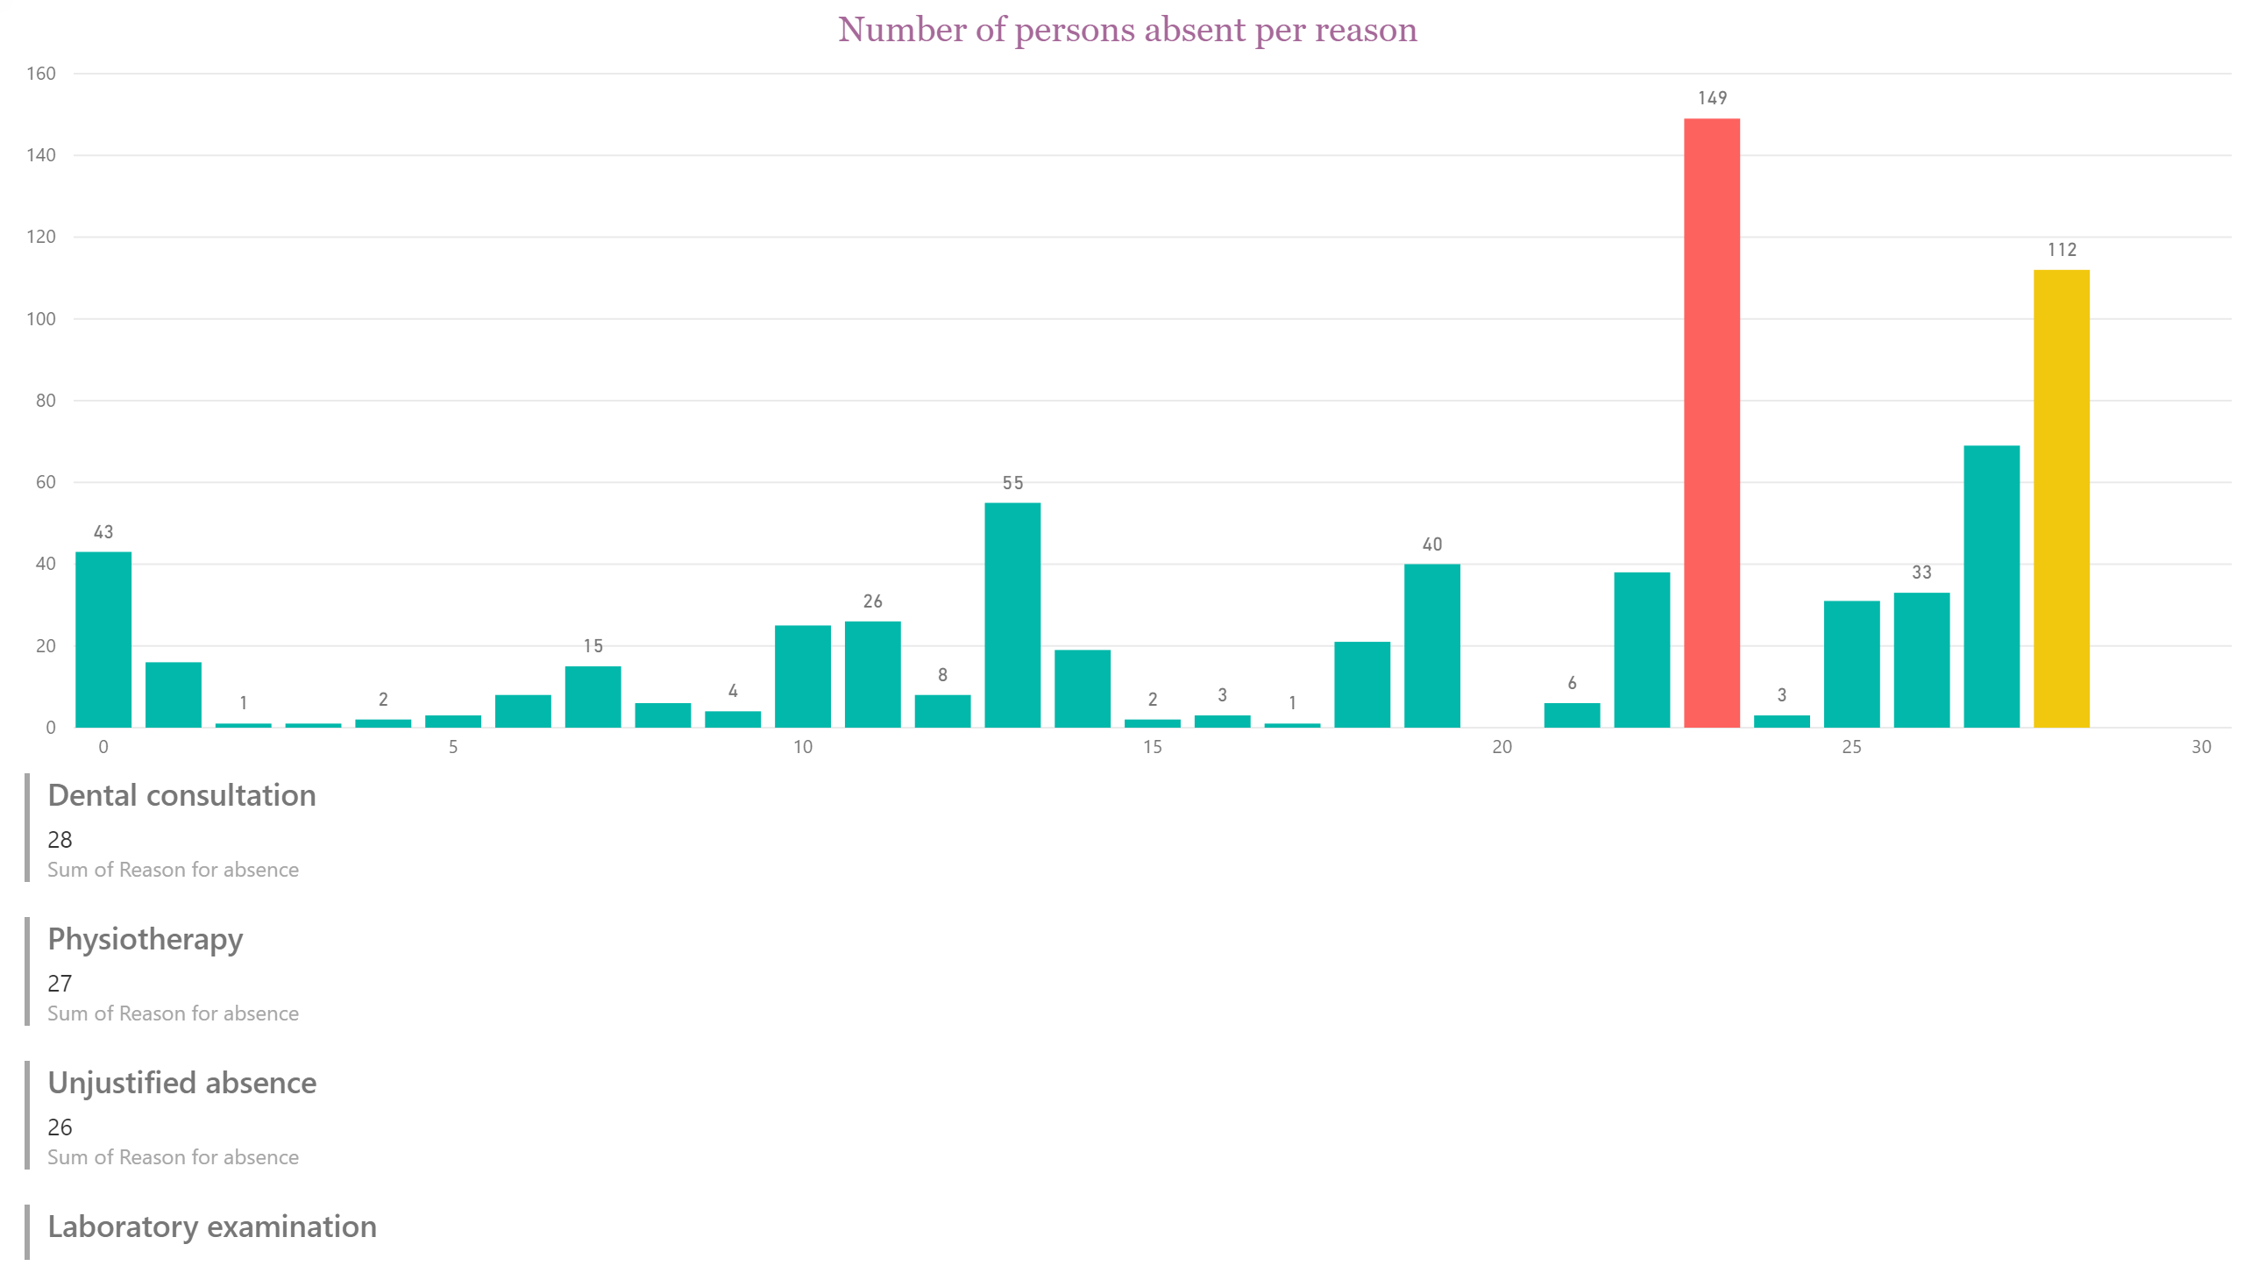

Slide 4
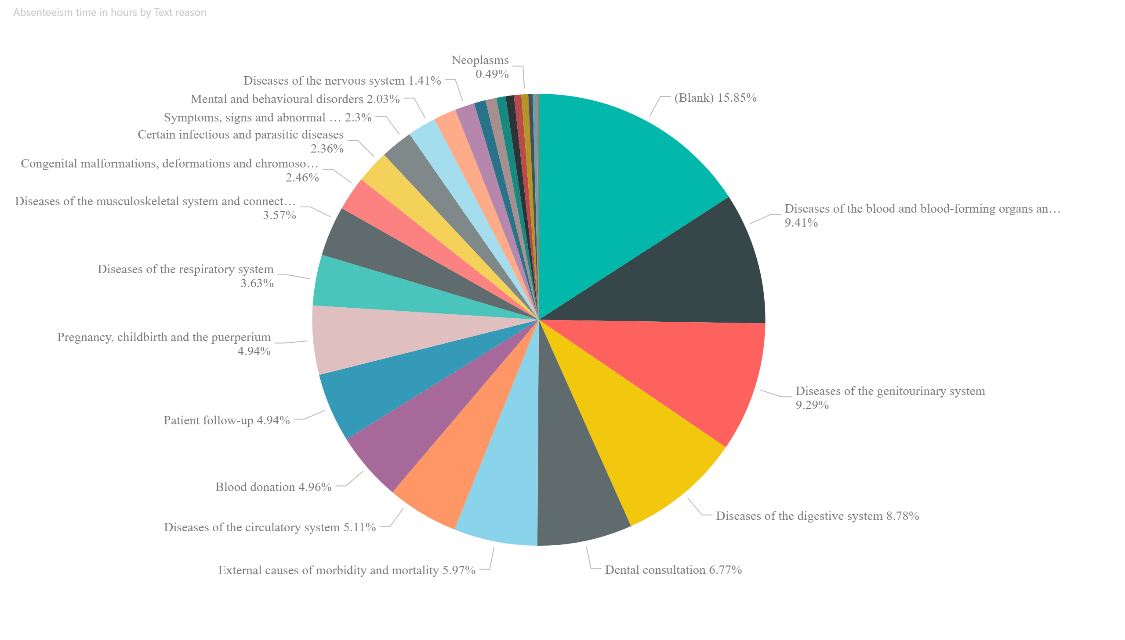

Slide 5
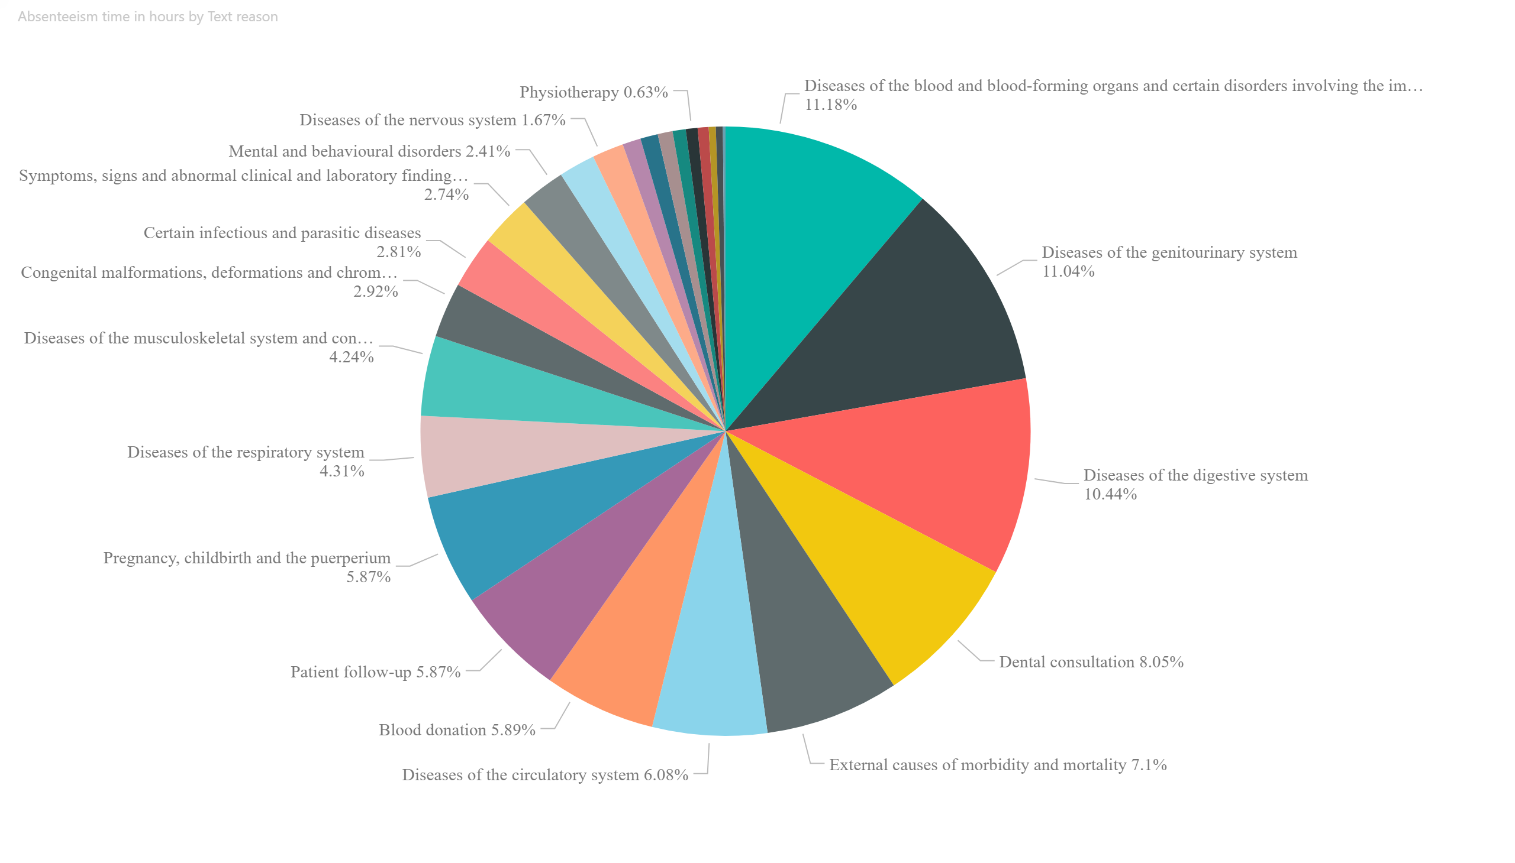

Slide 6
