Slide 1
Name of the project
TEMPERATURE CONVERTER

Slide 2
AIM OF THE PROJECT
The main Aim of my project on a temperature converter can be to create a tool that allows users to easily convert temperature values between different temperature scales.
Project could be used for various purposes, such as educational, scientific, or practical applications.

Slide 3
Uses:
A Temperature Converter can also provide additional benefits, such as:
Scientific Research: Temperature conversions are important in scientific research, especially in fields such as physics, chemistry, and engineering.

Slide 4
Everyday Use: A temperature converter project can be a practical tool for everyday use. For example, it can be used by people who travel frequently to different parts of the world where different temperature scales are used. It can also be used by people who need to convert temperature values for cooking, baking, or other household tasks.
Technical Applications: Temperature conversions are important in various technical applications, such as HVAC (Heating, Ventilation, and Air Conditioning), electronics, and manufacturing. A temperature converter project can be used by professionals working in these fields to quickly and easily convert temperature values as needed.

Slide 5
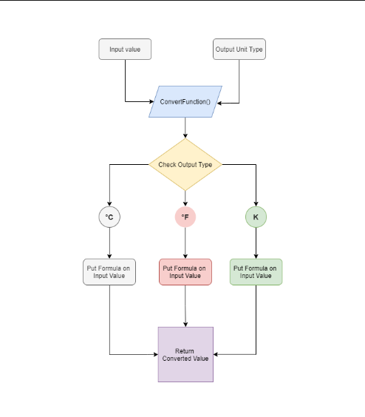



DFD

Slide 6
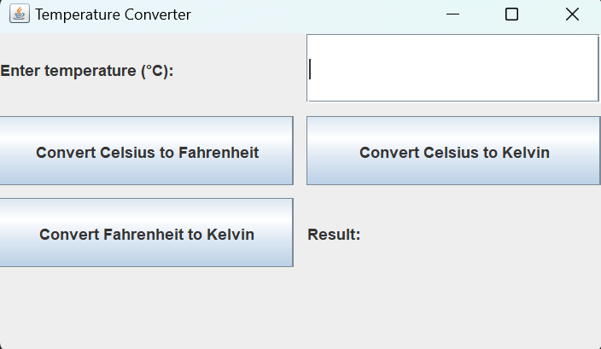
outcomes
The First module of Temperature Converter:

Slide 7
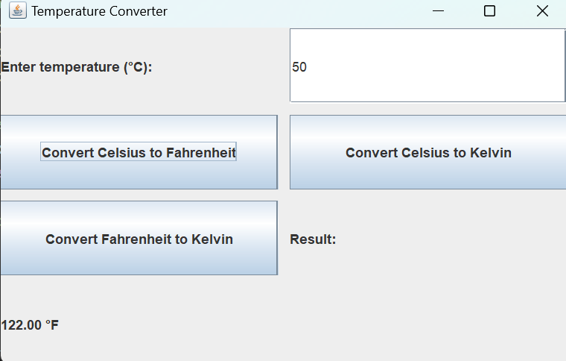
Converting Celsius to Fahrenheit:

Slide 8

Converting Celsius to Kelvin:

Slide 9
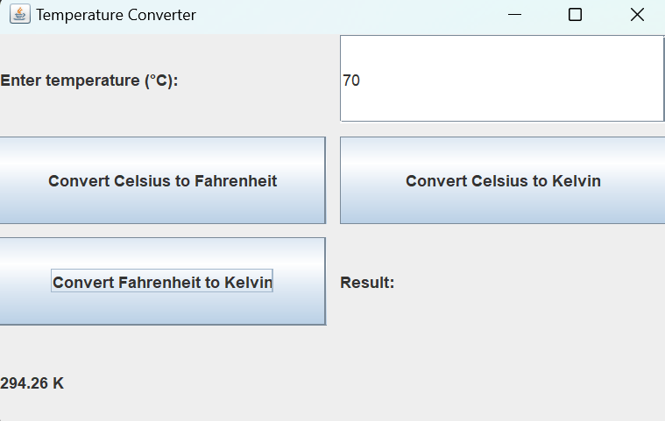
Converting Fahrenheit to kelvin:

Slide 10
HOW I MADE THIS
HERE TO MAKE THIS SYSTEM I USED JAVA AND J-FRAMES.
I have used several GUI components and classes to create a user-friendly interface.
Here I used j-frames buttons among them commonly used j frames buttons are:

Slide 11
JFrame: It is the main window of the GUI, which contains all the other components.
JLabel: It is used to display text or images on the JFrame.
JButton: It is used to create clickable buttons on the JFrame.

Slide 12
JTextField: it allows the editing of a single line of text.
JButton: It is used to create clickable buttons on the JFrame.
ActionListener: It is used to listen for events triggered by the user's interaction with the GUI components, such as clicking on a button.

Slide 13
CONCLUSION
Overall, the outcome of a temperature converter project should be a tool that is reliable, accurate, and easy to use, providing users with a valuable resource for converting temperature values between different units of measurement.

Slide 14
THANK YOU

