Slide 1
NEO- AI Conversational Agent
Ahmad Abdul Mogees 16I-0199
Khizar Shabbir 16I-0294
Supervisor: Dr. Mirza Omer Beg
Co-Supervisor: Mr. Shoaib Mehboob

Slide 2
Problem Domain
Conversational Expert
Improving Consistency
Real Life AI Friend

Slide 3
Research problem Statement
Conversation consistency of agent is very important for building long term confidence
Personality is a key differentiator in a conversational agent
We will be working on improving the conversation consistency of the agent according to its persona.

Slide 4
Improvised Theatre alongside Artificial Intelligences,2017
Two AI agents , Pyggy and A.L.Ex.
Pyggy using classic machine learning and deterministic rules
A.L.Ex. advanced natural language processing, and a much larger training dataset.

Slide 5
Strengths
Weaknesses
Dataset size
Dataset diversity
Captures the theme of dialogue
No automatic evaluation tools were used or evaluation
Absence of personality of chatbot

Slide 6
Dialogue Natural Language Inference,2019
NLI Dataset from Facebook
<category> <relation> <category>
Entailment, Neutral & Contradiction
Ranking of utterances
Consistency with persona
Metrics of consistency

Slide 7
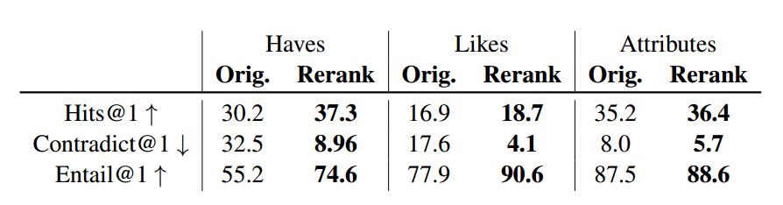
Strength and Weakness
Visible improvement in consistency with persona
Only consistency with persona is discussed
Consistency between utterances is not discussed

Slide 8
Context Dependent Recurrent Neural Network Language Model, 2012
Long Span Context Dependencies
Model Structure
Addition of Feature Layer
Fast Approximate Topic Representation

Slide 9
A Neural Chatbot with Personality,2017
Open-domain response generator with personality and identity
Training issues on Cornell Movie-Dialogs Corpus
T.V. shows scripts are more realistic
Chatbots that imitate characters in popular TV shows
Three phases of Training →

Slide 10
Three phases of training
Capturing basic dialog patterns from the conversations
Making dialogues more realistic by using TV show scripts
Fine tuning the model on the utterances of a specific character

Slide 11
Strengths
Weaknesses
Training method
Chatbot seemed to learn it’s identity
50% likely to believe that the response actually came from the real character
Data size was small
Inconsistencies in the scripts
Low score on automatic metrics like BLEU and ROUGE

Slide 12
Rasa: Open Source Language Understanding and Dialogue Management, 2017
Widely-used statistical dialogue system
Rasa’s architecture is modular by design
Rasa NLU and Rasa Core
Easy integration with other systems

Slide 13
Strengths
Fully decoupled Rasa Language understanding and Dialogue management
Allows trained models to be reused
Next action is also inspired by previous action (State tracker)
Use of topic model instead of Rasa NLU

Slide 14
System Diagram
Proposed Approach

Slide 15
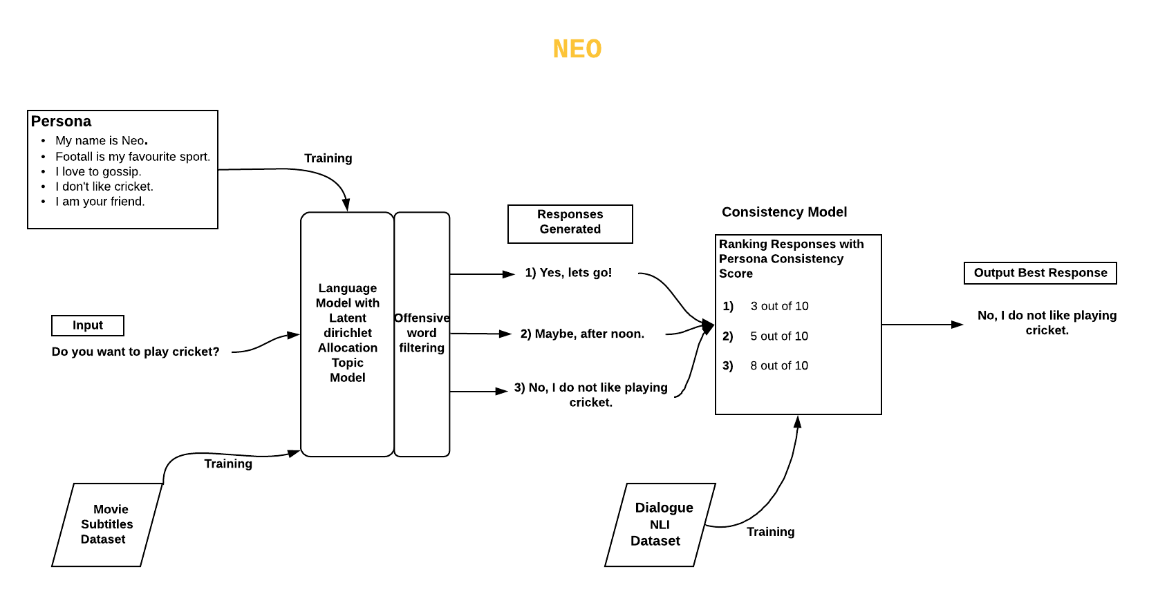

Slide 16
Work Done So far
Movies dataset from Opensubtitles.com having more than 108,000 subtitle files
Dialogue NLI dataset of 1.8GB
Poster
Formulation of approach
Prototype of chatbot built by using Rasa

Slide 17
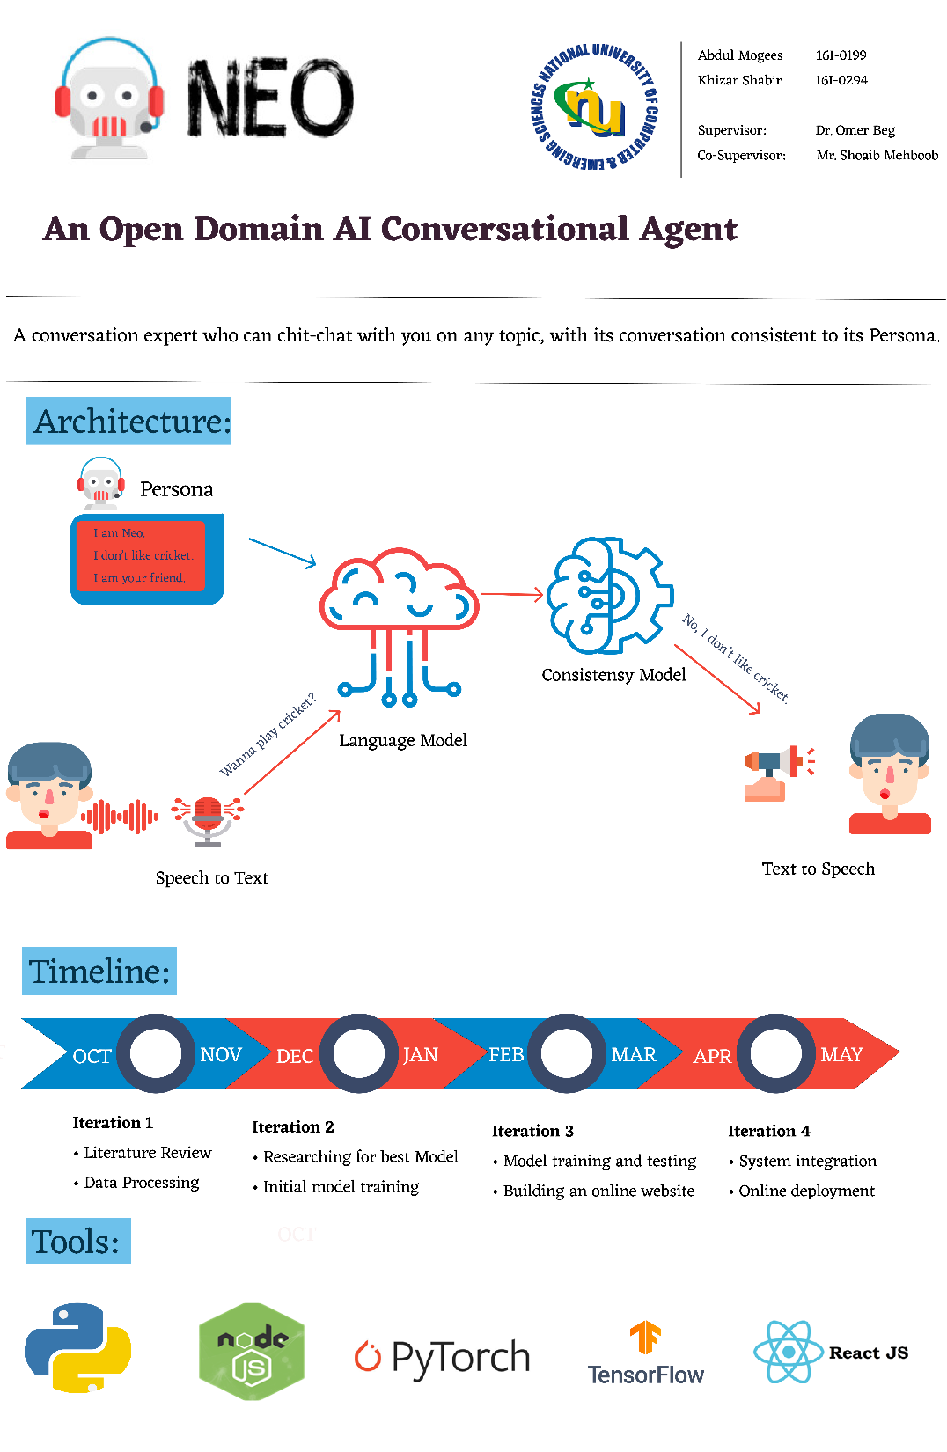

Slide 18
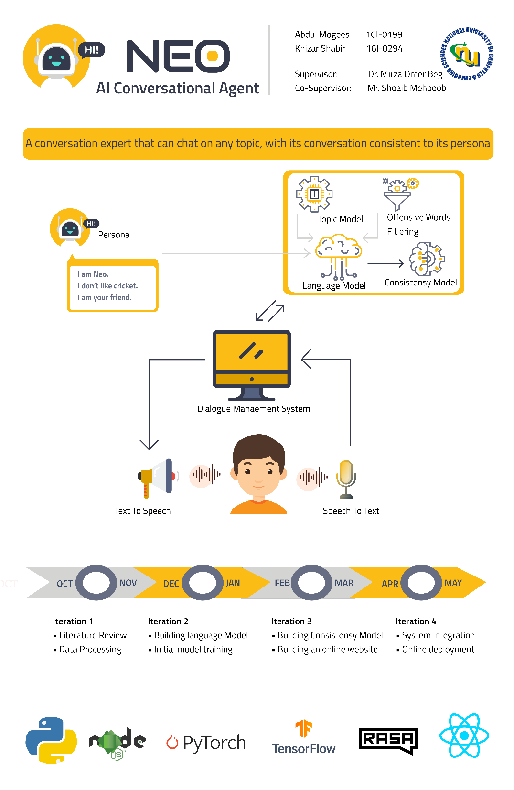

Slide 19
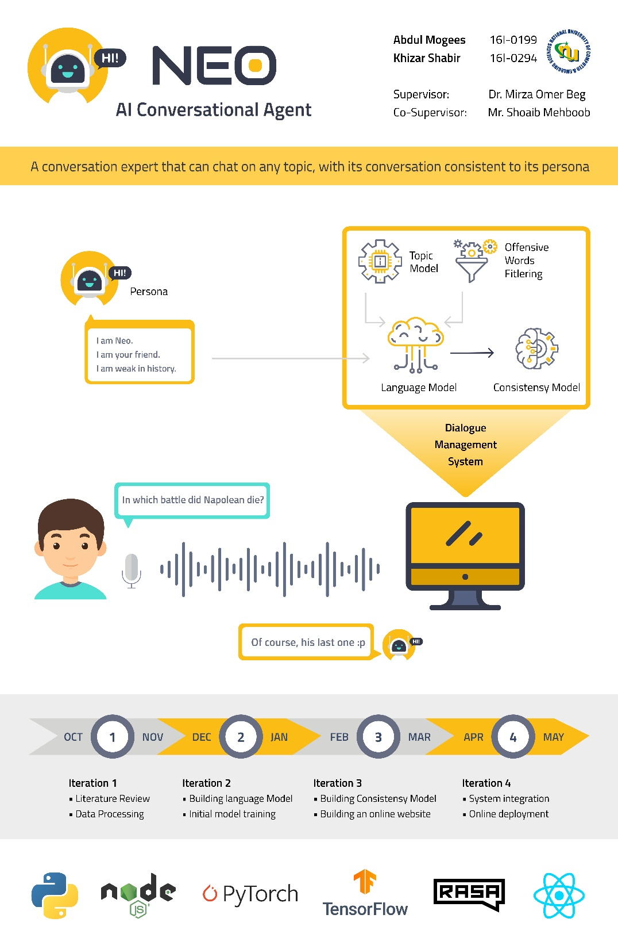

Slide 20
References
P. M. Kory W. Mathewson, "Improvised Theatre Alongside Artificial Intelligences," in AAAI, 2017.
. W. A. S. K. C. Sean Welleck, "Dialogue natural language inference," in arxiv.org, 2019.
D. M. T. C. H Nguyen, "A neural chatbot with personality," in semanticscholar.org, 2017.
G. Z. Tomas Mikolov, "Context Dependent Recurrent Neural Network Language Model," in IEEE, 2012.
J. F. N. P. A. N. Tom Bocklisch, "Rasa: Open source language understanding and dialogue management," in arXiv.org, 2017.

Slide 21
Thank you

Slide 22
QUESTIONS ?

