Slide 1

GHAT-SAFE
INNOVATORS CONCLAVE 2026 · SMART CITIES & CIVILTECH · IC26-04-10 OPEN INNOVATION
Software blind-curve warning for hairpin bends on ghat roads
Team CE Endeavours
Department of Civil Engineering · K.S.R.M. College of Engineering (Autonomous), Kadapa
Notes:
Introduce the team and the challenge: Smart Cities & CivilTech domain, Open CivilTech Innovation IC26-04-10. Our problem is mobility safety at blind hairpin bends on ghat roads.

Slide 2
Team CE Endeavours
SA
BB
MV
Sunkesula Ameer Besha
Bukke Balu Naik
Maddineni Venkata Siva Narayana
Reg. No. 249Y1A0134
B.Tech Civil Engineering · V Semester
Reg. No. 259Y5A0103
B.Tech Civil Engineering · V Semester
Reg. No. 259Y5A0122
B.Tech Civil Engineering · V Semester
Department of Civil Engineering, K.S.R.M. College of Engineering (Autonomous), Kadapa, Andhra Pradesh

Slide 3

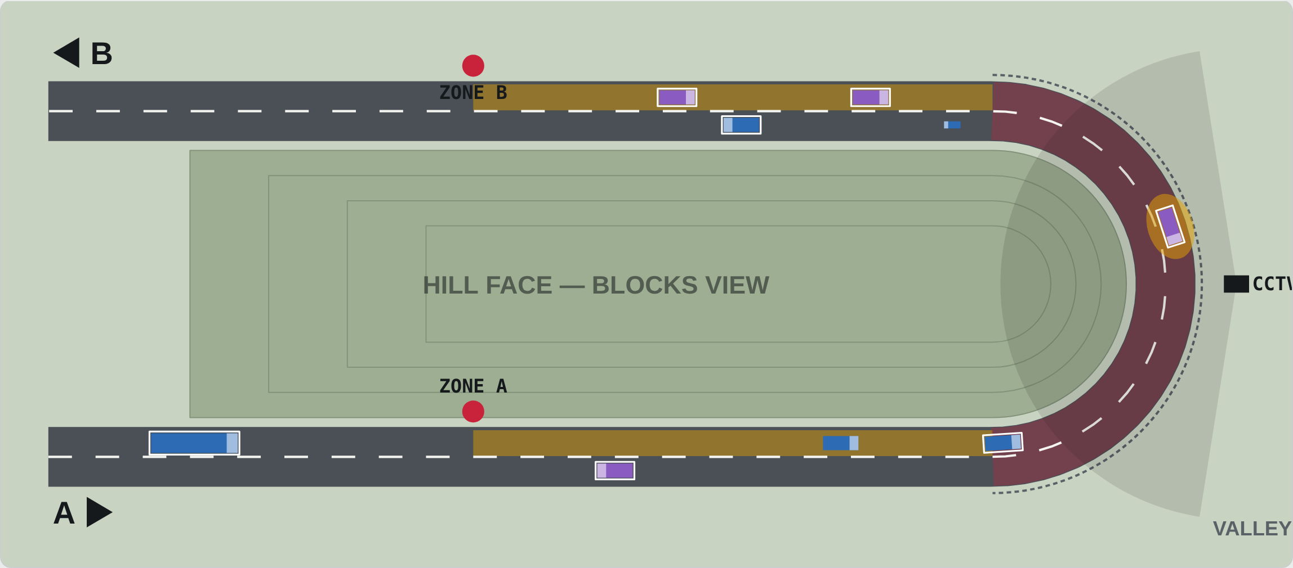



Blind hairpins hide oncoming vehicles until too late
Blind bend
The hill face hides an oncoming vehicle until it is a few metres away.
Steep, narrow road
Steep gradients, narrow lanes and no shoulder leave little room to recover.
Rain and fog
Wet surfaces cut tyre grip; fog and night cut visibility further.
Plan of a hairpin bend: the hill face (centre) blocks the line of sight between Approach A and Approach B. A roadside sign alone is easy to miss at night or in fog.
Overspeed and overtaking
Drivers enter the bend too fast or drift across the centre line.

Slide 4
Why it matters
4,80,583
1,72,890
4 E's
road accidents reported in India in 2023
people killed in road crashes in 2023
engineering, education, enforcement and emergency care are all needed
The gap we address: at a blind hairpin the driver needs to know an oncoming vehicle is there before it can be seen. Hardware sensor systems do this, but each bend needs poles, power, wiring and maintenance on a remote hillside.
Source: Ministry of Road Transport & Highways, Road Accidents in India 2023.

Slide 5
From roadside hardware to pure software
Function | Hardware prototype (earlier) | GHAT-SAFE software (now)
Detect vehicle | IR / radar sensor pair at each approach | Phone GPS crossing a geofence + AI detection on existing CCTV
Logic unit | Arduino / ESP32 at the roadside | Cloud bend-state engine, updated every second
Warning | Amber LED board on the opposite approach | Full-screen alert + voice in the driver app
Power | Solar panel and battery at site | None at site — phones and existing cameras
Monitoring | Manual site visits | Authority dashboard: alerts, overspeed, near-misses
Cost per bend | ₹1,550–₹2,800 for a demo model; more for field grade | Close to zero per bend; cost is app + server hosting
Same idea — Detect, Warn, Guide — but nothing has to be installed on the hillside.

Slide 6
How GHAT-SAFE works: Detect, Warn, Guide
1
Detect
2
Warn
3
Guide
Each bend has two virtual zones (geofences) on its approaches. The app reports the phone's GPS position and speed every second. Existing CCTV at the bend counts vehicles without the app.
The cloud engine checks both approaches. If a vehicle is coming from the other side, drivers get an alert on screen and by voice: “Vehicle ahead — slow down”.
The app shows the advisory speed for the bend and flags overspeed. Every event is logged for the road authority's dashboard.

Slide 7




System architecture
Driver app (Android)
GPS 1 Hz · speed · heading · on-phone geofences
Driver warning
Alert screen + voice in Telugu, Hindi, English · under 1 s
Bend-state engine (cloud)
Zone occupancy per bend → CLEAR / ONCOMING / HEAD-ON RISK · overspeed check · event log
Existing CCTV at bend
AI vehicle detection (YOLO) · counts and direction only
Authority dashboard
Bend risk ranking · audit and enforcement data
Stack: Flutter/Android app · FastAPI or Node.js backend · Redis (live state) · PostgreSQL + PostGIS (bend geometry, logs) · MQTT/WebSocket push · Python + OpenCV for CCTV

Slide 8
Zone length comes from stopping sight distance
SSD = v·t + v²/(2gf)
Geofence = SSD + v × 2 s
Condition | Advisory | f | SSD | Geofence
Clear | 25 km/h | 0.40 | 43.5 m | 66 m
Rain / wet | 20 km/h | 0.30 | 48.8 m | 71 m
Fog / night | 20 km/h | 0.35 | 45.8 m | 68 m
v = approach speed 40 km/h (11.1 m/s)
t = 2.5 s perception–reaction time
f = longitudinal friction, reduced for wet roads
2 s added for GPS update + mobile network delay
Each bend gets its own zones on the map, so a sharper or steeper bend can use longer zones. Values for t and f are editable per bend after the road-safety audit.

Slide 9
Decision logic: three warning states
CLEAR — DRIVE CAREFULLY
No vehicle in the opposite approach zone. App shows the advisory speed for the bend.
VEHICLE AHEAD — SLOW
A vehicle is in the opposite approach zone. Driver is told to slow below the advisory speed.
HEAD-ON RISK — HOLD LEFT
The oncoming vehicle is already inside the blind bend. Hold left and slow to 15 km/h.
Plus overspeed: any app user entering a zone more than 5 km/h above the advisory gets “Slow down, hairpin ahead”, and the event is logged.

Slide 10
Working prototype: live bend simulator
Vehicles enter from A and B with mixed speeds and types (car, bike, bus, truck)
Amber bands are the geofenced zones; red is the blind conflict zone
White outline = driver has the app
Controls: weather, traffic, app adoption, CCTV on/off, system on/off
Built as a web app: simulator, driver-app view and authority dashboard run in any browser for the live demo.

Slide 11
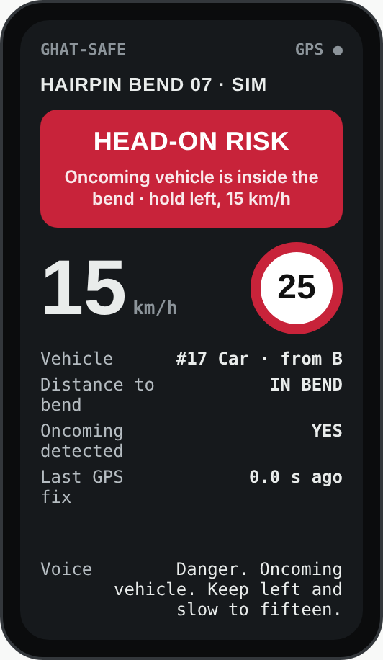
What the driver sees
Voice first
Spoken alert so the driver keeps eyes on the road. Telugu, Hindi and English.
One glance
Large alert colour, current speed and the bend's advisory speed — nothing else while moving.
Works in weak signal
Bend zones are stored on the phone, so the bend and overspeed alerts still work offline.
Privacy
Only position and speed near bends are sent. No names, no video, no tracking elsewhere.

Slide 12
Simulation result: near-misses drop sharply
16.7% → 0.5%
Near-miss rate with 60% app use and CCTV, versus no system.
At low app adoption, the existing CCTV matters most: it more than halves near-misses at 30% adoption.
Near-miss = opposing vehicles meet in the blind bend at a closing speed above 40 km/h. Each run: 3 simulated hours, moderate traffic, clear weather. These are model results that test the logic; real benefit must be measured in a field pilot.

Slide 13
Implementation plan and who owns it
MONTH 1
MONTH 2
MONTH 3
MONTH 4
Map bends
Baseline
Launch
Measure
Select 3–5 crash-prone hairpins with the road authority using police and accident records. Record each bend's geometry.
Two weeks of CCTV speed and conflict counts with the system off.
Release the app to APSRTC bus and goods-vehicle drivers first — high mileage on ghat roads, easy to reach through depots.
Four weeks with the system on. Compare near-miss rate, approach speed and overspeed share with the baseline.
Responsible stakeholders: AP Roads & Buildings Department and NHAI (bend data, approvals, signs), Ministry of Road Transport & Highways (road-safety programmes), traffic police (enforcement data), APSRTC (first driver group). The challenge lists MoHUA as a suggested alignment; for ghat roads, the road-owning agencies above are the right owners.

Slide 14
Measurable public-service outcomes
Near-miss rate
Approach speed
Overspeed share
Opposing meetings in the bend above 40 km/h closing speed, from CCTV
Average and 85th-percentile speed at zone entry
Percentage of app users above the advisory speed
Coverage
Alert delay
Cost per bend
Share of vehicles detected by app or camera
Time from zone entry to warning on the opposite side (target under 2 s)
Hosting and maintenance cost compared with a hardware unit

Slide 15
Assumptions, limits and safety
Adoption
Drivers without the app are invisible unless a camera covers the bend. That is why CCTV is part of the design.
GPS accuracy
Phone GPS is accurate to about 3–10 m and weakens under cliffs. The system warns about presence, not lane position.
Network gaps
Signal is patchy on ghat roads. Zones stored on the phone and the CCTV path reduce this risk but do not remove it.
Distraction
Alerts are voice-first with a locked, minimal screen while the vehicle is moving.
Not a replacement
Signs, chevrons, mirrors, markings and crash barriers from the road-safety audit stay. GHAT-SAFE adds a layer on top.

Slide 16
Safer bends start with earlier warnings
Detect early · Warn clearly · Validate safely
Thank you — questions welcome
Team CE Endeavours · Sunkesula Ameer Besha · Bukke Balu Naik · Maddineni Venkata Siva Narayana

