Slide 1

Data Mining
Milestone 6
Khashayar Namsehchi
WQD170034

Slide 2
Agenda Style
01
Objective
02
Dataset Information
03
Crawling & Analysis
04
Sentiment Analysis
05
Clustering
06
Stock recommendation
07
Predictive Modeling
08
Recommendation MODELING
09
Conclusion

Slide 3
Objective

Slide 4
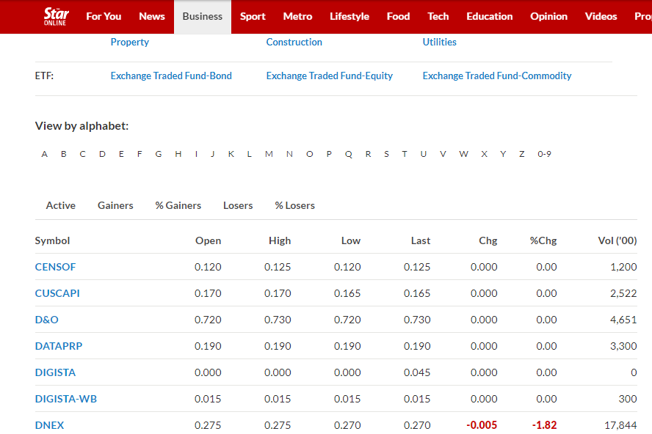
Stock investment Recommendation

Slide 5
Dataset Information

Slide 6
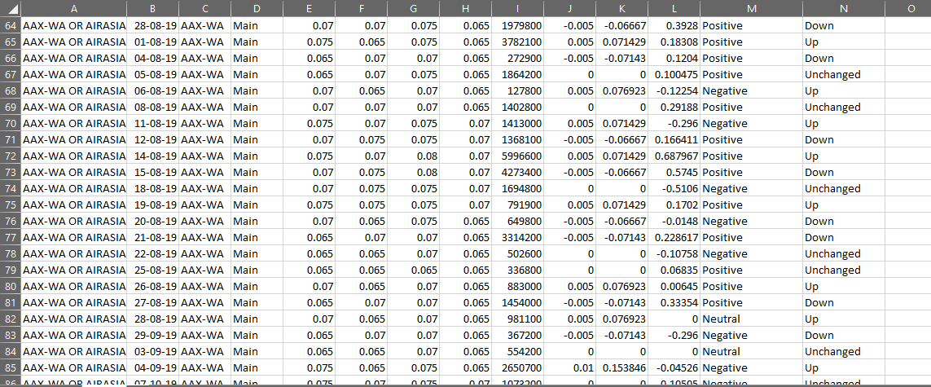
Dataset Overview
The Data comes from:
Stars Stock price
I3investor Financial
Twitter

Slide 7
The data including
Closing
High
Low
The trade volume for all stocks recorded on the portal since August 2019 until October 2019

Slide 8
Crawling & Analysis

Slide 9
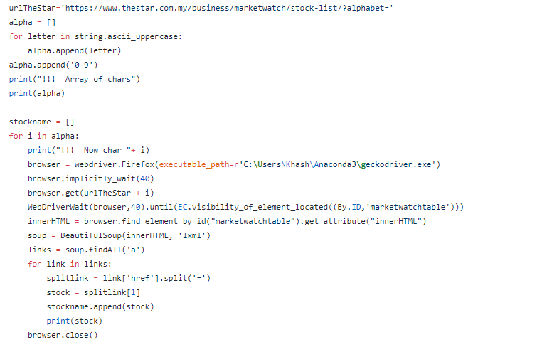
The piece of Python code for crawling the data from stars

Slide 10
Sentiment Analysis

Slide 11
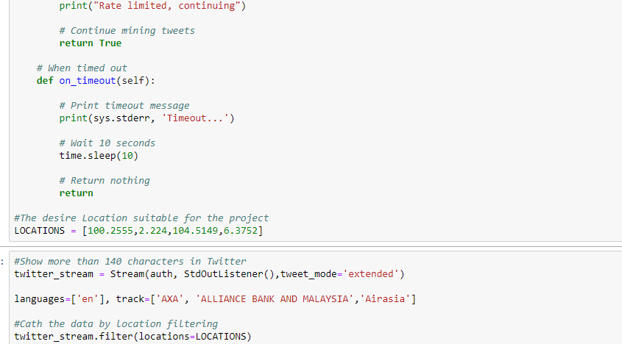
According to this part
crawling the data from
Twitter
The piece of Python code to investigate desire text from tweet in Malaysia Location

Slide 12
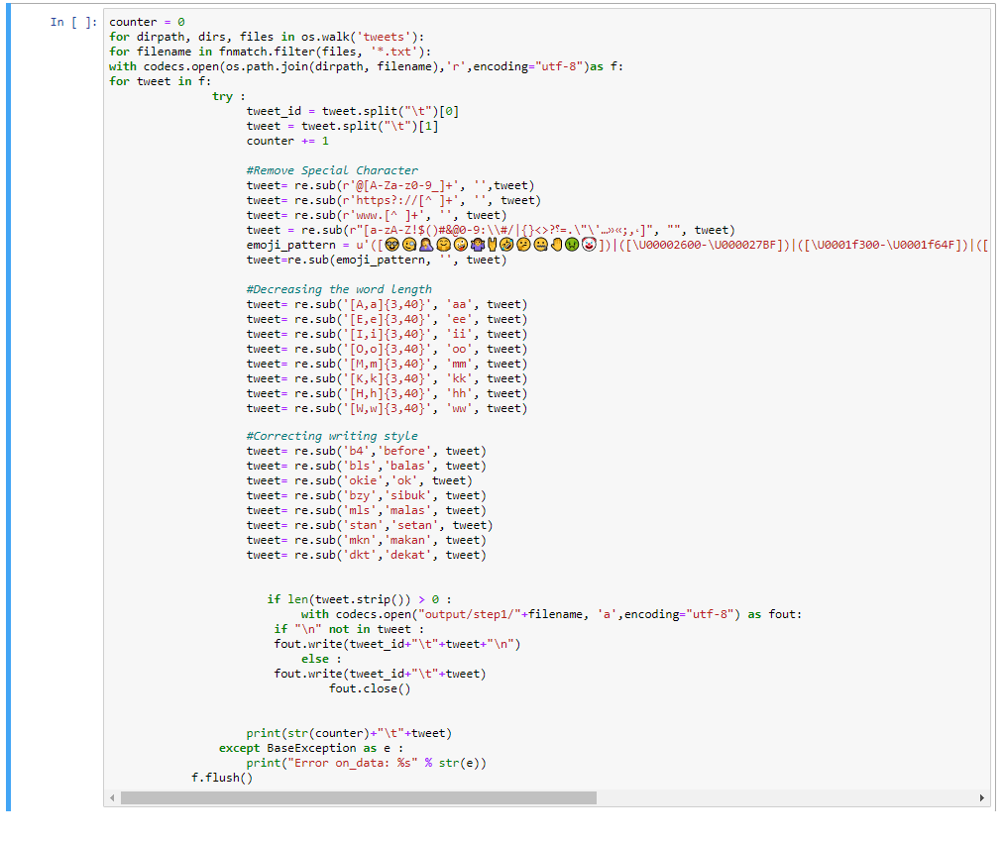
Pre-processing part
Using the Python for Text Analysis and Sentiment analysis part

Slide 13
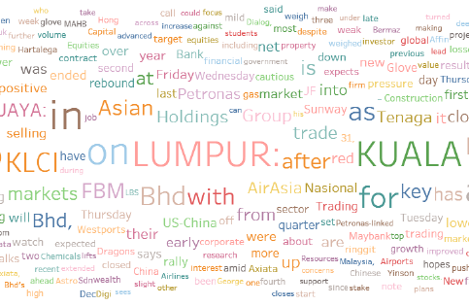
Tweets about the company were extracted in the word could

Slide 14
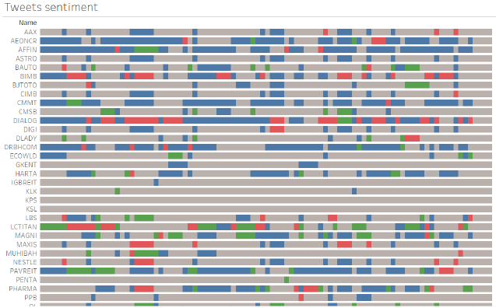
The Tweet sentiment Report
Negative
Positive
Neutral

Slide 15
Clustering

Slide 16
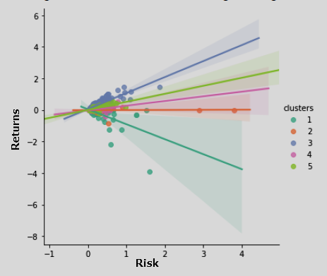
After running the clustering in enterprise miner.
We have 5 clusters
The Cluster No 3 is a high-risk cluster
the stock returns increases sharply as risk increases.
The Cluster No 1 is a low-risk cluster
The stock returns is relatively lower as compared with other clusters

Slide 17
Stock Recommendation

Slide 18
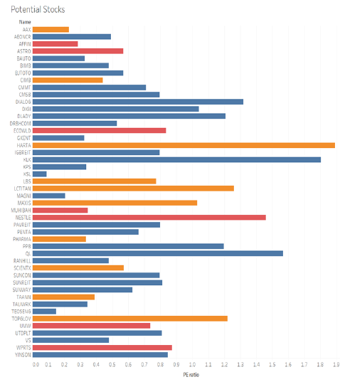

This information stand for the risk of company.
Low Risk
Medium Risk
High Risk
The data filtered by Price of Earnings ratio
Outcomes:
AirAsia X Bhd Low risk
MAXIS Bhd Low risk
NESTLE (Malaysia) Bhd Medium risk
Aeon Credit Service (M) Bhd High risk

Slide 19
Predictive Modeling

Slide 20
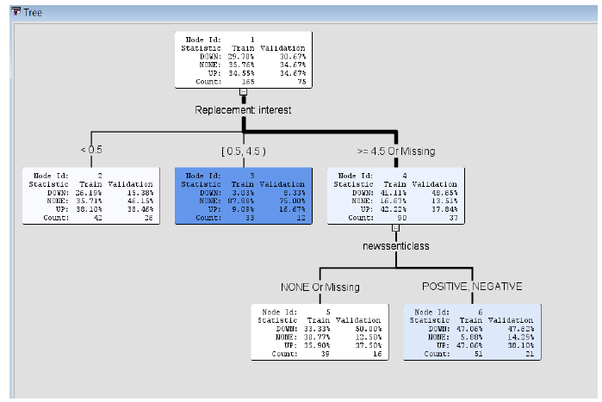
This information stand for the risk of company.

Slide 21
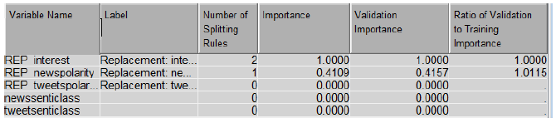
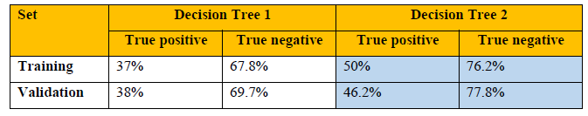
The important Variables base on the Entropy of Decision Tree
Classification Output

Slide 22
Recommendation MODELING

Slide 23
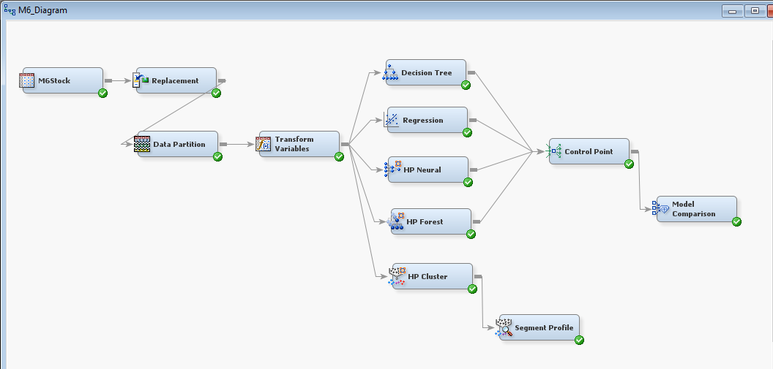
All Models Built in SAS Enterprise Miner.

Slide 24
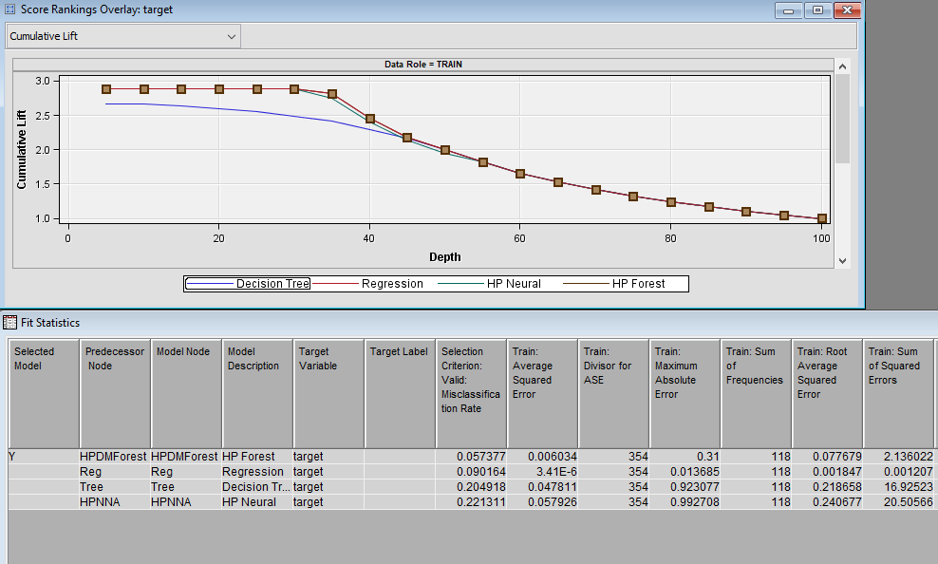

Slide 25
Conclusion

Slide 26
 | Outcome 01
 | This can be identified through unsupervised clustering method. leveraging on the rate of return and volatility information of stock prices
 | Outcome 02
 | HP forest can predict the movement of stocks based on news sentiment and interests
 | Outcome 03
 | news sentiment and interests (i.e. Twitter) is influential towards stock’s returns and should be monitored throughout investment period

Slide 27
Thank you

