Slide 1
ASSIGNMENT: GYM MANAGEMENT SYSTEM
Lecturer: NhungNTH69
Subject Code: DBI202
Group Members: Văn Hoàng Khoa
Lê Đăng Khoa
Trần Quang Hà
Bùi Hữu Sang
Cao Hoàng Tâm
Phạm Việt Hòa

Slide 2
INTRODUCTION
A Gym Management System is a database system used to manage gym operations and member activities.
The system helps manage:
• Gym members
• Membership packages
• Trainers
• Attendance records
• Payments

Slide 3
DATABASE STRUCTURE
The system contains 6 main tables:
• MEMBER
• MEMBERSHIP
• TRAINER
• GYM_PACKAGE
• ATTENDANCE
• PAYMENT
These tables are connected using Primary Keys and Foreign Keys.

Slide 4
MEMBER TABLE
Columns:
• MemberID (Primary Key)
• FullName
• DOB
• Gender
• Phone
• Email
• JoinDate

Slide 5
MEMBERSHIP TABLE
Columns:
• MembershipID (Primary Key)
• MemberID (FK)
• PackageID (FK)
• TrainerID (FK)
• StartDate
• EndDate
• Status

Slide 6
PAYMENT TABLE
Columns:
• PaymentID (Primary Key)
• MembershipID (FK)
• Amount
• PaymentDate
• PaymentMethod
• PaymentStatus

Slide 7
TRAINER TABLE
Columns:
• TrainerID (Primary Key)
• TrainerName
• Specialty
• Phone
• Email
• Salary

Slide 8
GYM PACKAGE TABLE
Columns:
• PackageID (Primary Key)
• PackageName
• DurationMonths
• Fee
• SessionLimit

Slide 9
ATTENDANCE TABLE
Columns:
• AttendanceID (Primary Key)
• MemberID (FK)
• CheckInTime
• CheckOutTime

Slide 10
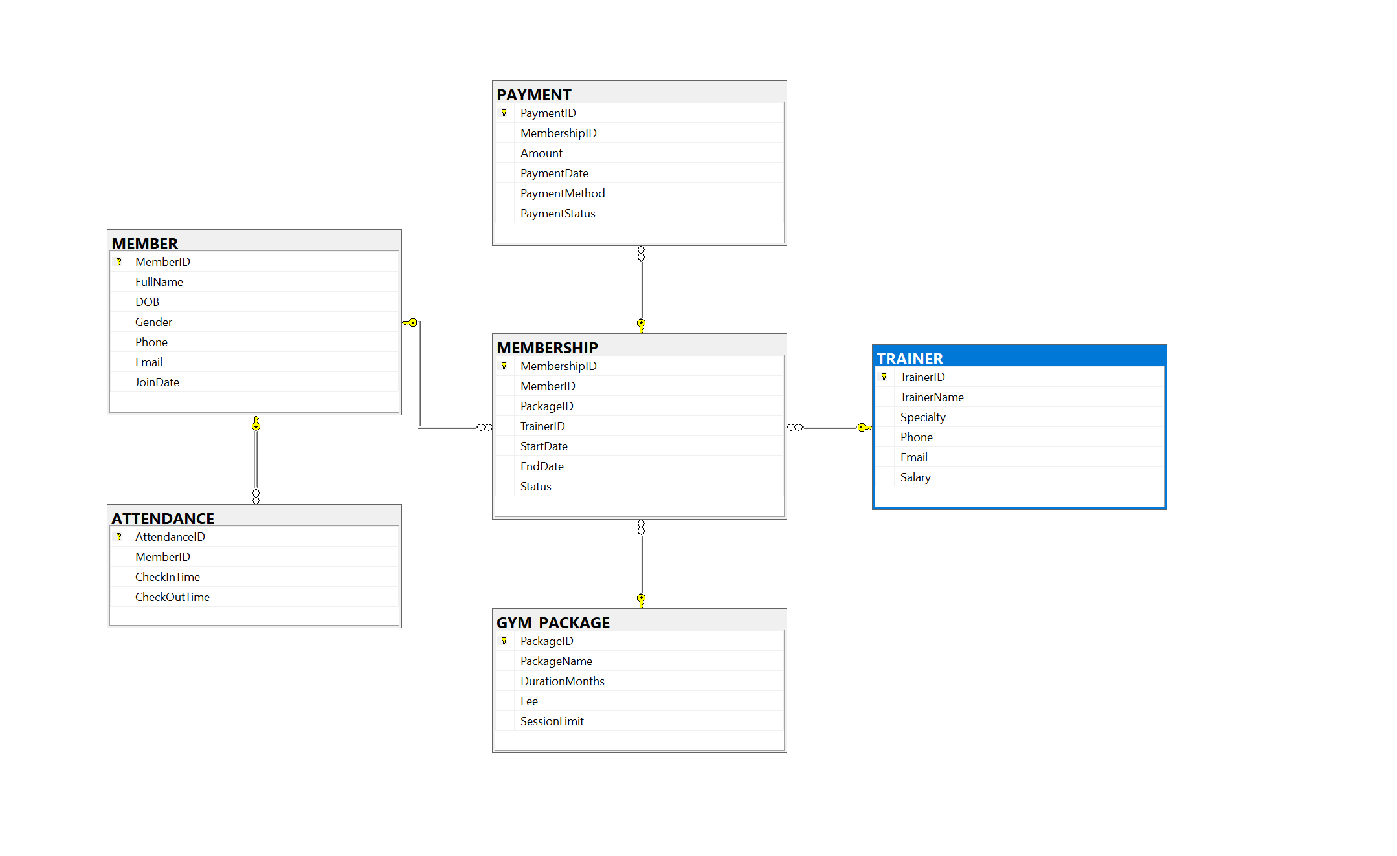
ENTITY RELATIONSHIP DIAGRAM

