Slide 1
LIFO (Last-In, First-Out), also known as a Stack, is an important data structure used to store and retrieve data in the reverse order of its entry: the data entered last will be retrieved first.
Introduction
LIFO has two important parameters: the number of memory cells and the data width, which determine the LIFO capacity. Two characteristic parameters of LIFO are:
The number of memory cells, also known as LIFO depth.
Memory cell width, corresponding to the width of the data being written and read.

Slide 2
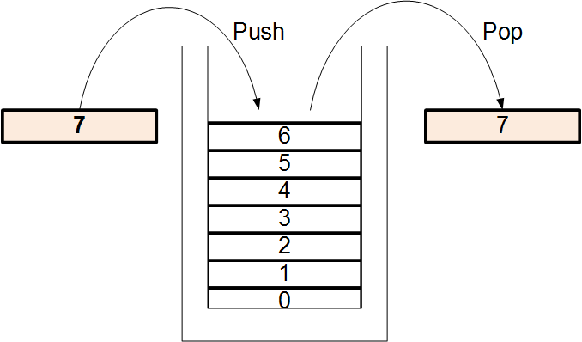
The two parameters above will determine the LIFO capacity. For example, if a LIFO has 4 memory cells and each cell stores 8 bits of data, the LIFO capacity is 4 * 8 = 32 bits or 4 bytes. To address the memory cells of the LIFO, a commonly used method is to use a write pointer and a read pointer. The pointer here is essentially a sequential counter.

Slide 3
LIFO usually has signals to report its operating status, such as:
Status | Description
Empty State | Does not contain any data.
Full State | The entire capacity has been filled.
Overflow State | It is full but writing continues. In this case, the data in LIFO remains unchanged and is not overwritten by new data.
Underflow State | It is empty but reading continues. In this case, the data output will hold the most recent old data value.
Threshold State (below or above a threshold value) | For example, if the amount of data in LIFO is less than or equal to 4, the low threshold is activated. The value 4 here is the low threshold.

Slide 4
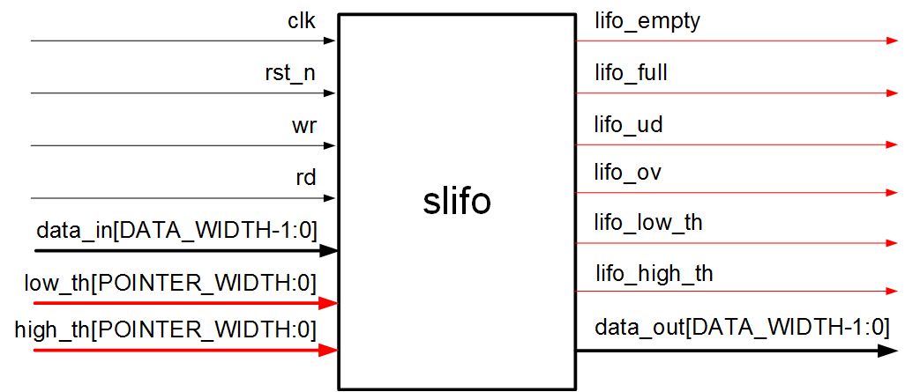
HIGH LEVEL BLOCK DESIGN

Slide 5
Input:
Port | Description
clk | Clock signal.
rst_n | Active-low reset signal.
wr | Data write signal into LIFO.
rd | Data read signal from LIFO.
data_in[DATA_WIDTH-1:0] | Data write bus with DATA_WIDTH bits.
low_th[POINTER_WIDTH-1:0] | Low threshold configuration signal with POINTER_WIDTH bits.
high_th[POINTER_WIDTH-1:0] | High threshold configuration signal with POINTER_WIDTH bits.

Slide 6
Output:
Port | Description
lifo_empty | Signal reporting LIFO is empty.
lifo_full | Signal reporting LIFO is full.
lifo_low_th | Signal reporting LIFO is below the low threshold.
lifo_high_th | Signal reporting LIFO is higher than or equal to the high threshold.
lifo_ov | Signal reporting LIFO overflow.
lifo_ud | Signal reporting LIFO underflow.
lifo_data_out[DATA_WIDTH-1:0] | Data read bus with DATA_WIDTH bits.

Slide 7
Parameters:
DATA_WIDTH: Sets the number of bits for 1 LIFO data cell, corresponding to the width of the write/read data bus.
POINTER_WIDTH: Sets the width of the write/read pointer. This value will determine the number of LIFO memory cells according to the formula: Number of LIFO memory cells =2^POINTER_WIDTH. For example, if POINTER_WIDTH is configured as 3, the number of LIFO memory cells is 2^3 = 8 cells.
Note: This LIFO does not allow simultaneous reading and writing, meaning only reading or writing can occur at a single point in time.

Slide 8
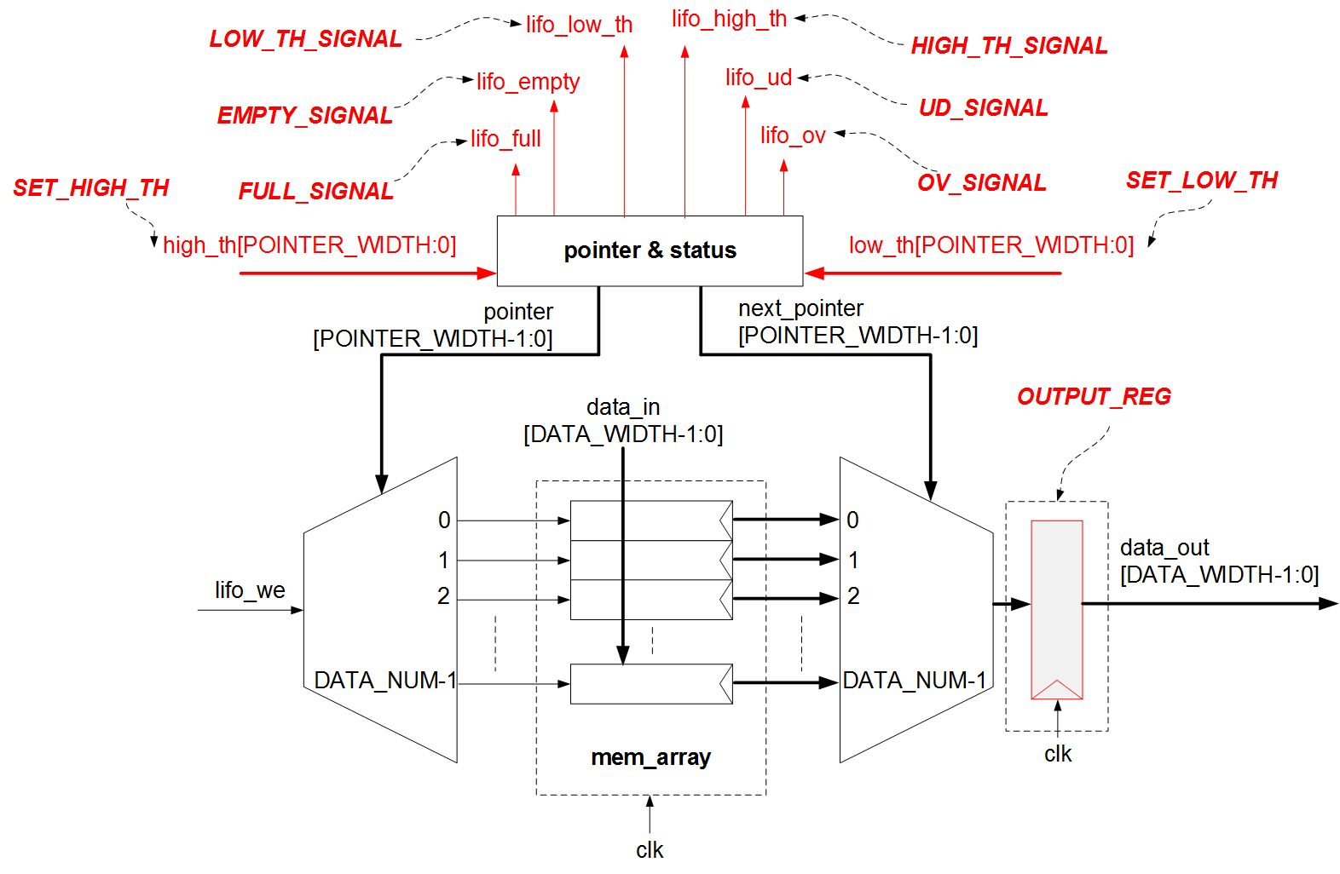
Read/Write Pointer
The read and write pointer for this LIFO design is just a single counter that operates according to the principle:
Increases by 1 when writing.
Decreases by 1 when reading.
The read/write pointer circuit can be implemented in two ways:
Using 1 adder and 1 subtractor.
Using 1 adder and 1 MUX. This method is based on the principle of converting a subtractor into a 2's complement addition circuit.

