Slide 1
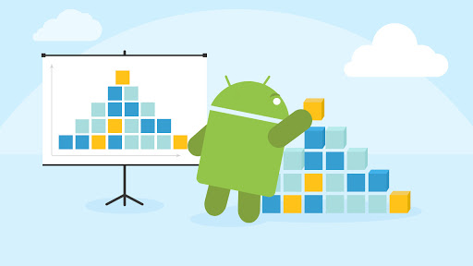
Modularization of Android App

Slide 2
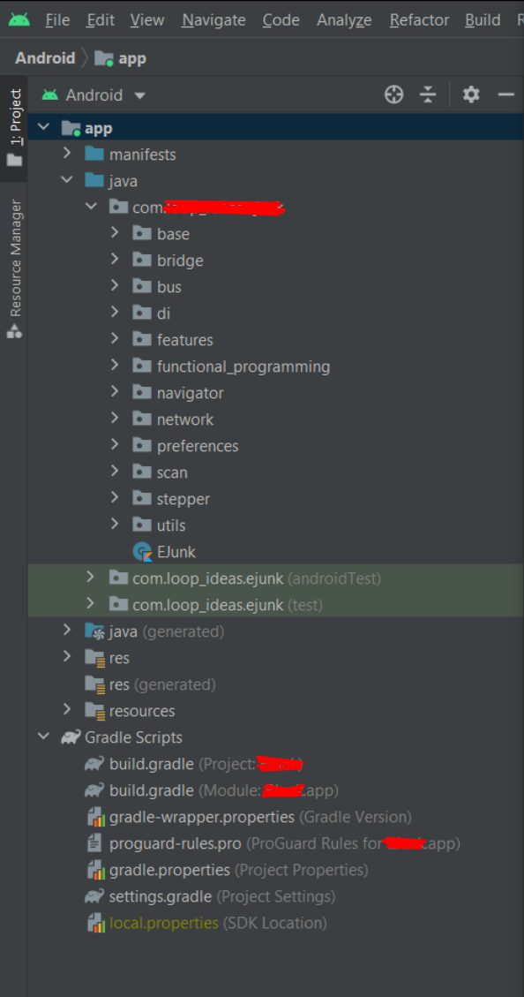
Single Module App

Slide 3
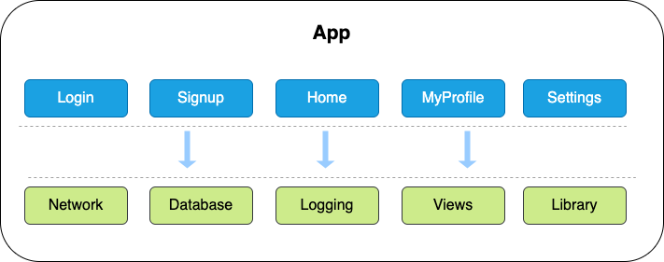
Single Module App

Slide 4
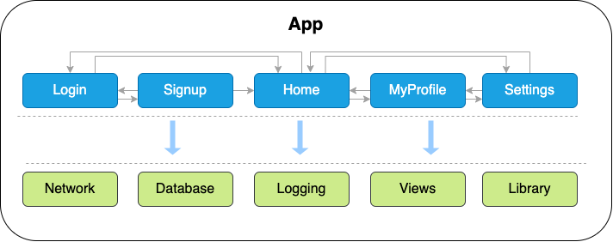
Single Module App
Hidden circular dependencies

Slide 5
Single Module App
Difficult to debug, maintain.
Build time is not optimized
Increase app size.
Difficult to reuse features.

Slide 6
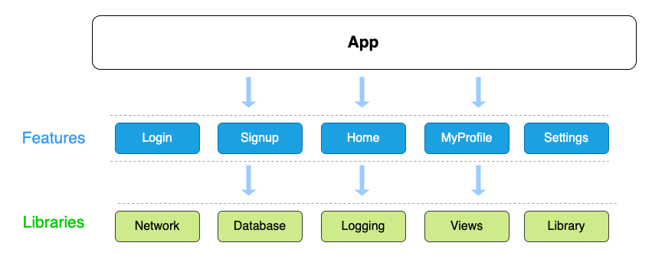
Multi Module App

Slide 7
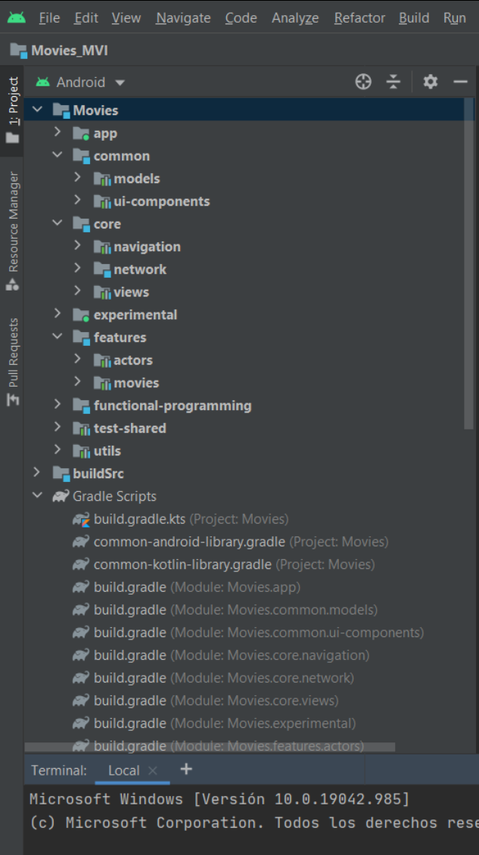
Monolithic project
Modularized project

Slide 8
What is Modularization ?
“ Modular programming is a software design technique that emphasizes separating the functionality of a program into independent, interchangeable modules, such that each contains everything necessary to execute only one aspect of the desired functionality. ”
Wikipedia

Slide 9
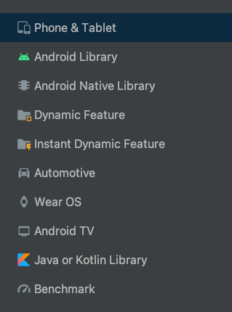
Application Module
apply plugin: 'com.android.application'
Android Library Module
apply plugin: 'com.android.library'
Dynamic Feature Module
apply plugin: 'com.android.dynamic-feature'
Kotlin Library Module
apply plugin: 'kotlin'

Slide 10
Dynamic Feature Module
Feature Delivery lets you customize the delivery of features in your app. Can uninstall modules.
Delivery types:
On-Demand delivery
Install-time delivery
Conditional delivery
Instant delivery

Slide 11
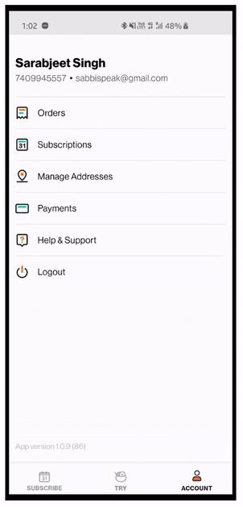
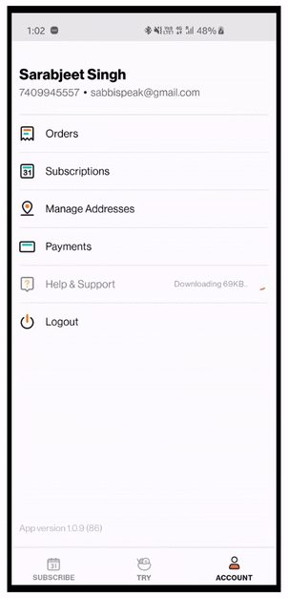
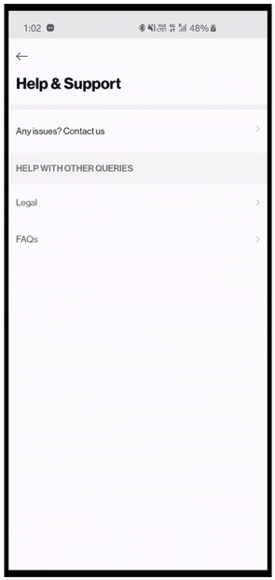
Dynamic Feature Module
The module will be downloaded and installed when need
Feature Delivery lets you customize the delivery of features in your app. Can uninstall modules.
Delivery types:
On-Demand delivery
Install-time delivery
Conditional delivery
Instant delivery

Slide 12
Dynamic Feature Module
Feature Delivery lets you customize the delivery of features in your app. Can uninstall modules.
Delivery types:
The module is available when install app
On-Demand delivery
Install-time delivery
Conditional delivery
Instant delivery

Slide 13
Dynamic Feature Module
The module is available if the device meets certain conditions. Ex: countries, camera,...
Feature Delivery lets you customize the delivery of features in your app. Can uninstall modules.
Delivery types:
On-Demand delivery
Install-time delivery
Conditional delivery
Instant delivery

Slide 14
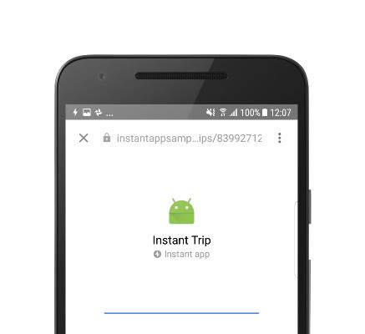
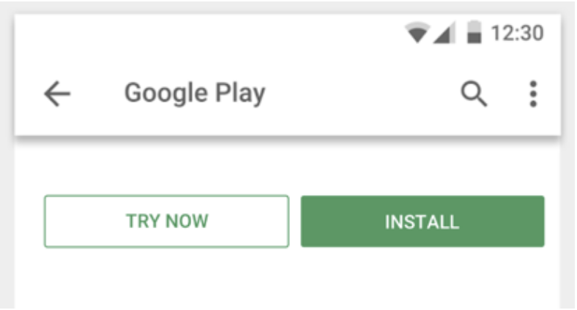
Dynamic Feature Module
Feature Delivery lets you customize the delivery of features in your app. Can uninstall modules.
Delivery types:
Instant app, user can try your app without installing it.
On-Demand delivery
Install-time delivery
Conditional delivery
Instant delivery
From URL (App Links)
From Google Play

Slide 15
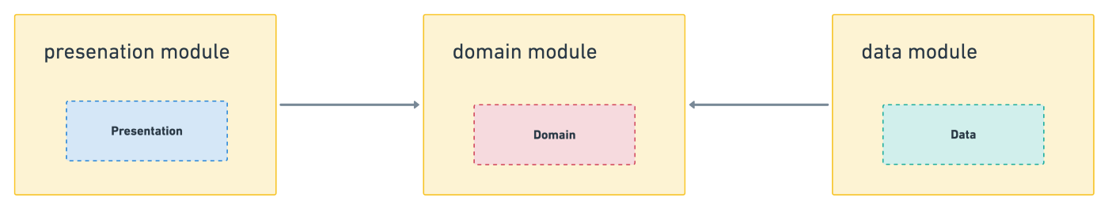
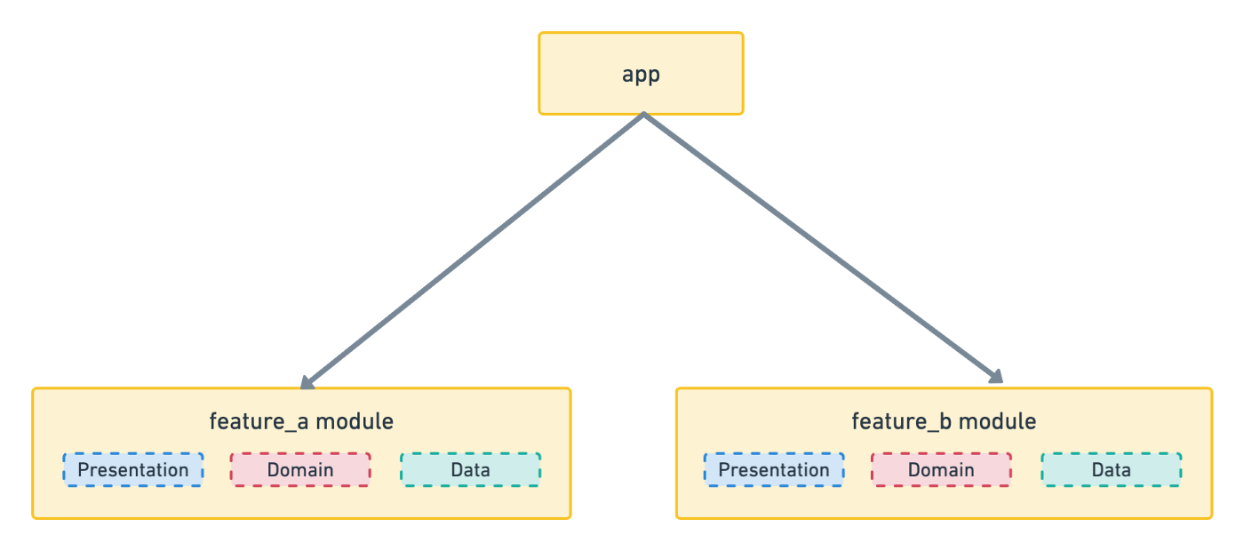
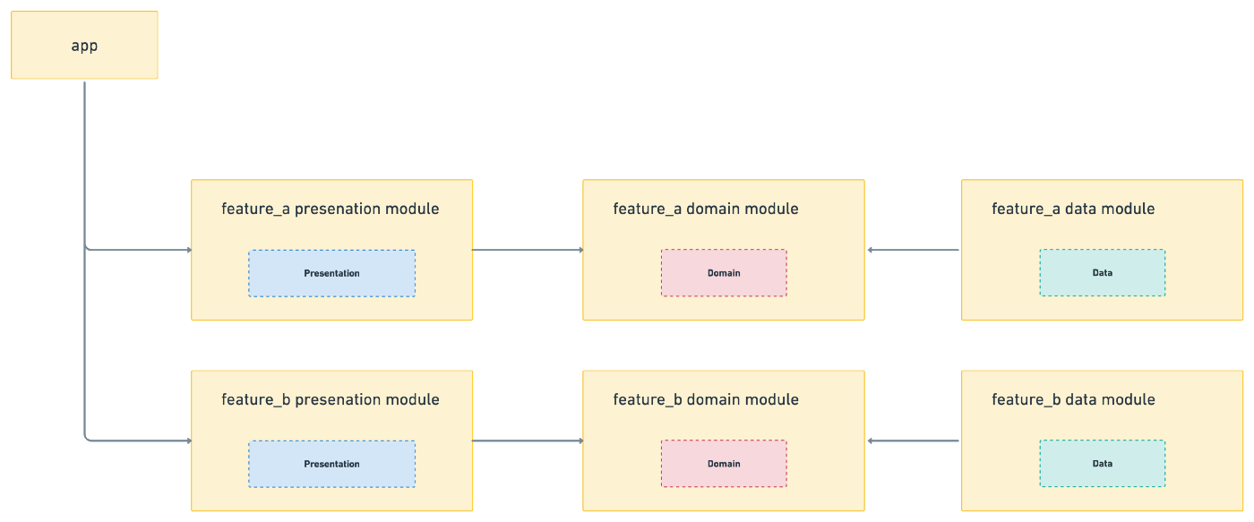
Multi ways of splitting modules

Slide 16
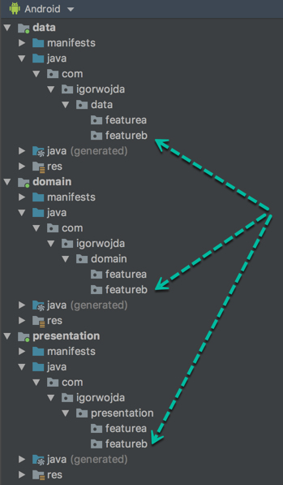
One layer per module
Advantage:
The layers are separate.
Defect:
The features inside a module can depend on each other.
Difficult to reuse features.
Scalability is not good.
Build time is not optimal.

Slide 17
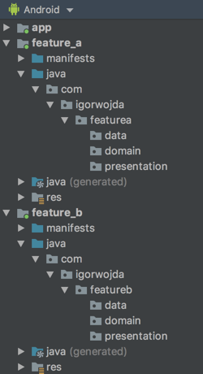
Layers inside the feature module
Advantage:
The features are separate.
Easy to scale up, maintain, develop.
Fast build.
Reusable features.
Support dynamic delivery.
Defect:
Navigating between features is more complex.

Slide 18
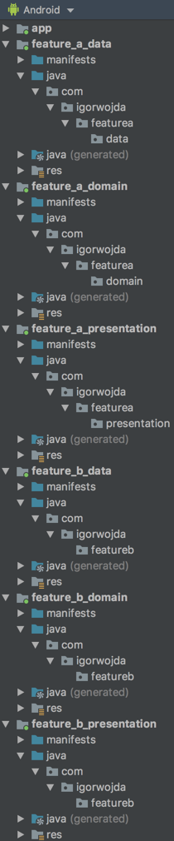
Layers per feature modules
Advantage:
Feature and layer of each feature are separate.
Easy to change technology in each layer.
Easy to scale up, maintain, develop.
Fast build.
Reusable features.
Defect:
Navigating between features is more complex.
Many modules, dependencies are complex.

Slide 19
Difficulties in implementation
1. Gradle: manage gradle libraries dependencies and android min max SDK versions.
=> Use common gradle file for android library modules.
2. Navigation: The features doesn’t know each other.
=> Use deeplink to navigate.
3. Dependencies: circular dependencies.
=> Aware that modules how depend on each other.
4. Duplicate code: There will probably be code duplication between feature modules.
=> Create a new module that contains the duplicate code and feature modules will depend on that module.
5. DI: Hilt cannot process annotations in feature modules.
=> Use Dagger to perform dependency injection in your feature modules.

Slide 20
Final
Single Module App
Multi Modules App
Difficult to debug, maintain.
Easy to debug, maintain.
Build time is not optimized
Build time is optimized.
Increase app size.
App size is optimized.
Difficult to reuse features.
Easy to reuse features.
Enable of dynamic delivery.
Experiment with new technologies.
Easy to scale up project.

Slide 21
Thanks for listening ❤️

