Slide 1
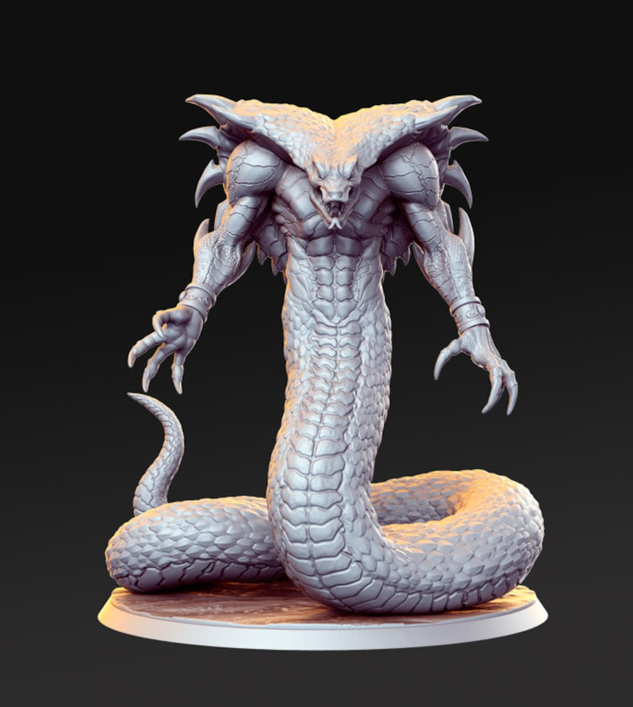
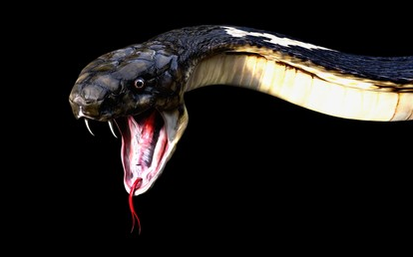
3D Snake Game
Designed by : BI11-122 Nguyễn Đăng Khoa
BI11-074 Phạm Vũ Hải
BI11-134 Nguyễn Tùng Lâm
BI11-128 Vũ Đúc Kiên
BI11-205 Tạ Đình Thái Nhân

Slide 2

Overview of the game
Using threejs,
A popular JavaScript library for creating 3D graphics in web applicatiom

Slide 3
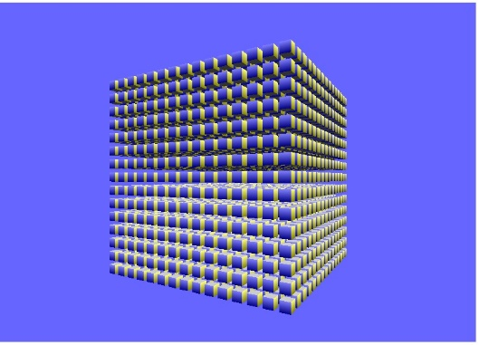


Overview of the game
The game features :
a 3D environment with a cube-shaped play area
a snake that moves through the cube
an apple that the snake tries to eat

Slide 4
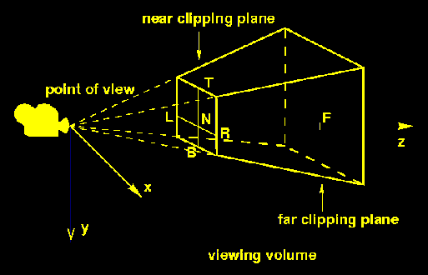

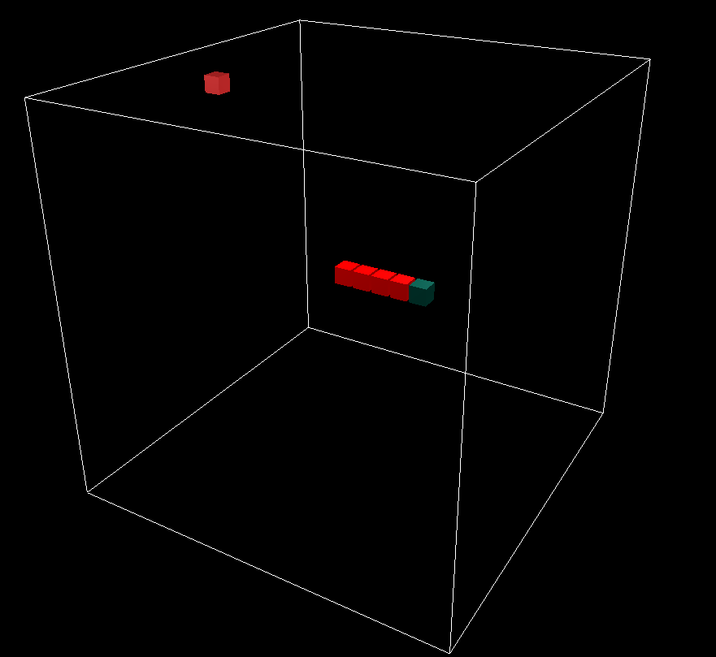
Overview of the game
The game uses a perspective camera to create a 3D view of the play area
The snake is made up of a series of cube-shaped objects, each of which is colored differently to distinguish the head from the body
The apple is also a cube-shaped object, and is randomly placed within the play area at the start of each game and after the snake eats the apple

Slide 5
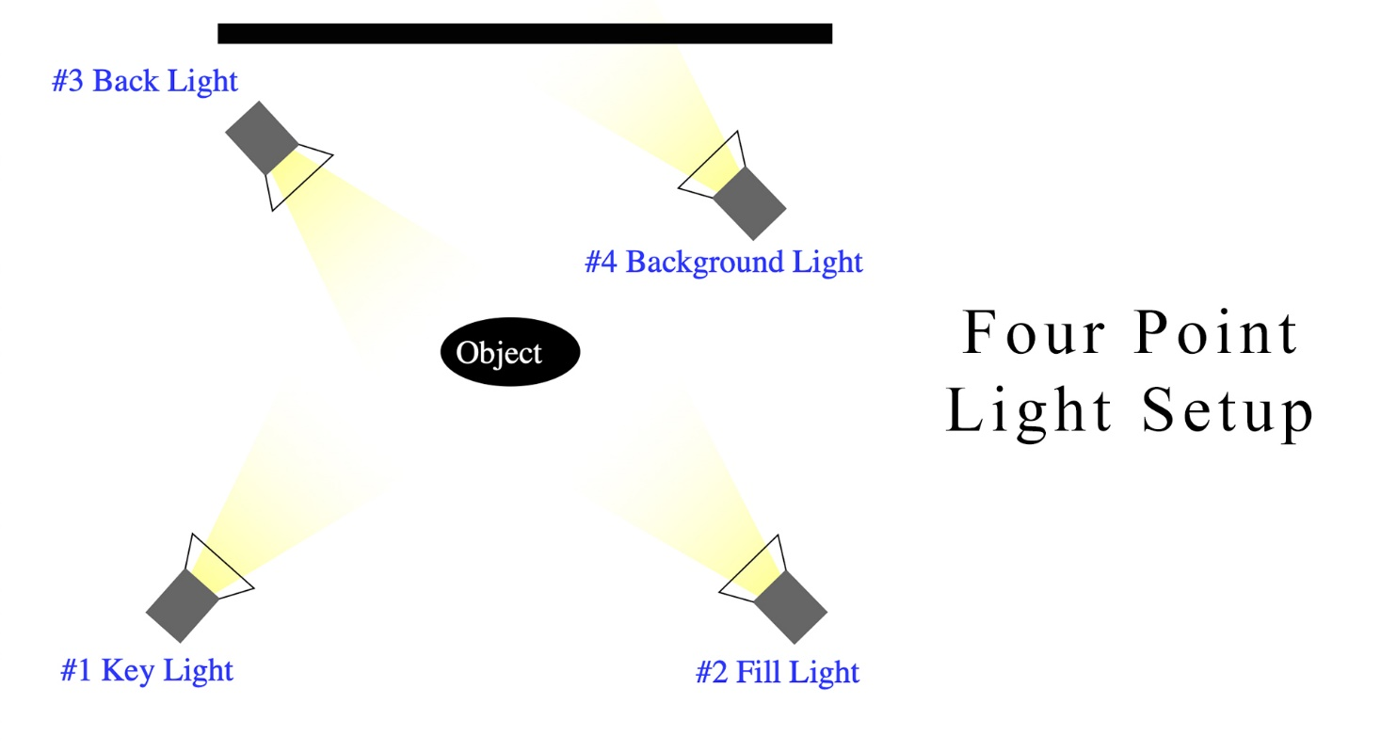
Overview of the game
The game uses four point lights placed at different locations around the play area
The game also includes a score counter that updates each time the snake eats an apple
The game is implemented using JavaScript and HTML, with Three.js and OrbitControls.js libraries used to create the 3D environment and camera controls

Slide 6

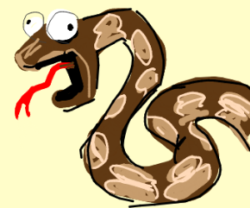
Overview of the game
The game uses the requestAnimationFrame() method to create a smooth animation loop that updates the position of the snake and apple, and checks for collisions between them.
The game also includes error handling to restart the game if the snake collides with itself or goes out of bounds.

Slide 7



How to play
Click and drag to start the game
Use the arrow key to move in the same “floor”
Use q and a to move up/down the floor

Slide 8

Demo

