Slide 1

House Prices – Advanced Regression Techniques
Khoa TRUONG

Slide 2
Overview of the Data
With over 70 explanatory variables, we will try to use some of them to predict the house prices.
The reason not to use all: Overfitting.
Each categorical features have more than 4 categories, and there are 53 categorical features.
22 numerical features.
Log transformed the price so model prediction would favor the dense part of distribution of prices.
How to choose which features to use?

Slide 3
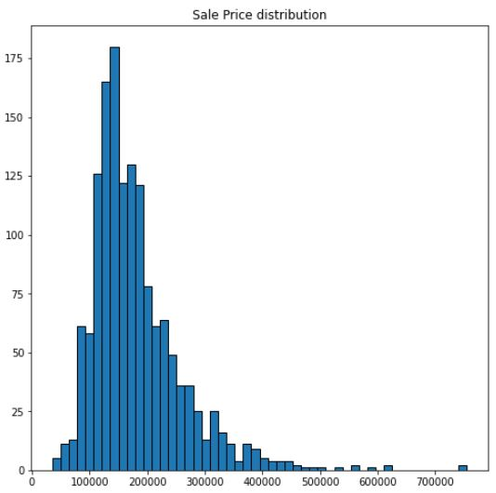
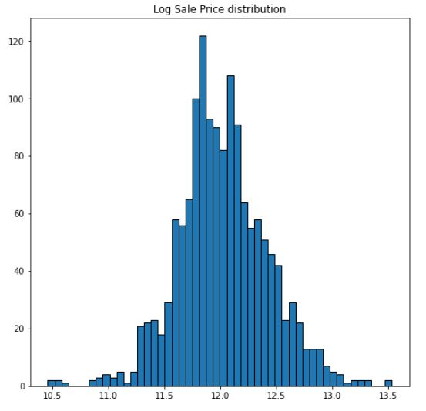
Price Distribution

Slide 4
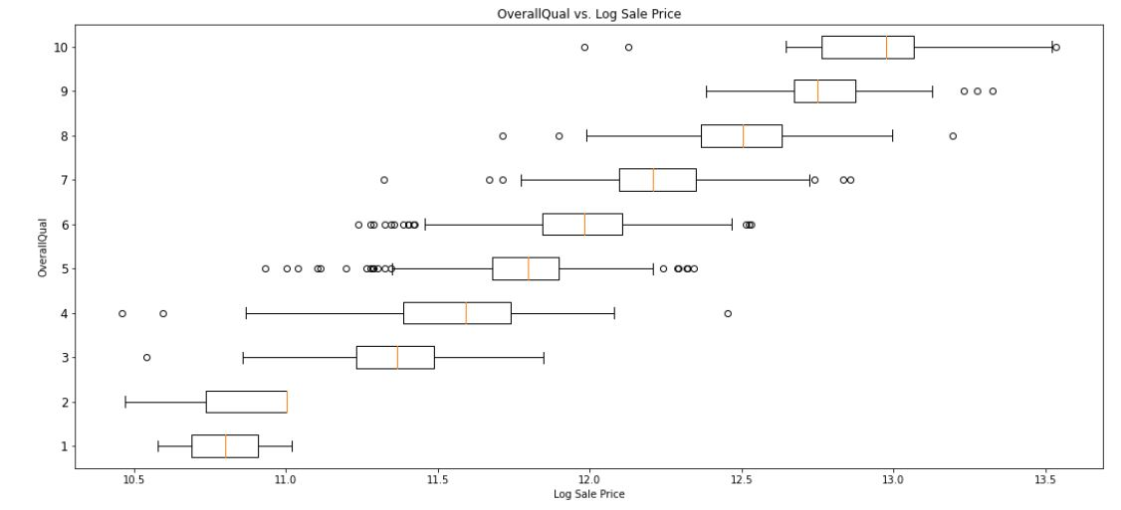
Boxplots for Categorical values

Slide 5
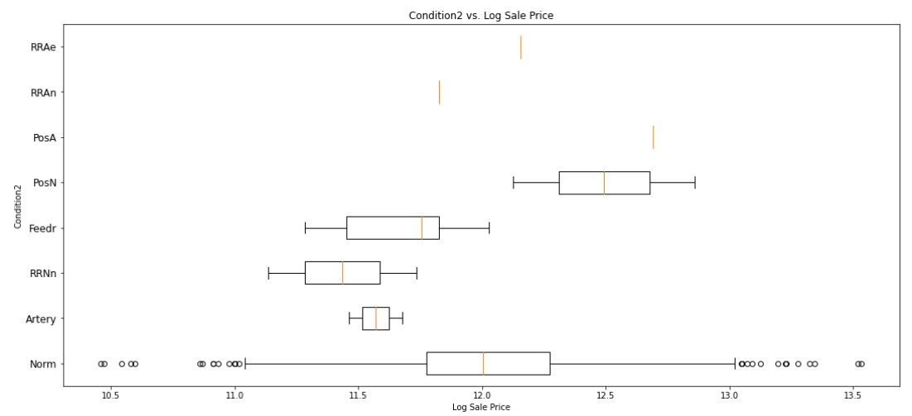
Bad feature

Slide 6
Using ANOVA For Feature Selection
ANOVA would show that within a categorical feature, the mean of log prices within one group may or may not be significantly different than the other group.
Choosing only 32 categorical features.

Slide 7
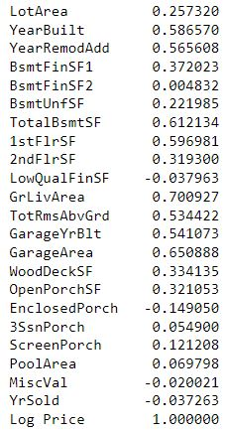
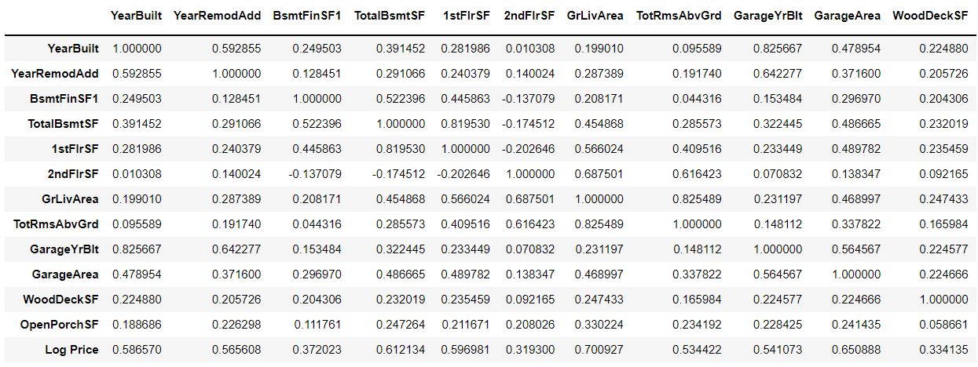
Numerical features
Choose numerical features that have a correlation > 0.3. Remove features that are highly correlated with one another.

Slide 8
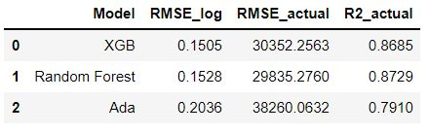
Results
End up with 38 features.
Rank 2365/4222.

