Slide 1
Tennis Match Prediction
Khoa Truong

Slide 2
Why Predicting the winner of tennis matches?
Fun!
Only focus on predicting singles men matches.
Players perform differently based on the court surfaces, which heavily affects the outcomes.
=> Makes the prediction interesting.

Slide 3
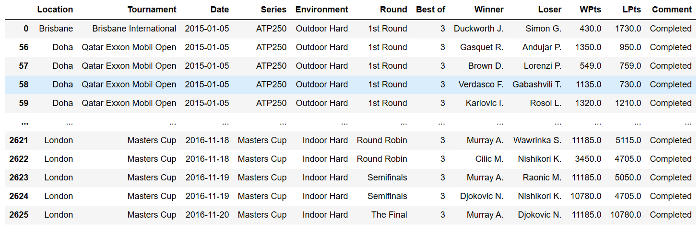
Datasets
http://www.tennis-data.co.uk/
2010 – 2022
Only choose completed matches. No injuries or walkover.
Multiple tournaments and series.

Slide 4
Preparing the Data for Analysis
Does the last 2 years performance have an effect on the results of the matches in the current year?
Winning_rate: the probability of winning of the player for a specific year, serie, and environment.
Keep the current ranking points of the players BEFORE entering the match.
Features: Winning_rates of the last 2 years of each players, their ranking points, series, environment.
Target: player that wins.

Slide 5
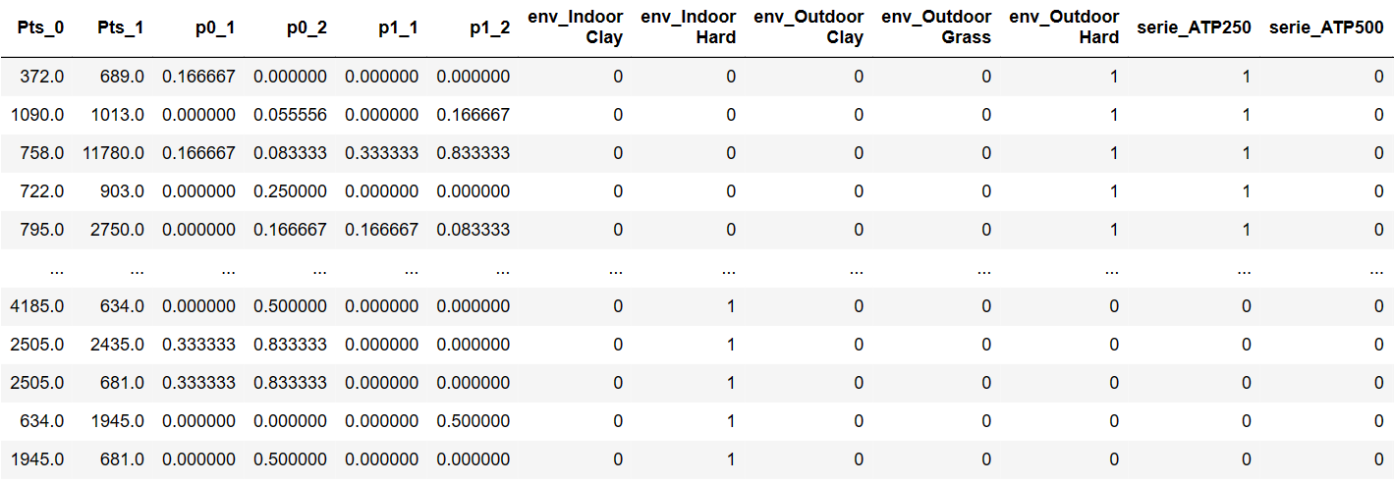
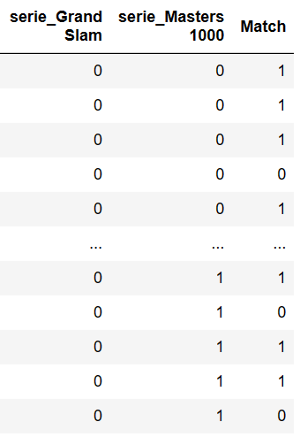
Dataset after cleaning

Slide 6
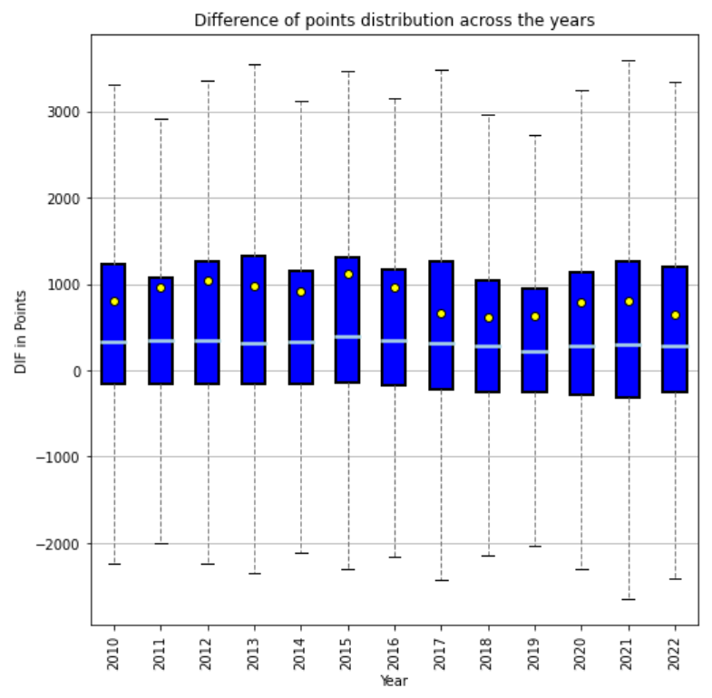
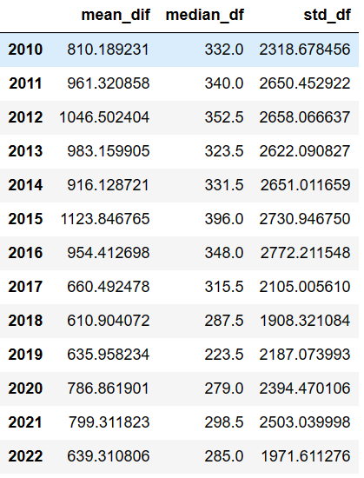
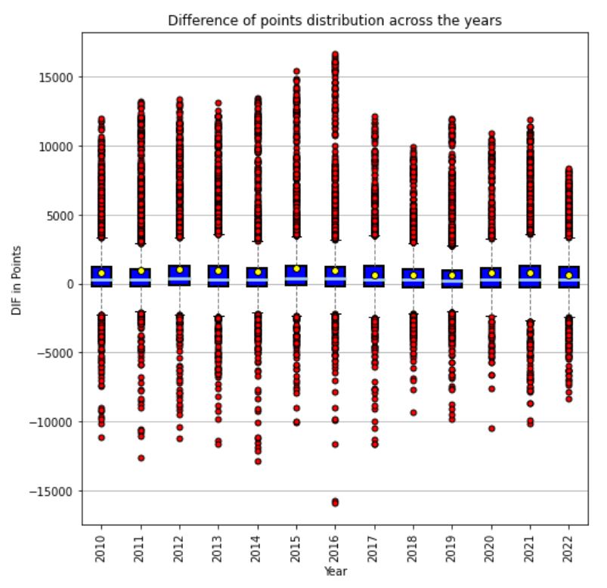
DATA ANALYSIS
Around 75% of winners have higher ranking points.
High std due to outliers.
The higher the difference, the better the model will perform.

Slide 7
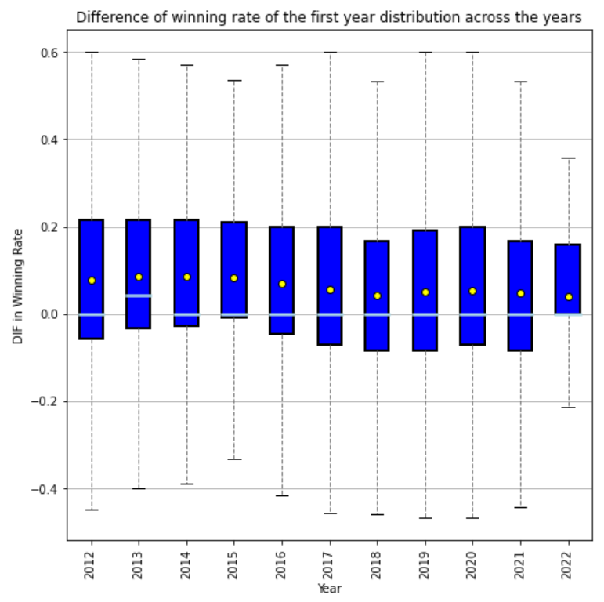
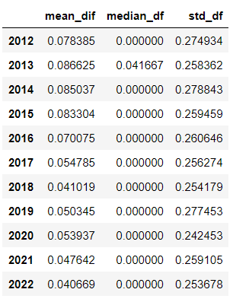
Difference of win rates (first year)
Difference of win rates
= probability of winning based on the court environment and serie – the loser’s.
Only around 50% of the difference is positive, but the difference is wider.

Slide 8
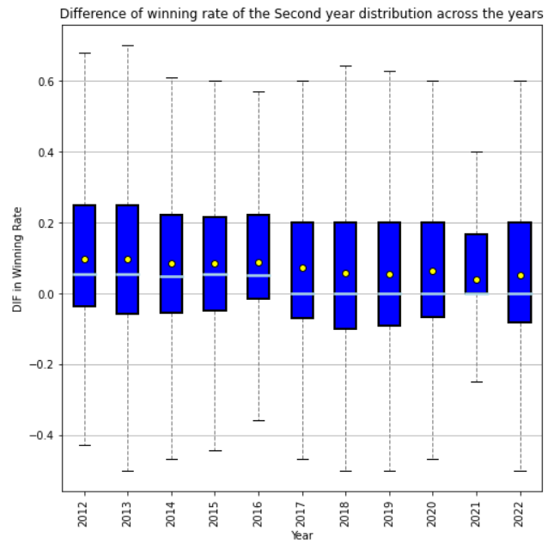
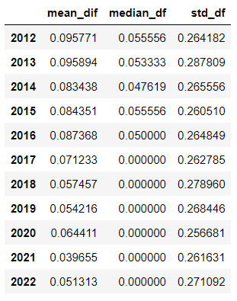
Difference of win rates (second year)
Almost have the same distribution as the first year.
Overall, the mean difference is higher so it can have some impacts on our results.

Slide 9
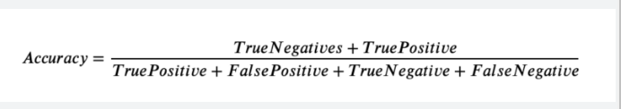

Predictions
Used 4 different machine learning classifiers: Logistic Regression, Gaussian Naive Nayes, QuadraticDiscriminantAnalysis, RidgeClassifier.
Metric: Accuracy. How many instances that we predict correctly?

Slide 10
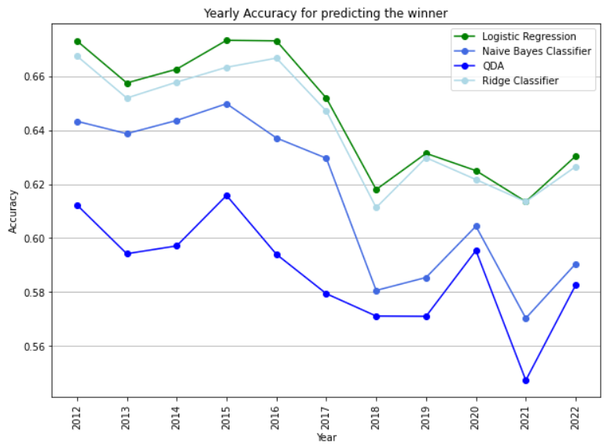
Yearly Accuracy

Slide 11
Challenge
Not enough player statistics.
Player styles such as serving, left-handed or right-handed, etc. can really affect the outcome of the match.

