Slide 1
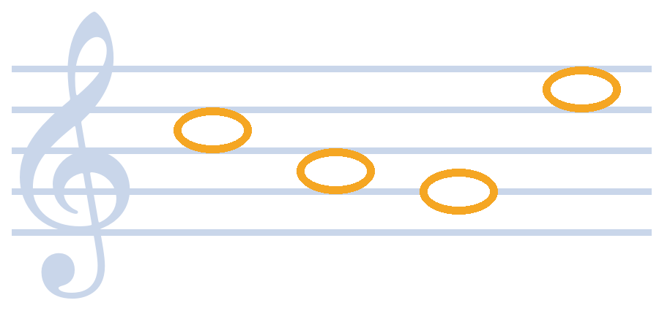
Crack the Code
Read the notes. Find the letters. Reveal the word.
A music-notation code-breaking task. No music knowledge needed.
Notes:
Start away from the PC with the iPad in your hand. Say: 'I'm not tied to the desk any more.' Then hand the iPad to a volunteer.

Slide 2
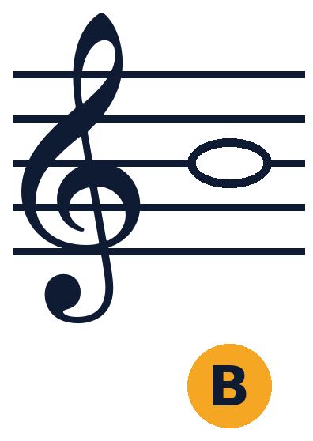
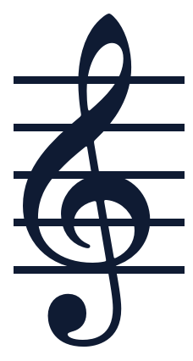
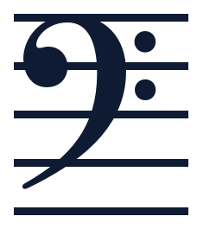
How the code works
1
Find the clef
2
Read the note
3
Write the letter
The curly symbol is treble. The backwards C with two dots is bass. Each clef has its own key.
Count up from the bottom line: line, space, line, space. Each position is one letter.
Put the letter in the box under the note, then read the hidden word.
B
A
G
Treble
Bass
Notes:
Keep this brief: three steps. Do not teach music. The key on the next slides does the work.

Slide 3
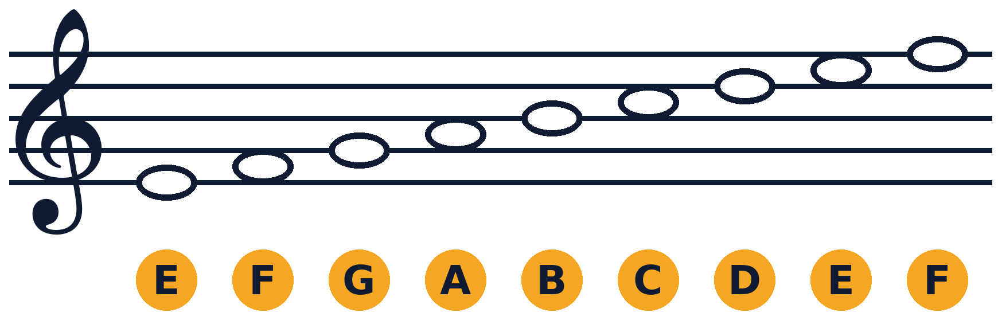
Treble clef key
Lines, bottom to top: E G B D F Spaces, bottom to top: F A C E
Notes:
Leave this on screen while the volunteer decodes. Point out the five lines and four spaces, counting up from the bottom.

Slide 4
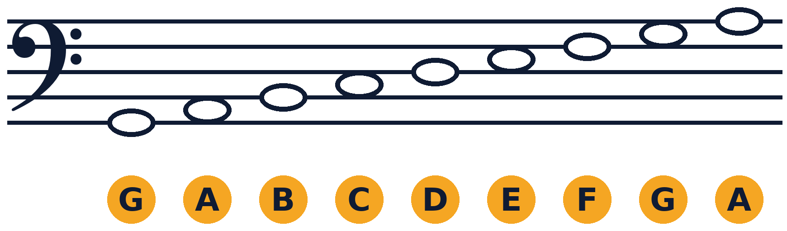
Bass clef key
Lines, bottom to top: G B D F A Spaces, bottom to top: A C E G
Notes:
Same stave, different clef, so the notes move. This is the only extra thing to learn.

Slide 5
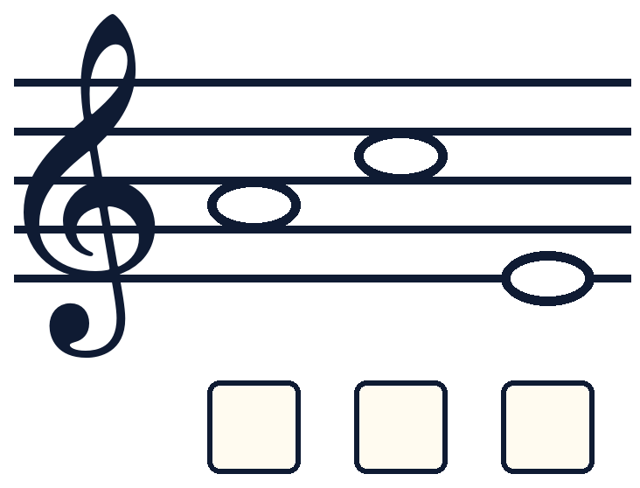
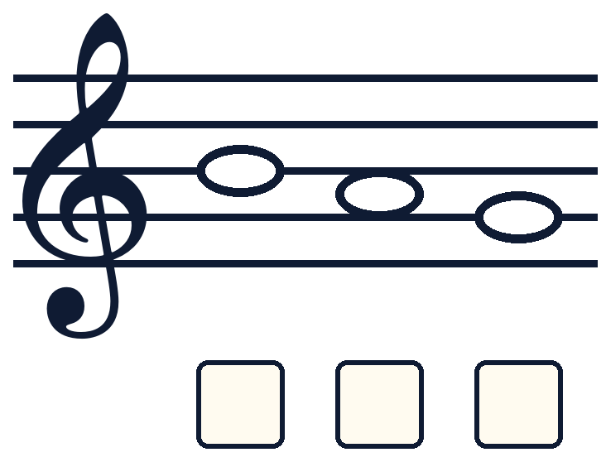
Treble clef: 1 and 2
1
2
Lines: E G B D F | Spaces: F A C E
Notes:
Volunteer 1 takes the iPad and writes a letter in each box with the Pencil. Pinch to zoom on one note. Everyone else decodes the same code on paper. Answers are on the last slides.

Slide 6
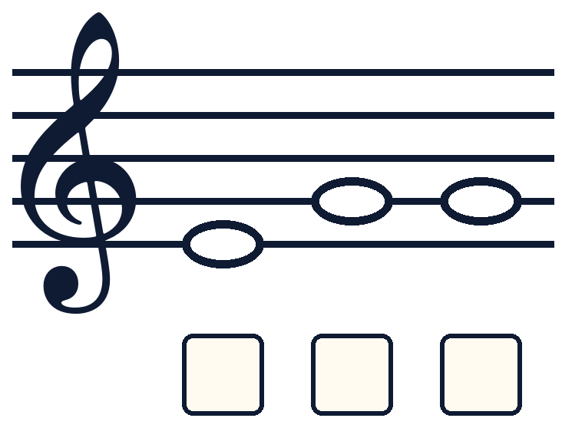
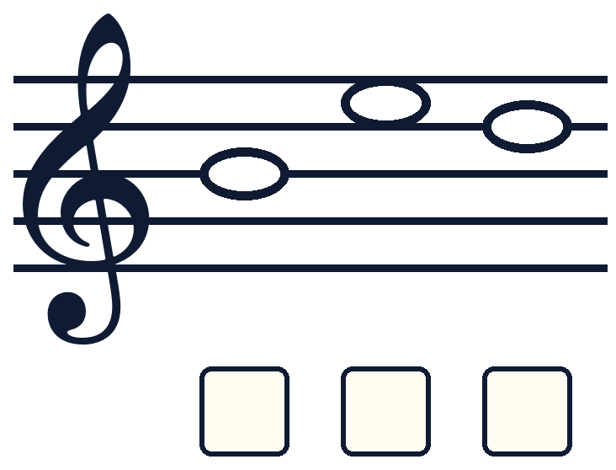
Treble clef: 3 and 4
3
4
Lines: E G B D F | Spaces: F A C E
Notes:
Codes 3 and 4. One volunteer marks on the iPad, everyone else decodes on paper.

Slide 7
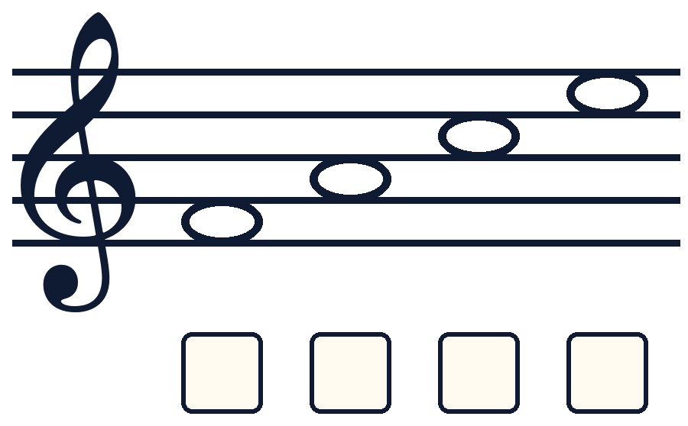
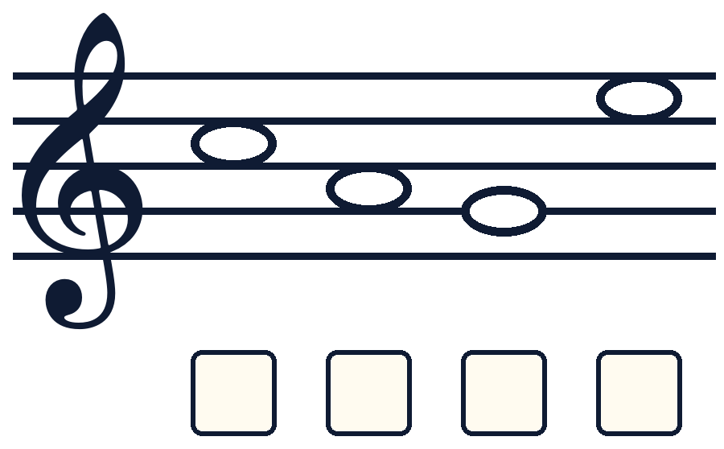
Treble clef: 5 and 6
5
6
Lines: E G B D F | Spaces: F A C E
Notes:
Codes 5 and 6. One volunteer marks on the iPad, everyone else decodes on paper.

Slide 8
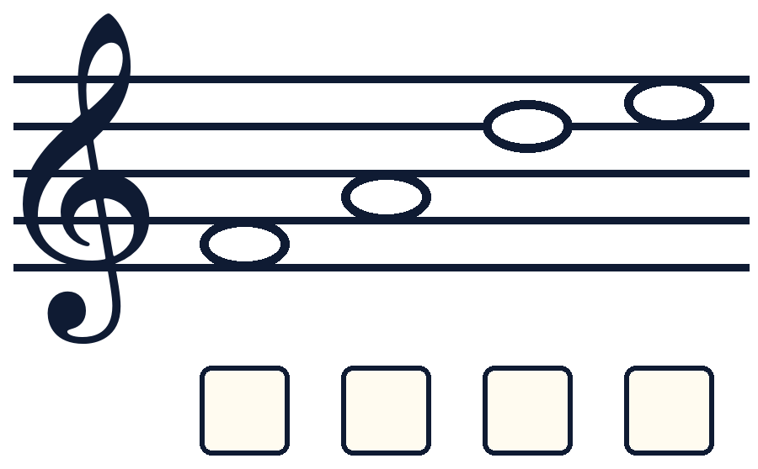
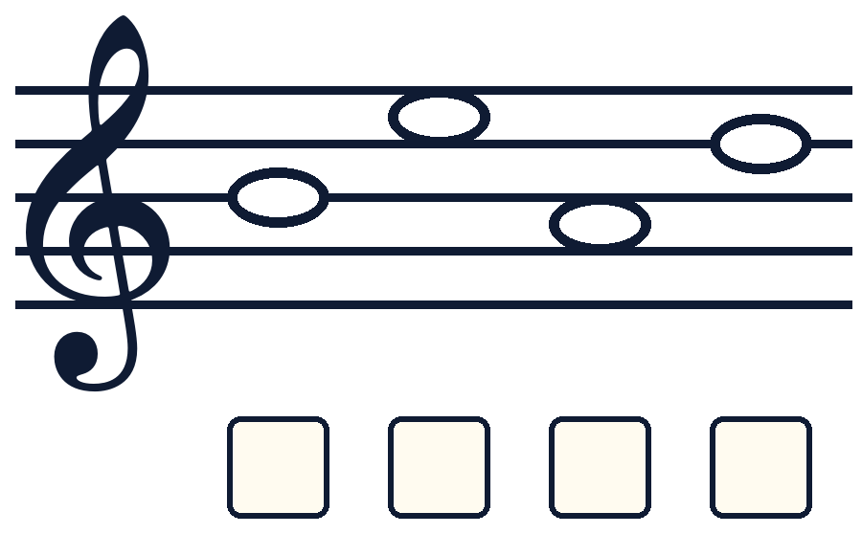
Treble clef: 7 and 8
7
8
Lines: E G B D F | Spaces: F A C E
Notes:
Codes 7 and 8. One volunteer marks on the iPad, everyone else decodes on paper.

Slide 9
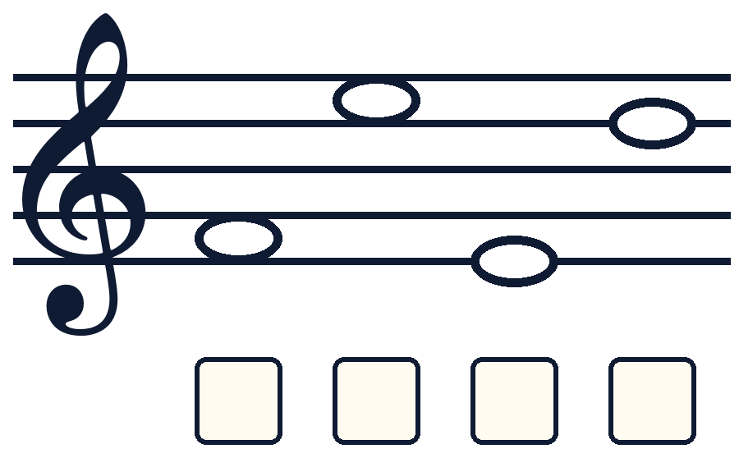
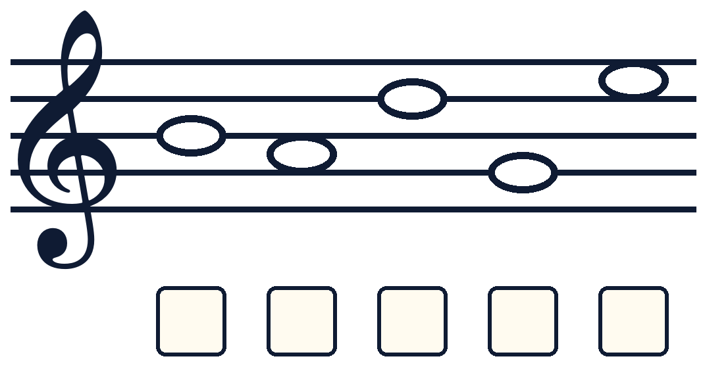
Treble clef: 9 and 10
9
10
Lines: E G B D F | Spaces: F A C E
Notes:
Codes 9 and 10. One volunteer marks on the iPad, everyone else decodes on paper.

Slide 10
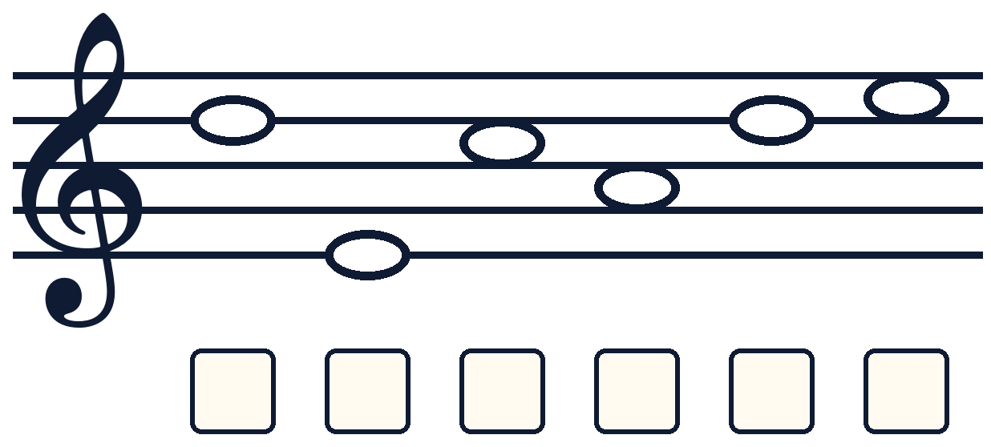
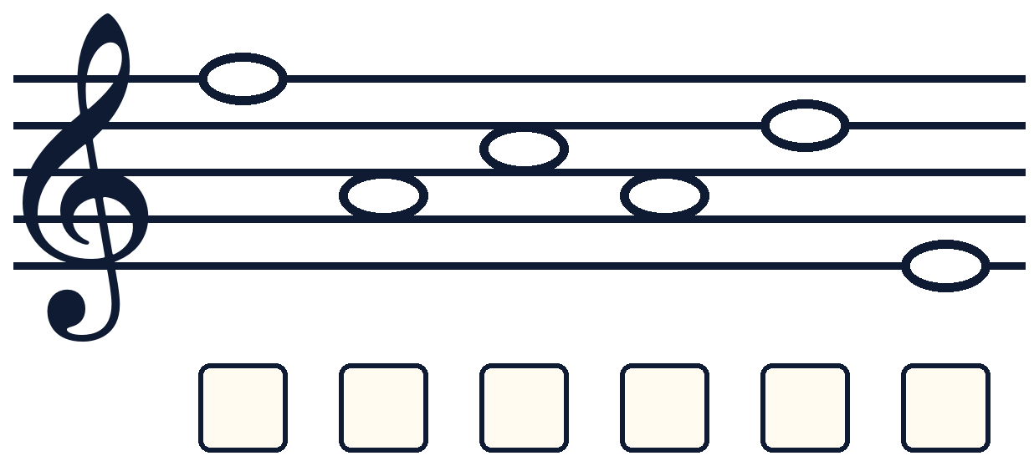
Treble clef: 11 and 12
11
12
Lines: E G B D F | Spaces: F A C E
Notes:
Codes 11 and 12. One volunteer marks on the iPad, everyone else decodes on paper.

Slide 11
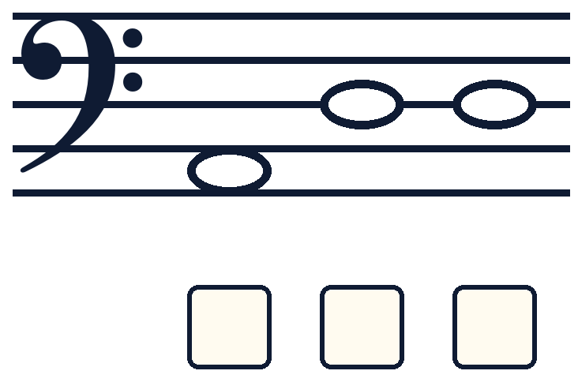
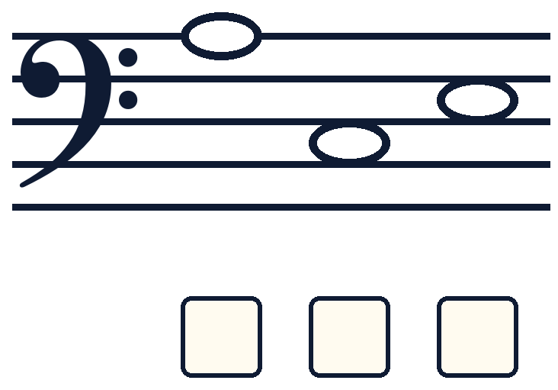
Bass clef: 1 and 2
1
2
Lines: G B D F A | Spaces: A C E G
Notes:
Same routine in bass clef. The notes move on the stave, so point teachers back to the bass key.

Slide 12
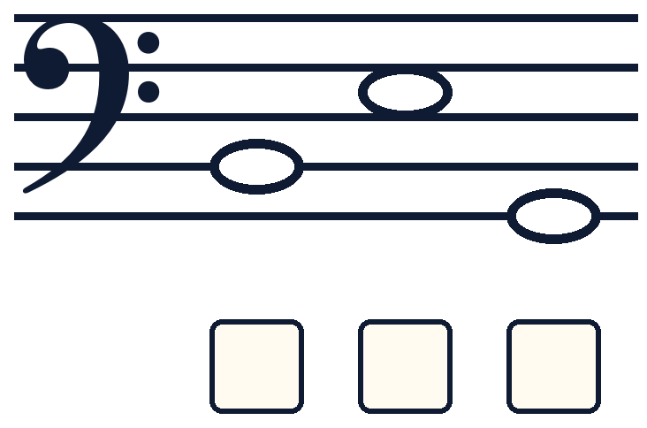
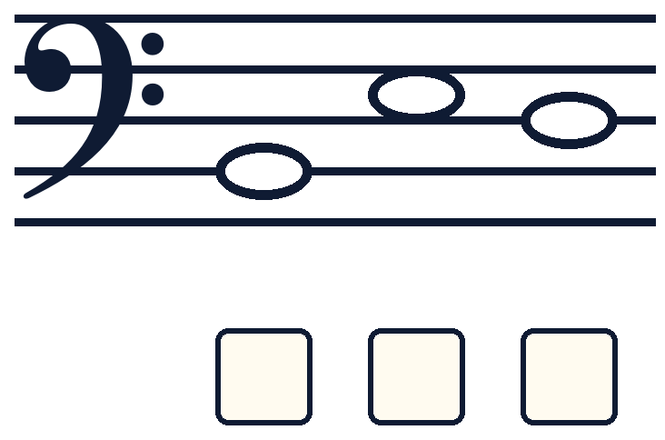
Bass clef: 3 and 4
3
4
Lines: G B D F A | Spaces: A C E G
Notes:
Codes 3 and 4. One volunteer marks on the iPad, everyone else decodes on paper.

Slide 13
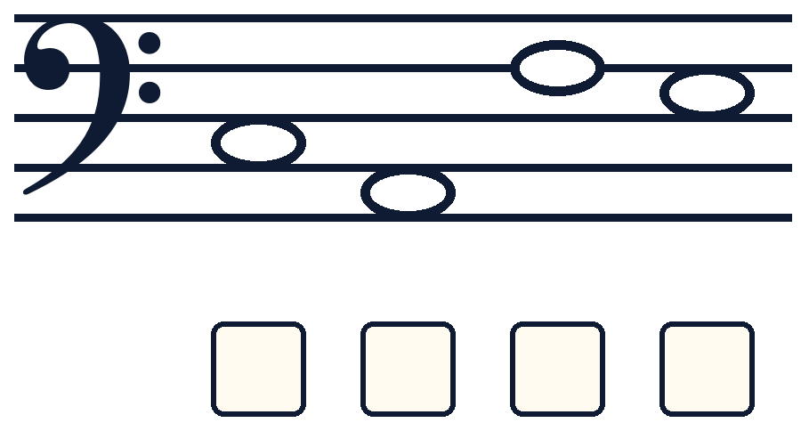
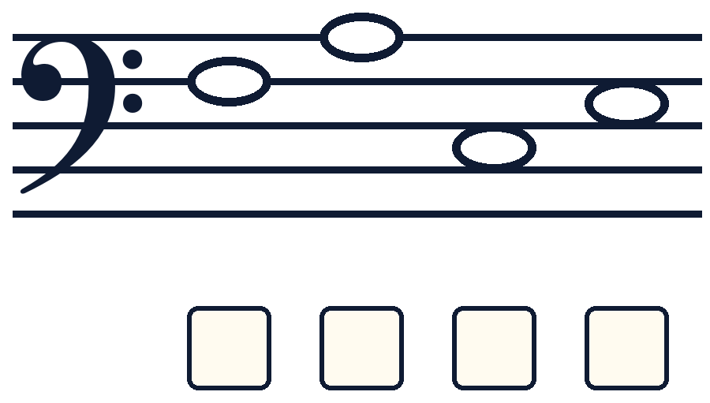
Bass clef: 5 and 6
5
6
Lines: G B D F A | Spaces: A C E G
Notes:
Codes 5 and 6. One volunteer marks on the iPad, everyone else decodes on paper.

Slide 14
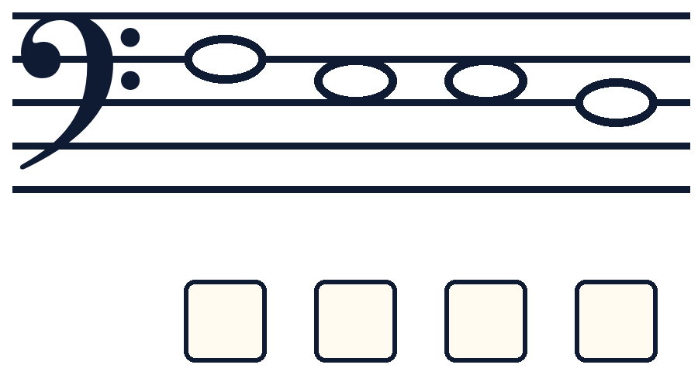
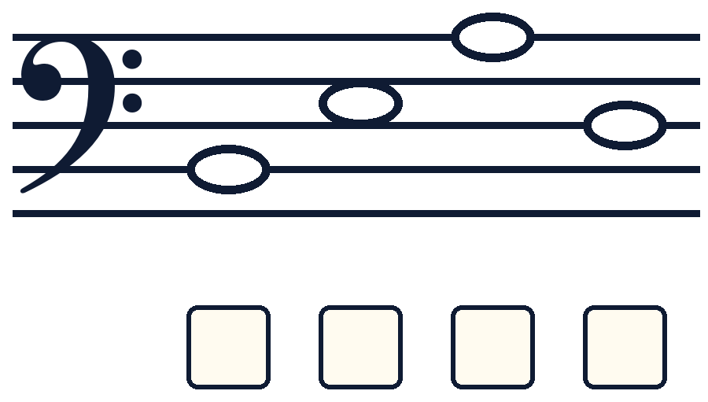
Bass clef: 7 and 8
7
8
Lines: G B D F A | Spaces: A C E G
Notes:
Codes 7 and 8. One volunteer marks on the iPad, everyone else decodes on paper.

Slide 15
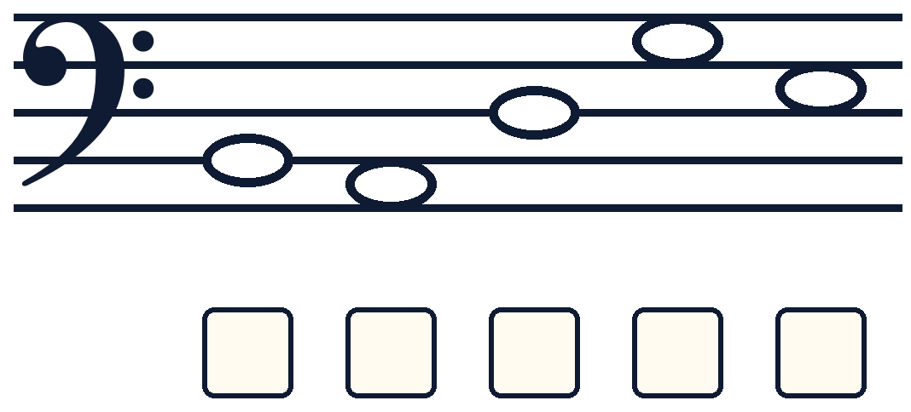
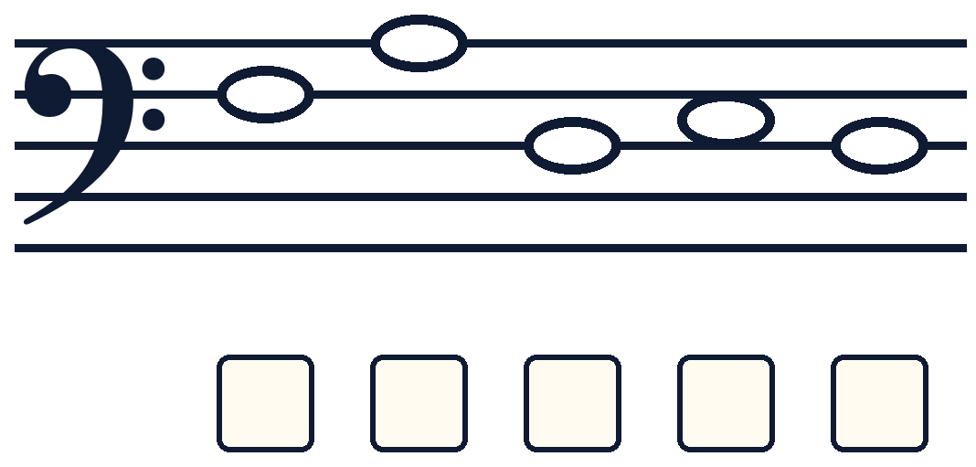
Bass clef: 9 and 10
9
10
Lines: G B D F A | Spaces: A C E G
Notes:
Codes 9 and 10. One volunteer marks on the iPad, everyone else decodes on paper.

Slide 16
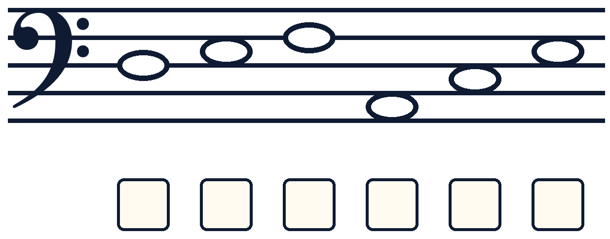
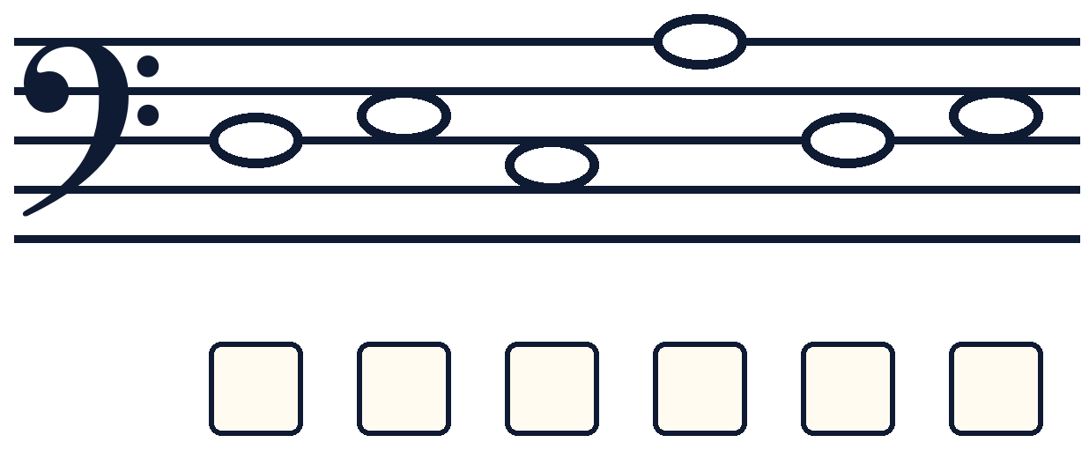
Bass clef: 11 and 12
11
12
Lines: G B D F A | Spaces: A C E G
Notes:
Codes 11 and 12. One volunteer marks on the iPad, everyone else decodes on paper.

Slide 17
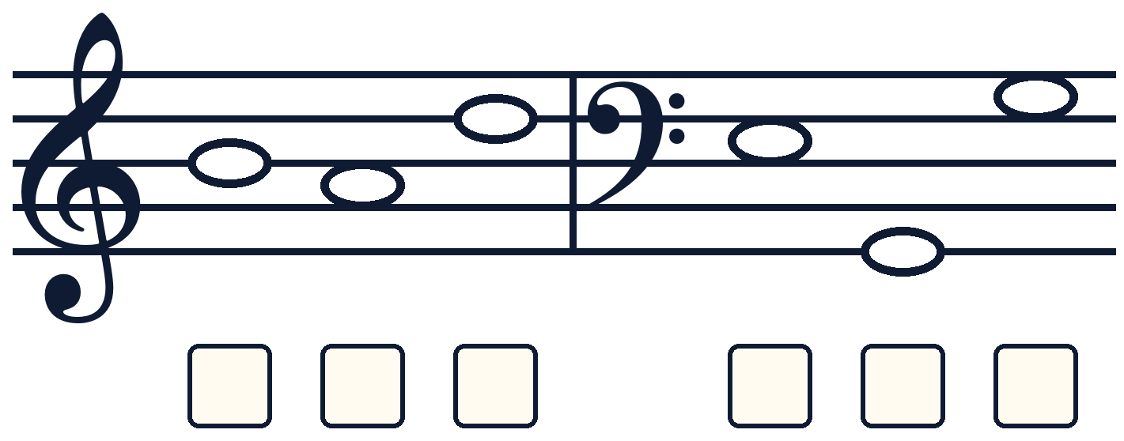
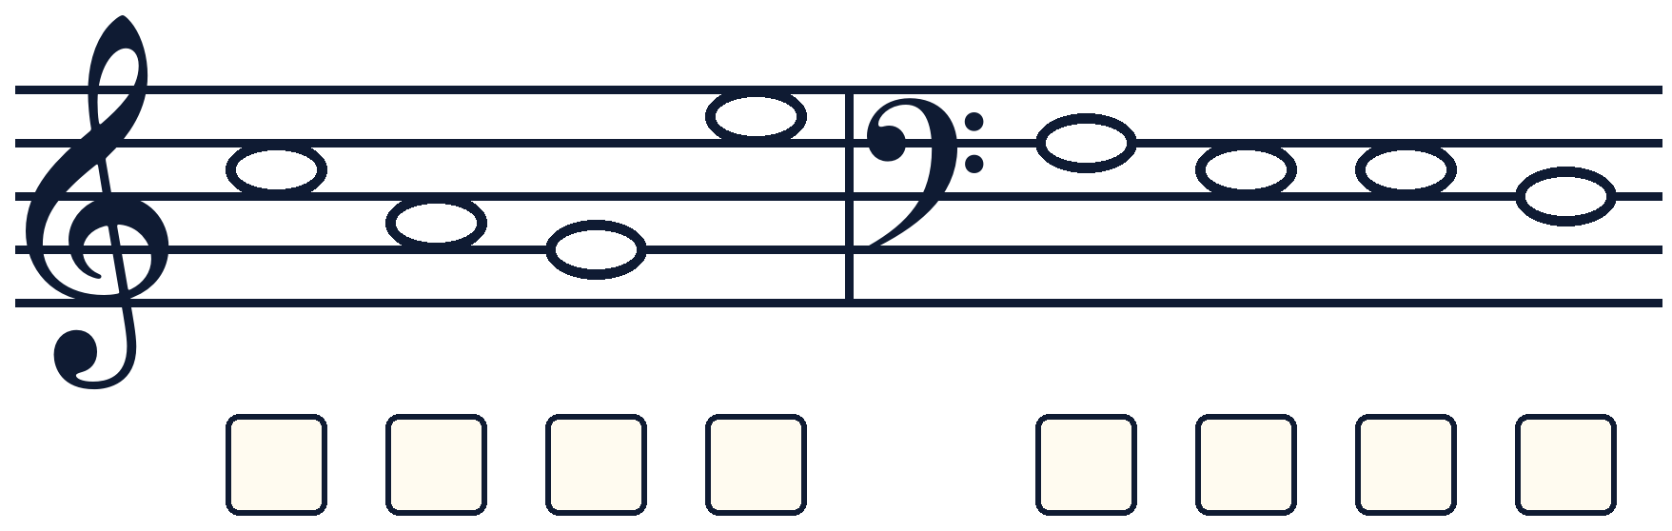
Mixed clefs: 1 and 2
The clef changes halfway. Check each one!
1
2
Notes:
Each code has two words: a treble word, then a bass word after the bar line. Ask: which clef is it now?

Slide 18
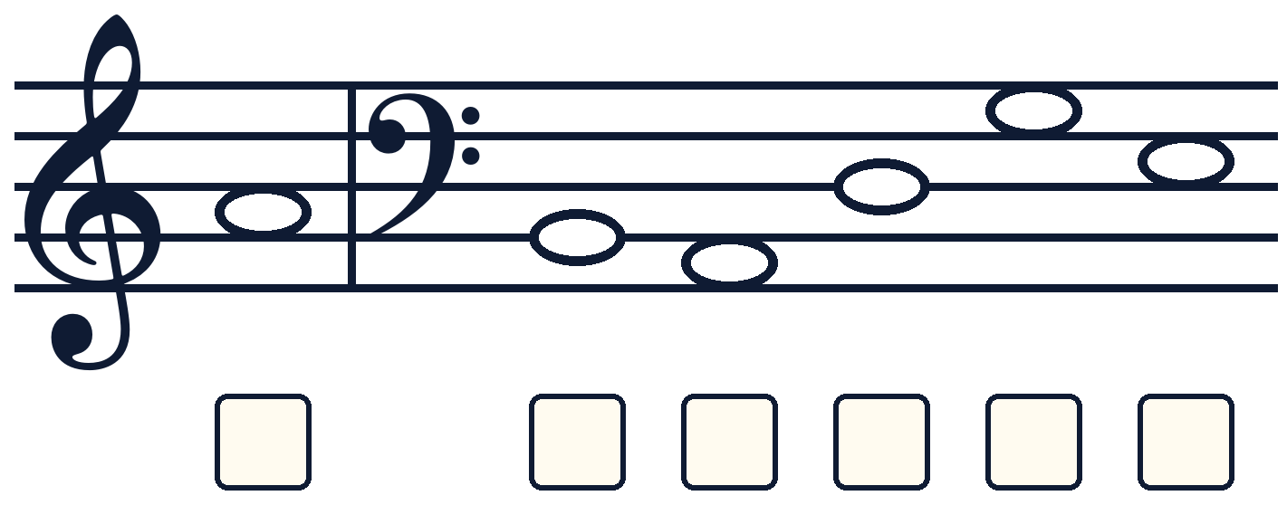
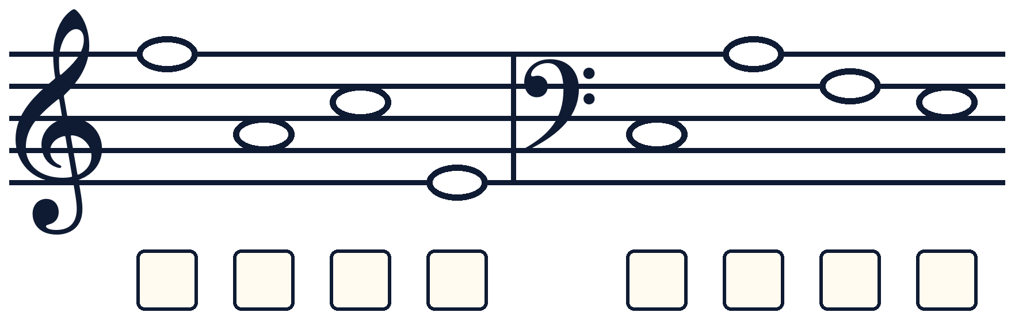
Mixed clefs: 3 and 4
The clef changes halfway. Check each one!
3
4
Notes:
Mixed codes 3 and 4.

Slide 19
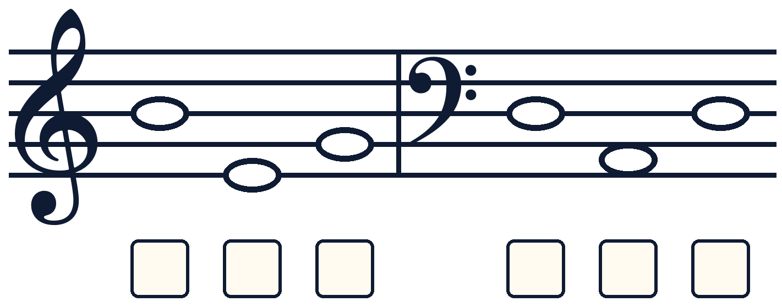
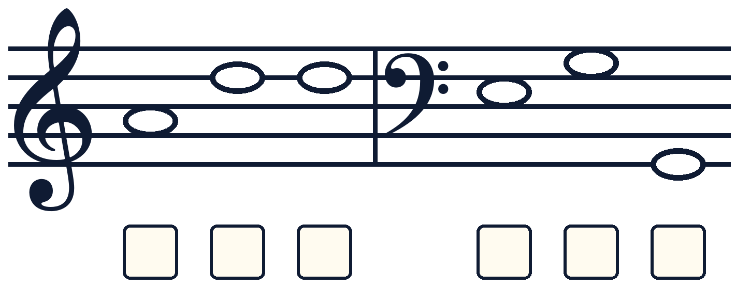
Mixed clefs: 5 and 6
The clef changes halfway. Check each one!
5
6
Notes:
Mixed codes 5 and 6.

Slide 20
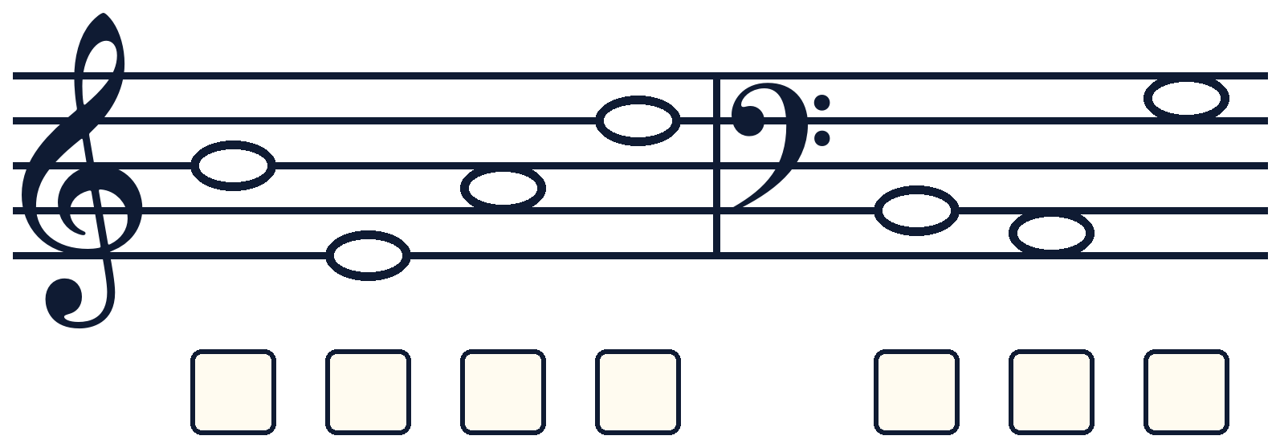
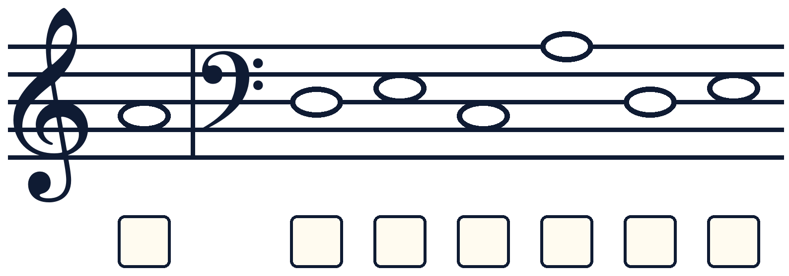
Mixed clefs: 7 and 8
The clef changes halfway. Check each one!
7
8
Notes:
Mixed codes 7 and 8.

Slide 21
Answers: Treble clef
1 ACE
5 FACE
9 FEED
2 BAG
6 CAGE
10 BADGE
3 EGG
7 FADE
11 DECADE
4 BED
8 BEAD
12 FACADE
Notes:
Reveal only after everyone has had a go.

Slide 22
Answers: Bass clef
1 ADD
5 CAFE
9 BADGE
2 ACE
6 FACE
10 FADED
3 BEG
7 FEED
11 DEFACE
4 BED
8 BEAD
12 DECADE
Notes:
Reveal only after everyone has had a go.

Slide 23
Answers: Mixed clefs
1 BAD EGG
5 BEG DAD
2 CAGE FEED
6 ADD EGG
3 A BADGE
7 BEAD BAG
4 FACE CAFE
8 A DECADE
Notes:
Reveal only after everyone has had a go.

