Slide 1

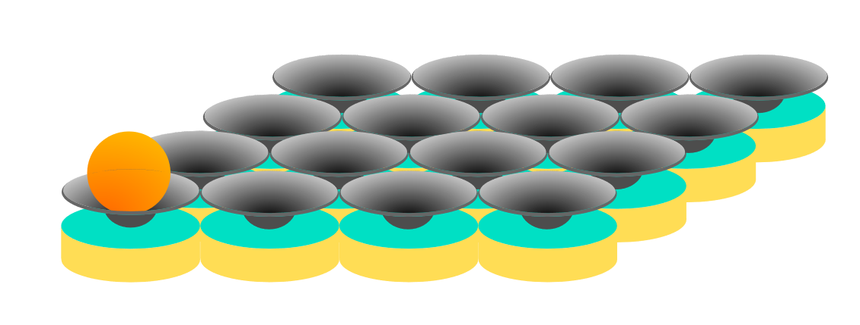

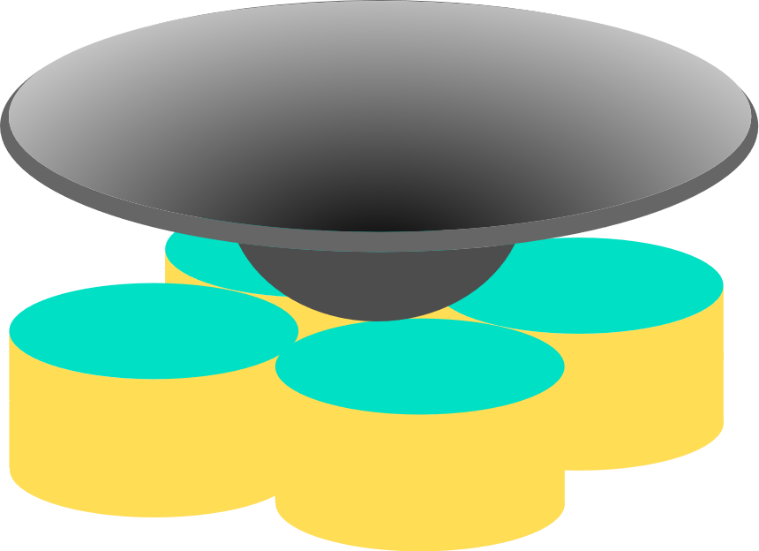

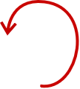


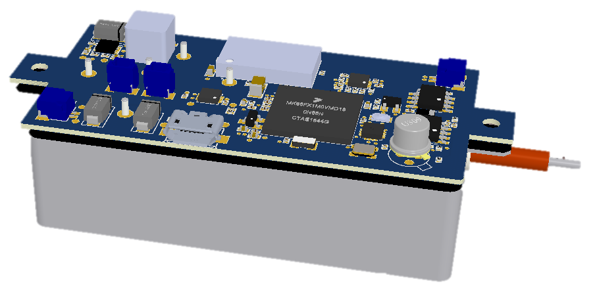
Object Motion Control Using HASEL Array
Stretchable Sensor Skin
Fabrication
Quad Donut Control
Control
y
x
PCB Design
Circuit
Centralized Control and Communication via WIFI
Notes:
Bonding all actuators together at this stage make it difficult to fix if one of the actuator fails
Separating all actuators and use wifi communication allows us to remove faulty actuator faster
On top of the array, I will lay a sheet of thin and soft fabric to make the ball rolling velocity and acceleration more gradual
All actuators are connected to ESP32’s which communicate with a central PC via WIFI. The input of the system is the desired path and its speed.
We will use an overhead camera as a ground truth to track the ball’s motion.
Each element of the array has its own internal classical feedback control which has a HV converter, a displacement sensor (stretchable sensor skin), and ESP32.
The controller must control not only the final position of the donut, but also its acceleration (How do we do this?). The actuator acceleration allows us to measure the force the actuator exerts on the ball.

Slide 2
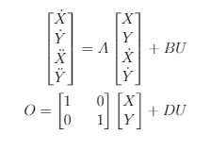












Object Motion Control Using HASEL Array
Top view
n
1. The first actuator has coordinate A(0,0)
2. Actuator diameter is D (unit) => A(i,j) actuator corresponds to (i*D, j*D)
3. An array has mxn elements
4. Each actuator has an IR detector to determine when the ball passes by. Ball position at time kT corresponds to k^{th} actuator that toggles IR signal, and T is the time elapse between two adjacent actuators that detect the ball
=> Sampling time T is therefore not fixed and dependent on ball’s velocity
5. The stiffness of the cover layer will determine its ability to conform to the actuators’ heights.
6. The ball’s state space model has the form:
A(m,1)
D
A(m,n)
End
m
Start
Covering Fabric
$X,Y$:
Position of the ball
A(0,0)
A(1,n)
ActuatedRail
$\dot{X},\dot{Y}$:
Velocity of the ball
Sequentially Actuated with Delay
Un-actuated
$$O:$$
Measured Position
Sequentially Actuated
=> No sensor to measure the velocity of the ball => Statistical Estimation to reconstruct the ball velocity
=> Input U is modeled as the combined forces caused by the actuator and the sine component of the gravitation
Side view
$${\vec{F}}_{T}$$
$$\vec{T}$$
$$ϴ_{i}=\tan{\frac{h_{i}−h_{i−1}}{D}}$$
Covering Fabric
$${\vec{N}}_{T}$$
+
Θ
F
N
$${\vec{F}}_{i}=mg\sin{ϴ_{i}}$$
$$h_{1}$$
$$h_{2}$$
$$h_{3}$$
$$…$$
G
D
Θ
Notes:
The more elements the better the resolution in terms of sampling rate and speed control. Controlling speed of a ball does not work well if we have any array less than 6x6. As you can see the thickness of the rail is 3D (3 actuators).
We could scale down the size of the donut, use one high voltage circuit for 3 to 4 actuators, and use HV diode to switch between actuators or activate all of them.
I think 8x8 might be a good size to get started. It gives us enough room to obtain different paths.
Shane has a miniaturized HV optocoupler, I have created a miniature PCB with all components, and we also proved that the HV coating works well for a trace thickness of 12mil and 3 mm gap. We could use 1inch^3 HV converter now, because we don’t use the actuator self-sensing capability.
We could make our lives easier not to deal with the non-constant sampling time T by integrating a speed sensor into the ball ☺
If you approve this proposal, I will get started with an array of 8x8 linear actuators and study its 2D control as well as doing some mathematical simulations.
We could start with a circular “array” so that we could generate a pepetual motion, also reduce the number of actuators for this purpose. Or we can simply start with a speed control of the wave propagation

Slide 3
Object Motion Control Using HASEL Array
Possible Next Step
Ball Controlled 1D Ring of HASEL
1D Wave Propagation Control
Open-loop Ball Delivery in 2D Array
Infinite distance travel
Modelling Ball Dynamics
Control is straight forward
Simple, doesn’t need control
Can be compared with closed-loop
Pros:
Cons:
Difficult first step
Might not help as much when controlling a ball
What is load?
What is disturbance?
Fabrication challenges to begin with

