Slide 1
Fall 2026
LAB 0: QUEUES
Analysis of Simple to Multiqueues
By: Jace Rausch, Joy Mosisa, Jay Singh, Khoi Huynh, Luc Mwizerwa

Slide 2
OVERVIEW
01. Simple Queue Analysis
This lab studies how queues behave as systems get busy. We looked at:
  What happens when wait times increase
  What happens when work is rejected
  How adding capacity or connecting more queues changes things
  All of the above at different scales ranging from small to large
02. Small Multiqueues
03. Medium Multiqueue
04. Large Multiqueue
05. Summary

Slide 3
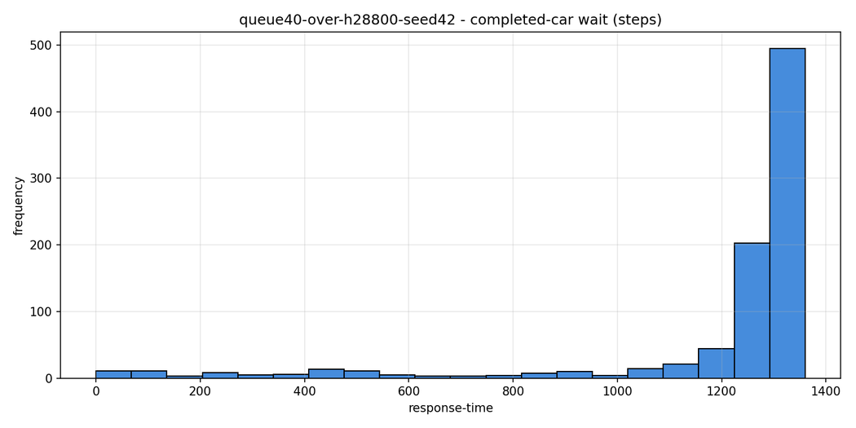
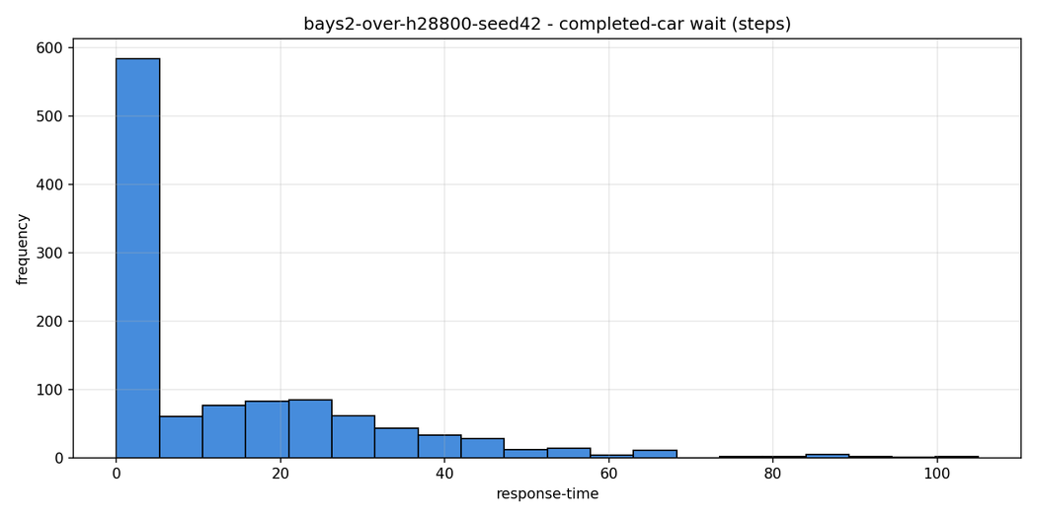
SIMPLE QUEUE ANALYSIS
  What it shows: FIFO queue simulation of a car wash results showing how congestion affects wait time, throughput, and rejected cars
  Results: With 1 bay, avg wait reached 99.3 mins and 246 cars were rejected. 2 bays reduced average wait to 2.18 mins and eliminated rejections.
  Main takeaway: The wash bay was the bottleneck, so adding service capacity was more effective than adding queue space.

Slide 4
SMALL MULTIQUEUES
  What are they: Multiple queues that are connected together sharing thoousands of jobs. Everytime a job is finsihed it is handed of to the next queue instead imediatley exiting the system.
  Example: An example of this would be the Texas Road Network where we have each intersection as queue, each lane as a server, and each road is an edge. Each neighborhood would be a small multi-queue.
  Main Takeaway : The slowest part of the queue sets the speed fr the entire chain. If jobs pile up upfront the parts after it stay idle. Fixing this and the bottleneck is removed.

Slide 5
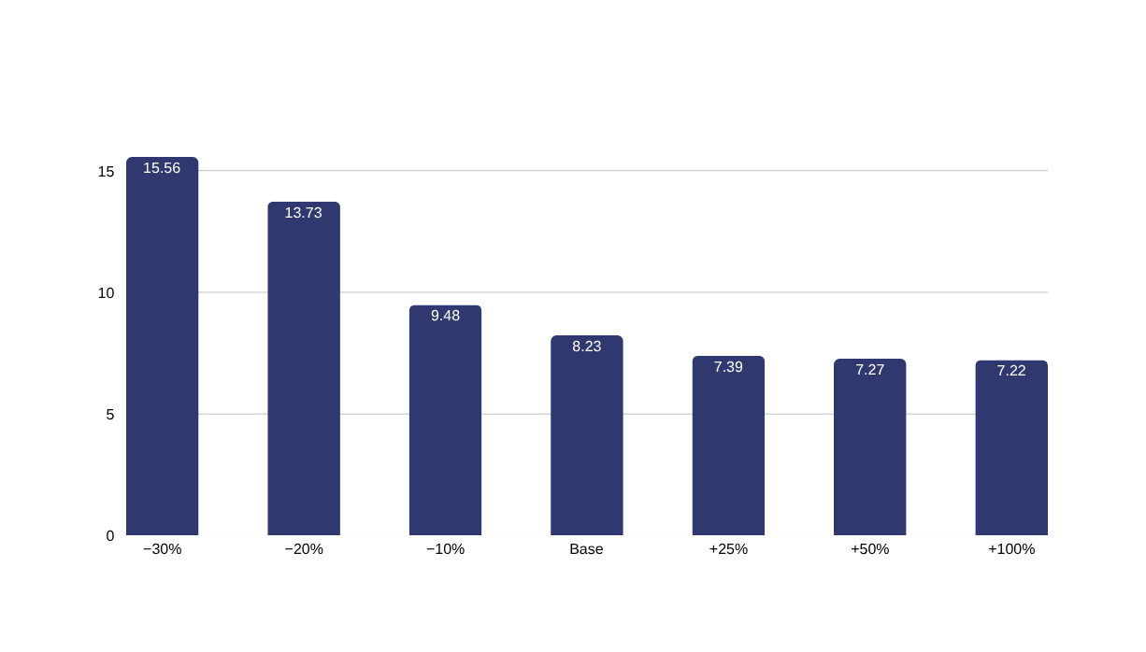
MEDIUM MULTIQUEUES - (ROAD NETWORK)
200 intersections, 10 highway exits: parallel egress prevents city-wide gridlock
Average commute travel time (steps)
10 EXITS
disperse traffic and
prevent exit gridlock
Unlike the 1-exit network,
10 parallel highway exits let
cars depart simultaneously
(rush-hour loss drops to 8.5%).
Congestion shifts from highway
exits to interior city crossroads.
Lane reductions (−30%) cause interior merge crossroads to back up, doubling travel time.

Slide 6
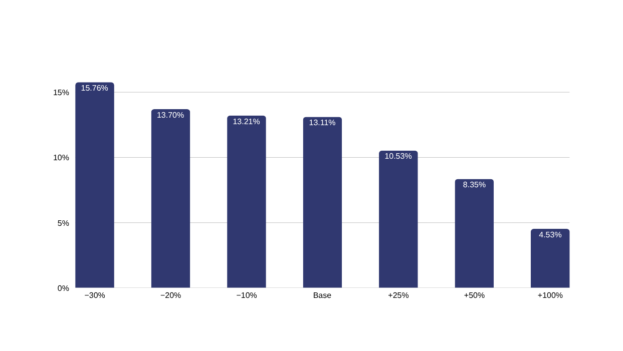
LARGE MULTIQUEUES - (REGIONAL NETWORK)
2,000 intersections, 62 highway exits: regional traffic across 45-hop commute paths
Vehicles lost to gridlock (%)
INTERIOR
MERGES
cause gridlock, not
highway exit ramps
Thousands of neighborhood routes converge onto the same central avenues.
Widening every road (+100% lanes) cannot eliminate gridlock: 4.5% of cars still back up at major merges.
62 highway exits flow freely; gridlock concentrates where converging commuter streams meet.

Slide 7
SUMMARY
What we did
What we found
  We built a queue simulation toolchain and used it on single queues and networks of up to thousands of queues.
The bottleneck sets the speed.
  The slowest queue sets the system's throughput, no matter how fast the rest is. Once arrivals exceed its capacity, queues fill up and jobs get dropped.
Lesson learned
  Fix the slowest queue first.
  Never run at 100%.
  Size your queues for the rush hour, not the average day.

