Slide 1
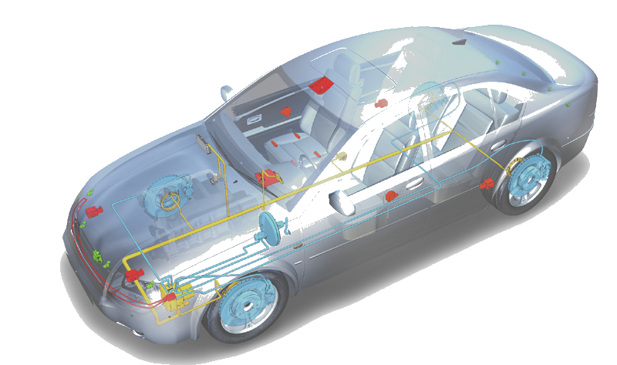


Abt-FKT-DNC09-DCOM Workshop
CanTp Training V6.0
CDG-SMT/ESB3
Chassis Systems Control
Confidential | CDG-SMT/ESB3 Daniel Hahn | 21/01/08 | © Robert Bosch GmbH 2007. All rights reserved, also regarding any disposal, exploitation, reproduction, editing, distribution, as well as in the event of applications for industrial property rights.

Slide 2
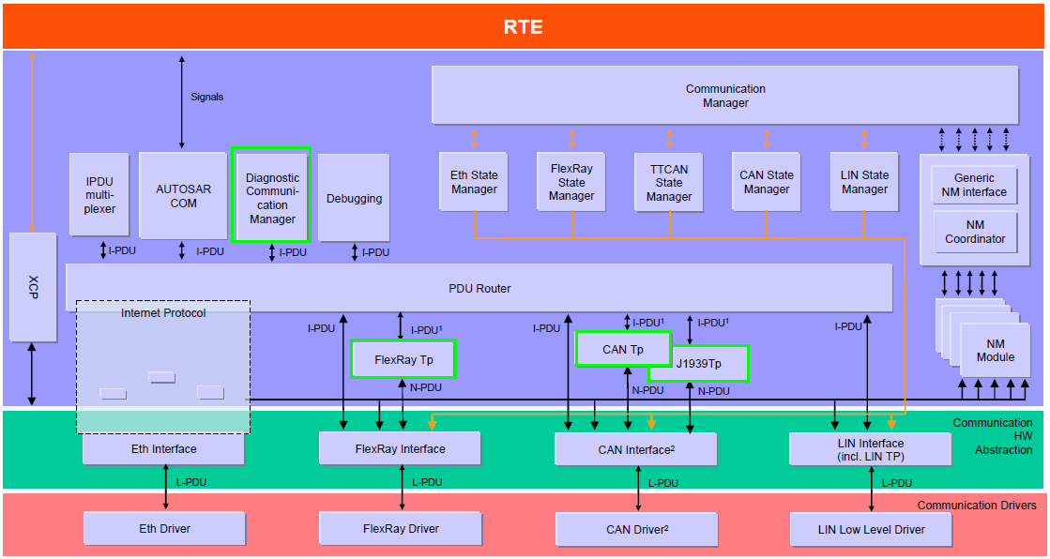

Autosar Communication Stack
DCOM FrTp Training
Chassis Systems Control
Confidential | RBEI/EAR2-Venkat Sundar | 21/01/08 | © Robert Bosch GmbH 2007. All rights reserved, also regarding any disposal, exploitation, reproduction, editing, distribution, as well as in the event of applications for industrial property rights.

Slide 3
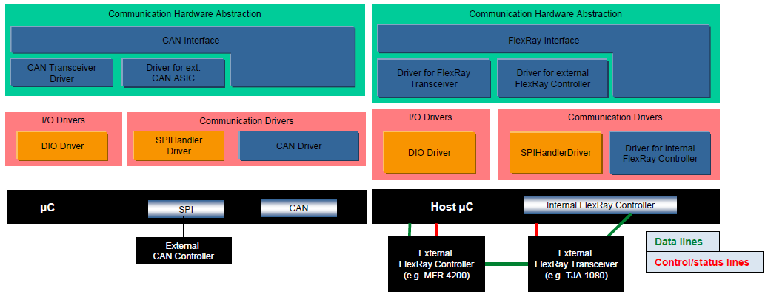
DCOM FrTp Training
Application
ComM
DiagAdapt (DGS)
Appl
DCOM
RTE
BswM
Dem
Dcm
IoHwAb
PduR
Nvm
SchM(RTE)
CanTp
J1939Tp
FrArTp /
FrTp AR3.1
FrIsoTp /
FrTp AR4.0
OEM
FrTp
Chassis Systems Control
Confidential | RBEI/EAR2-Venkat Sundar | 21/01/08 | © Robert Bosch GmbH 2007. All rights reserved, also regarding any disposal, exploitation, reproduction, editing, distribution, as well as in the event of applications for industrial property rights.

Slide 4
Agenda
DCOM CanTp Training
Introduction to ISO 15765 – Part2
ISO 15765 “Transport Protocol” Features
Introduction to AUTOSAR CanTp
Additional AUTOSAR CanTp Features
CUBEC CanTp Configuration Example
Chassis Systems Control
Confidential | CDG-SMT/ESB3 Daniel Hahn | 21/01/08 | © Robert Bosch GmbH 2007. All rights reserved, also regarding any disposal, exploitation, reproduction, editing, distribution, as well as in the event of applications for industrial property rights.

Slide 5
ISO 15765 – Part 2 (Network Layer Services)
DCOM CanTp Training
ISO 15765 – Part 2 specifies an unconfirmed communication protocol tailored to meet the requirements of CAN based diagnostic systems.
ISO 15765 – Part 2 is providing the following services:
  Segmentation of data, which do not fit into a single CAN frame, in transmit direction
  Reassembling of data in receive direction
  Control of data flow
  Detection of errors in segmentation sessions
Chassis Systems Control
Confidential | CDG-SMT/ESB3 Daniel Hahn | 21/01/08 | © Robert Bosch GmbH 2007. All rights reserved, also regarding any disposal, exploitation, reproduction, editing, distribution, as well as in the event of applications for industrial property rights.

Slide 6
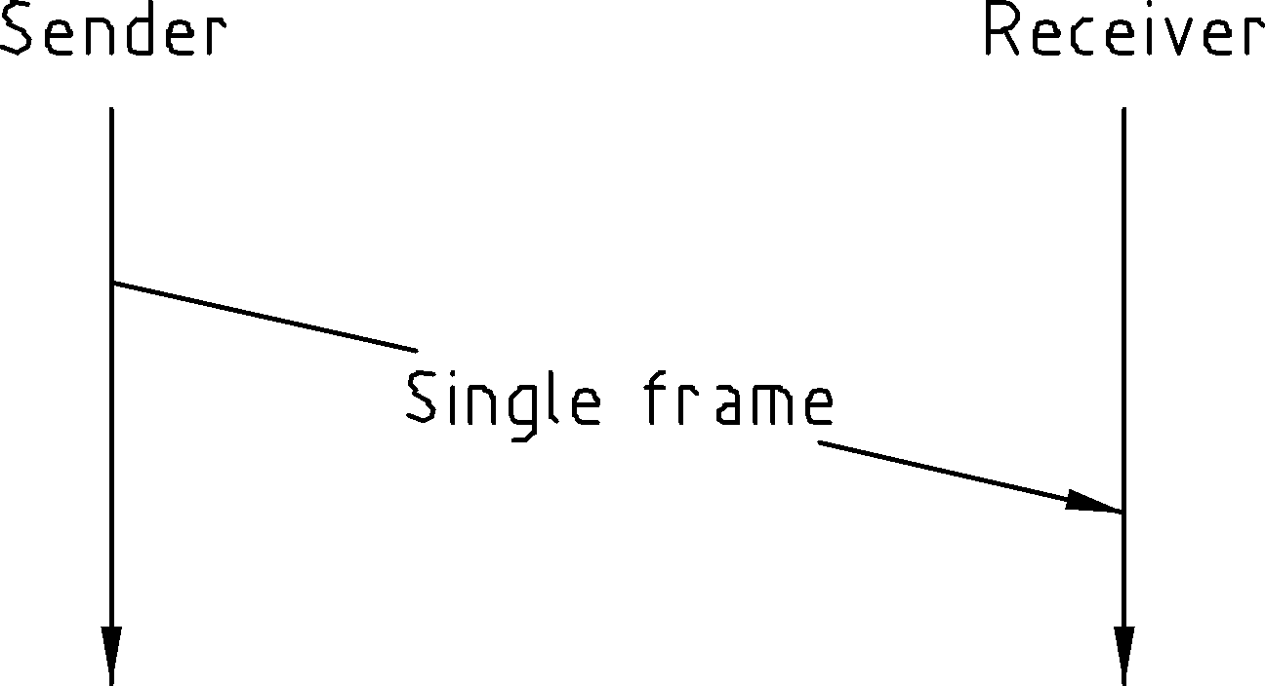
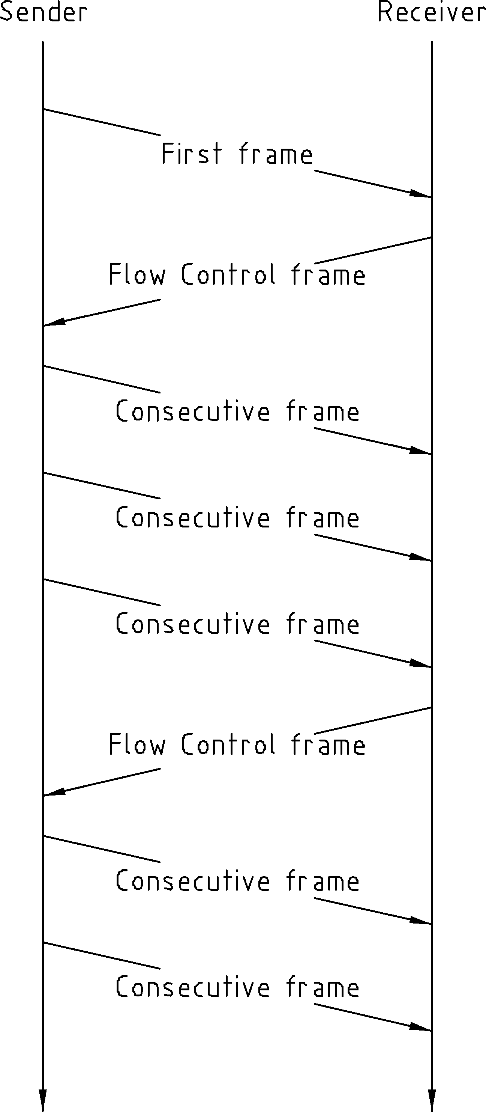
ISO 15765 – Segmented Message Transmission
DCOM CanTp Training
Un-Segmented message transmission
Segmented message transmission
Unsegmented Transmission
Single Frame (SF)
Segmented Transmission
Sender starts with First Frame (FF)
Receiver confirms with Flow Control (FC)
Sender sends remaining transmission data with Consecutive Frames (CF)
Chassis Systems Control
Confidential | CDG-SMT/ESB3 Daniel Hahn | 21/01/08 | © Robert Bosch GmbH 2007. All rights reserved, also regarding any disposal, exploitation, reproduction, editing, distribution, as well as in the event of applications for industrial property rights.

Slide 7
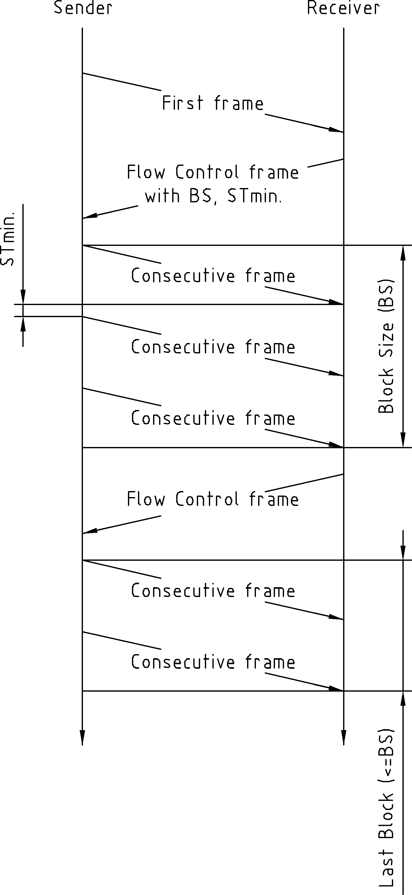
ISO 15765 – STmin, BS
DCOM CanTp Training
Flow Control Parameter
Minimum Separation Time (STmin)
Minimum Time the sender shall wait between 2 CFs
Block Size (BS)
Maximum number of CFs the receiver allows the sender to send in one block, before waiting for the next CF.
BS = 0 (infinite)
All Consecutive Frames (CF) will be send without any further Flow Control frames
Chassis Systems Control
Confidential | CDG-SMT/ESB3 Daniel Hahn | 21/01/08 | © Robert Bosch GmbH 2007. All rights reserved, also regarding any disposal, exploitation, reproduction, editing, distribution, as well as in the event of applications for industrial property rights.

Slide 8
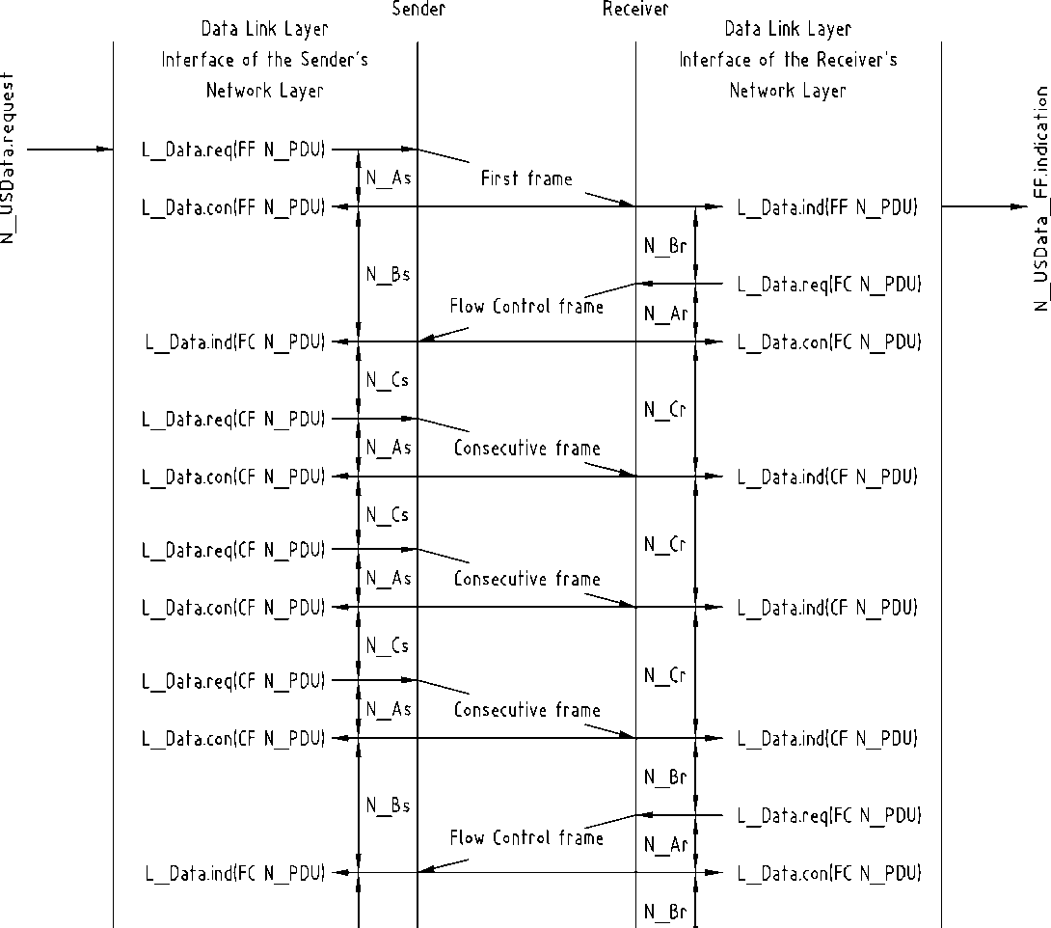
ISO 15765 – Timing-Parameter
DCOM CanTp Training
Timing Parameter
As/Ar
Time for transmission of the CAN frame
Bs
Time until reception of the next Flow Control Frame
Br
Time until transmission of the next Flow Control Frame
Cs
Time until transmission of the next Consecutive Frame
Cr
Time until reception of the next Consecutive Frame
FF
FC
CF
CF
CF
FC
Chassis Systems Control
Confidential | CDG-SMT/ESB3 Daniel Hahn | 21/01/08 | © Robert Bosch GmbH 2007. All rights reserved, also regarding any disposal, exploitation, reproduction, editing, distribution, as well as in the event of applications for industrial property rights.

Slide 9
ISO 15765 – Normal / Extended Addressing
DCOM CanTp Training
Normal Addressing
Frame Type | Byte 1 |  | Byte 2 | Byte 3 | Byte 4-8
 | Bit 7- 4 | Bit 3 – 0
Single Frame (SF) | SF = 0x0 | SF_DL | Data
First Frame (FF) | FF = 0x1 | FF_DL |  | Data
Consecutive Frame (CF) | CF = 0x2 | SN | Data
Flow Control (FC) | FC = 0x3 | FS | BS | STmin | N/A
TA - Target Address
PCI - Protocol Control Information
Extended Addressing
Frame Type | Byte 1 | Byte 2 |  | Byte 3 | Byte 4 | Byte 5-8
 |  | Bit 7- 4 | Bit 3 – 0
Single Frame (SF) | TA | SF = 0x0 | SF_DL | Data
First Frame (FF) | TA | FF = 0x1 | FF_DL |  | Data
Consecutive Frame (CF) | TA | CF = 0x2 | SN | Data
Flow Control (FC) | TA | FC = 0x3 | FS | BS | STmin | N/A
Flow Status
0x0: Clear to Send
0x1: Wait
0x2: Overflow
Legend
SF_DL: 4 Bit Single Frame Data Length FF_DL: 12 Bit First Frame Data Length
SN: Sequence Number FS: Flow Status
BS: Block Size STmin: Minimum Separation Time
Chassis Systems Control
Confidential | CDG-SMT/ESB3 Daniel Hahn | 21/01/08 | © Robert Bosch GmbH 2007. All rights reserved, also regarding any disposal, exploitation, reproduction, editing, distribution, as well as in the event of applications for industrial property rights.

Slide 10
ISO 15765 – Target Address Type
DCOM CanTp Training
Target Address Type
The parameter Target Address Type shall be used to encode the communication model used by the communicating entities.
Communication Models
Two communication models are specified:
Physical addressing (1 to 1 communication)
shall be supported for all types of network layer messages.
Functional addressing (1 to n communication)
shall only be supported for Single Frame communication.
Chassis Systems Control
Confidential | CDG-SMT/ESB3 Daniel Hahn | 21/01/08 | © Robert Bosch GmbH 2007. All rights reserved, also regarding any disposal, exploitation, reproduction, editing, distribution, as well as in the event of applications for industrial property rights.

Slide 11
ISO 15765 – Padding
DCOM CanTp Training
CAN Frame Data Padding
The DLC (data Length Code) is always set to 8. If the CAN Frame to be transmitted is shorter than 8 bytes, then the sender has to set the DLC to the maximum value 8 (padding of unused data bytes).
In particular this can be the case for a Single Frame, a Flow Control Frame or the last Consecutive Frame of a segmented message.
Chassis Systems Control
Confidential | CDG-SMT/ESB3 Daniel Hahn | 21/01/08 | © Robert Bosch GmbH 2007. All rights reserved, also regarding any disposal, exploitation, reproduction, editing, distribution, as well as in the event of applications for industrial property rights.

Slide 12
Trace – Extended Addressing Request
DCOM CanTp Training
Target Address
PCI Bytes
470.4103 1 6FF Rx d 8 11 03 22 10 00 00 00 00 SF
470.4258 1 611 Rx d 8 FF 10 14 62 10 00 03 04 FF
470.4278 1 6FF Rx d 8 11 30 02 05 00 00 00 00 FC
470.4292 1 611 Rx d 8 FF 21 05 06 07 08 09 0A CF
470.4355 1 611 Rx d 8 FF 22 0B 0C 0D 0E 0F 10 CF
470.4377 1 6FF Rx d 8 11 30 02 05 00 00 00 00 FC
470.4398 1 611 Rx d 8 FF 23 11 12 13 00 00 00 CF
Request
22 10 00
Response
62 10 00 …
Chassis Systems Control
Confidential | CDG-SMT/ESB3 Daniel Hahn | 21/01/08 | © Robert Bosch GmbH 2007. All rights reserved, also regarding any disposal, exploitation, reproduction, editing, distribution, as well as in the event of applications for industrial property rights.

Slide 13
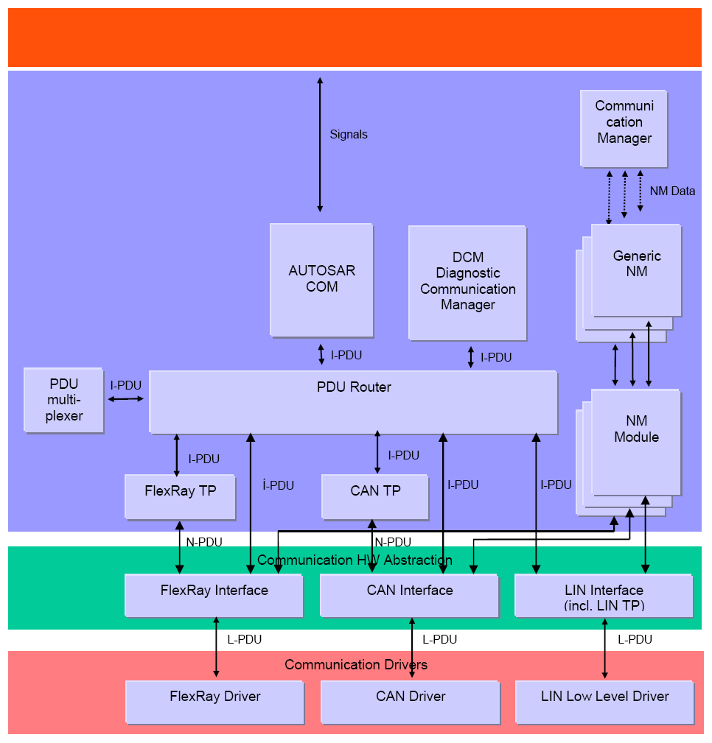
AUTOSAR - Communication Stack
DCOM CanTp Training
PDU (Protocol Data Unit)
In layered systems, it refers to a data unit that is specified in the protocol of a given layer.
This contains user data of that layer (SDU) plus possible protocol control information (PCI).
Furthermore, the PDU of layer X is the SDU of its lower layer X-1 (i.e. (X)-PDU = (X-1)-SDU).
I-PDU
PDU of the AUTOSAR COM/DCM module.
CAN N-PDU
This is the PDU of the CAN Transport Layer. It contains a unique identifier, data length and data (protocol control information plus the whole N-SDU or a part of it)
Chassis Systems Control
Confidential | CDG-SMT/ESB3 Daniel Hahn | 21/01/08 | © Robert Bosch GmbH 2007. All rights reserved, also regarding any disposal, exploitation, reproduction, editing, distribution, as well as in the event of applications for industrial property rights.

Slide 14
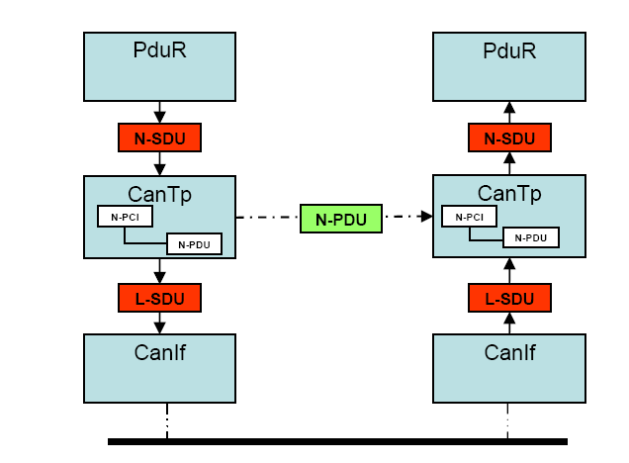
AUTOSAR CanTp - PDUs and SDUs
DCOM CanTp Training
PDU (Protocol Data Unit)
In layered systems, it refers to a data unit that is specified in the protocol of a given layer.
This contains user data of that layer (SDU) plus possible protocol control information (PCI).
Furthermore, the PDU of layer X is the SDU of its lower layer X-1 (i.e. (X)-PDU = (X-1)-SDU).
SDU (Service Data Unit)
In layered systems, this refers to a set of data that is sent by a user of the services of a given layer, and is transmitted to a peer service user.
Chassis Systems Control
Confidential | CDG-SMT/ESB3 Daniel Hahn | 21/01/08 | © Robert Bosch GmbH 2007. All rights reserved, also regarding any disposal, exploitation, reproduction, editing, distribution, as well as in the event of applications for industrial property rights.

Slide 15
AUTOSAR CanTp - Interfaces to CAN-IF
DCOM CanTp Training
Std_ReturnType CanIf_Transmit ( PduIdType CanTxPduId, const PduInfoType *PduInfoPtr )
This service initiates a request for transmission of the CAN L-PDU specified by the CanTxPduId and CAN related data in the L-PDU structure.
void CanTp_RxIndication (PduIdType CanTpRxPduId,const PduInfoType* CanTpRxPduPtr)
This function is called by the CAN Interface after a successful reception of a RxCAN L-PDU.
void CanTp_TxConfirmation (PduIdType CanTpTxPduId)
All transmitted CAN frames belonging to the CAN Transport Layer will be confirmed by this function.
Chassis Systems Control
Confidential | CDG-SMT/ESB3 Daniel Hahn | 21/01/08 | © Robert Bosch GmbH 2007. All rights reserved, also regarding any disposal, exploitation, reproduction, editing, distribution, as well as in the event of applications for industrial property rights.

Slide 16
AUTOSAR CanTp - Interfaces to PDU Router
DCOM CanTp Training
void PduR_CanTpRxIndication ( PduIdType CanTpRxPduId, NotifResultType Result )
This function is called by the CAN TP after successful/unsuccessful reception of data.
BufReq_ReturnType PduR_CanTpProvideRxBuffer ( PduIdType CanTpRxPduId, PduLengthType TpSduLength, PduInfoType **PduInfoPtr )
This service is called by the CAN TP for requesting a new buffer to fill in the received data.
Std_ReturnType CanTp_Transmit(PduIdType CanTpTxSduId,const PduInfoType* CanTpTxInfoPtr)
This service is used to request the transfer of segmented data.
BufReq_ReturnType PduR_CanTpProvideTxBuffer ( PduIdType CanTpTxPduId, PduInfoType **PduInfoPtr, uint16 Length )
This function is called by the CAN TP for requesting a transmit buffer
void PduR_CanTpTxConfirmation ( PduIdType CanTpTxPduId, NotifResultType Result )
This function is called by the CAN Transport Protocol after successful/unsuccesful transmision of a transmit request
Chassis Systems Control
Confidential | CDG-SMT/ESB3 Daniel Hahn | 21/01/08 | © Robert Bosch GmbH 2007. All rights reserved, also regarding any disposal, exploitation, reproduction, editing, distribution, as well as in the event of applications for industrial property rights.

Slide 17
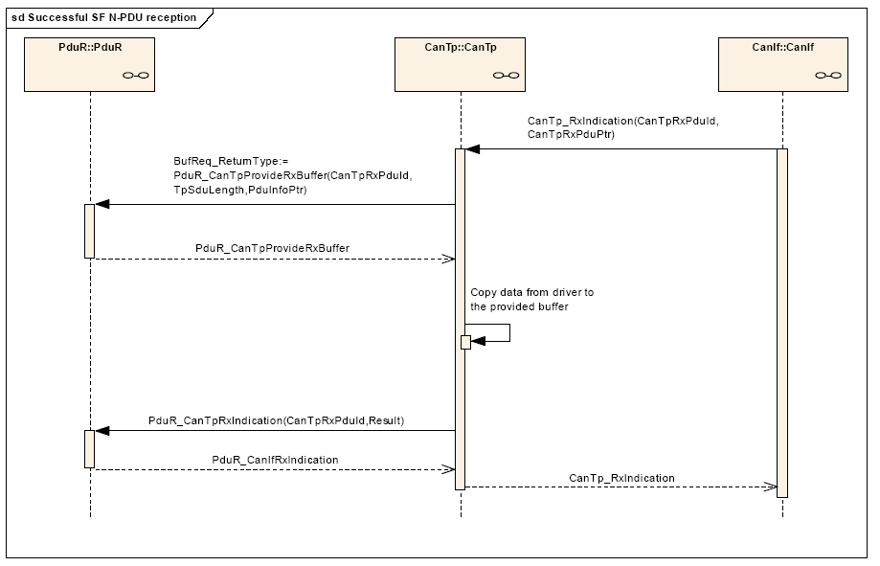
AUTOSAR CanTp - SF N-PDU Reception
DCOM CanTp Training
Chassis Systems Control
Confidential | CDG-SMT/ESB3 Daniel Hahn | 21/01/08 | © Robert Bosch GmbH 2007. All rights reserved, also regarding any disposal, exploitation, reproduction, editing, distribution, as well as in the event of applications for industrial property rights.

Slide 18
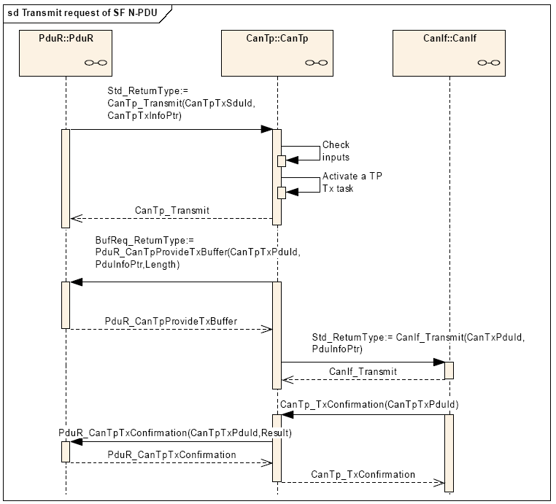
AUTOSAR CanTp - SF N-PDU Transmission
DCOM CanTp Training
Chassis Systems Control
Confidential | CDG-SMT/ESB3 Daniel Hahn | 21/01/08 | © Robert Bosch GmbH 2007. All rights reserved, also regarding any disposal, exploitation, reproduction, editing, distribution, as well as in the event of applications for industrial property rights.

Slide 19
AUTOSAR CanTp - Br / Cs - Timeout
DCOM CanTp Training
CanTp166:
At the reception of a FF or a SF, the CanTp module shall start a time-out N_Br before requesting a Rx buffer. If a buffer has not been provided before the timer elapsed, the CanTp module shall abort the communication.
CanTp167:
After a transmission request from upper layer, the CanTp module shall start
time-out N_Cs before requesting a Tx buffer. If a buffer has not been
provided before the timer elapsed, the CanTp module shall abort the
communication.
N_Br and N_Cs are defined as “performance parameters in ISO15765” but
AUTOSAR CanTp is “redefining” N_Br and N_Cs as timeout parameter for
requesting Rx/Tx buffers!
Chassis Systems Control
Confidential | CDG-SMT/ESB3 Daniel Hahn | 21/01/08 | © Robert Bosch GmbH 2007. All rights reserved, also regarding any disposal, exploitation, reproduction, editing, distribution, as well as in the event of applications for industrial property rights.

Slide 20
CanTp – Connection Channels
DCOM CanTp Training
A Rx Connection (Rx-N-SDU) is linked to connection channels. Sharing of RX Connections is allowed!
Each Tx Connection (Tx-N-SDU) is statically linked to one connection channel.
Each connection channel is independent of the other connection channels. This means that a connection channel uses its own resources, such as internal buffer, timer, or state machine.
If a connection channel is assigned to multiple connections, then resources are shared between different connections, and the CAN Transport Layer will reject transmission or abort receiving, if no free connection channels are available.
Channel 1
Rx Connection 1
Rx Connection 2
Tx Connection 1
Channel 2
Rx Connection 3
Tx Connection 2
Chassis Systems Control
Confidential | CDG-SMT/ESB3 Daniel Hahn | 21/01/08 | © Robert Bosch GmbH 2007. All rights reserved, also regarding any disposal, exploitation, reproduction, editing, distribution, as well as in the event of applications for industrial property rights.

Slide 21
CanTp – Example for Connection Channels
DCOM CanTp Training
Channel 1
Channel 2
Rx Connection 1 DiagRx_CanTp2Pdur
Rx N-PDU DiagRx_Npdu_CanIf2CanTp
Tx FC N-PDU DiagTx_Npdu_CanTp2CanIf
Addr. Format Standard
Com. Type Physical
Rx Connection 2 DiagRxFunc_canTp2Pdur
Rx N-PDU DíagRxFunc_Npdu_CanIf2CanTp
Tx FC N-PDU -
Addr. Format Standard
Com. Type Functional
Tx Connection 1 DiagTx_Pdur2CanTp
Tx N-PDU DiagTx_Npdu_CanTp2CanIf
Rx FC N-PDU DiagRx_Npdu_CanIf2CanTp
Addr. Format Standard
Com. Type Physical
Rule
Tx N-PDUs cannot be shared between Connection Channels. They belong to only one Connection Channel.
In case it is required to use the same Can ID for Tx in different Connection Channels, then it is required to create two unique N-PDU Ids in CanTp which maps to the same CAN Id
Chassis Systems Control
Confidential | CDG-SMT/ESB3 Daniel Hahn | 21/01/08 | © Robert Bosch GmbH 2007. All rights reserved, also regarding any disposal, exploitation, reproduction, editing, distribution, as well as in the event of applications for industrial property rights.

Slide 22
CanTp – Reference Configuration (1)
DCOM CanTp Training
CanTpGeneral
CanTpDevErrorDetect: False
CanTpOsTimerUse: CyclicCount
CanTpMainFunctionPeriod: 1
CanTpVersionInfoAPI: False
TxNSdu (Tx Physical)
CanTpTxNSduRef: DiagXMT_Pdur2CanTp
CanTpTxNSduId: 0
CanTpAddressingFormat: CanTpStandard
CanTpRxPaddingActivation: CanTpOff
CanTpPaddingValue: 0
CanTpRxTaType: CanTpPhysical
CanTpOffsetCorForSTmin: 0
CanTpNas: 50
CanTpNbs: 1000
CanTpNcs: 800
CanTpRxDl: 1
CanTpRxChannel: 0
CanTpTxNPdu
CanTpRxNPduRef: DiagXMT_Npdu_CanTp2CanIf
CanTpRxNPduId: 0
For detailed Information on the CUBEC CanTp parameters please also refer to the “Guideline-CanTp-Configuration.doc” document!
CanTpRxFcNPdu
CanTpTxFcNPduRef: DiagRCV_Npdu_CanIf2CanTp
CanTpTxFcNPduId: 0
Chassis Systems Control
Confidential | CDG-SMT/ESB3 Daniel Hahn | 21/01/08 | © Robert Bosch GmbH 2007. All rights reserved, also regarding any disposal, exploitation, reproduction, editing, distribution, as well as in the event of applications for industrial property rights.

Slide 23
CanTp – Example for Connection Channels (2)
DCOM CanTp Training
RxNSdu (Rx Physical)
CanTpRxNSduRef: DiagRCV_cantp2Pdur
CanTpRxNSduId: 0
CanTpAddressingFormat: CanTpStandard
CanTpRxPaddingActivation: CanTpOff
CanTpPaddingValue: 0
CanTpRxTaType: CanTpPhysical
CanTpBs: 0
CanTpSTmin: 0
CanTpNar: 50
CanTpNbr: 100
CanTpNcr: 1000
CanTpRxDl: 1
CanTpRxWftMax: 0
CanTpRxChannel: 0
RxNSdu (Rx Functional)
CanTpRxNSduRef: DiagRCVFun_CanTp2PduR
CanTpRxNSduId: 1
CanTpAddressingFormat: CanTpStandard
CanTpRxPaddingActivation: CanTpOff
CanTpPaddingValue: 0
CanTpRxTaType: CanTpFunctional
CanTpBs: 0
CanTpSTmin: 0
CanTpNar: 50
CanTpNbr: 100
CanTpNcr: 1000
CanTpRxDl: 1
CanTpRxWftMax: 0
CanTpRxChannel: 1
CanTpRxNPdu
CanTpRxNPduRef: DiagRCV_Npdu_CanIf2CanTp
CanTpRxNPduId: 0
CanTpRxNPdu
CanTpRxNPduRef: DiagRCVFunc_Npdu_CanIf2CanTp
CanTpRxNPduId: 1
CanTpTxFcNPdu
CanTpTxFcNPduRef: DiagXMT_Npdu_CanTp2CanIf
CanTpTxFcNPduId: 0
Chassis Systems Control
Confidential | CDG-SMT/ESB3 Daniel Hahn | 21/01/08 | © Robert Bosch GmbH 2007. All rights reserved, also regarding any disposal, exploitation, reproduction, editing, distribution, as well as in the event of applications for industrial property rights.

Slide 24
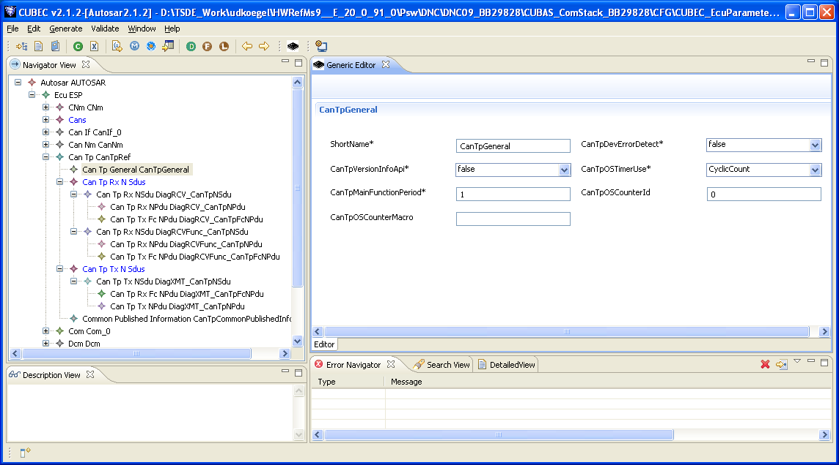
CUBEC – CanTp Configuration (CUBEC 2.1.2)
DCOM CanTp Training
Chassis Systems Control
Confidential | CDG-SMT/ESB3 Daniel Hahn | 21/01/08 | © Robert Bosch GmbH 2007. All rights reserved, also regarding any disposal, exploitation, reproduction, editing, distribution, as well as in the event of applications for industrial property rights.

Slide 25
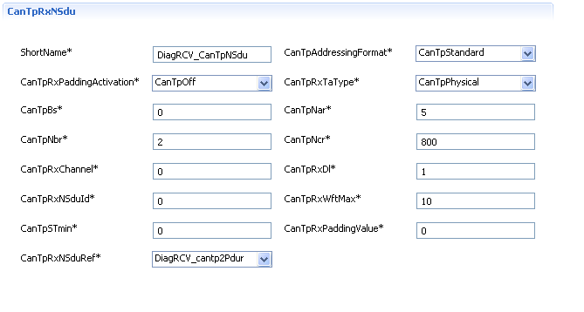
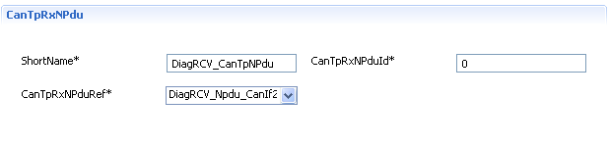
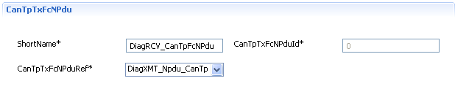
CUBEC – CanTp Configuration (CUBEC 2.1.2)
DCOM CanTp Training
CanTp→Pdur
Rx-Sdu-Reference/Id
Address-Format
Communication Type
BlockSize / STmin
A,B,C-Timing
Padding & Padding Byte
Channel
Max. No. Wait - Frames
CanIf → CanTp
Rx-NPdu – Reference/Id
CanTp →CanIf
FC-NPdu – Reference/Id
Chassis Systems Control
Confidential | CDG-SMT/ESB3 Daniel Hahn | 21/01/08 | © Robert Bosch GmbH 2007. All rights reserved, also regarding any disposal, exploitation, reproduction, editing, distribution, as well as in the event of applications for industrial property rights.

Slide 26
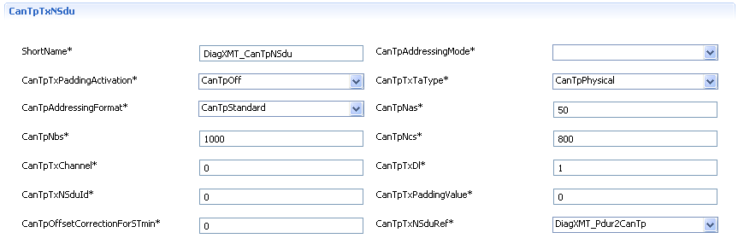
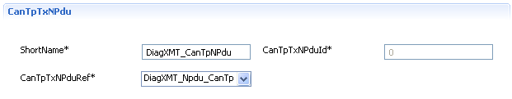
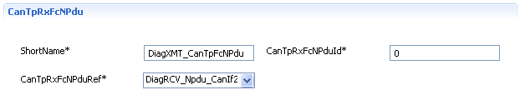
CUBEC – CanTp Configuration (CUBEC 2.1.2)
DCOM CanTp Training
Pdur → CanTp
Tx-Sdu-Reference/Id
Address-Format
Communication Type
A,B,C-Timing
Padding & Padding Byte
Channel
CanTp → CanIf
Tx-NPdu – Reference/Id
CanIf → CanTp
FC-NPdu – Reference/Id
Chassis Systems Control
Confidential | CDG-SMT/ESB3 Daniel Hahn | 21/01/08 | © Robert Bosch GmbH 2007. All rights reserved, also regarding any disposal, exploitation, reproduction, editing, distribution, as well as in the event of applications for industrial property rights.

Slide 27

DCOM FrTp Training
Chassis Systems Control
Confidential | RBEI/EAR2-Venkat Sundar | 21/01/08 | © Robert Bosch GmbH 2007. All rights reserved, also regarding any disposal, exploitation, reproduction, editing, distribution, as well as in the event of applications for industrial property rights.

Slide 28

DCOM FrTp Training
Chassis Systems Control
Confidential | RBEI/EAR2-Venkat Sundar | 21/01/08 | © Robert Bosch GmbH 2007. All rights reserved, also regarding any disposal, exploitation, reproduction, editing, distribution, as well as in the event of applications for industrial property rights.

