Slide 1
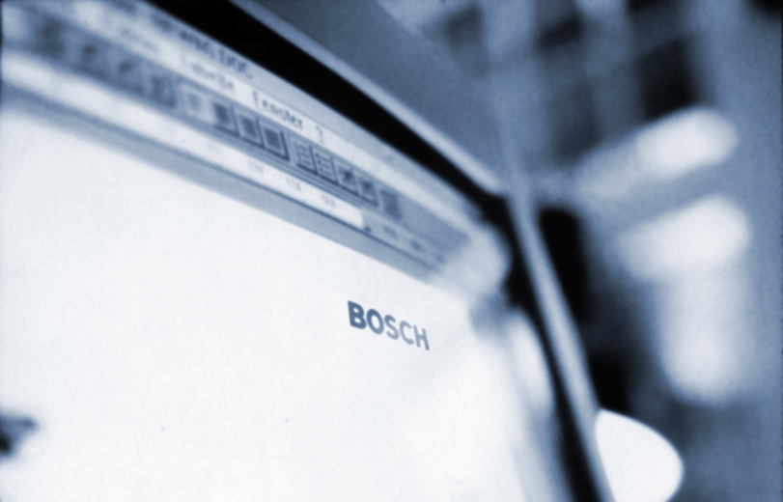
Controller Area Network
CAN

Slide 2
Introduction to CAN
The Necessity
Usage of more and more electronics in Modern Motor Vehicles
Usage of dedicated “Electronic Control Units” for each individual functionality
The need for information exchange between various ECUs and also to share some sensors in common
ENGINE
CO NTROL
ANTI-LOCK
BREAKING
BODY
ELECTRONICS
ACTIVE
SUSPENSION
AIR
BAGS
TRANSMISSION
CONTROL

Slide 3
Introduction to CAN
The communication between ECUs
By point to point interconnection
ENGINE
CO NTROL
ANTI-LOCK
BREAKING
ACTIVE
SUSPENSION
AIR
BAGS
DISADVANTAGES
Unreliability
More material cost and
More production time

Slide 4
Introduction to CAN
The Solution
Adopting Bus communication instead of point to point communication
Adopting a protocol to transmit and receive information through the bus
The various vehicle bus protocols available are “CAN”, “A-BUS” from Peugeot and Renault, and J1850 from Chrysler, General Motors and Ford
ENGINE
CO NTROL
ANTI-LOCK
BREAKING
AIR
BAGS
CAN
CAN
CAN
CAN BUS
In Europe, “CAN” is the leading vehicle bus protocol

Slide 5
Introduction to CAN
The “Controller Area Network” (CAN)
Advanced Serial Bus protocol that efficiently supports distributed control system
Developed by Robert Bosch GMBH, Germany in late 1980s and also holds the license
Internationally standardized by the International Standardization Organization (ISO) and the Society of Automotive Engineers (SAE)
Apart from automotive application “CAN” is also used in Industrial automation, Medical equipment, Building automation and household appliances

Slide 6
The Basic Concepts
CAN Bus Characteristics
There are two logic states on the bus called “Dominant” and “Recessive”
The Dominant bit (logic level ‘0’) overwrite the Recessive bit (logic level ‘1’)
5v
TRUTH TABLE
C B A BUS
D D D D
D D R D
D R D D
D R R D
R D D D
R D R D
R R D D
R R R R
CAN BUS
R T
R T
R T
NODE A
NODE B
NODE C

Slide 7
The Basic Concepts
Characteristics of ‘CAN’
Can is a multi-master Bus
Theoriticaly No limitation on the number of nodes
Configuration flexibility - No node addressing
Prioritization of messages through “Identifiers”
Multicast reception with the time synchronization
System wide data consistency
Guarantee of latency times
Error detection and error signaling
automatic retransmission of corrupted messages as soon as the bus is idle again
Distinction between temporary errors and permanent failures of nodes and autonomous switching off of defect nodes
Notes:
k
k
k
k
k
k
k
k
k
k
k
k
k
k

Slide 8
The Protocol
The ‘CAN’ Protocol is subdivided into
Data Link Layer
- Logical Link Control (LLC) sub-layer
- Medium Access Control (MAC) sub-layer
Physical layer
of the ISO/ OSI Reference Model

Slide 9
The Protocol
Scope of Different layers
Data Link Layer
Physical Layer
Logical Link Control layer
Bit Encoding/Decoding
Acceptance Filtering
Synchronization
Overload Notification
Bit Timing
Recovery Management
Medium Access control layer
Data Encapsulation/Decapsulation
Frame Coding (Stuffing/de-stuffing)
Medium Access Management
Error Detection/error signaling
Acknowledgement and
Serialization/de-serialization

Slide 10
The Basic Concepts
Bus Access and Arbitration
Bus access through CSMA with AMP
NODE
Arbitration phase
A 0 1 0 0
Remainder
B 0 1 0 1
Node B looses arbitration
C 0 1 1 0
Node C looses arbitration
BUS 0 1 0 0
Advantages
No Collision
Transmission of highest priority message within the latency time

Slide 11
The Protocol
Frame Formats
Standard Frame - 11bit Identifier
Extended Frame - 29 bit Identifier
Frame Types
Data Frame
Remote Frame
Error Frame
Overload Frame

Slide 12
The Protocol
Standard Data Frame Format
Arbitration Field
Control Field
Data Field
CRC Field
ACK
End of Frame
Inter-
Field
mission
RTR
r0
SOF
11 Bit Identifier
IDE
DLC (4)
0 to 64 Bits
15 Bits
7 Bits
3 Bits
Bus Idle
CRC Delimiter
Ack Slot
Bus Idle
Ack Delimiter
Extended Data Frame Format
Arbitration Field
Control Field
Data Field
r1
SOF
SRR
RTR
r0
11 Bit Identifier
IDE
18 Bit Identifier
DLC (4)
0 to 64 Bits
Difference between Standard Frame and Extended Frame
Differs only in Arbitration field and Control field

Slide 13
The Protocol
Remote Frame Format
Arbitration Field
Control Field
CRC Field
ACK
End of Frame
Inter-
Field
mission
RTR
r0
SOF
11 Bit Identifier
IDE
DLC (4)
15 Bits
7 Bits
3 Bits
CRC Delimiter
Ack Slot
Ack Delimiter
Node acting as Receiver for certain data initiates a Remote frame
Consists of all the fields except data field as compared to a data frame
Contrary to Data Frames, the RTR bit is recessive
Exists for both the standard and extended format

Slide 14
The Protocol
Error Frame Format (Active Error Frame)
Error Condition
Uncompleted
Error Frame
Inter-
Frame
mission
6 Bits
0 -6 Bits
8 Bits
3 Bits
Superposition of
Error Delimiter
Error Flag
Error flag can be transmitted by both Transmitter and Receiver node
Error flag can start within the frame that is currently being transmitted
Types of Error flags
Active Error flag - consists of 6 consecutive ‘dominant’ bit sent by Error Active node
Passive Error flag - consists of 6 consecutive ‘recessive’ bit sent by Error passive
node

Slide 15
TEC<=255
Error Handling
REC > 127
OR
ERROR
PASSIVE
TEC > 255
Reset
TEC > 127
ERROR
ACTIVE
BUS
OFF
REC <= 127
OR
TEC <= 127
REC <= 127
OR
TEC <= 127
Re-
Initialization
only

Slide 16
Overload Frame Format
Condition under which overload frame is transmitted
Receiver requires a delay to receive next Data or Remote frame
Detection of a ‘dominant bit at the first or second bit of Intermission
Detection of a ‘dominant’ bit at the 8th bit of an Error or overload Delimiter
End of Frame or
OverloadFrame
Inter-
Error Delimiter or
mission
Overload Delimiter
6 Bits
0 -6 Bits
8 Bits
3 Bits
Superposition of
Overload
Overload Flag
Delimiter
Overload frame always starts within the Intermission slot of previous frame

Slide 17
Interframe Spacing
The space separating Data / Remote frames from any preceding frame
After the transmission of a frame by an Error Active node
Previous Frame
Interframe Spacing
Next frame
3 Bits
Inter-mission
Bus idle
After the transmission of a frame by an Error Passive node
Previous Frame
Interframe Spacing
Next frame
3 Bits
8 Bits
Inter-mission
Suspend
Bus idle
Transmission

Slide 18
Message Validation
For transmitter the message is valid, if there is no error until the EOF
For receiver the message is valid, if there is no error until last but one bit
of the EOF
Types of Error
CRC Error
Acknowledge Error
Form Error
Bit Error
Stuff Error
Notes:
CRC Error
# CRC is calculated for bits starting from SOF to end of
data field.
# CRC is 15 bit.
#Transmitter and Receiver calculates the CRC the same
way and if the received CRC and the calculated CRC at
the receiver end is not same, the receiver discards the
frame and transmits and error frame.
************************************************
Acknowledge Error
# A frame must be acknowledged by at least one node,
otherwise Ack error.
# No error frame will be generated as no node has received
any frame, but the transmitter has to transmit once again.
************************************************
Form Error
# If there is dominant bit in,
1. CRC delimiter
2. Acknowledge delimiter
3.End of frame
4. Intermission
an error frame is generated and the message is
repeated.
************************************************
Bit Error
# The transmitted bit and the bit sampled on the bus should be same except in arbitration field and ACK slot. If not,
then a bit error has occured and the transmitter stops the
frame and send an error frame.
************************************************
Stuff Error
# If 6 or more consecutive bits with same polarity is received , then stuff error. An error frame is generated.
# This is applicable for bits from SOF to CRC delimiter.

Slide 19

Message Coding
Non-Return-to-Zero coding
Keeps the frequency of the signal on the bus to minimum.
“1”
“0”
1 1 0 1 0 0 1 1 ………………..
Bit-Stuffing
Ensures sufficient Recessive and Dominant edges for Re-Synchronization.
Data Stream
1
1
2
3
4
5
6
7
8
9
10
1
2
3
1
2
1
2
3
4
5
6
1
2
Bit Stream
1
1
2
3
4
5
S
6
7
8
9
10
S
1
2
3
1
2
1
2
3
4
5
S
6
1
2

Slide 20
Bus Synchronization
Hard Synchronization at Start of Frame Bit
All nodes synchronize on leading edge of SOF bit
SOF
IDENTIFIER FIELD
Intermission or Bus idle
Re-synchronization on each recessive to dominant edge
Ensures correct sampling up to the last bit
Bit Stream
1
1
2
3
4
5
S
6
7
8
9
10
S
1
2
3
1
2
1
2
3
4
5
S
6
1
2
Re-Sync
Re-Sync
Re-Sync
Re-Sync
Re-Sync
Re-Sync

Slide 21
Bit Construction
CAN frame
Synchronization Segment (1 Bit)
Propagation Time Segment (1 to 8 Bits)
Phase Buffer Segment 1 (1 to 8 Bits)
1 Time Quantum
Phase Buffer Segment 2 (1 to 8 Bits)
1 Bit Time
Sample Point
Each segment is an integer multiple of the Time Quantum
Time Quantum per bit - 8 to 25
Bit rate - a function of the width of Time Quantum and the number of Time quantum in each segment

Slide 22
T H A N K
Y O U

