Slide 1

Index:
>RAM and ROM :- Basic Properties.
> Addressmap
> Flash division
> Overview of Ramusage
> Init concept for Rams
> Linker Files (group.inv and locate.inv)
> Sections
> MemMap
MemLay Presentation
Internal | RBEI/EBA1 | 14/05/2015 | © Robert Bosch Engineering and Business Solutions Private Limited 2015. All rights reserved, also regarding any disposal, exploitation, reproduction, editing, distribution, as well as in the event of applications for industrial property rights.

Slide 2
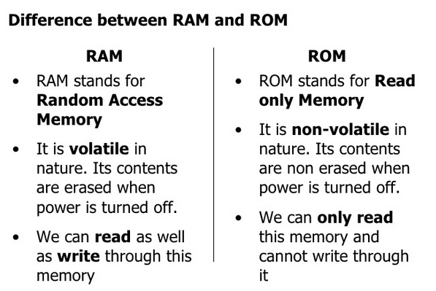
.
MemLay Presentation
Internal | RBEI/EBA1 | 14/05/2015 | © Robert Bosch Engineering and Business Solutions Private Limited 2015. All rights reserved, also regarding any disposal, exploitation, reproduction, editing, distribution, as well as in the event of applications for industrial property rights.

Slide 3
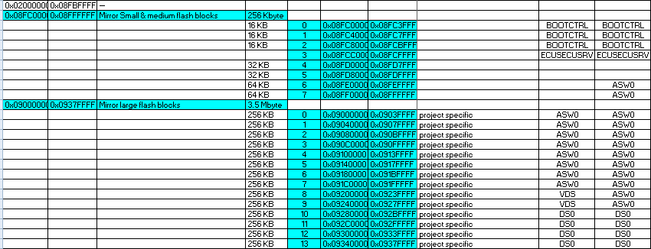

Address Map
MemLay Presentation
JDP Dev4
Internal | RBEI/EBA1 | 14/05/2015 | © Robert Bosch Engineering and Business Solutions Private Limited 2015. All rights reserved, also regarding any disposal, exploitation, reproduction, editing, distribution, as well as in the event of applications for industrial property rights.

Slide 4
Overview of Ramusage
Titel des Kapitels
Each Core has a local Data-Ram (RAMx)
Each Core has a Instruction-Ram (PRAMx)
One global Data-Ram is available (SYSRAM)
Optional RAM for calibration on special HW (EDRAM)
RamUseCases
  Drv_Ram, normal volatile (cleared after each Reset)
  Temp-Ram, can be used for BootCtrl, SB and ASW (part of Drv_Ram0)
  FixRam for BootCtrl, SB and HSM (only cleared at PowerOn)
  ProtRam (cleared at PowerOn, Trap or HW Reset)
  PORST Ram (only cleared at PowerOn)
  Free_Ram (unuse by norm SW, can be used for calibaration)
  CSA is part of Drv_Ram
  Stack is part Drv_Ram
Internal | RBEI/EBA1 | 14/05/2015 | © Robert Bosch Engineering and Business Solutions Private Limited 2015. All rights reserved, also regarding any disposal, exploitation, reproduction, editing, distribution, as well as in the event of applications for industrial property rights.

Slide 5
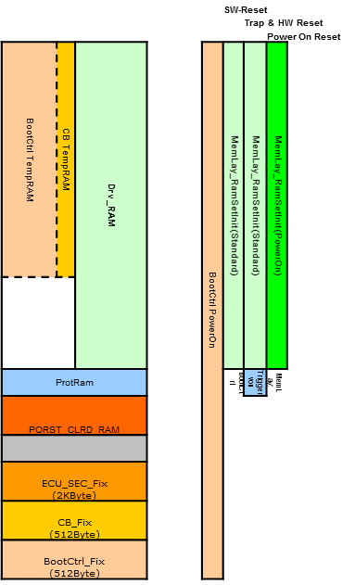
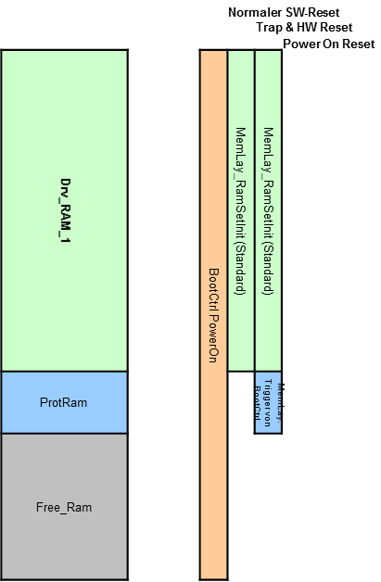
Overview of Rams and Init concept for Rams
Titel des Kapitels
RAM0
RAM1
Internal | RBEI/EBA1 | 14/05/2015 | © Robert Bosch Engineering and Business Solutions Private Limited 2015. All rights reserved, also regarding any disposal, exploitation, reproduction, editing, distribution, as well as in the event of applications for industrial property rights.

Slide 6
Init concept for Rams
Titel des Kapitels
PowerOn:
  BootCtrl clears all RAMs complete
  In ASW only TempRam of RAM0 must be cleared
SW-Reset
  BootCtrl clears only TempRam
  In ASW all TempRams were cleared
Trap & HW Reset
  BootCtrl clears only TempRam
  In ASW all TempRams were cleared
  In ASW all Prot Rams were cleared
Internal | RBEI/EBA1 | 14/05/2015 | © Robert Bosch Engineering and Business Solutions Private Limited 2015. All rights reserved, also regarding any disposal, exploitation, reproduction, editing, distribution, as well as in the event of applications for industrial property rights.

Slide 7




Linker Files (group.inv and locate.inv)
Titel des Kapitels
Sort in all variable into RAM and functions, const and init-values into Flash
group.inv
  Sort in all compiler sections into relative linker sections
  This file can be modified by the projects to change the memory layout
locate.inv
  Generate absolute linker sections
  Sort in all relative linker sections into absolute linker sections
  This file shouldn´t be modified by the projects to change the memory layout.
  Provide LinkerLabels for all sections to use this address in the code
Internal | RBEI/EBA1 | 14/05/2015 | © Robert Bosch Engineering and Business Solutions Private Limited 2015. All rights reserved, also regarding any disposal, exploitation, reproduction, editing, distribution, as well as in the event of applications for industrial property rights.

Slide 8
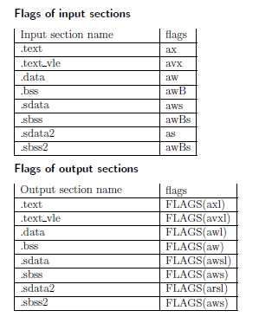
Sections
MemLay Presentation
Default Sections Section Flags:-
.text :- CODE
.data :- Initialized Variables.
.bss:- Uninitialized Variables.
.rodata :- Constants
Internal | RBEI/EBA1 | 14/05/2015 | © Robert Bosch Engineering and Business Solutions Private Limited 2015. All rights reserved, also regarding any disposal, exploitation, reproduction, editing, distribution, as well as in the event of applications for industrial property rights.

Slide 9

MemMap
MemLay Presentation
Bsw_MemMap.h file is a central file containing definition of the sections.
A module specific MemMap.h file is references the Bsw_MemMap.h file for pragma definition.
E.g of pragma definition
# pragma section “.bss.ram0” awB
int a;
int b;
#pragma section
Internal | RBEI/EBA1 | 14/05/2015 | © Robert Bosch Engineering and Business Solutions Private Limited 2015. All rights reserved, also regarding any disposal, exploitation, reproduction, editing, distribution, as well as in the event of applications for industrial property rights.

