Slide 1
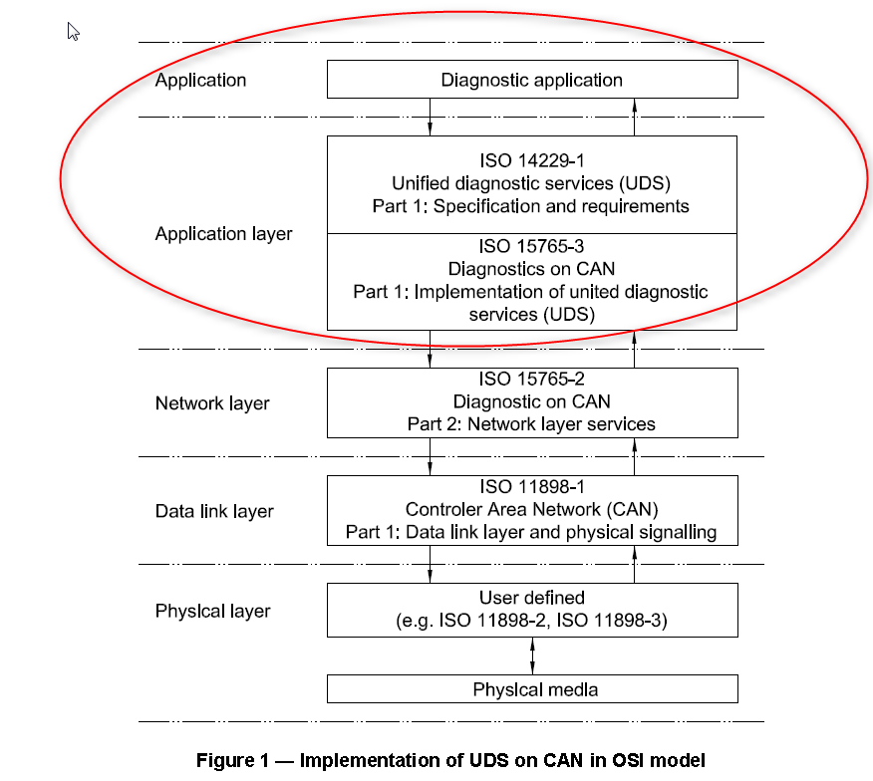
OSI Model
UDS
1
Internal | RBEI/ECA | 12/09/2016
© Robert Bosch Engineering and Business Solutions Private Limited 2016. All rights reserved, also regarding any disposal, exploitation, reproduction, editing, distribution, as well as in the event of applications for industrial property rights.

Slide 2
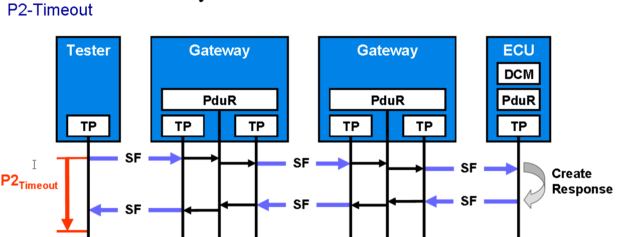
Protocol timings
UDS
2
Internal | RBEI/ECA | 12/09/2016
© Robert Bosch Engineering and Business Solutions Private Limited 2016. All rights reserved, also regarding any disposal, exploitation, reproduction, editing, distribution, as well as in the event of applications for industrial property rights.

Slide 3
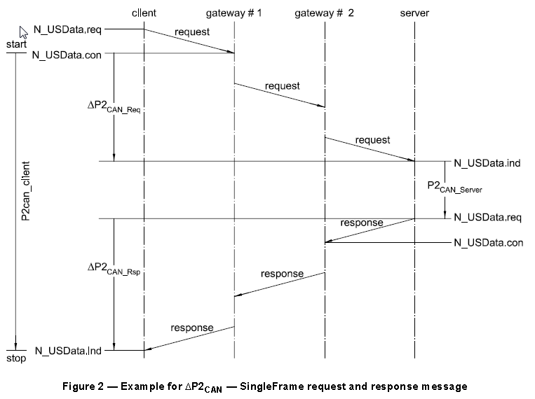
P2 Time Design
UDS
P2CAN_Server protocol specifies Max 50ms
P2CAN_Client should be Min P2CAN_Server_max+ΔP2CAN. Max decided by system design
3
Internal | RBEI/ECA | 12/09/2016
© Robert Bosch Engineering and Business Solutions Private Limited 2016. All rights reserved, also regarding any disposal, exploitation, reproduction, editing, distribution, as well as in the event of applications for industrial property rights.

Slide 4
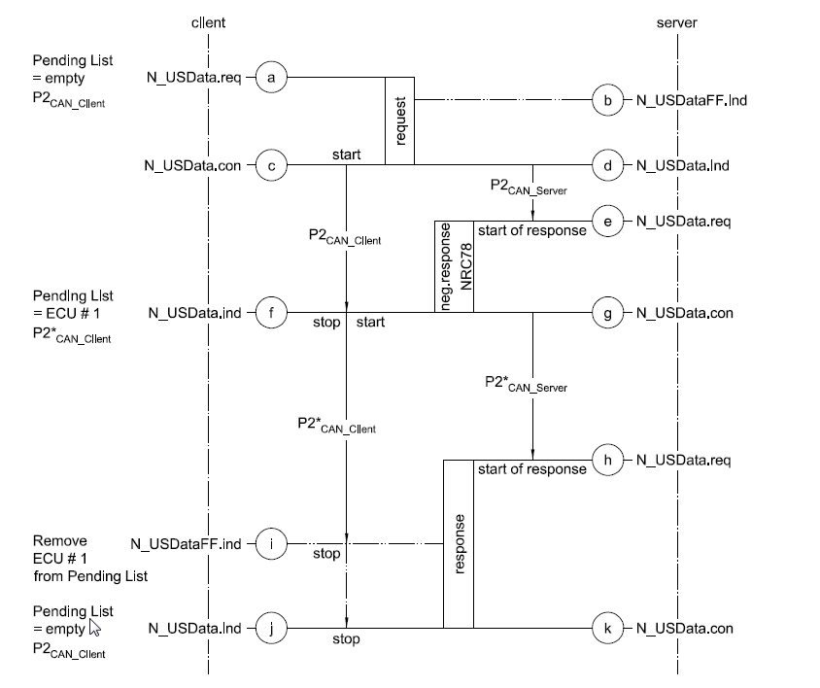
Enhanced Response Time
UDS
P2* Time
NRC 78
4
Internal | RBEI/ECA | 12/09/2016
© Robert Bosch Engineering and Business Solutions Private Limited 2016. All rights reserved, also regarding any disposal, exploitation, reproduction, editing, distribution, as well as in the event of applications for industrial property rights.

Slide 5
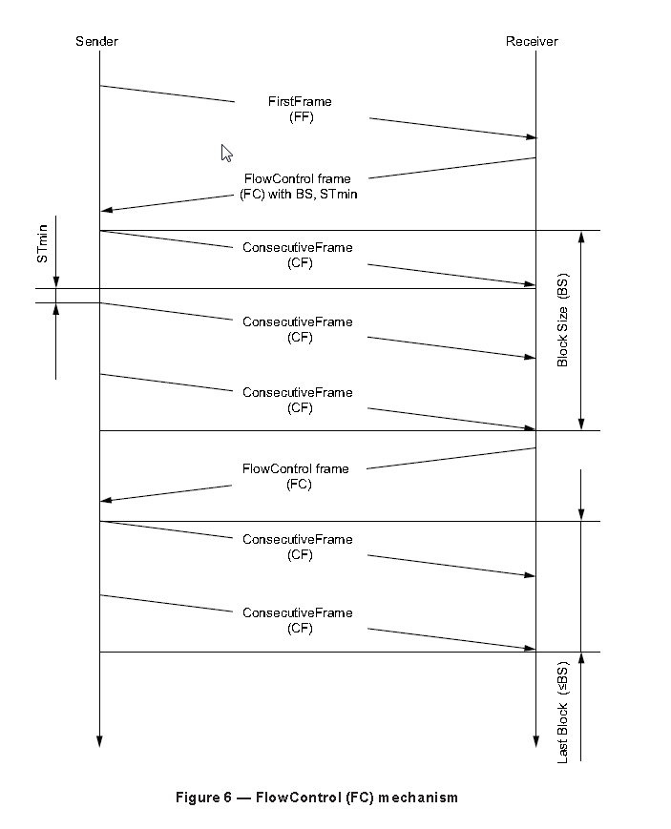
Flow control
UDS
5
Internal | RBEI/ECA | 12/09/2016
© Robert Bosch Engineering and Business Solutions Private Limited 2016. All rights reserved, also regarding any disposal, exploitation, reproduction, editing, distribution, as well as in the event of applications for industrial property rights.

Slide 6
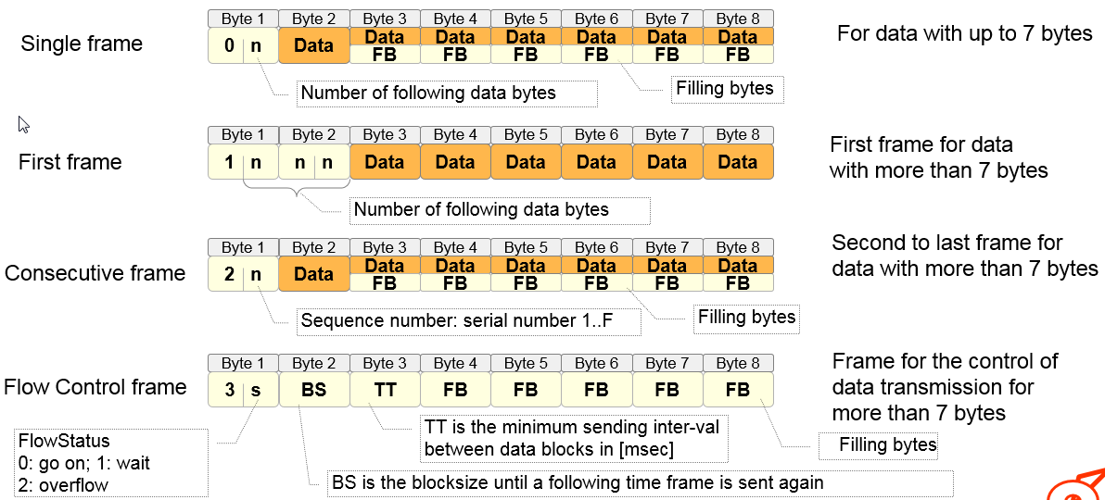
Multi frame data
UDS
6
Internal | RBEI/ECA | 12/09/2016
© Robert Bosch Engineering and Business Solutions Private Limited 2016. All rights reserved, also regarding any disposal, exploitation, reproduction, editing, distribution, as well as in the event of applications for industrial property rights.

Slide 7
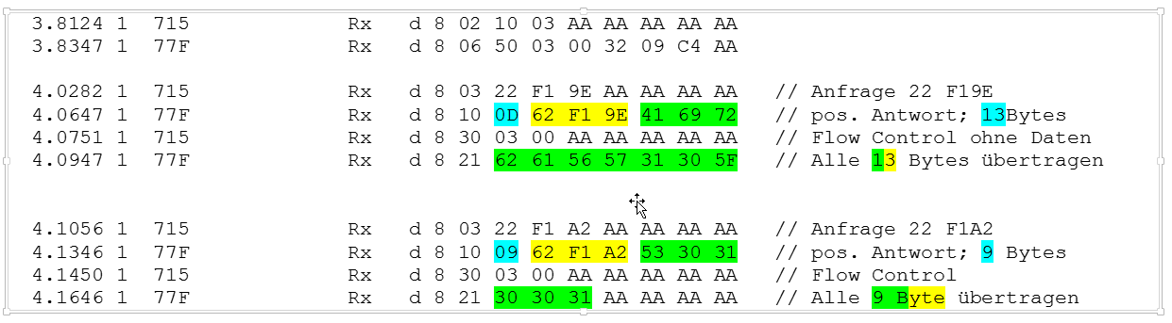
Example
UDS
7
Internal | RBEI/ECA | 12/09/2016
© Robert Bosch Engineering and Business Solutions Private Limited 2016. All rights reserved, also regarding any disposal, exploitation, reproduction, editing, distribution, as well as in the event of applications for industrial property rights.

Slide 8
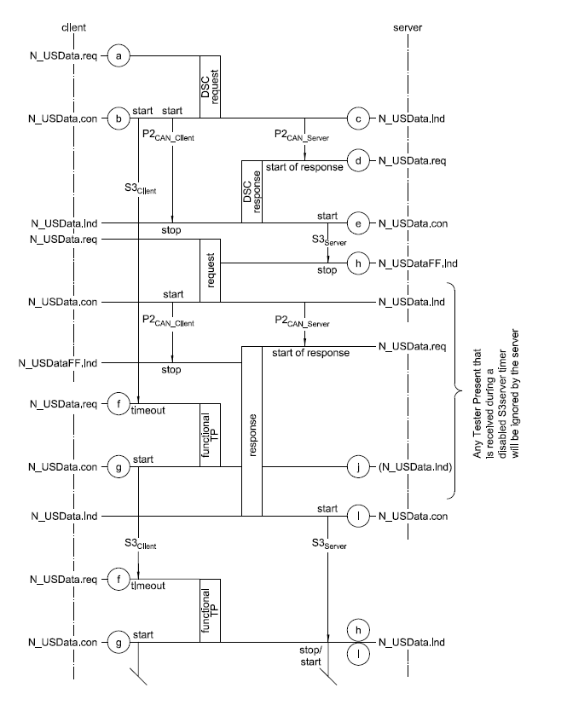
S3 Timeout
UDS
8
Internal | RBEI/ECA | 12/09/2016
© Robert Bosch Engineering and Business Solutions Private Limited 2016. All rights reserved, also regarding any disposal, exploitation, reproduction, editing, distribution, as well as in the event of applications for industrial property rights.

Slide 9
Request structure
UDS
CAN ID
SID
Parameter
Data
Data as per requirements
SSID/DID
Service identifier
Every control unit has two unambiguous CAN IDs for request and response
9
Internal | RBEI/ECA | 12/09/2016
© Robert Bosch Engineering and Business Solutions Private Limited 2016. All rights reserved, also regarding any disposal, exploitation, reproduction, editing, distribution, as well as in the event of applications for industrial property rights.

Slide 10
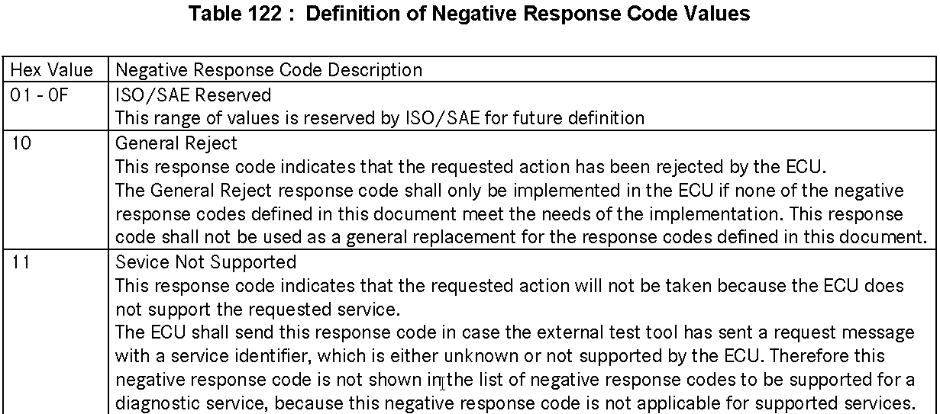
Negative response
UDS
CAN ID
7FH
SID
NRC – Negative response code
10
Internal | RBEI/ECA | 12/09/2016
© Robert Bosch Engineering and Business Solutions Private Limited 2016. All rights reserved, also regarding any disposal, exploitation, reproduction, editing, distribution, as well as in the event of applications for industrial property rights.

Slide 11
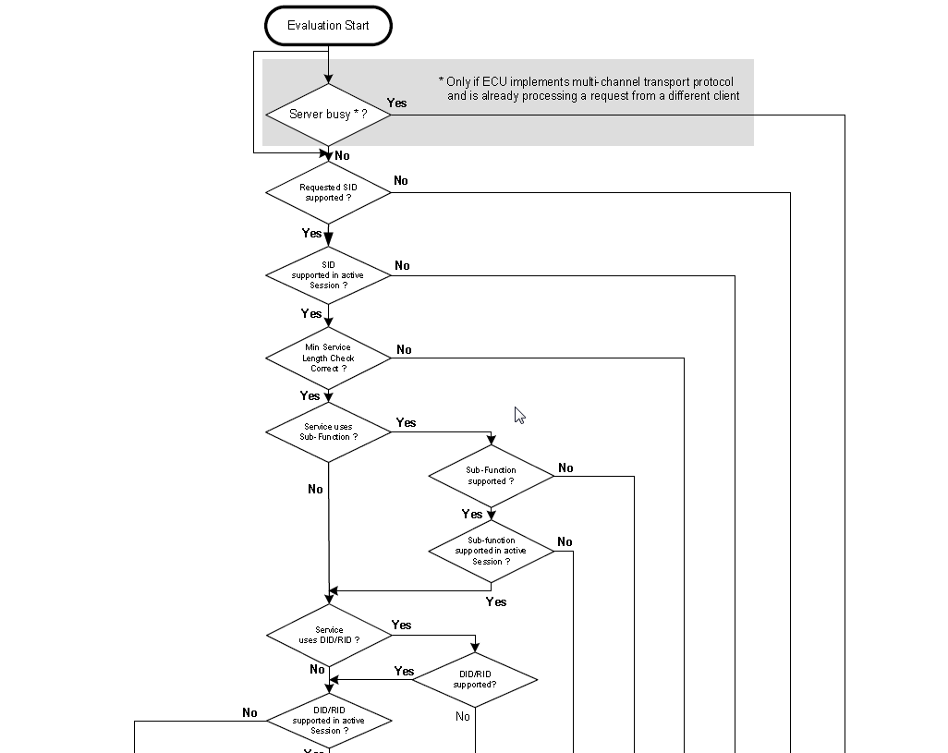
NRC priority - 1
UDS
11
Internal | RBEI/ECA | 12/09/2016
© Robert Bosch Engineering and Business Solutions Private Limited 2016. All rights reserved, also regarding any disposal, exploitation, reproduction, editing, distribution, as well as in the event of applications for industrial property rights.

Slide 12
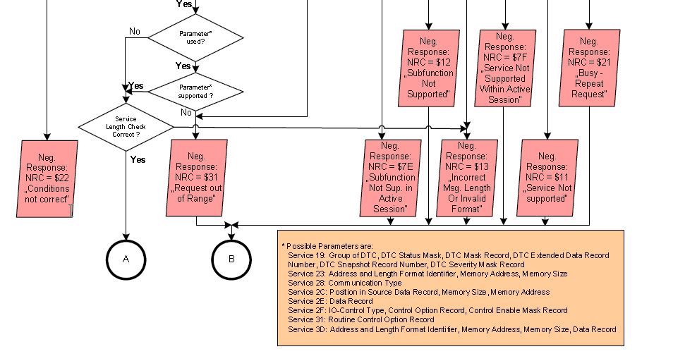
NRC priority - 2
UDS
12
Internal | RBEI/ECA | 12/09/2016
© Robert Bosch Engineering and Business Solutions Private Limited 2016. All rights reserved, also regarding any disposal, exploitation, reproduction, editing, distribution, as well as in the event of applications for industrial property rights.

Slide 13
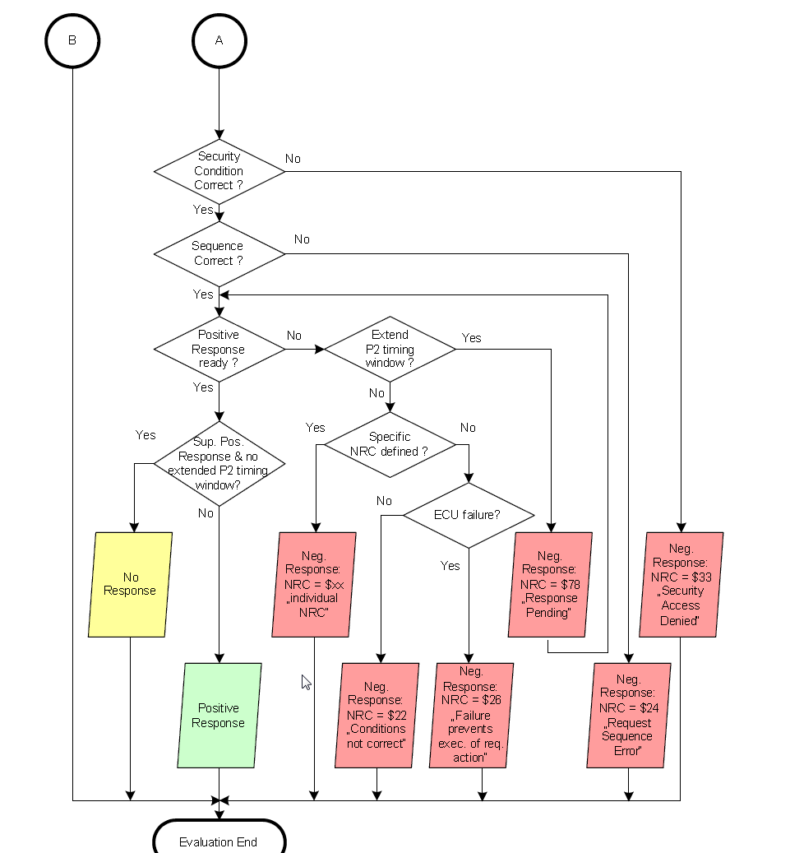
NRC priority - 3
UDS
13
Internal | RBEI/ECA | 12/09/2016
© Robert Bosch Engineering and Business Solutions Private Limited 2016. All rights reserved, also regarding any disposal, exploitation, reproduction, editing, distribution, as well as in the event of applications for industrial property rights.

Slide 14
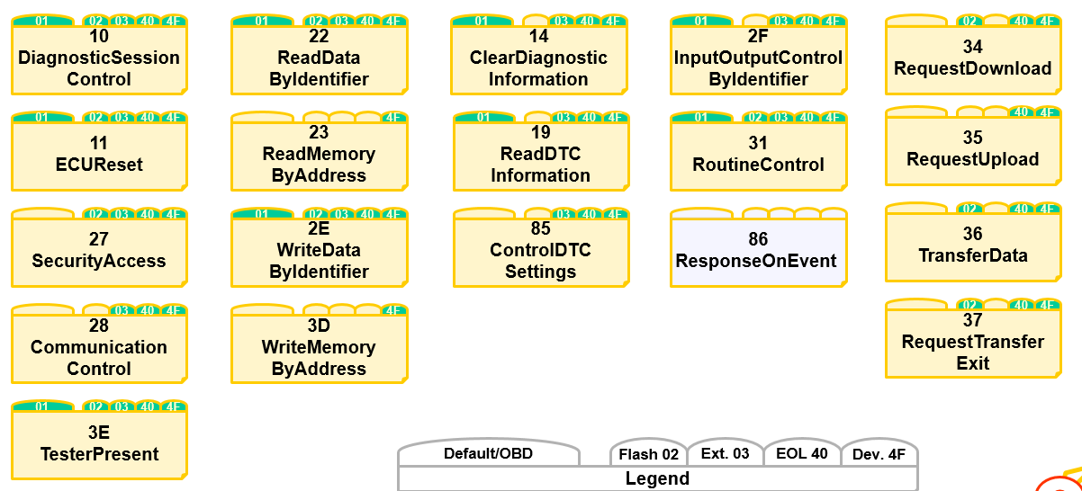
Services and sessions
UDS
14
Internal | RBEI/ECA | 12/09/2016
© Robert Bosch Engineering and Business Solutions Private Limited 2016. All rights reserved, also regarding any disposal, exploitation, reproduction, editing, distribution, as well as in the event of applications for industrial property rights.

Slide 15
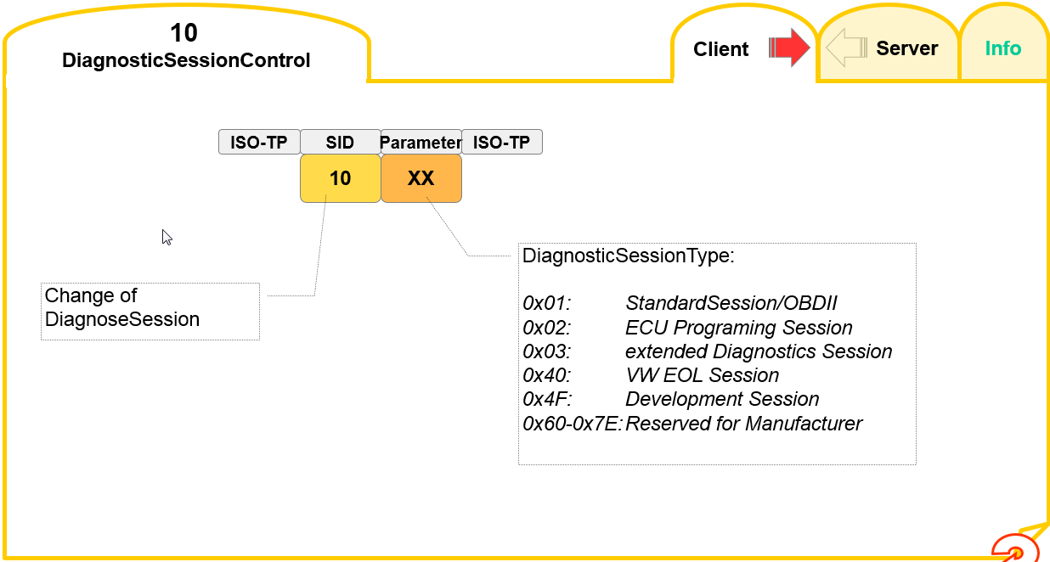
SID – 10. Request
UDS
15
Internal | RBEI/ECA | 12/09/2016
© Robert Bosch Engineering and Business Solutions Private Limited 2016. All rights reserved, also regarding any disposal, exploitation, reproduction, editing, distribution, as well as in the event of applications for industrial property rights.

Slide 16
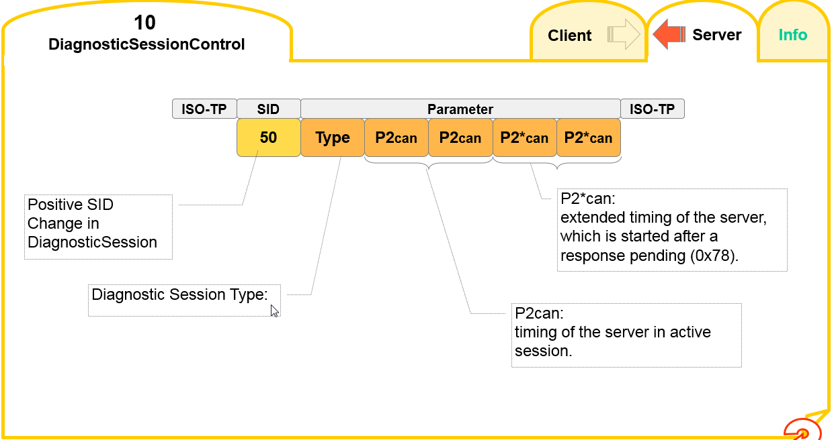
SID – 10. Response
UDS
16
Internal | RBEI/ECA | 12/09/2016
© Robert Bosch Engineering and Business Solutions Private Limited 2016. All rights reserved, also regarding any disposal, exploitation, reproduction, editing, distribution, as well as in the event of applications for industrial property rights.

Slide 17
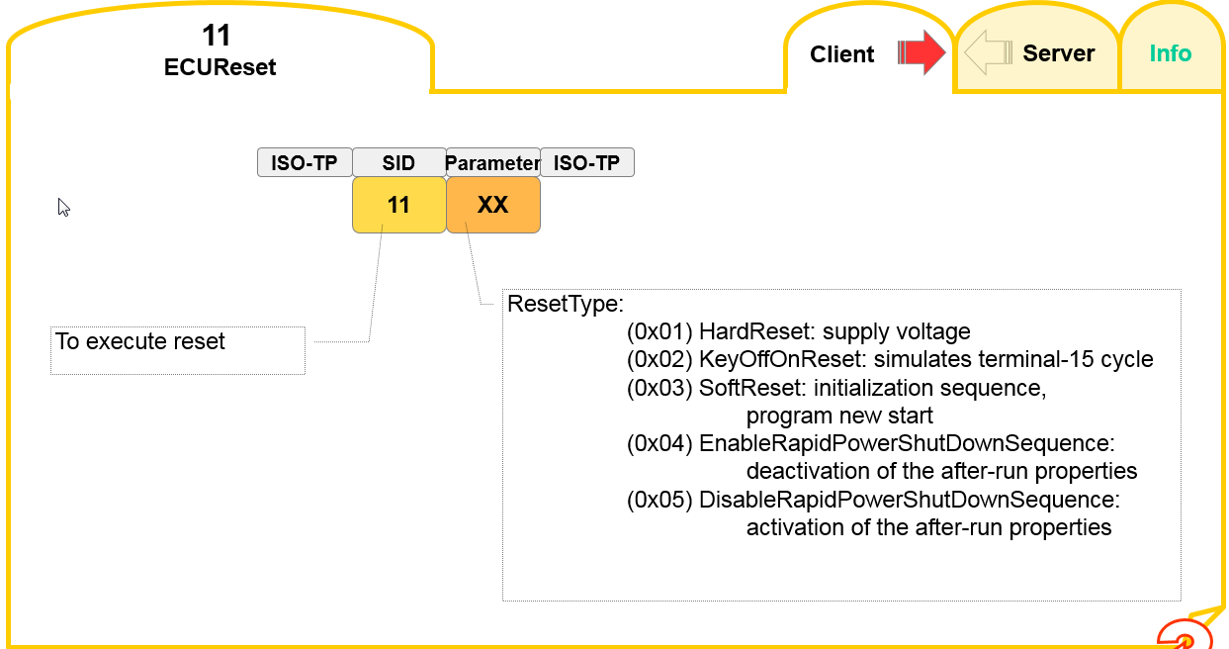
SID – 11. Request
UDS
17
Internal | RBEI/ECA | 12/09/2016
© Robert Bosch Engineering and Business Solutions Private Limited 2016. All rights reserved, also regarding any disposal, exploitation, reproduction, editing, distribution, as well as in the event of applications for industrial property rights.

Slide 18
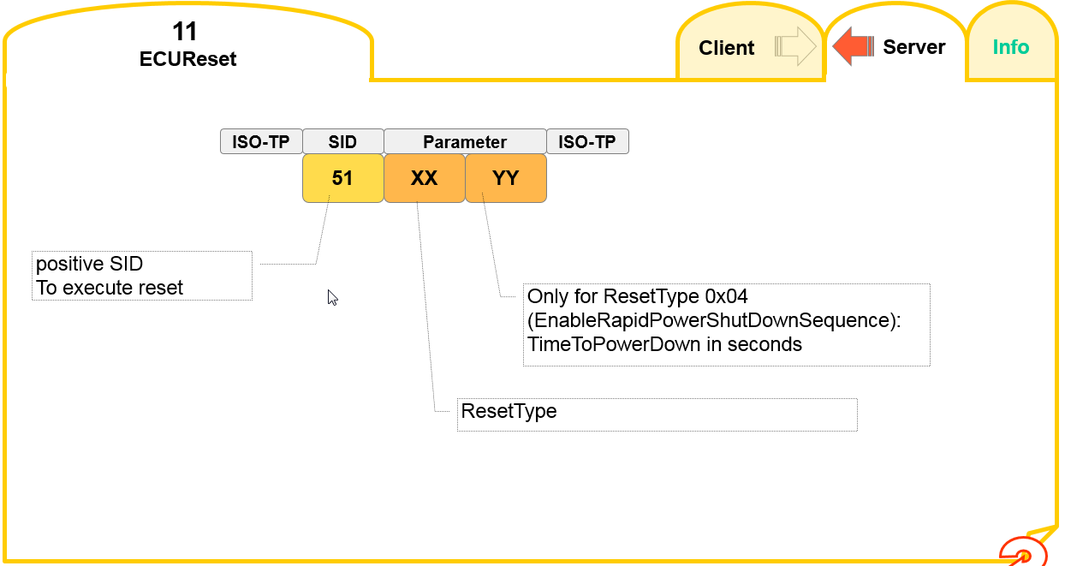
SID - 11. Response
UDS
18
Internal | RBEI/ECA | 12/09/2016
© Robert Bosch Engineering and Business Solutions Private Limited 2016. All rights reserved, also regarding any disposal, exploitation, reproduction, editing, distribution, as well as in the event of applications for industrial property rights.

Slide 19
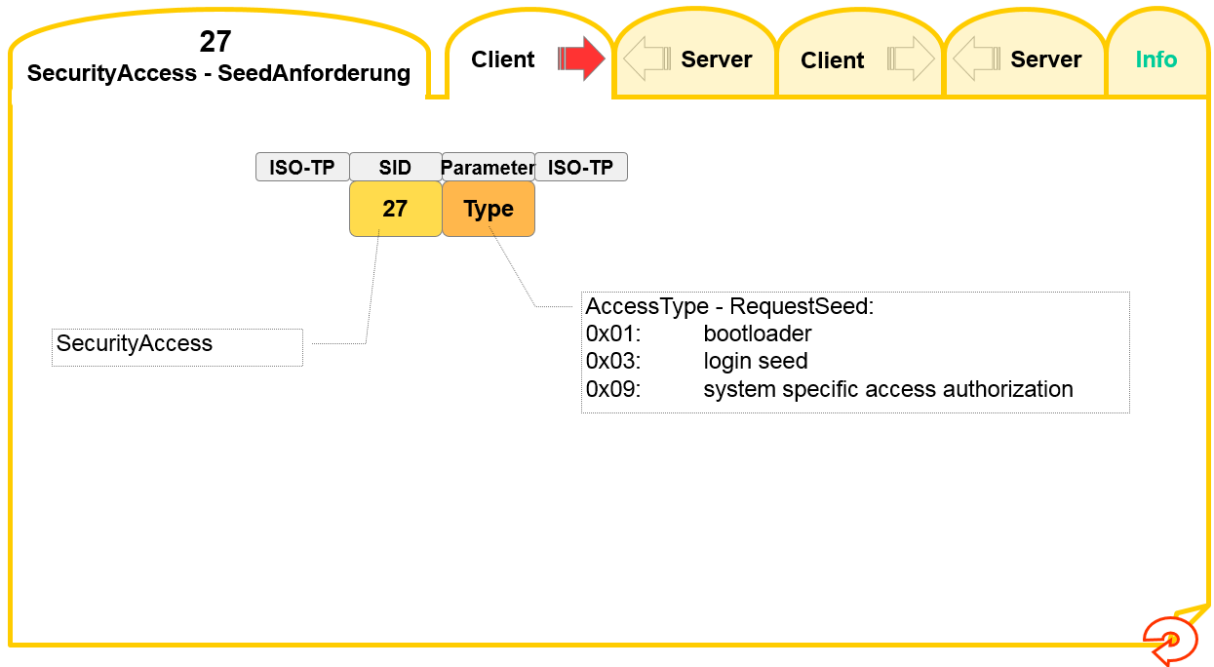
SID – 27. Request-1
UDS
19
Internal | RBEI/ECA | 12/09/2016
© Robert Bosch Engineering and Business Solutions Private Limited 2016. All rights reserved, also regarding any disposal, exploitation, reproduction, editing, distribution, as well as in the event of applications for industrial property rights.

Slide 20
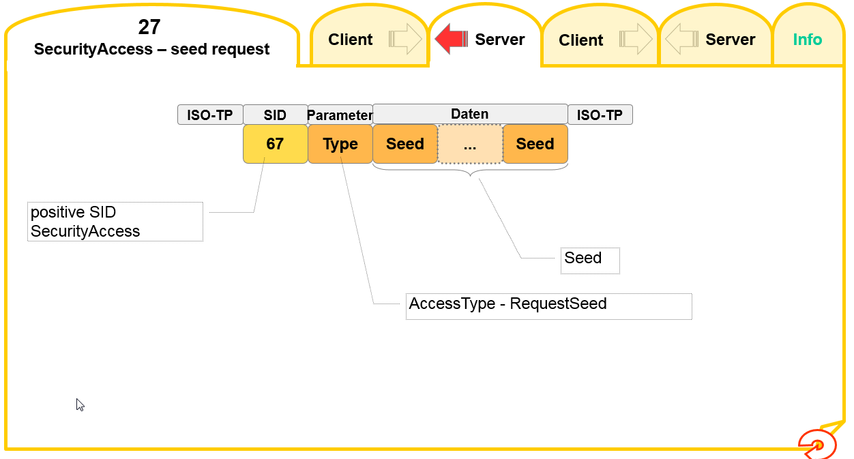
SID – 27. Response-1
UDS
20
Internal | RBEI/ECA | 12/09/2016
© Robert Bosch Engineering and Business Solutions Private Limited 2016. All rights reserved, also regarding any disposal, exploitation, reproduction, editing, distribution, as well as in the event of applications for industrial property rights.

Slide 21
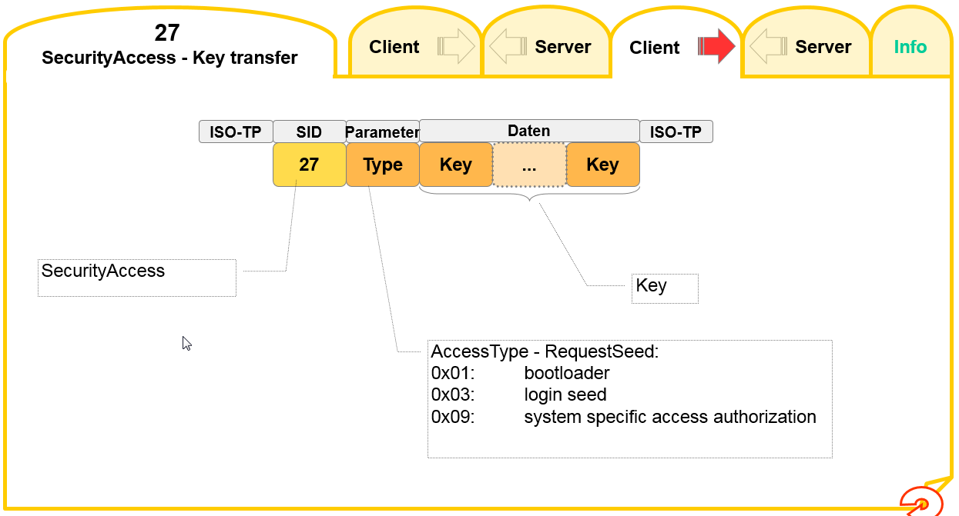
SID – 27. Request-2
UDS
21
Internal | RBEI/ECA | 12/09/2016
© Robert Bosch Engineering and Business Solutions Private Limited 2016. All rights reserved, also regarding any disposal, exploitation, reproduction, editing, distribution, as well as in the event of applications for industrial property rights.

Slide 22
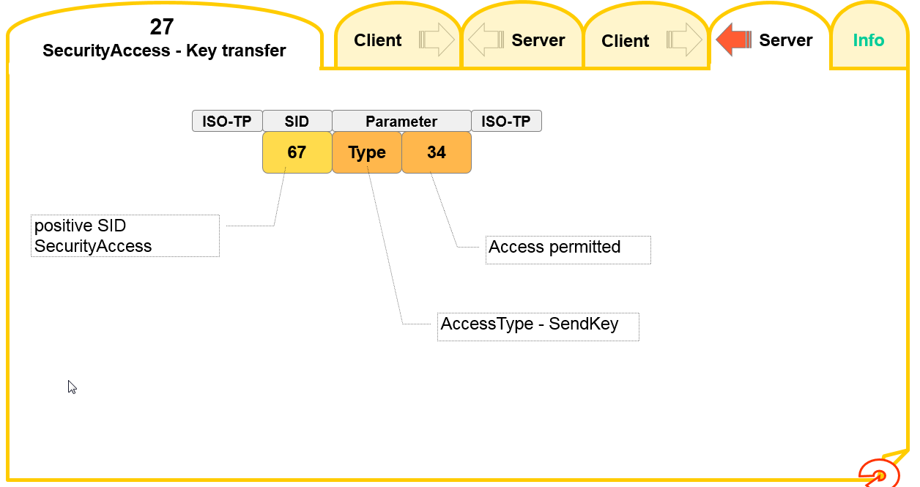
SID – 27. Response-2
UDS
22
Internal | RBEI/ECA | 12/09/2016
© Robert Bosch Engineering and Business Solutions Private Limited 2016. All rights reserved, also regarding any disposal, exploitation, reproduction, editing, distribution, as well as in the event of applications for industrial property rights.

Slide 23
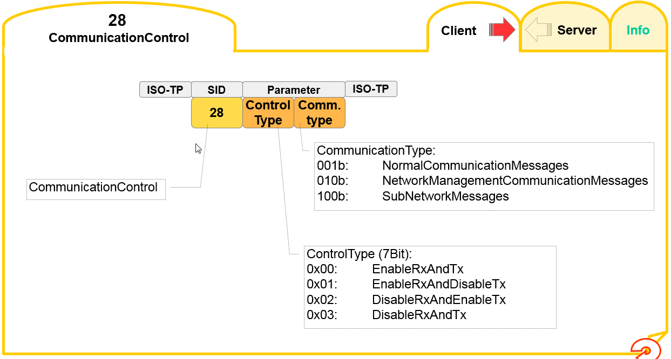
SID – 28. Request
UDS
23
Internal | RBEI/ECA | 12/09/2016
© Robert Bosch Engineering and Business Solutions Private Limited 2016. All rights reserved, also regarding any disposal, exploitation, reproduction, editing, distribution, as well as in the event of applications for industrial property rights.

Slide 24
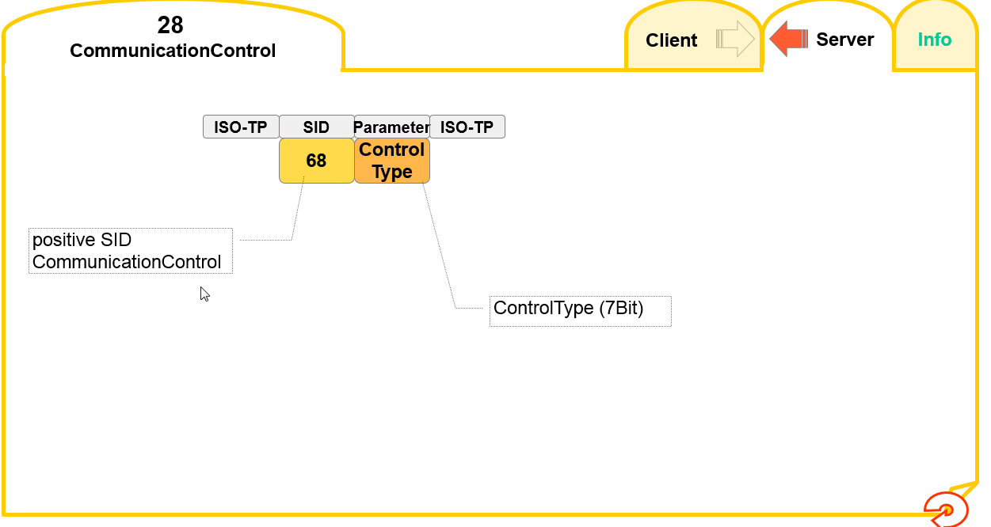
SID – 28. Response
UDS
24
Internal | RBEI/ECA | 12/09/2016
© Robert Bosch Engineering and Business Solutions Private Limited 2016. All rights reserved, also regarding any disposal, exploitation, reproduction, editing, distribution, as well as in the event of applications for industrial property rights.

Slide 25
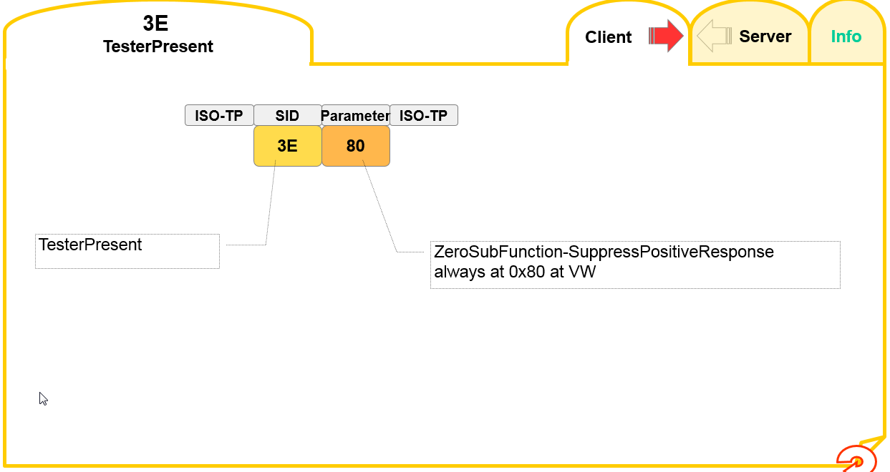
SID – 3E. Request
UDS
25
Internal | RBEI/ECA | 12/09/2016
© Robert Bosch Engineering and Business Solutions Private Limited 2016. All rights reserved, also regarding any disposal, exploitation, reproduction, editing, distribution, as well as in the event of applications for industrial property rights.

Slide 26
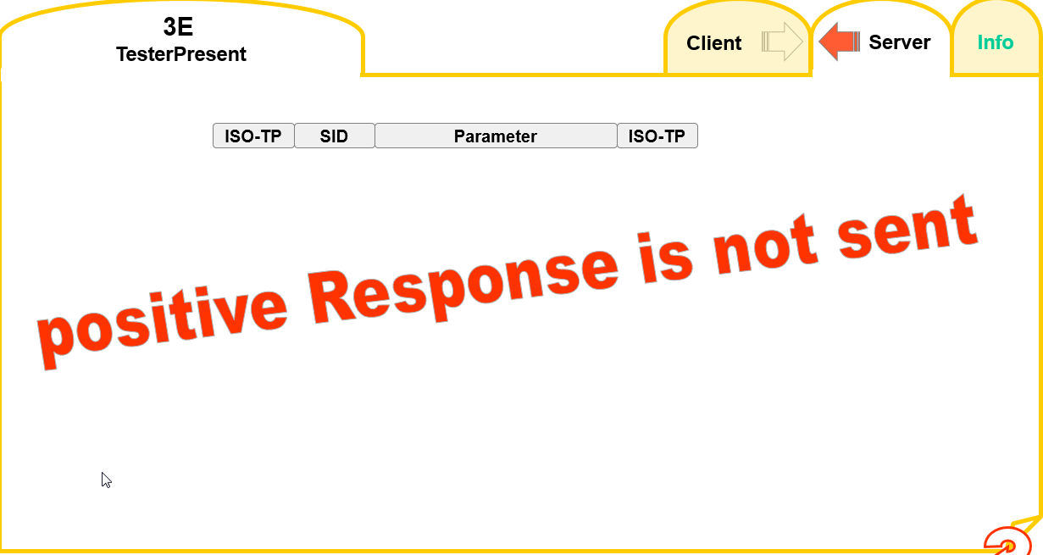
SID – 3E. Response
UDS
26
Internal | RBEI/ECA | 12/09/2016
© Robert Bosch Engineering and Business Solutions Private Limited 2016. All rights reserved, also regarding any disposal, exploitation, reproduction, editing, distribution, as well as in the event of applications for industrial property rights.

Slide 27
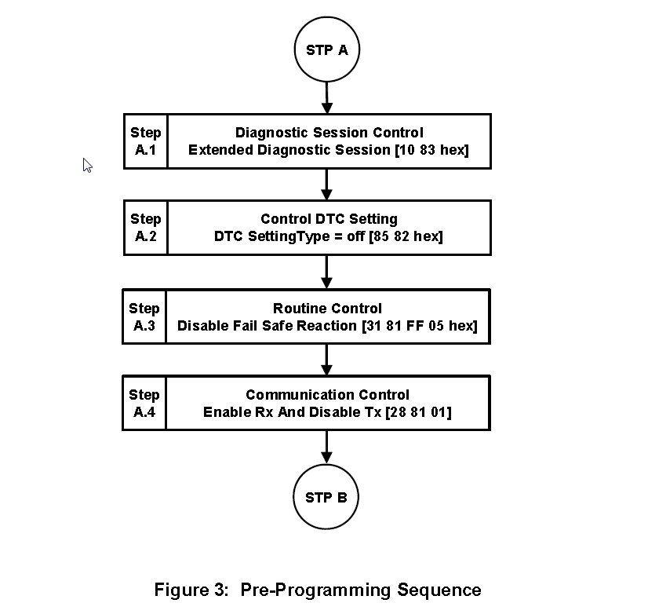
Use case – Download - 1
UDS
This use case is provided to demonstrate different diagnostics services usage
27
Internal | RBEI/ECA | 12/09/2016
© Robert Bosch Engineering and Business Solutions Private Limited 2016. All rights reserved, also regarding any disposal, exploitation, reproduction, editing, distribution, as well as in the event of applications for industrial property rights.

Slide 28
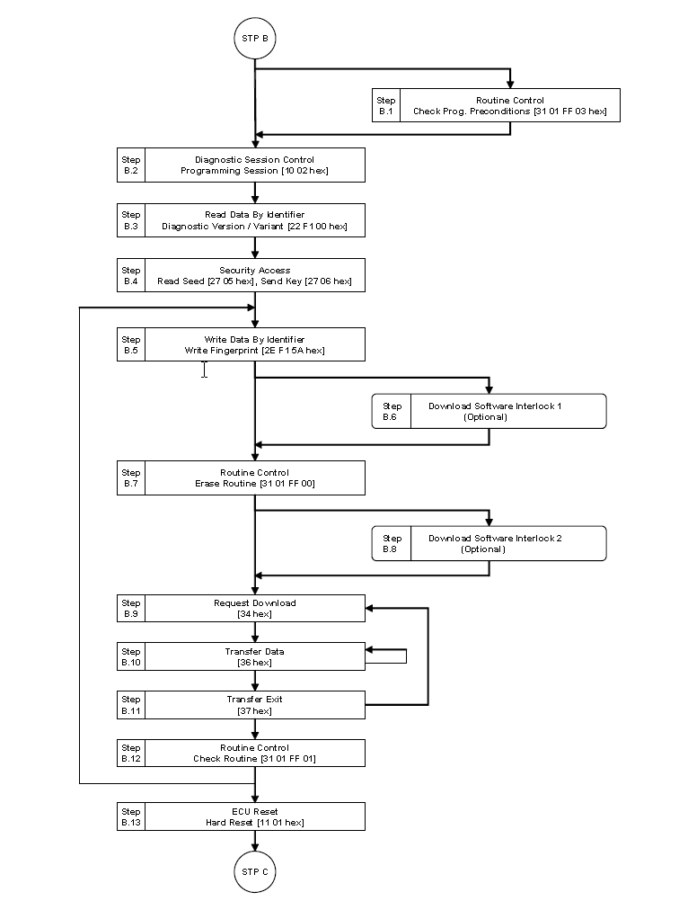
Use case – Download - 2
UDS
28
Internal | RBEI/ECA | 12/09/2016
© Robert Bosch Engineering and Business Solutions Private Limited 2016. All rights reserved, also regarding any disposal, exploitation, reproduction, editing, distribution, as well as in the event of applications for industrial property rights.

Slide 29
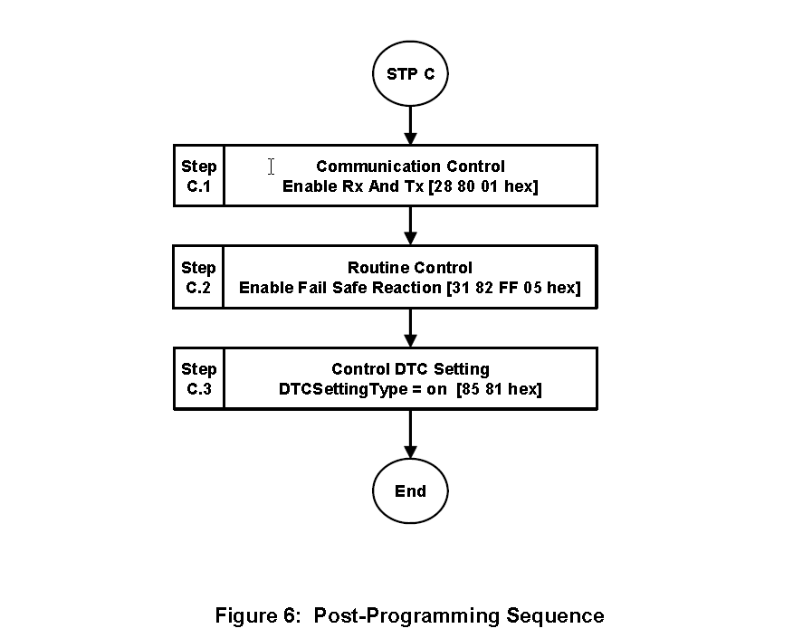
Use case – Download - 3
UDS
29
Internal | RBEI/ECA | 12/09/2016
© Robert Bosch Engineering and Business Solutions Private Limited 2016. All rights reserved, also regarding any disposal, exploitation, reproduction, editing, distribution, as well as in the event of applications for industrial property rights.

