Slide 1

MDG1 BSW Mcal Expert Training – Dio
Dio
Digital Input Output
Cross Divisional Group - Software, Methods and Tools
Internal | CDG-SMT/ESS | 2015-11-20 | © Robert Bosch GmbH 2015. All rights reserved, also regarding any disposal, exploitation, reproduction, editing, distribution, as well as in the event of applications for industrial property rights.

Slide 2
Overview
MDG1 BSW Mcal Expert Training – Dio
The Dio Mcal provides
Configuration Interface for
Microcontroller port pins / ports
C-API for
Reading from microcontroller port pins
Writing to microcontroller port pins
Reading of a complete port
Cross Divisional Group - Software, Methods and Tools
Internal | CDG-SMT/ESS | 2015-11-20 | © Robert Bosch GmbH 2015. All rights reserved, also regarding any disposal, exploitation, reproduction, editing, distribution, as well as in the event of applications for industrial property rights.

Slide 3
Io Stack Architecture
MDG1 BSW Mcal Expert Training – Dio
IoSigDio
IoMcuDio
External Devices
…
External Devices
Dio
Port
Cross Divisional Group - Software, Methods and Tools
Internal | CDG-SMT/ESS | 2015-11-20 | © Robert Bosch GmbH 2015. All rights reserved, also regarding any disposal, exploitation, reproduction, editing, distribution, as well as in the event of applications for industrial property rights.

Slide 4
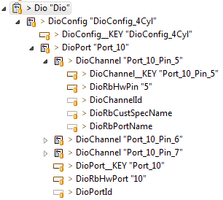
Configuration structure
MDG1 BSW Mcal Expert Training – Dio
PostBuild Name
Port Container ShortName
Name which is used for Dio_ReadChannel / Dio_WriteChannel API. In this case
DioConf_DioChannel_Port_10_Pin_5
Hardware Pin number
Alternative name only visible in report
This needs to be empty.
Content is pushed by Dio script
Name which is used for
Dio_ReadPort
API.
DioConf_DioRbPortName_<Name>
The identifier must be equal for both tags
Hardware Port identifier
Cross Divisional Group - Software, Methods and Tools
Internal | CDG-SMT/ESS | 2015-11-20 | © Robert Bosch GmbH 2015. All rights reserved, also regarding any disposal, exploitation, reproduction, editing, distribution, as well as in the event of applications for industrial property rights.

Slide 5
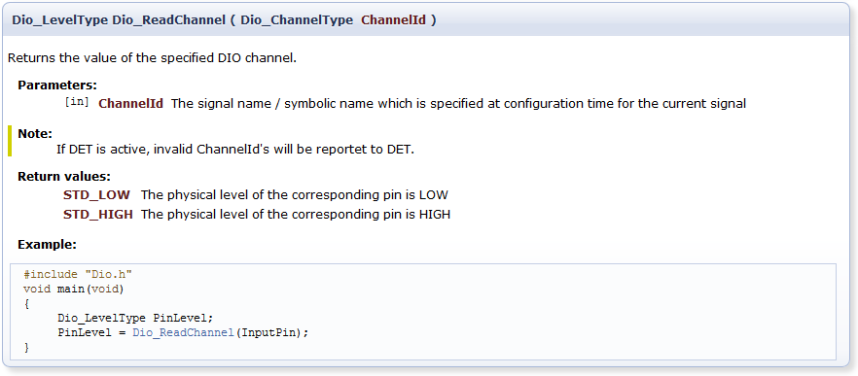
Dio_ReadChannel API
MDG1 BSW Mcal Expert Training – Dio
Cross Divisional Group - Software, Methods and Tools
Internal | CDG-SMT/ESS | 2015-11-20 | © Robert Bosch GmbH 2015. All rights reserved, also regarding any disposal, exploitation, reproduction, editing, distribution, as well as in the event of applications for industrial property rights.

Slide 6
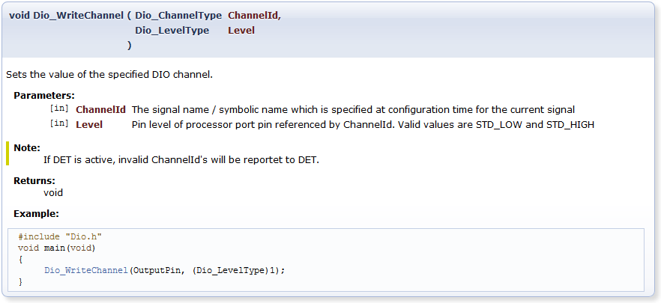
Dio_WriteChannel API
MDG1 BSW Mcal Expert Training – Dio
Cross Divisional Group - Software, Methods and Tools
Internal | CDG-SMT/ESS | 2015-11-20 | © Robert Bosch GmbH 2015. All rights reserved, also regarding any disposal, exploitation, reproduction, editing, distribution, as well as in the event of applications for industrial property rights.

Slide 7
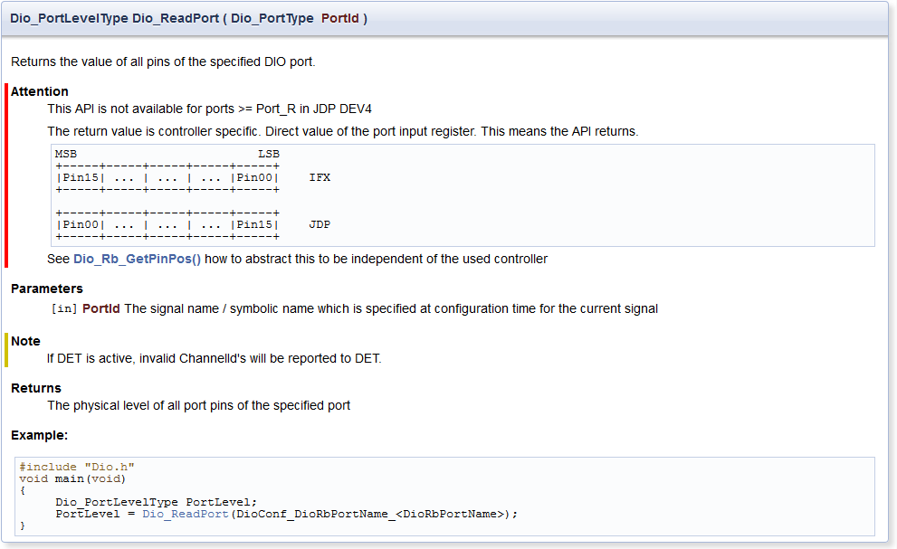
Dio_ReadPort API
MDG1 BSW Mcal Expert Training – Dio
Cross Divisional Group - Software, Methods and Tools
Internal | CDG-SMT/ESS | 2015-11-20 | © Robert Bosch GmbH 2015. All rights reserved, also regarding any disposal, exploitation, reproduction, editing, distribution, as well as in the event of applications for industrial property rights.

Slide 8
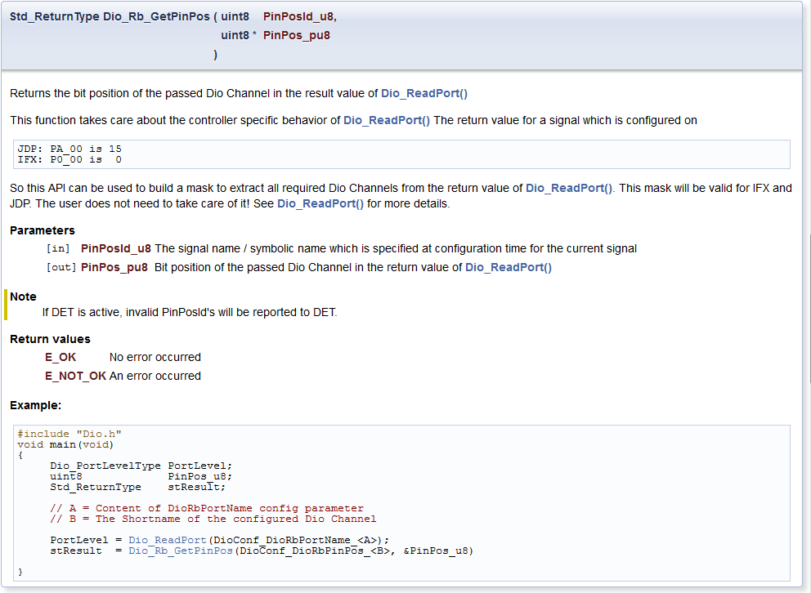
Dio_Rb_GetPinPos API
MDG1 BSW Mcal Expert Training – Dio
Cross Divisional Group - Software, Methods and Tools
Internal | CDG-SMT/ESS | 2015-11-20 | © Robert Bosch GmbH 2015. All rights reserved, also regarding any disposal, exploitation, reproduction, editing, distribution, as well as in the event of applications for industrial property rights.

Slide 9
Configuration for ReadPort usage
MDG1 BSW Mcal Expert Training – Dio
Manual
configuration
rba_IoMcuDio_ConfigSet "rba_IoMcuDio_ConfigSet_4Cyl"{
rba_IoMcuDio_SignalDio "FscQcv_Start1"{
rba_IoMcuDio_Connector = "DIO_00_02"
rba_IoMcuDio_Direction = "Input"
rba_IoMcuDio_DirectionChangeable = false
}
}
DioConfig "DioConfig_4Cyl"{
DioPort "Port_00"{
DioChannel "FscQcv_Start1"{
DioRbPortName = "FscPort"
}
}
}
Merged configuration
DioConfig "DioConfig_4Cyl"
{
DioPort "Port_00"
{
DioRbHwPort = "0"
DioChannel "FscQcv_Start1"
{
DioRbHwPin = 2
DioRbPortName = "FscPort"
}
}
}
PortConfigSet "PortConfigSet_4Cyl"
{
PortContainer "Port_00"
{
PortPin "FscQcv_Start1"
{
PortPinDirection = "PORT_PIN_DIRECTION_INPUT"
PortPinDirectionChangeable = false
PortPinInitialMode = "PORT_PIN_MODE_OUTPUT_DIO"
PortPinRbHwConnector = "PORT_00_02"
PortPinMode = "PORT_PIN_MODE_OUTPUT_DIO"
PortPinModeChangeable = false
}
}
}
The final configuration is forwarded by rba_IoMcuDio to Dio and Port → so they are always consistent. The manual Dio configuration is also merged with the forwarded one.
Cross Divisional Group - Software, Methods and Tools
Internal | CDG-SMT/ESS | 2015-11-20 | © Robert Bosch GmbH 2015. All rights reserved, also regarding any disposal, exploitation, reproduction, editing, distribution, as well as in the event of applications for industrial property rights.

Slide 10
ReadPort API usage in C
MDG1 BSW Mcal Expert Training – Dio
#include "Std_Types.h"
#include "Dio.h"
// Configured Names: DioRbPortName = FscPort, DioChannel = FscQcv_Start1, DioChannel = FscQcv_Start2
//
// The final result variable (FscQcv_Signal_u8) should have the following format for IFX and JDP
// and be independent of the hardware assignment of the FscQcv_Start1, FscQcv_Start2 hardware pin
// MSB LSB
// +-----+-----+-----+---------------+---------------+
// | ... | ... | ... | FscQcv_Start2 | FscQcv_Start1 |
// +-----+-----+-----+---------------+---------------+
void foo(void)
{
Dio_PortLevelType PortLevel;
Std_ReturnType stResult;
uint8 FscQcv_Start1Pos_u8;
uint8 FscQcv_Start2Pos_u8;
uint8 FscQcv_Signal_u8;
stResult = Dio_Rb_GetPinPos(DioConf_DioRbPinPos_FscQcv_Start1, &FscQcv_Start1Pos_u8);
stResult = Dio_Rb_GetPinPos(DioConf_DioRbPinPos_FscQcv_Start2, &FscQcv_Start2Pos_u8);
// Check stResult for E_OK and do error handling
PortLevel = Dio_ReadPort(DioConf_DioRbPortName_FscPort);
FscQcv_Signal_u8 =
((PortLevel & (1 << FscQcv_Start2Pos_u8)) >> (FscQcv_Start2Pos_u8 - 1)) |
((PortLevel & (1 << FscQcv_Start1Pos_u8)) >> (FscQcv_Start1Pos_u8 - 0));
}
Cross Divisional Group - Software, Methods and Tools
Internal | CDG-SMT/ESS | 2015-11-20 | © Robert Bosch GmbH 2015. All rights reserved, also regarding any disposal, exploitation, reproduction, editing, distribution, as well as in the event of applications for industrial property rights.

Slide 11
Further Info
MDG1 BSW Mcal Expert Training – Dio
Cubas Dio Intranet: \\bosch.com\dfsrb\DfsDE\DIV\CDG\Prj\CUBAS\40_IoStack\10_Mcal\10_IFX_JDP\12_Dio\Dio-Intranet\Dio.htm
Connect https://connect.bosch.com/wikis/home/wiki/Wfcd673234084_44d1_a72b_f4889ef65cfb/page/Dio
Cross Divisional Group - Software, Methods and Tools
Internal | CDG-SMT/ESS | 2015-11-20 | © Robert Bosch GmbH 2015. All rights reserved, also regarding any disposal, exploitation, reproduction, editing, distribution, as well as in the event of applications for industrial property rights.

