Slide 1
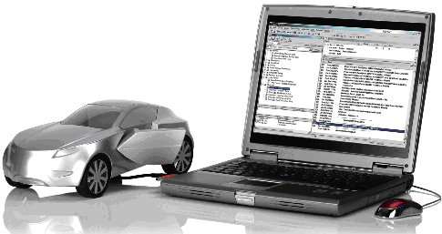

Flash Boot-Loader
Agenda
Flash Boot Loader
————————————
Introduction
————————————
Architecture
————————————
Memory Layout
————————————
Fun(1): Start Up
————————————
Fun(2): Reprogramming
————————————
Reprogramming
————————————
Diagnostics
————————————
Features
————————————
AUTOSAR Boot block
RBEI\EAR | 1/16/2012 | © Robert Bosch Engineering and Business Solutions Limited 2012. All rights reserved, also regarding any disposal, exploitation, reproduction, editing, distribution, as well as in the event of applications for industrial property rights.

Slide 2
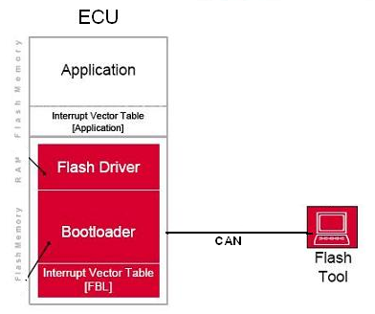




Flash Boot-Loader
Introduction
Agenda
————————————
FBL is a Stand alone program, that initializes the device.
Special feature of FBL is to reprogram the application software on need basis.
Introduction
————————————
Architecture
————————————
Memory Layout
————————————
Fun(1): Start Up
————————————
Fun(2): Reprogramming
————————————
Where is it used ?
Reprogramming
————————————
Diagnostics
————————————
Features
... during the development phase:
internal and customer samples
————————————
AUTOSAR Boot block
... during manufacturing phase:
end of Line, Stock, Transfer
... during product lifetime:
service, trading organization, workshops
... for the replacement parts market:
Division Automotive Aftermarket
RBEI\EAR | 1/16/2012 | © Robert Bosch Engineering and Business Solutions Limited 2012. All rights reserved, also regarding any disposal, exploitation, reproduction, editing, distribution, as well as in the event of applications for industrial property rights.

Slide 3
Architecture
Flash Boot-Loader
Agenda
Typical ECU SW Architecture
————————————
Diagnostics
Services
Timer
Module
Introduction
————————————
Architecture
EEPROM/NVM
Transport
Protocol
NVM handling
————————————
Calibration Area
Memory Layout
————————————
Fun(1): Start Up
Application SW
Communication
Driver [CAN]
EEPROM
Driver
————————————
Fun(2): Reprogramming
————————————
Boot Loader
Flash Driver and uC Absrtaction
Reprogramming
Boot Block
————————————
Diagnostics
————————————
Boot Manager
Features
Decision
Module
uC Initialization
————————————
AUTOSAR Boot block
FBL
System View
Functional View
Component View
RBEI\EAR | 1/16/2012 | © Robert Bosch Engineering and Business Solutions Limited 2012. All rights reserved, also regarding any disposal, exploitation, reproduction, editing, distribution, as well as in the event of applications for industrial property rights.

Slide 4
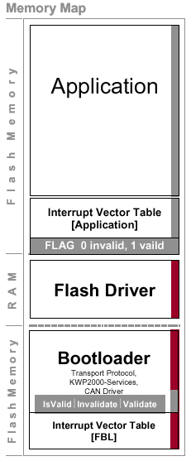
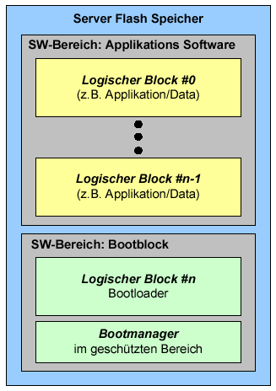
Flash Boot-Loader
Typical Memory Layout
Agenda
————————————
Introduction
————————————
Architecture
————————————
Memory Layout
————————————
Fun(1): Start Up
————————————
Fun(2): Reprogramming
————————————
Reprogramming
————————————
Diagnostics
————————————
Features
————————————
AUTOSAR Boot block
RBEI\EAR | 1/16/2012 | © Robert Bosch Engineering and Business Solutions Limited 2012. All rights reserved, also regarding any disposal, exploitation, reproduction, editing, distribution, as well as in the event of applications for industrial property rights.

Slide 5
Start Up
Flash Boot-Loader
Power Up
Agenda
————————————
At every Power-up
Responsible Boot Manager
  Controller Initialization
    E.g. Operating frequency, PLL stabilization
  Port Initialization
    E.g. CAN lines, SPI lines…
  Validity Check of the application SW
      Validation flags
      Checksum over a certain critical area
      Dependency b/w logical blocks
  Boot-loader Updater/Trojan Request handling
  EOL SW Request handling
Introduction
————————————
Architecture
Initialization
————————————
Memory Layout
————————————
Fun(1): Start Up
————————————
Reprogramming Request
Fun(2): Reprogramming
————————————
No
Reprogramming
Yes
————————————
ASW Validation
Diagnostics
————————————
Features
Invalid
Valid
————————————
AUTOSAR Boot block
FBL
ASW
RBEI\EAR | 1/16/2012 | © Robert Bosch Engineering and Business Solutions Limited 2012. All rights reserved, also regarding any disposal, exploitation, reproduction, editing, distribution, as well as in the event of applications for industrial property rights.

Slide 6
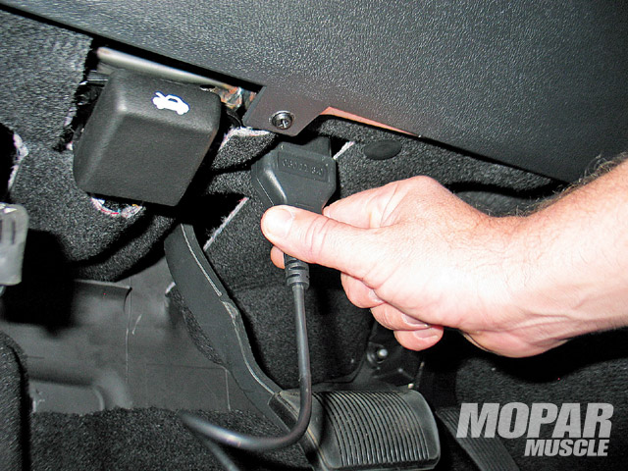
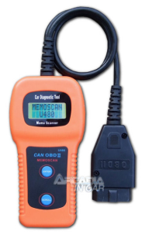
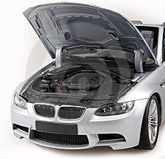
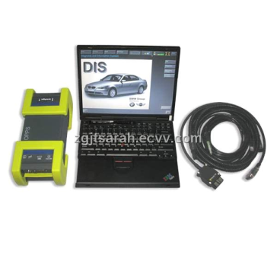
Reprogramming
Flash Boot-Loader
Agenda
————————————
Introduction
————————————
Architecture
————————————
Memory Layout
————————————
Fun(1): Start Up
————————————
Fun(2): Reprogramming
————————————
Reprogramming
————————————
Tester
Diagnostics
————————————
Features
————————————
AUTOSAR Boot block
Communication Medium
& Protocol Eg. CAN/UDS
RBEI\EAR | 1/16/2012 | © Robert Bosch Engineering and Business Solutions Limited 2012. All rights reserved, also regarding any disposal, exploitation, reproduction, editing, distribution, as well as in the event of applications for industrial property rights.

Slide 7
Flash Boot-Loader
Reprogramming
Agenda
Before transferring control to bootloader
  Preconditions are checked
    Eg. Engine/Vehicle speed
  DTC is turned Off
  Inter ECU communication is turned Off
This phase has no significance when control is already in the bootloader
————————————
The Re-Programming sequence
    OEM specific
    Protocol dependent
General procedure/flow
Introduction
————————————
Architecture
————————————
Memory Layout
————————————
Fun(1): Start Up
————————————
Fun(2): Reprogramming
————————————
Reprogramming
————————————
ASW
Diagnostics
Pre Programming
————————————
Features
————————————
FBL
Programming
AUTOSAR Boot block
ASW
Post Programming
RBEI\EAR | 1/16/2012 | © Robert Bosch Engineering and Business Solutions Limited 2012. All rights reserved, also regarding any disposal, exploitation, reproduction, editing, distribution, as well as in the event of applications for industrial property rights.

Slide 8
Flash Boot-Loader
Reprogramming
Agenda
————————————
The Re-Programming sequence
    OEM specific
    Protocol dependent
General procedure/flow
Introduction
————————————
Architecture
————————————
Enter Programming session
Security Access [Seed & Key]
Write Finger print [optional]
Erase Memory
Download
Verify
Exit/Reset
Downloads – ASW Software, Flash drivers, calibration data, EEPROM Data etc
Memory Layout
————————————
Fun(1): Start Up
————————————
Fun(2): Reprogramming
————————————
Reprogramming
————————————
ASW
Diagnostics
Pre Programming
————————————
Features
————————————
FBL
Programming
AUTOSAR Boot block
ASW
Post Programming
RBEI\EAR | 1/16/2012 | © Robert Bosch Engineering and Business Solutions Limited 2012. All rights reserved, also regarding any disposal, exploitation, reproduction, editing, distribution, as well as in the event of applications for industrial property rights.

Slide 9
Flash Boot-Loader
Reprogramming
Agenda
————————————
The Re-Programming sequence
    OEM specific
    Protocol dependent
General procedure/flow
Introduction
————————————
Architecture
————————————
Memory Layout
————————————
Fun(1): Start Up
————————————
Fun(2): Reprogramming
————————————
Reprogramming
————————————
ASW
Diagnostics
Pre Programming
————————————
Features
————————————
FBL
Programming
AUTOSAR Boot block
Enable Inter ECU Communication
Enable DTCs
Enter default session
ASW
Post Programming
RBEI\EAR | 1/16/2012 | © Robert Bosch Engineering and Business Solutions Limited 2012. All rights reserved, also regarding any disposal, exploitation, reproduction, editing, distribution, as well as in the event of applications for industrial property rights.

Slide 10
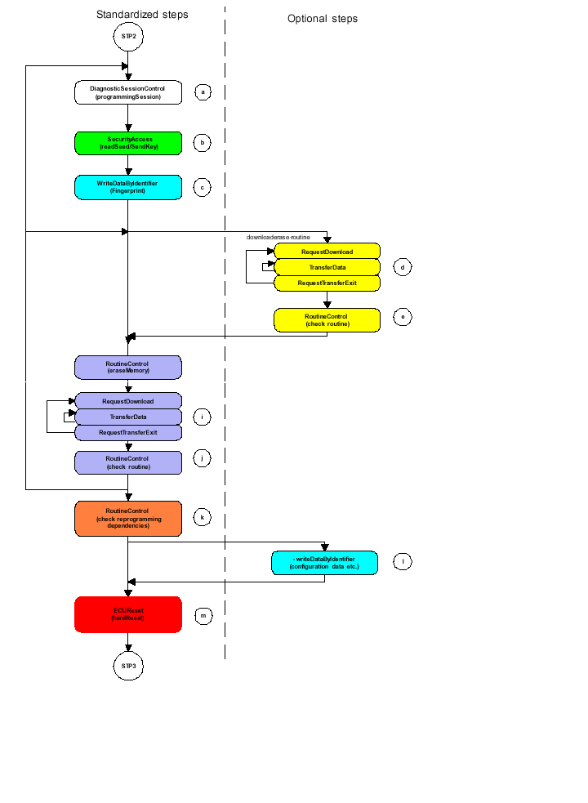
Flash Boot-Loader
List of Diagnostics Services in FBL
Agenda
————————————
DiagnosticSessionControl ($10)
ECU Reset ($11)
ReadDataByIdentifier ($22)
Security Access ($27)
Communication Control ($28)
WriteDataByIdentifier ($2E)
Routine Control ($31)
Request Download ($34)
Transfer Data ($36)
Request Transfer Exit ($37)
Tester Present ($3E)
ControlDTCSettings ($85)
Introduction
————————————
Architecture
————————————
Memory Layout
————————————
Fun(1): Start Up
————————————
Fun(2): Reprogramming
————————————
Reprogramming
————————————
Diagnostics
————————————
Features
————————————
AUTOSAR Boot block
RBEI\EAR | 1/16/2012 | © Robert Bosch Engineering and Business Solutions Limited 2012. All rights reserved, also regarding any disposal, exploitation, reproduction, editing, distribution, as well as in the event of applications for industrial property rights.

Slide 11
Flash Boot-Loader
ASW – FBL Interface
Agenda
————————————
NVM interface – PDM, EEPROM, FlPdm, Data Backup during re-programming an ASW
RAM interface
  ‘NO CLEAR’ areas for Information exchange,
    Especially for re-programming request
Introduction
————————————
Architecture
————————————
Memory Layout
————————————
Fun(1): Start Up
————————————
Fun(2): Reprogramming
————————————
Reprogramming
————————————
FBL
R/W
Shared
Area
R/W
ASW
Diagnostics
————————————
Features
————————————
AUTOSAR Boot block
ASW Area
R/W
RBEI\EAR | 1/16/2012 | © Robert Bosch Engineering and Business Solutions Limited 2012. All rights reserved, also regarding any disposal, exploitation, reproduction, editing, distribution, as well as in the event of applications for industrial property rights.

Slide 12

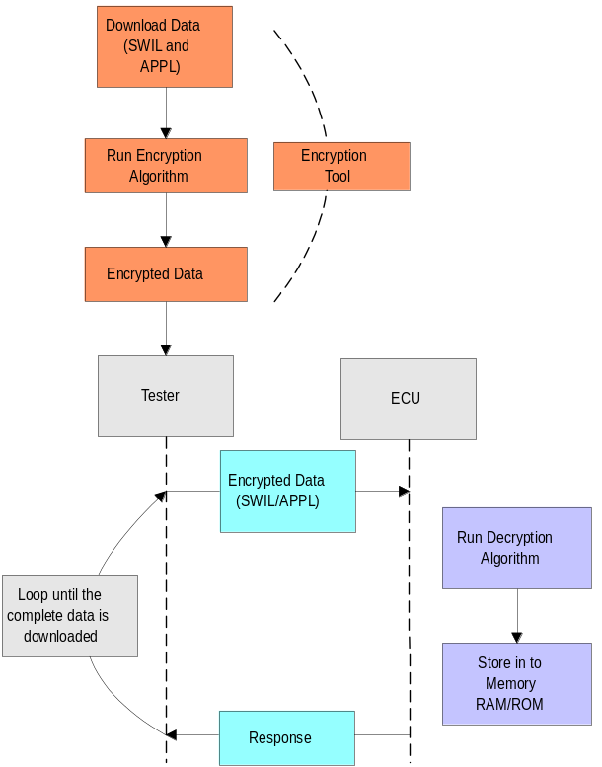


Flash Boot-Loader
Agenda
Proof of authenticity - software signature
————————————
Introduction
Encryption and Decryption
————————————
Architecture
SW
————————————
Memory Layout
Signature
tool
————————————
Fun(1): Start Up
————————————
Fun(2): Reprogramming
M = Hash(SW)
————————————
Reprogramming
————————————
SW
Diagnostics
————————————
+
Features
PIN
————————————
Signature =
RSA(secret key, M)
AUTOSAR Boot block
RBEI\EAR | 1/16/2012 | © Robert Bosch Engineering and Business Solutions Limited 2012. All rights reserved, also regarding any disposal, exploitation, reproduction, editing, distribution, as well as in the event of applications for industrial property rights.

Slide 13

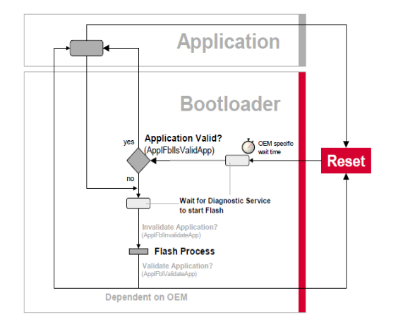
Flash Boot-Loader
Back Door Entry
Agenda
————————————
Introduction
————————————
Architecture
————————————
Memory Layout
————————————
Security Access – Seed and Key
Fun(1): Start Up
————————————
Fun(2): Reprogramming
Tool
ECU
————————————
Reprogramming
request secured access
————————————
Diagnostics
seed = random()
————————————
seed
Features
————————————
key = f_{Cust} (seed)
AUTOSAR Boot block
Key‘ = f_{Cust} (seed)
Key
grant secured access
key =?= key‘
RBEI\EAR | 1/16/2012 | © Robert Bosch Engineering and Business Solutions Limited 2012. All rights reserved, also regarding any disposal, exploitation, reproduction, editing, distribution, as well as in the event of applications for industrial property rights.

Slide 14
Flash Boot-Loader
Boot Loader Updater / Trojan
Agenda
————————————
Used to replace an actual boot-loader in the system
BM and BL should be independent
The BLU/Trojan is downloaded as an application sw
Introduction
————————————
Architecture
————————————
Memory Layout
————————————
Fun(1): Start Up
Init Drivers
————————————
Fun(2): Reprogramming
Erase Block
————————————
Write Block
Reprogramming
————————————
Power-Up
Check block
Diagnostics
————————————
Features
Invalidate
BLU
————————————
AUTOSAR Boot block
Reset
RBEI\EAR | 1/16/2012 | © Robert Bosch Engineering and Business Solutions Limited 2012. All rights reserved, also regarding any disposal, exploitation, reproduction, editing, distribution, as well as in the event of applications for industrial property rights.

Slide 15
Flash Boot-Loader
Boot Loader Updater / Trojan
Agenda
————————————
Introduction
Normal Operation
BLU downloaded
BL Erased
New BL in Place
BLU invalidated
————————————
Architecture
BLU/Trojan with
New BL Image
BLU Status = Valid
BLU/Trojan with
New BL Image
BLU Status = Valid
BLU/Trojan with
New BL Image
BLU Status = Valid
BLU Status = Invalid
Application SW
BLU/Trojan with
New BL Image
ASW Status = Valid
————————————
Memory Layout
————————————
Fun(1): Start Up
————————————
Fun(2): Reprogramming
————————————
Reprogramming
————————————
Diagnostics
————————————
Appl Start
BLU Start
BLU Start
BLU Start
BLU Start
Features
Boot loader
BL Status
Boot loader
Erased!
BL Status
New BL Copied
BL Status
New BL
Boot loader
New BL Status
————————————
BL Status
AUTOSAR Boot block
BL Start
BL Start
BL Start
BL Start
New BL Start
Boot Manager
Boot Manager
Boot Manager
Boot Manager
Boot Manager
BLU download
On Reset
@ PowerUp
RBEI\EAR | 1/16/2012 | © Robert Bosch Engineering and Business Solutions Limited 2012. All rights reserved, also regarding any disposal, exploitation, reproduction, editing, distribution, as well as in the event of applications for industrial property rights.

Slide 16
Flash Boot-Loader
SWIL / Flash Driver
Agenda
————————————
Flash Driver execution is always from RAM
    Downloaded on to RAM via Tester [SWIL]
        Used when the system does not support BLU
        Used when Driver is provided by another supplier
    Copied on to RAM by the FBL
        Used when system supports BLU
Introduction
————————————
Architecture
————————————
Memory Layout
————————————
Fun(1): Start Up
————————————
Fun(2): Reprogramming
————————————
Reprogramming
————————————
Diagnostics
————————————
Features
————————————
AUTOSAR Boot block
RBEI\EAR | 1/16/2012 | © Robert Bosch Engineering and Business Solutions Limited 2012. All rights reserved, also regarding any disposal, exploitation, reproduction, editing, distribution, as well as in the event of applications for industrial property rights.

Slide 17
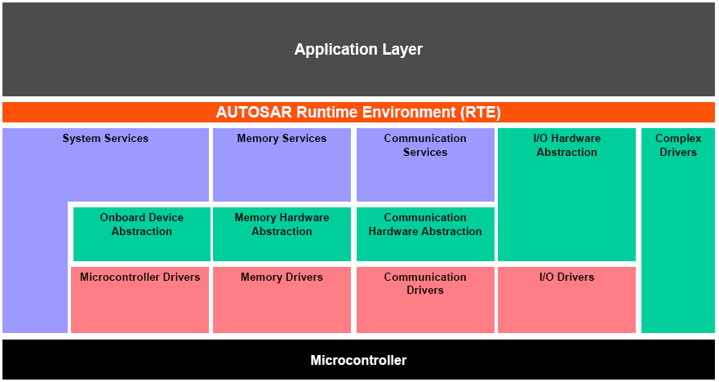
AUTOSAR Architecture
Flash Boot-Loader
Agenda
————————————
Introduction
————————————
Architecture
————————————
Memory Layout
————————————
Fun(1): Start Up
————————————
Fun(2): Reprogramming
————————————
Reprogramming
————————————
Diagnostics
————————————
Features
————————————
AUTOSAR Boot block
RBEI\EAR | 1/16/2012 | © Robert Bosch Engineering and Business Solutions Limited 2012. All rights reserved, also regarding any disposal, exploitation, reproduction, editing, distribution, as well as in the event of applications for industrial property rights.

Slide 18
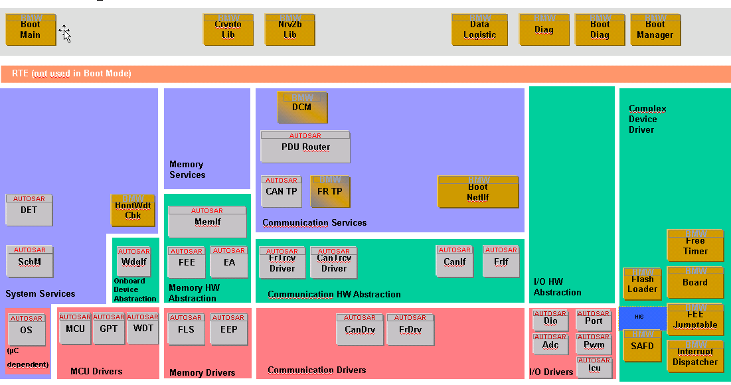
Boot Loader with AUTOSAR compliance
Flash Boot-Loader
Agenda
————————————
Introduction
————————————
Architecture
————————————
Memory Layout
————————————
Fun(1): Start Up
————————————
Fun(2): Reprogramming
————————————
Reprogramming
————————————
Diagnostics
————————————
Features
————————————
AUTOSAR Boot block
RBEI\EAR | 1/16/2012 | © Robert Bosch Engineering and Business Solutions Limited 2012. All rights reserved, also regarding any disposal, exploitation, reproduction, editing, distribution, as well as in the event of applications for industrial property rights.

Slide 19
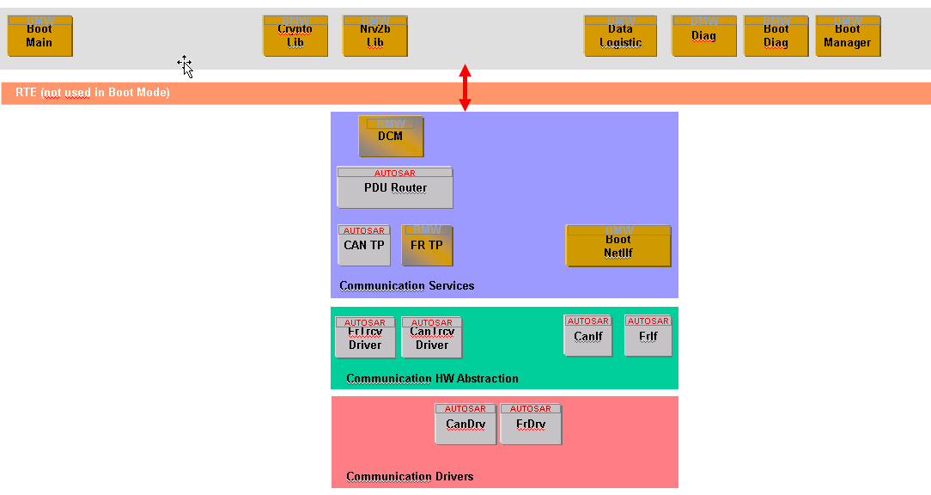
Communication Services
Flash Boot-Loader
Agenda
————————————
Introduction
————————————
Architecture
————————————
Memory Layout
————————————
Fun(1): Start Up
————————————
Fun(2): Reprogramming
————————————
Reprogramming
————————————
Diagnostics
————————————
Features
————————————
AUTOSAR Boot block
DCM services specific to flash - $31,$34,$36,$37 are project specific implementation
RBEI\EAR | 1/16/2012 | © Robert Bosch Engineering and Business Solutions Limited 2012. All rights reserved, also regarding any disposal, exploitation, reproduction, editing, distribution, as well as in the event of applications for industrial property rights.

Slide 20
Flash Boot-Loader
Thank you !
RBEI\EAR | 1/16/2012 | © Robert Bosch Engineering and Business Solutions Limited 2012. All rights reserved, also regarding any disposal, exploitation, reproduction, editing, distribution, as well as in the event of applications for industrial property rights.

