Slide 1
RISC-V Vector Processing Unit
Targeting ASIC Tapeout
rv32im_zicsr_zve32x_zvl128b | VLEN=128 | SEW=8/16/32 | LMUL=1/2/4/8
Pham Anh Khoi · HCMUT · Capstone Project 2 · June 2026

Slide 2
System Architecture
riscv_vpu_top: scalar pipeline + VPU + IMEM/DMEM + UART on single clock domain

Slide 3
5-Stage Scalar Core (RV32IM)
• Pipeline: IF → ID → EX → MEM → WB, synchronous IMEM/DMEM
– 1-cycle read latency, Harvard architecture
• Full forwarding: EX→MEM, MEM→WB bypass mux
• Hazard detection
– Load-use stall: freeze PC + IF/ID, bubble into EX
– VPU stall: freeze all stages until vpu_ready = 1
• VPU dispatch: OP-V in EX stage
– vpu_insn_vld + vpu_insn + rs1/rs2_data to VPU
– vsetvl* writeback: wait cfg_done, write vl to scalar RF

Slide 4
VPU Subsystem Architecture
• vproc_system_wrapper: instantiates all VPU submodules
– Decoder (32b → 49-bit ctrl_bus), FIFO depth-8, FSM 9-state
– 4 × vproc_vregfile (32 × 32b each), 4 processor lanes
– vproc_vec_lsu, vproc_reduction, vproc_vcsr
• 49-bit ctrl_bus: vs1/vs2/vd addresses, funct6, flags (is_widen, is_masking, is_reduction…)
• Instruction FIFO (depth 8): decouple scalar from VPU execution
– Prevents duplicate push during scalar stall via vpu_ready gating

Slide 5
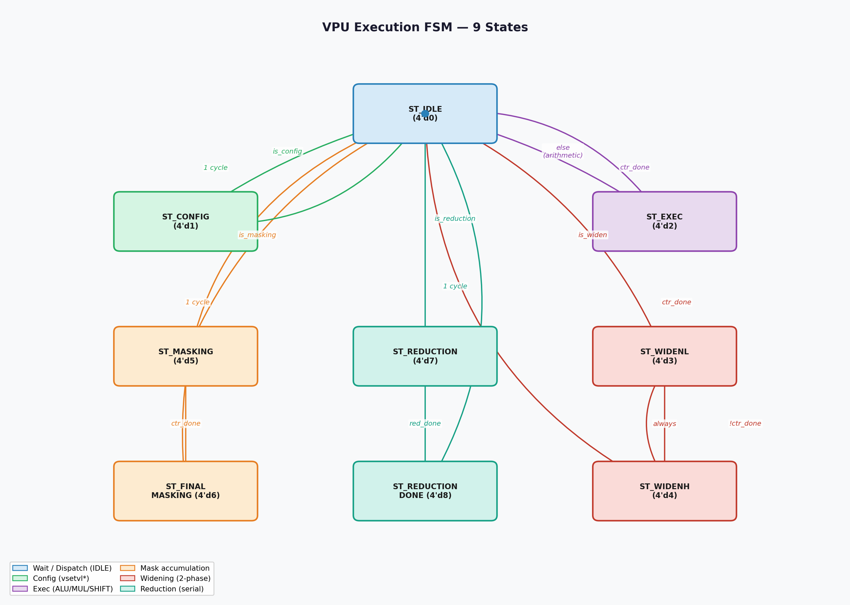
VPU Execution FSM — 9 States
• ST_IDLE (0): dispatch hub, wait for instruction from FIFO
• ST_CONFIG (1): vsetvl/vsetvli — 1 cycle, update CSR vl/vtype
• ST_EXEC (2): arithmetic/logic/shift/mul/minmax — N_elem/4 cycles
• ST_WIDENL/WIDENH (3/4): widening — 2-phase per group
• ST_MASKING (5) + ST_FINAL_MASKING (6): compare → pack mask bits
• ST_REDUCTION (7) + ST_REDUCTION_DONE (8): serial accumulation
– T_red = N_elem + 1 cycles | T_exec = ceil(N_elem / (32/SEW)) cycles

Slide 6
Execution Lane & Functional Units
• 4 lanes × 32-bit = processes 128-bit VRF register in 1 group
– SEW=8: 4 elements/cycle | SEW=16: 2/cycle | SEW=32: 1/cycle
• Adder: VADD/VSUB/VRSUB/VADC/VSBC — carry-save, no cross-lane carry
• Multiplier: VMUL/VMULH/VMULHU/VMULHSU, widening output lo/hi
• Shifter: VSLL/VSRL/VSRA — amount masked to log2(SEW) bits
• Compare: 4-bit result/word → mask write buffer → ST_FINAL_MASKING
• MinMax: signed/unsigned per-element mux

Slide 7
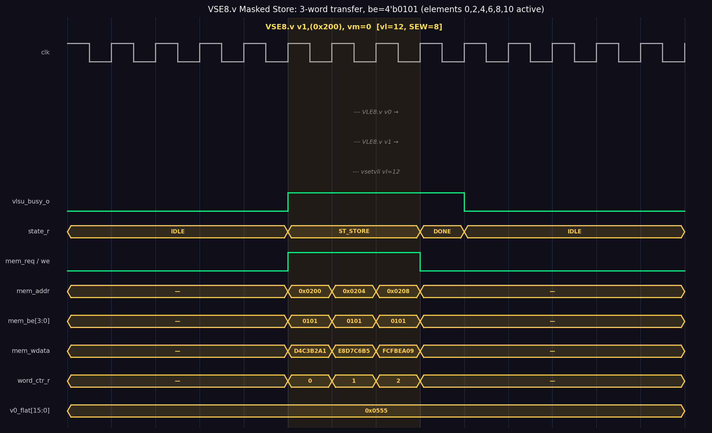
Vector LSU — Masked Store Waveform
• Unit-stride: VLE8/16/32.v (load), VSE8/16/32.v (store)
• Prefetch pipeline: ST_IDLE issues word-0 request; data arrives on first ST_LOAD cycle
• Masked store (vm=0): mem_be[j] = v0_flat[word_ctr×4 + j] for SEW=8
– Tail suppression: last_word_be computed from vl mod 4
• Hazards: RAW scoreboard (vrf_busy_r[31:0]), WAW guard, WAR guard

Slide 8
Verification Results
• 172/172 PASS — Instruction regression (tb_vproc_all_instr)
– 13 sections: CONFIG, ALU VV/VX/VI, VRSUB, Logic, Shift, MinMax, Compare, MUL, Widening, LMUL=2, Reduction, OPMVX
• 75/75 PASS — Vector LSU (tb_vproc_vlsu)
– VLE/VSE e8/e16/e32, random VL, masked store byte-enable
• 16384/16384 PASS — Lena 128×128 system benchmark
– 35853 cycles, max pixel error = 0 vs BT.601 reference
• Regression policy: every RTL change must pass 172-test gate

Slide 9
FPGA Synthesis & Performance
• Fmax: 47.18 MHz (fast-corner) — 2.87× vs original 16.44 MHz
– Slow-corner: −4.436 ns violation (scalar ALU carry chain bottleneck)
• Area: 10,438 ALMs — 25% reduction after serial reduction redesign
• Fmax evolution: 16.44 → 32.5 → 47.18 MHz
– Fix 1: serial reduction (remove 64-deep adder tree)
– Fix 2: break 143-node FIFO feedback loop
• Performance: ~10× speedup vs scalar RV32IM for BT.601 inner loop
– 2.18 cycles/pixel, bandwidth-bound at SEW=8

Slide 10


FPGA Demo — DE10-Standard VGA Output
RGB original (SW[0]=1)
Grayscale BT.601 (SW[0]=0)
Both images pre-loaded via MIF | 16384/16384 pixels byte-exact | max_error=0 | Hardware verified

Slide 11
Conclusion & Future Work
• Achievements
– Complete Zve32x VPU — 172/172 regression PASS
– End-to-end verified: UART streaming + BT.601 image processing + FPGA demo
– 47.18 MHz, 10,438 ALMs on Cyclone V — 3× frequency, 25% area improvement
– VGA display hardware-verified on DE10-Standard board
• Path to ASIC Tapeout
– Fix async reset in lsu.sv (#8) — synthesis prerequisite
– Lint pass — latch audit (#9) required before DC/Yosys
– Replace behavioral DMEM with standard-cell SRAM macro (#15)
• Feature Extensions
– vslide1up/vslide1down for FIR/overlap-save workloads
– Formal verification + STA closure + clock-gating insertion

