Slide 1
Topic 1: Personal Photo Album Mining
Steven Vo – 150201133@svuca.edu

Slide 2
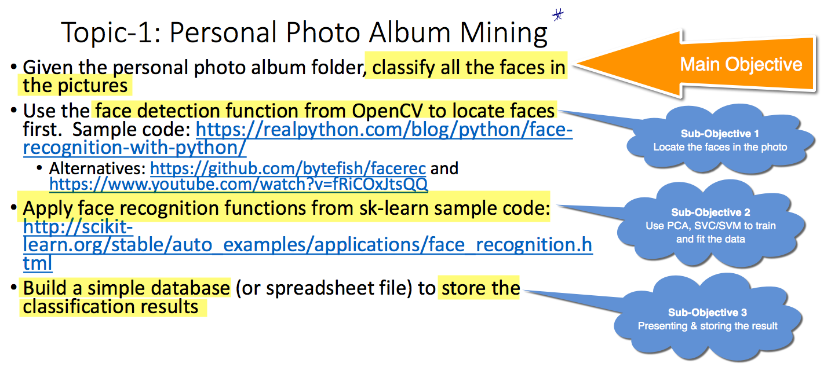

Slide 3
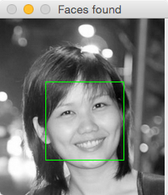
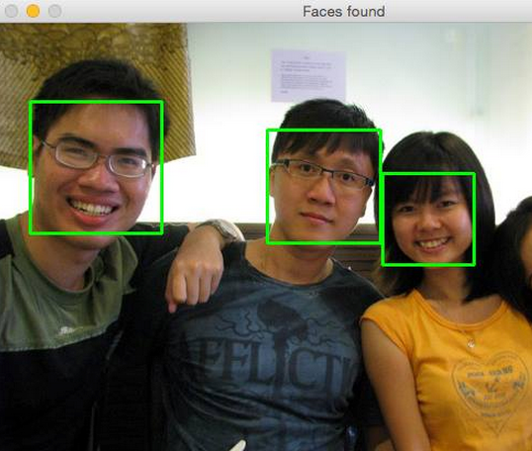
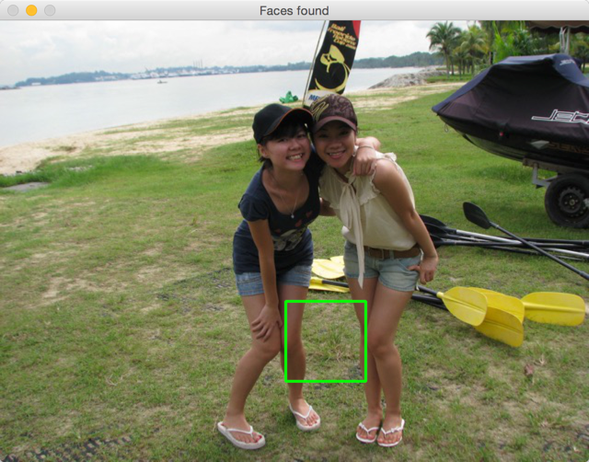
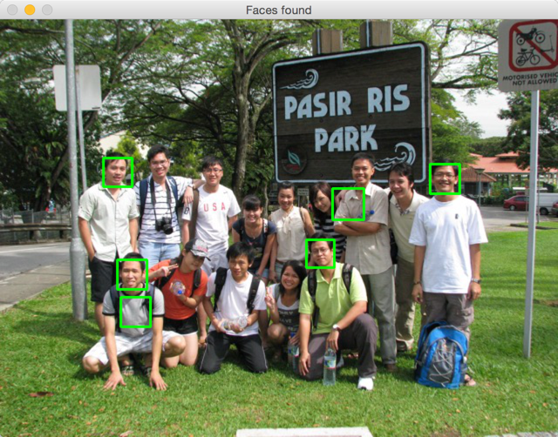
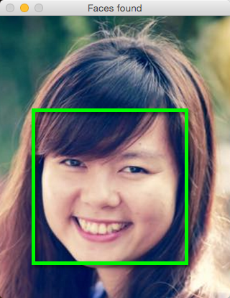
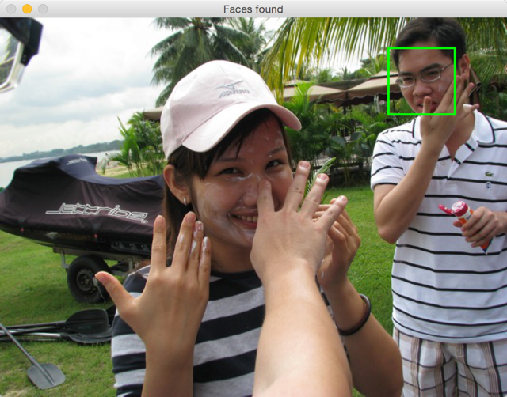
Obj-1: Locate The Face
Locate the faces in photos – using OpenCV

Slide 4
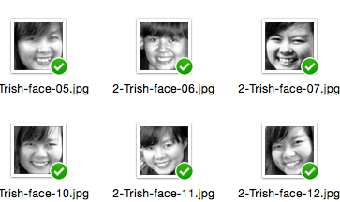
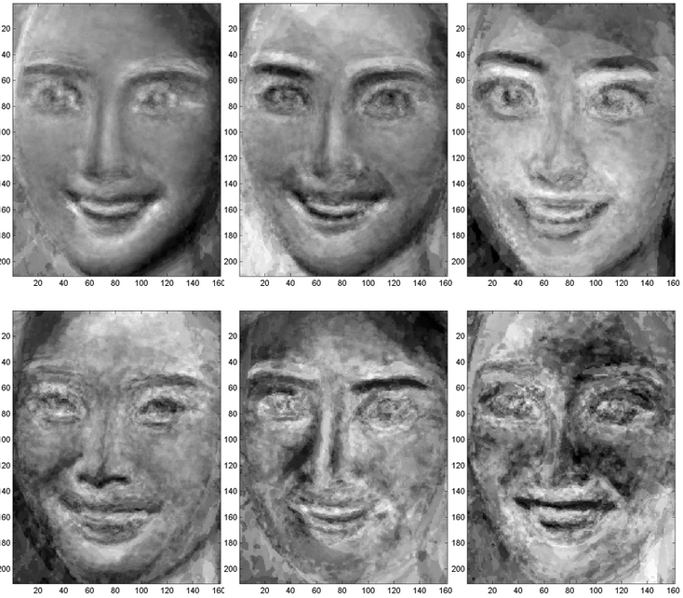
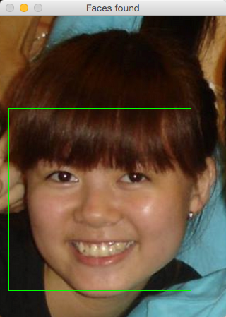
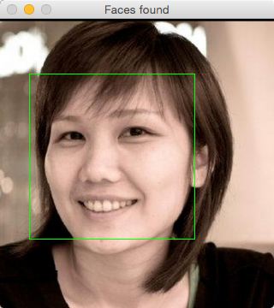
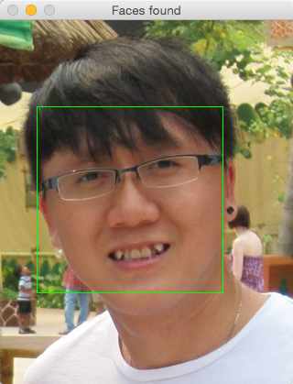
Obj2 – Recognize the face
The program should go through these 5 steps before it can recognize a face properly
Training Data
Test Data
PCA
Training
Validation
Training Data
Eigenfaces
Trish
Tracy
Steven

Slide 5
Obj3 – Presenting and Storing Data
The classification result will be stored into a database, which can be implemented by
File system (txt, dat, etc.)
Spreadsheet (xlsx, csv, etc.)
“Real-world” database system (mongo, redis, mysql, etc.)

