Slide 1
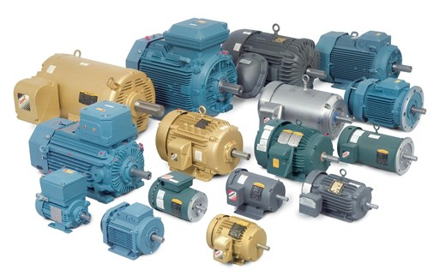

Slide 2
MOTORS
BY:Nayera Khaled
Submitted to:Mostafa
12/7/2017

Slide 3
Contnet
-DC Motors
-Servo Motors
-Stepper Motors

Slide 4
Motors
Device that converts electrical or other energy into mechanical energy or imparts motion.
There are many types of motors like:
1.DC Motors
2.Servo Motors
3.Stepper Motors

Slide 5
DC Motors
D.C. machines are the electro mechanical energy converters which work from a d.c. source and generate mechanical power or convert mechanical power into a d.c. power.
-Types of DC motors
1.Series Wound
2.Shunt Wound
3.Separately Excited

Slide 6
Series Wound
The series DC motor is an industry workhorse for both high and low power, fixed and variable speed electric drives.
Applications range from cheap toys to automotive applications.
They are inexpensive to manufacture and are used in variable speed household appliances such as sewing machines and power tools.
Its high starting torque makes it particularly suitable for a wide range of traction applications.

Slide 7
2.Shunt Wound
Fixed speed applications such as automotive windscreen wipers and fans.
3.Separately Excited
Train and automotive traction applications.
Note:if you want know more about types of dc motors you can use this link
http://www.mpoweruk.com/motorsdc.htm

Slide 8
Arduino-DC Motors
A DC motor (Direct Current motor) is the most common type of motor. DC motors normally have just two leads, one positive and one negative. If you connect these two leads directly to a battery, the motor will rotate. If you switch the leads, the motor will rotate in the opposite direction.
We will use Arduino to control motor speed and direction of the spin of dc motor.

Slide 9
Servo Motors
A Servo Motor is a small device that has an output shaft. This shaft can be positioned to specific angular positions by sending the servo a coded signal. As long as the coded signal exists on the input line, the servo will maintain the angular position of the shaft. If the coded signal changes, the angular position of the shaft changes.

Slide 10
The use of Servo Motors
servos are used in radio-controlled airplanes to position control surfaces like the elevators and rudders. They are also used in radio-controlled cars, puppets, and of course, robots.
Servos are extremely useful in robotics. The motors are small, have built-in control circuitry, and are extremely powerful for their size.

Slide 11
Arduino-Servo Motors
We use arduino to communicate with the angle of servo motors.
The control wire is used to communicate the angle. The angle is determined by the duration of a pulse that is applied to the control wire. This is called Pulse Coded Modulation. The servo expects to see a pulse every 20 milliseconds (.02 seconds). The length of the pulse will determine how far the motor turns. A 1.5 millisecond pulse, for example, will make the motor turn to the 90-degree position (often called as the neutral position). If the pulse is shorter than 1.5 milliseconds, then the motor will turn the shaft closer to 0 degrees. If the pulse is longer than 1.5 milliseconds, the shaft turns closer to 180 degrees.

Slide 12
Stepper motors
A Stepper Motor or a step motor is a brushless, synchronous motor, which divides a full rotation into a number of steps. Unlike a brushless DC motor, which rotates continuously when a fixed DC voltage is applied to it, a step motor rotates in discrete step angles.

Slide 13
Arduino-stepper motors
to move a stepper motor, you tell it to move a certain number of steps in one direction or the other, and tell it the speed at which to step in that direction. There are numerous varieties of stepper motors. The methods described here can be used to infer how to use other motors and drivers which are not mentioned in this tutorial. However, it is always recommended that you consult the datasheets and guides of the motors and drivers specific to the models you have.

Slide 14
Usefull links
https://www.tutorialspoint.com/arduino
http://www.mpoweruk.com/motorsdc.htm

