Slide 1


Slide 2
ARDUINO Communication Protocols
BY: Nayera Khaled
Submitted to: Mostafa
12/7/2017

Slide 3
Communication Protocols
Communication Protocols
Parallel Communication
-advanatges
-disadvantages
Serial Communication
-3 protocols:
1. UART
--functions
2.SPI
3.I^2C

Slide 4
Communication Protocols
Devices need to communicate with each other to relay information about the environment, express changes in their states, or request auxiliary actions be performed. With any serious hobby electronics work, you’re bound to run into one or more of the main communication protocols in use, be it when working with different sensors, or with modules such as the ESP8266.
Hundreds of communication protocols have been defined to achieve this data exchange. Each protocol can be categorized into one of the two categories: parallel or serial.

Slide 5
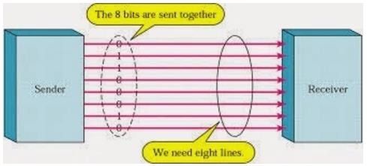
Parallel Communication
is the ideal solution for shorter distances up to several meters. However, in other cases when it is necessary to establish communication between two devices for longer distances it is not possible to use parallel connection. Parallel interfaces transfer multiple bits at the same time. They usually require buses of data - transmitting across eight, sixteen, or more wires. Data
is transferred in huge, crashing waves of 1’s and 0’s.

Slide 6
-Advantages:
Parallel communication certainly has its advantages. It is faster than serial, straightforward, and relatively easy to implement.
-Disadvantages:
it requires many input/output (I/O) ports and lines. If you have ever had to move a project from a basic Arduino Uno to a Mega, you know that the I/O lines on a microprocessor can be precious and few.

Slide 7
Serial Communication
we prefer serial communication, Because of parallel communication’s disadvantages.
most Arduino boards are built with several different systems for serial communication as standard equipment.
Which of these systems are used depends on the following factors −
How many devices the microcontroller has to exchange data with?
How fast the data exchange has to be?
What is the distance between these devices?
Is it necessary to send and receive data simultaneously?
One of the most important things concerning serial communication is the Protocol, which should be strictly observed. It is a set of rules, which must be applied such that the devices can correctly interpret data they mutually exchange. Fortunately, Arduino automatically takes care of this, so that the work of the programmer/user is reduced to simple write (data to be sent) and read (received data).

Slide 8
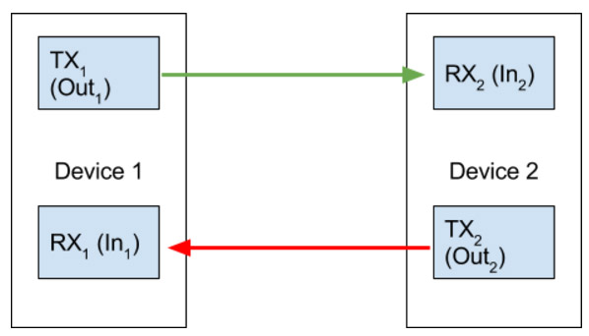
3 protocols:
1. UART
Universal Asynchronous Receiver/Transmitter (UART). UART is a form of serial communication because data is transmitted as sequential bits (we’ll get to this in a bit). The wiring involved with setting up communication is very simple: one line for transmitting data (TX) and one line for receiving data (RX). As you may expect, the TX line is used to for the data to send device, and the RX line is used to receive data. Together the TX and RX lines of a device using serial communication form a serial port through which communication can occur.

Slide 9
-Functions we use in UART --Serial.begain(transmission speed) --Serial.print(‘text’) --Serial.println(‘text’) 2.SPI 3.I^2C

Slide 10
Usefull links
https://www.tutorialspoint.com/arduino/arduino_communication.htm
http://www.deviceplus.com/how-tos/arduino-guide/arduino-communication-protocols-tutorial/

