Slide 1
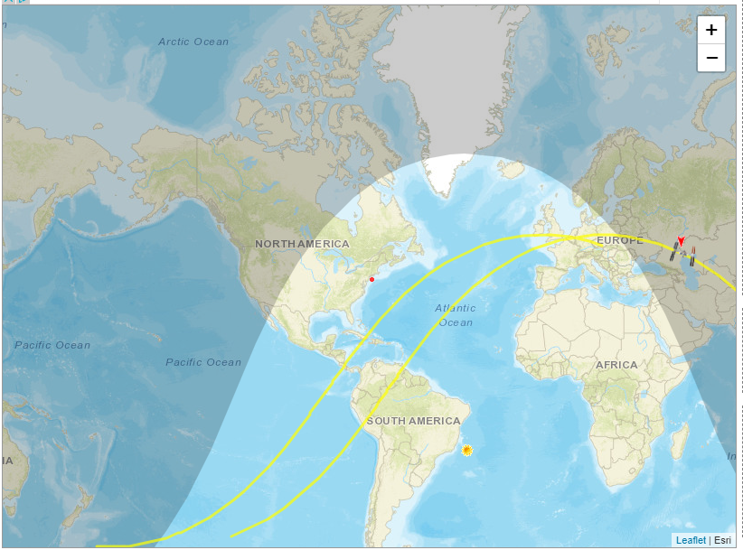
N2YO Satellite Tracking System (http://www.n2yo.com)
Team members:
Ravi Chinnamanaidu
Azzy cecers
Kholiswa
Michael Stiffner

Slide 2
Introduction: The “N2YO” site provides the details of the satellites launched from various countries, the site provides details of the satellites launched, countries that launched, number of satellites for each country, satellites categories, satellite name and other updated satellite launch programs. The launched satellite are tracked through the N2YO APIs to get Latitude Longitude Azimuth Elevation Radius Altitude And other attributes, as part of this project we went through the website to understand their existing APIs they published, the site also provides more menus to get more details of each satellites. Each satellites key attributes to get the details Satellite Name Satellite ID ( Norad ID) ( this is the primary key to get the satellites details across the globe) Satellite Category Satellite Type Launch location Launch date The APIs they are supporting to get the details https://www.n2yo.com/api/ Get TLE Get Satellite Positions Get visual Passes Whatsup

Slide 3
Get TLE ( two line element of satellite) based on Satellite ID https://api.n2yo.com/rest/v1/satellite/tle/25544&apiKey=589P8Q-SDRYX8-L842ZD-5Z9 , JSON response
{ "info": {
"satid": 25544,
"satname": "SPACE STATION",
"transactionscount": 4
},
"tle": "1 25544U 98067A 18077.09047010 .00001878 00000-0 35621-4 0 9999\r\n2 25544 51.6412 112.8495 0001928 208.4187 178.9720 15.54106440104358"
}
Get Satellite Positions ( The real time satellite positions) based on Satellite ID https://api.n2yo.com/rest/v1/satellite/positions/25544/41.702/-76.014/0/2/&apiKey=589P8Q-SDRYX8-L842ZD-5Z9 JSON response

Slide 4
{
"info": {
"satname": "SPACE STATION",
"satid": 25544,
"transactionscount": 5
},
"positions": [
{
"satlatitude": -39.90318514,
"satlongitude": 158.28897924,
"sataltitude": 417.85,
"azimuth": 254.31,
"elevation": -69.09,
"ra": 44.77078138,
"dec": -43.99279118,
"timestamp": 1521354418
},
{
"satlatitude": -39.86493451,..}
]
}

Slide 5
Get Virtual Passes based on Satellite ID https://api.n2yo.com/rest/v1/satellite/visualpasses/25544/41.702/-76.014/0/2/300/&apiKey=589P8Q-SDRYX8-L842ZD-5Z9 JSON response
{
"info": {
"satid": 25544,
"satname": "SPACE STATION",
"transactionscount": 4,
"passescount": 3
}, "passes": [
{
"startAz": 307.21,
"startAzCompass": "NW",
"startEl": 13.08,
"startUTC": 1521368025,
"maxAz": 225.45,
"maxAzCompass": "SW", {
..
}
]
}
"passes": [
{
"startAz": 307.21,
"startAzCompass": "NW",
"startEl": 13.08,
"startUTC": 1521368025,
"maxAz": 225.45,
"maxAzCompass": "SW",
"maxEl": 78.27,
"maxUTC": 1521368345,
"endAz": 132.82,
"endAzCompass": "SE",
"endEl": 0,
"endUTC": 1521368660,
"mag": -2.4,
"duration": 485
},

Slide 6
Get Virtual Passes based on Satellite ID https://api.n2yo.com/rest/v1/satellite/radiopasses/25544/41.702/-76.014/0/2/40/&apiKey=589P8Q-SDRYX8-L842ZD-5Z9 JSON response
{
"info": {
"satid": 25544,
"satname": "SPACE STATION",
"transactionscount": 2,
"passescount": 2
},
"passes": [
{
"startAz": 311.57,
"startAzCompass": "NW",
"startUTC": 1521451295,
"maxAz": 37.98,…}
]
}
"passes": [
{
"startAz": 311.57,
"startAzCompass": "NW",
"startUTC": 1521451295,
"maxAz": 37.98,
"maxAzCompass": "NE",
"maxEl": 52.19,
"maxUTC": 1521451615,
"endAz": 118.6,
"endAzCompass": "ESE",
"endUTC": 1521451925
},

Slide 7
Whatsup based on Satellite ID https://api.n2yo.com/rest/v1/satellite/above/41.702/-76.014/0/70/18/&apiKey=589P8Q-SDRYX8-L842ZD-5Z9 JSON response
{
"info": {
"category": "Amateur radio",
"transactionscount": 17,
"satcount": 3
},
"above": [
{
"satid": 20480,
"satname": "JAS 1B (FUJI 2)",
"intDesignator": "1990-013C",
"launchDate": "1990-02-07",
"satlat": 49.5744,
"satlng": -96.7081,
"satalt": 1227.9326
},..
]
}

