Slide 1
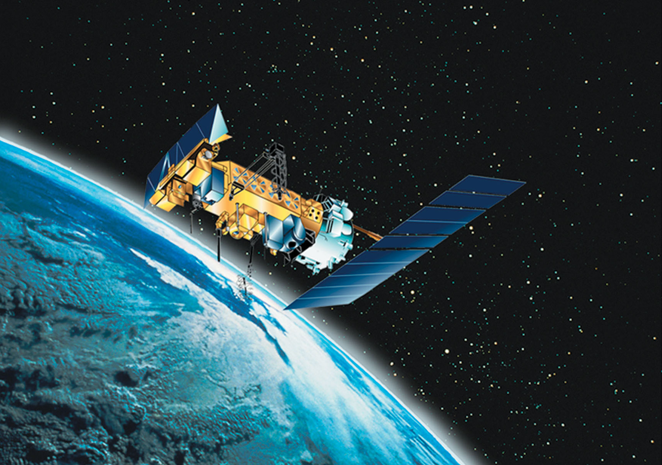
Satellite Exploration
Azzy Caceres, Michael Striffler,
Kholiswa Tsotetsi & Ravi Chinnamanaidu

Slide 2
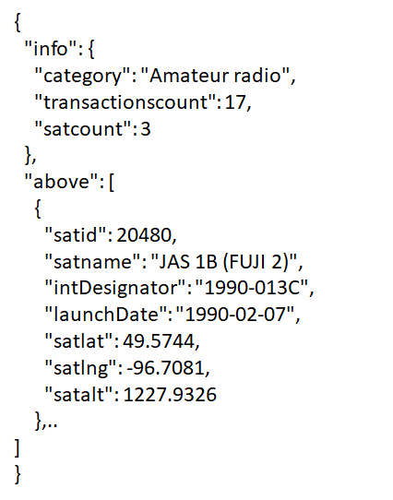
Data Source: N2YO
Provides the details of the satellites launched from various countries, the site provides details of the satellites launched, countries that launched, number of satellites for each country, satellites categories, satellite name and other updated satellite launch programs.
API Call:
Returned JSON Response:

Slide 3
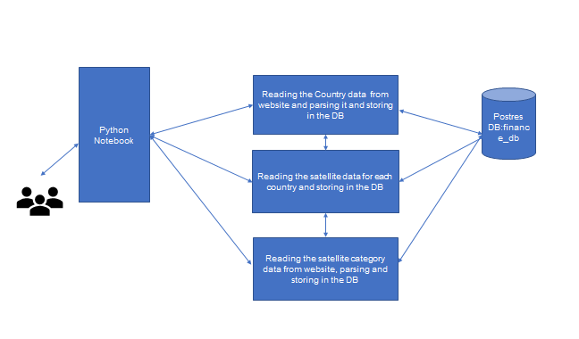
Screen Scraping N2YO

Slide 4
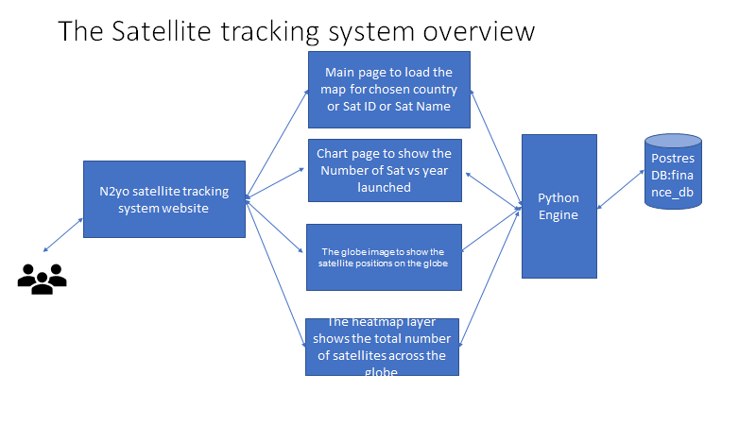
The Satellite tracking system Overview

Slide 5
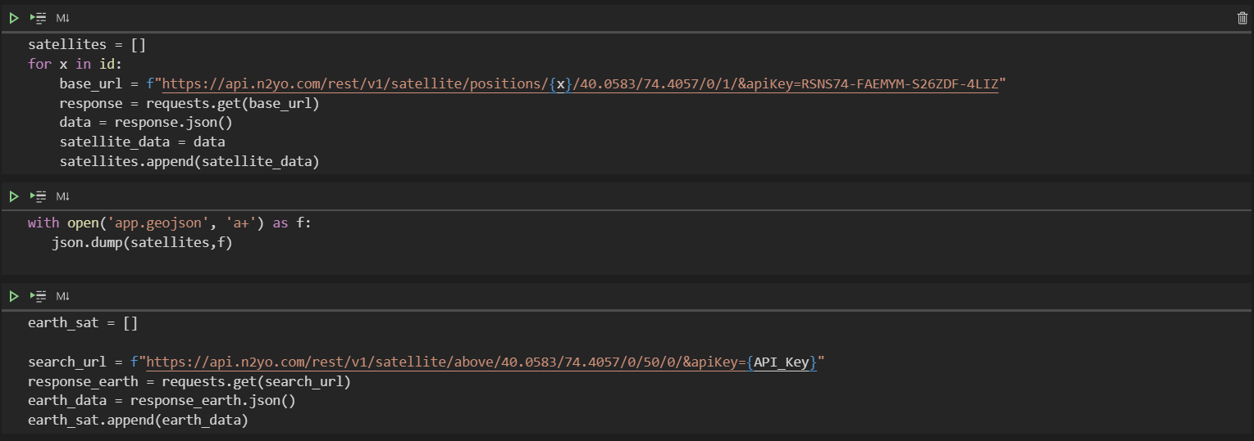
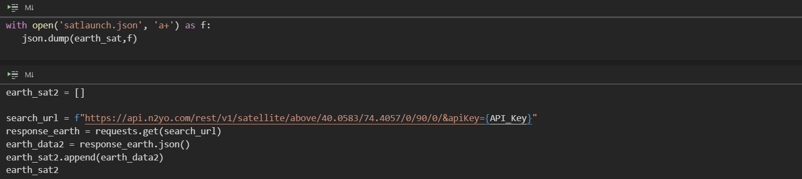
Reading API to Create JSON and GeoJSON Files

Slide 6
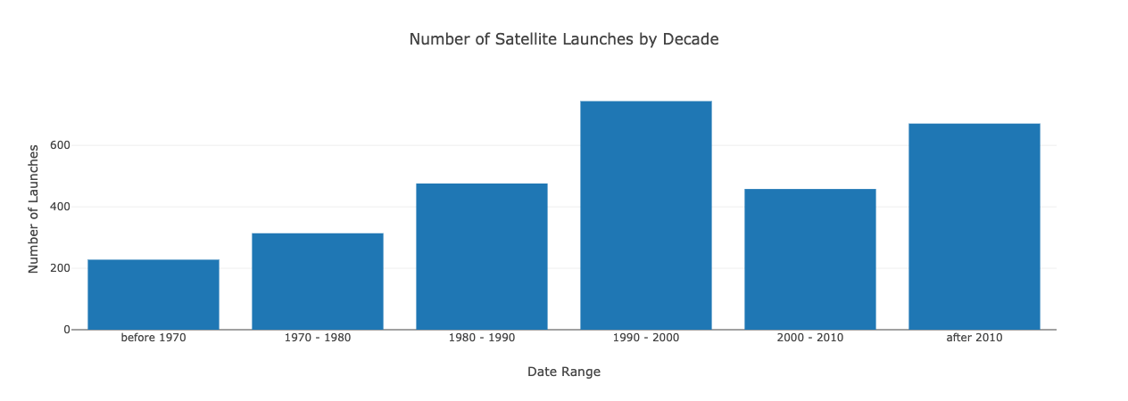
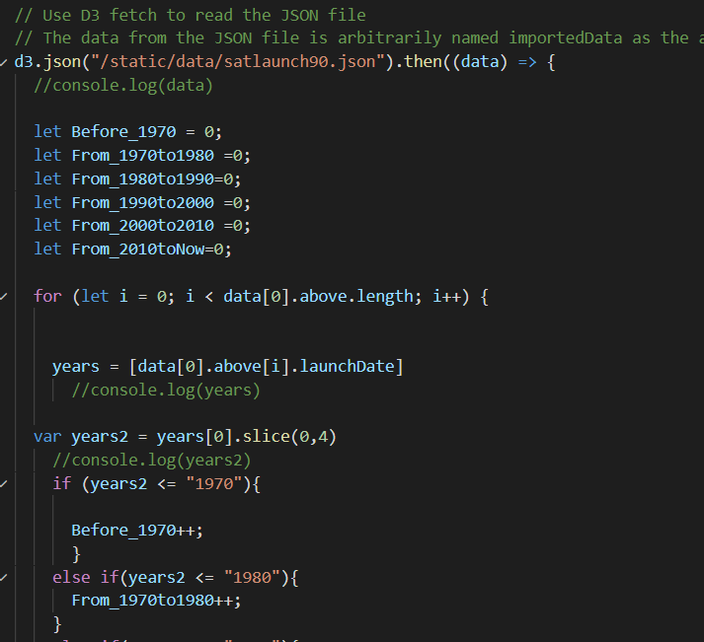
Visualization: Bar Chart Launch Dates
Libraries Used: Plotly, D3

Slide 7
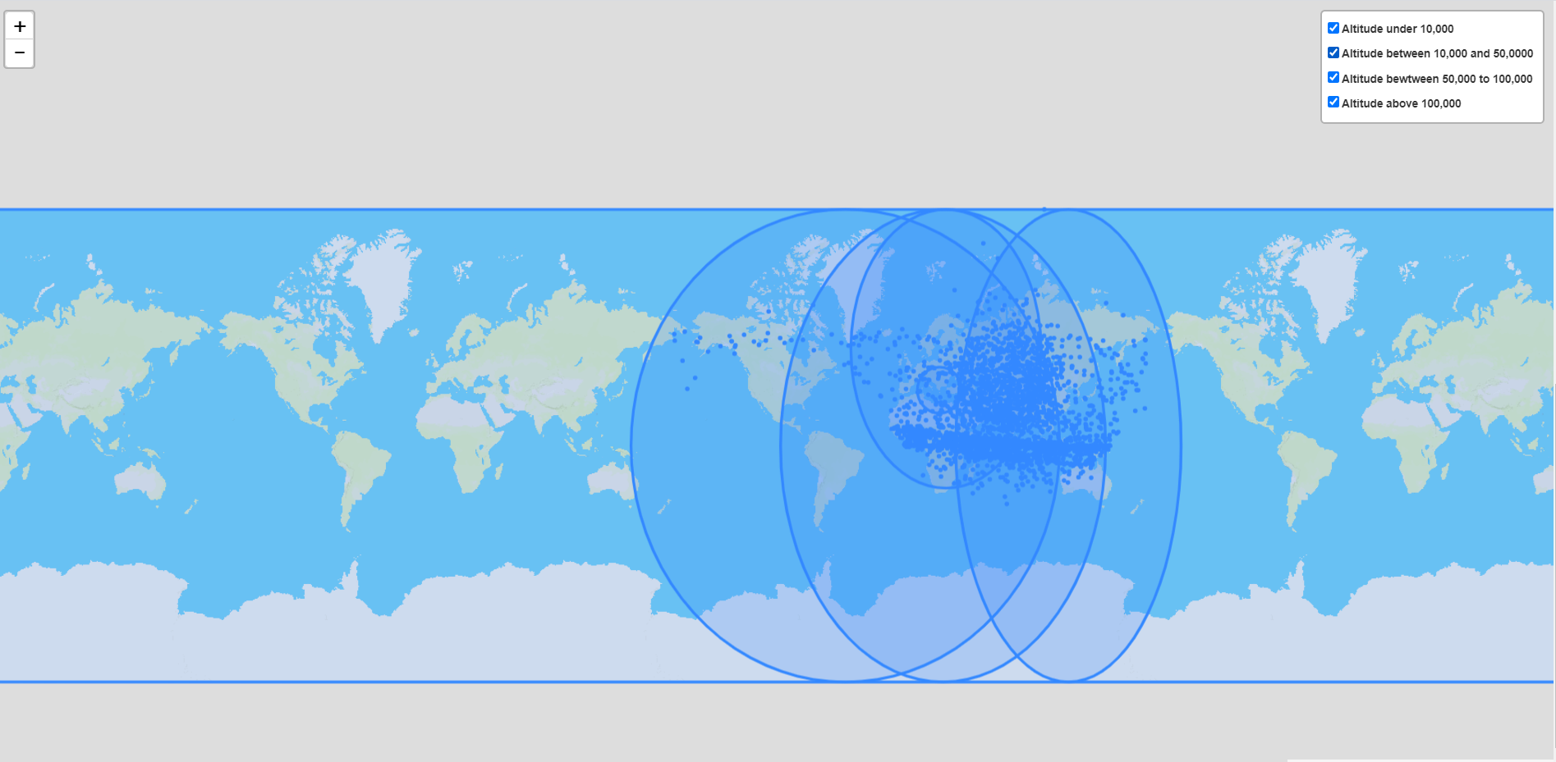
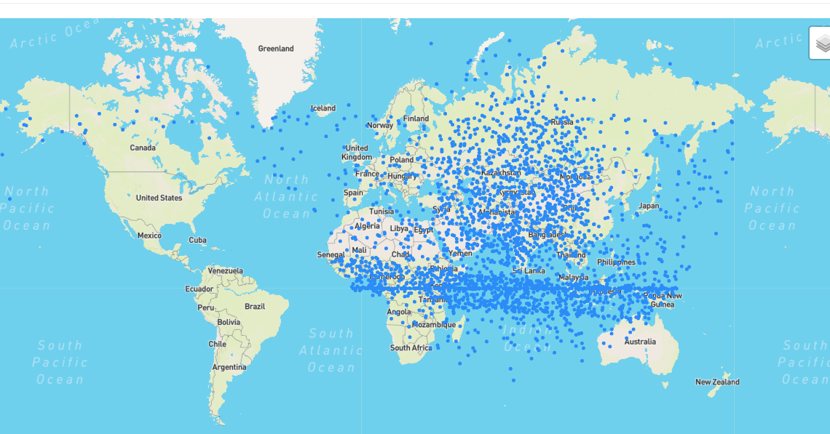
Visualization: Altitude Map of Current Satellites
Libraries Used: Leaflet, D3

Slide 8
Subset of Satellites-Earth Resources
This section has three dropdown pages
Currently in Orbit- Map that shows the satellites in orbit under the Earth Resource category, using rockets as the icon
Currently in Orbit Globe - Map that shows satellites in orbit under Earth Resource category, on a globe to see a 3D aspect
Launch Sites- Map that shows where these satellites were launched and which country was responsible for the satellite

Slide 9
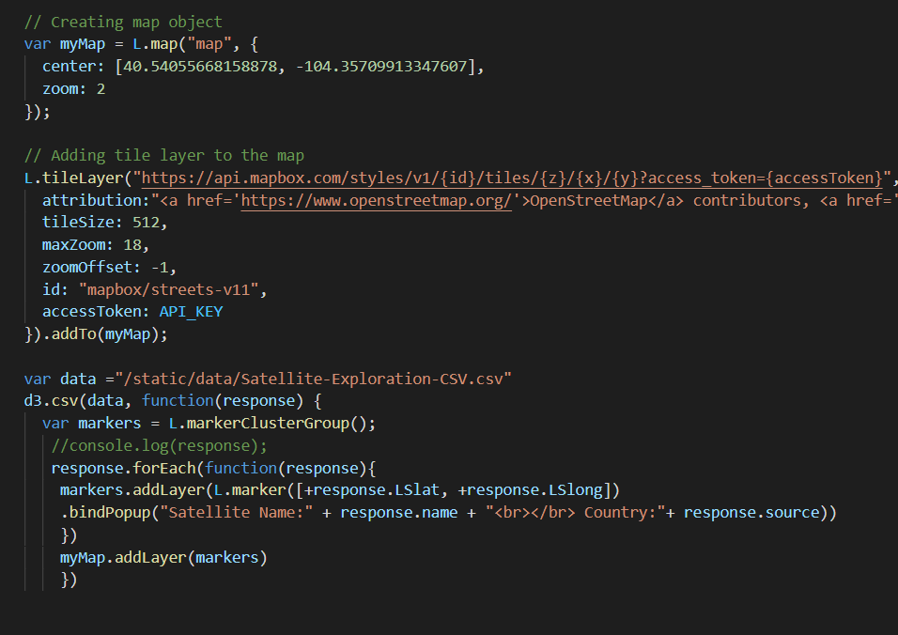
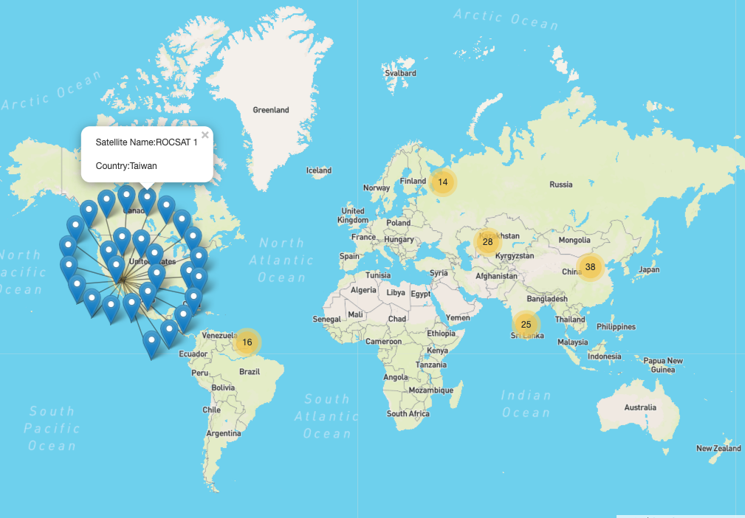
Visualization: Cluster Map of Satellite Landing Sites
Libraries Used: Leaflet, D3

Slide 10
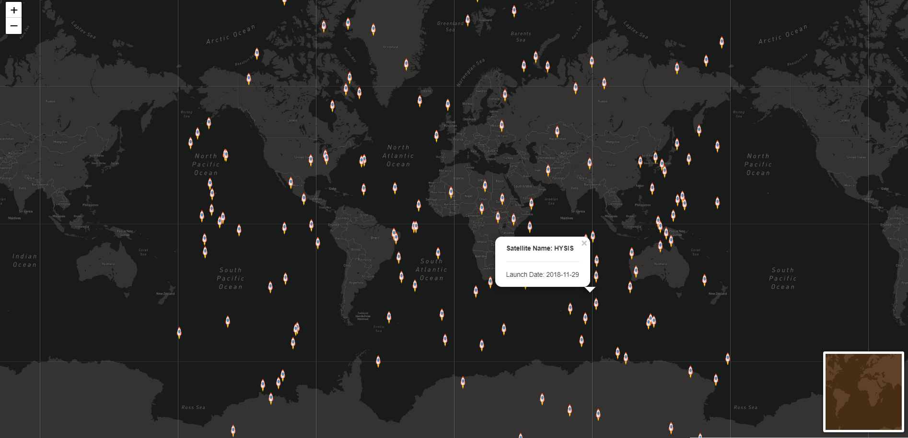
Visualization: Current Earth Resources Satellites in Orbit
Libraries Used: Leaflet, D3

Slide 11
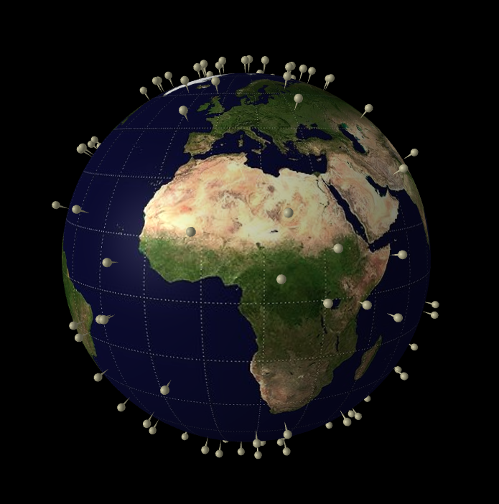
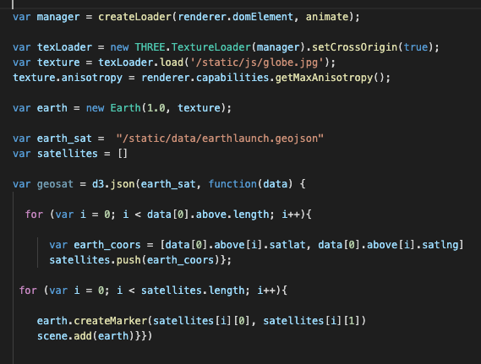
Visualization: Current Earth Resources Satellites in Orbit
Libraries Used: ThreeJS, D3
Code Snapshot

