Slide 1
Cover letters & CV / Résumé
Week 10

Slide 2
Curriculum Vitae vs Résumé
Your résumé is a bit shorter (aim for 1-2 pages) while a CV is a bit longer (2-3 pages)
A CV will include your academic history: papers, presentations, publications, etc
A résumé often includes a section on objectives but is focused on relevant work experiences and skills
Depending on the application, you will use one or the other

Slide 3
Résumé: Method
Include your contact information at the top
List your goal or objective (i.e. I am a university looking for additional experience in education.)
List experience/interests chronologically, from most recent to least recent
List any certifications and skills (first aid, languages, technology experience with Macs or PCs)
Include 2 references at the bottom

Slide 4
Résumé: Tips and Tricks
Choose a format that is interesting and clear
No work experience? List extracurricular and volunteer roles instead
Be consistent in how you list and describe different activities
Use the words that they use (Applicant Tracking System)
Tailor your résumé to the job

Slide 5
Samples
Cameron McIntyre (résumé)
Alexi Katsanis (CV)
Emily Crompton (CV for technical writing job)

Slide 6
Cover Letter
A cover letter is your chance to add more info than your résumé can give
This is the place to include your likes, skills, talents, and passion as well as how they relate to the job
Choose one or two things to talk about and then expand on those in your cover letter

Slide 7
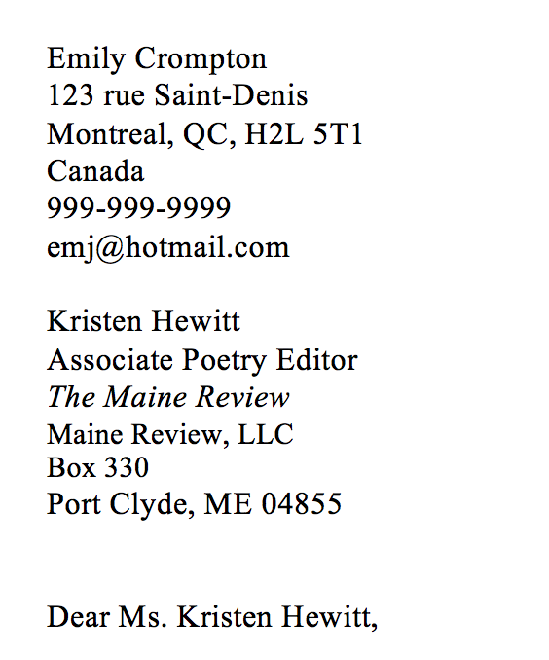
Cover Letter: Format
Write in the letter style, including your contact information and the information of the employer
Figure out who will be looking at your letter and address the letter to them (e.g. Dear Ms Emily Crompton)
Conclude with Sincerely, Your Full Name

Slide 8
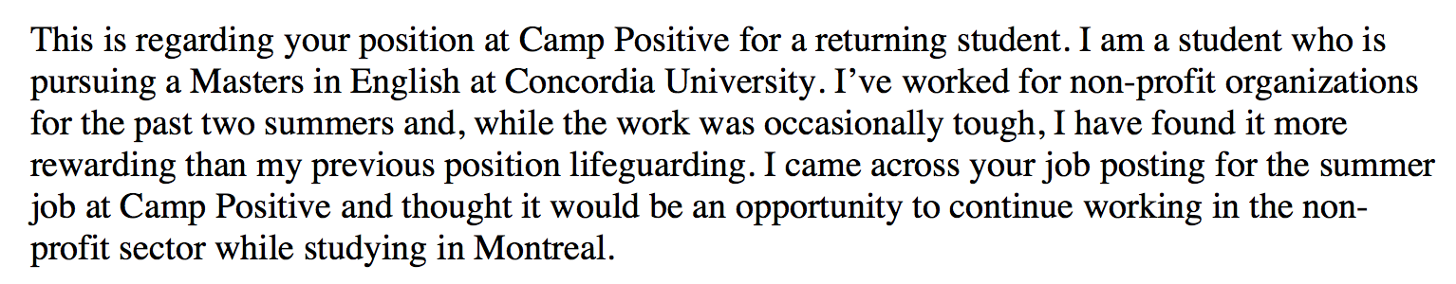
Cover Letter: Para 1
Explain why you are writing the letter
How you heard about the job
Intro to your cover letter

Slide 9
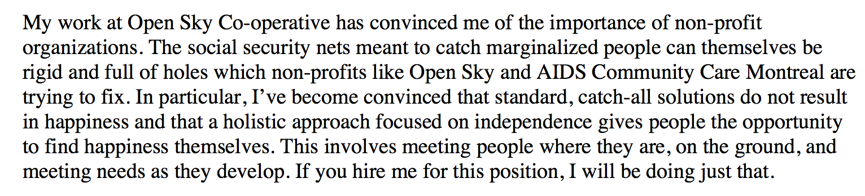
Cover Letter: Para 2&3
Past experience, skill, or passion
Explain how you learned that skill and how it would be important to the job

Slide 10
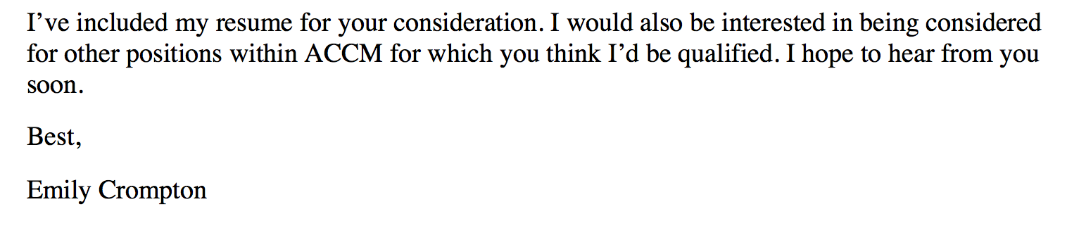
Cover Letter: Concluding Para
End your application by restating your interest and offering to provide any additional information

Slide 11
Cover Letter: Tips and Tricks
Spell check everything
Talk about how past jobs and experiences have helped you develop (e.g. Although I was initially shy and anxious when speaking in public, my experience as a TA has made me confident when presenting in front of a variety of audiences.)
If you are interested in the job, don’t be afraid to say so

Slide 12
Cover Letter Samples
Cameron McIntyre

Slide 13
Bonus Section: Interview
Research the company to which you are applying
Wear something that you look good but also feel comfortable wearing. Don’t wear something that will make you fidget
Bring a copy of your résumé with you
Take time after a question is asked to formulate a well, thought-out answer
Did you understand the question? If no, ask for clarification
Make eye contact, nod, etc. Practice these thing on your own time
Bring a question for them, if you’re feeling confident!

Slide 14
Bonus Section: Interview
What is your greatest weakness/strength?
Describe one scenario in a past job where you had a problem. What did you do to fix it?
What is the biggest error you’ve made on a job?
Tell me about yourself.
How do you fit with our team?
You have [a gap in your work history/no experience/no relevant experience]. Why should we hire you?
How do you work in a team?
Give an example where you worked under pressure.
How do you deal with criticism?

