Slide 1

FINTECH CENTER OF GENERAL SECRETARIAT OF FSA
Super App & Mini App Platform
Unified Mobile Architecture, Multi-Tier Partner Integration & Automated Security Framework
ZERO-TRUST ARCHITECTURE • 4 INTEGRATION TIERS • AUTOMATED CI/CD • NATIONAL SSO READY
Non-Bank Financial Services Authority (FSA) • Core Engineering Architecture Review

Slide 2
FINTECH CENTER • GENERAL SECRETARIAT OF FSA
AGENDA
Executive Table of Contents
Four foundational strategic domains governing platform architecture, integration, security, and roadmap.
01 1. Platform Vision & System Architecture
• 1.1 Strategic Vision (The Dilemma vs. Unified Solution)
• 1.2 End-to-End System Architecture (4-Phase Integration Pipeline)
03 3. Partner Portal & Enterprise Security
• 3.1 Partner Self-Service Backoffice & 6-Step Wizard
• 3.2 Automated Security Pipeline (8 Pre-Flight Gates & 12 Scanners)
02 2. Core Features & 4 Integration Tiers
• 2.1 4 Flexible Integration Tiers (WebView, Flutter, Native, Deep Link)
• 2.2 Platform Core Features (Size Cleaner, Codegen, Dynamic RBAC)
04 4. CI/CD Assembly, QA & Strategic Roadmap
• 4.1 Jenkins Codegen Assembly, Nexus Registry & Dual QA Engine
• 4.2 Operational Milestones & Strategic Roadmap (CamDigiKey, HR)

Slide 3
FINTECH CENTER • GENERAL SECRETARIAT OF FSA
1.1 STRATEGIC VISION
Operational Dilemma vs. Unified Solution
Transforming fragmented citizen applications into a unified, secure digital public service gateway.
Operational Challenges & Fragmentation [CRITICAL RISKS]
• Severe Citizen App Fatigue
Citizens must download dozens of separate standalone government apps for individual ministry services.
• Fragmented Security & Identity
Inconsistent authentication standards, variable security postures, and scattered citizen profiles.
• High Partner Onboarding Overhead
Slow integration cycles with manual code reviews, duplicated infrastructure, and high dev costs.
• Decentralized Governance Void
No centralized control to enforce regulatory compliance, inspect dependencies, or revoke versions.
Unified Super App Architecture [ENTERPRISE SOLUTION]
• Single Citizen Digital Portal
Consolidates all public and financial services into one authoritative, state-level mobile gateway.
• Bank-Grade Zero-Trust Security
Centralized CamDigiKey national SSO, automated SAST vulnerability scanning, and strict sandbox isolation.
• Automated Self-Service Onboarding
6-step developer portal with live reachability probes, automated manifest validation, and dynamic routing.
• Centralized Regulatory Governance
Immediate capability revocation, multi-tenant RBAC permissions, and end-to-end immutable audit logging.

Slide 4
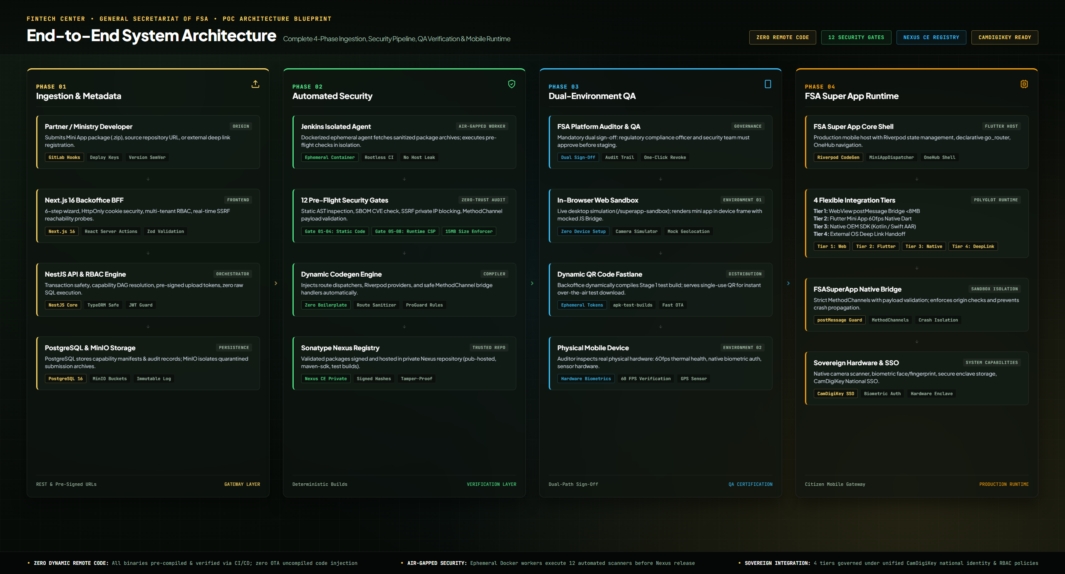
FINTECH CENTER • GENERAL SECRETARIAT OF FSA
1.2 SYSTEM ARCHITECTURE
End-to-End System Architecture Blueprint
Complete 4-phase decoupled integration pipeline: ingestion, security scanning, dual-environment QA, and mobile runtime.
4 Architectural Pillars
• Phase 01: Ingestion Gateway
Next.js 16 Backoffice BFF, NestJS Orchestrator, PostgreSQL metadata, and MinIO storage.
• Phase 02: Automated Security
Jenkins ephemeral worker, 12 security gates, AST scanner, and Sonatype Nexus CE repository.
• Phase 03: Dual-Environment QA
In-browser web sandbox device emulator and physical Android QR code fastlane verification.
• Phase 04: Mobile Runtime
Flutter host, 4 flexible integration tiers, MethodChannels, and CamDigiKey National SSO.
[CERTIFIED POC ARCHITECTURE]

Slide 5
FINTECH CENTER • GENERAL SECRETARIAT OF FSA
2.1 INTEGRATION TIERS
4 Flexible Partner Integration Tiers
Supporting existing web applications, high-performance Flutter modules, native OEM SDKs, and external ecosystem apps.
TIER 01
WebView Mini App
• Zero App Rebuild
Instantly embed existing web applications with zero mobile compilation required.
• JS Bridge Isolation
Restricted JavaScript bridge communicates over monitored postMessage channels.
• Automated Auth
Direct JWT session token injection via secure headers and CamDigiKey handoff.
HTML5 / React / Vue • <8MB
TIER 02
Flutter Mini App
• 60 FPS Native UI
Delivers fluid 60fps animations with Flutter Riverpod state architecture.
• Native Channel Bridge
Direct MethodChannel access to host camera, biometric auth, and secure storage.
• Decoupled Routes
Dynamic route registry allows independent module versioning and testing.
Dart / Riverpod • Hot Launch
TIER 03
Native Mobile SDK
• Direct OEM Modules
Integrates iOS Swift and Android Kotlin frameworks for intensive processing.
• Hardware Access
Low-level hardware access for NFC chip reading, secure element, and Bluetooth.
• Execution Guards
Strict in-flight execution guards prevent crashes from propagating to host.
Kotlin / Swift • NFC & Secure Enclave
TIER 04
External Deep Link
• App-to-App Handoff
Cryptographic single sign-on handoff to external bank and agency applications.
• Zero Binary Footprint
Adds zero megabytes to the core Super App package size.
• Verified Return URL
Cryptographically signed return callbacks verify transaction results.
Custom URL Schemes • App Links

Slide 6
FINTECH CENTER • GENERAL SECRETARIAT OF FSA
2.2 PLATFORM CAPABILITIES
Core Platform Features & Architecture
Engineered for high-volume citizen services, automated governance, and enterprise-grade performance.
Smart Size & Asset Cleaner
• Binary Symbol Stripping: Strips unused symbols, duplicate assets, and debug metadata from release builds.
• Strict Size Enforcer: Blocks builds exceeding 15MB to ensure rapid citizen mobile app downloads.
Dynamic Code Generator
• Automated Routing: Generates Riverpod providers, route tables, and bridge wrappers dynamically.
• Zero Human Error: Eliminates manual integration boilerplate and prevents route collision issues.
Multi-Tenant Backoffice RBAC
• Role-Based Isolation: Strict separation between FSA regulatory auditors, QA staff, and ministry developers.
• Audit Tracking: Logs every permission update, approval decision, and status modification.
Live Web Sandbox Emulator
• In-Browser Device Frame: Instant desktop simulation of mobile viewports, touch gestures, and bridge APIs.
• Hardware Mocking: Mocks camera feeds, GPS coordinates, and auth tokens without physical devices.
Pre-Flight Security Scanner
• 8 Automated Gates: Scans AST code, third-party SBOM packages, and SSRF network endpoints automatically.
• Immediate Quarantine: Quarantines non-compliant commits before reaching staging and release builds.
Git Multi-Branch & Nexus Sync
• Webhook Pipeline: Tracks dev, staging, and production branches with automated webhook builds.
• Nexus Enterprise Registry: Stores version-pinned, tamper-evident packages in private Nexus registry.

Slide 7
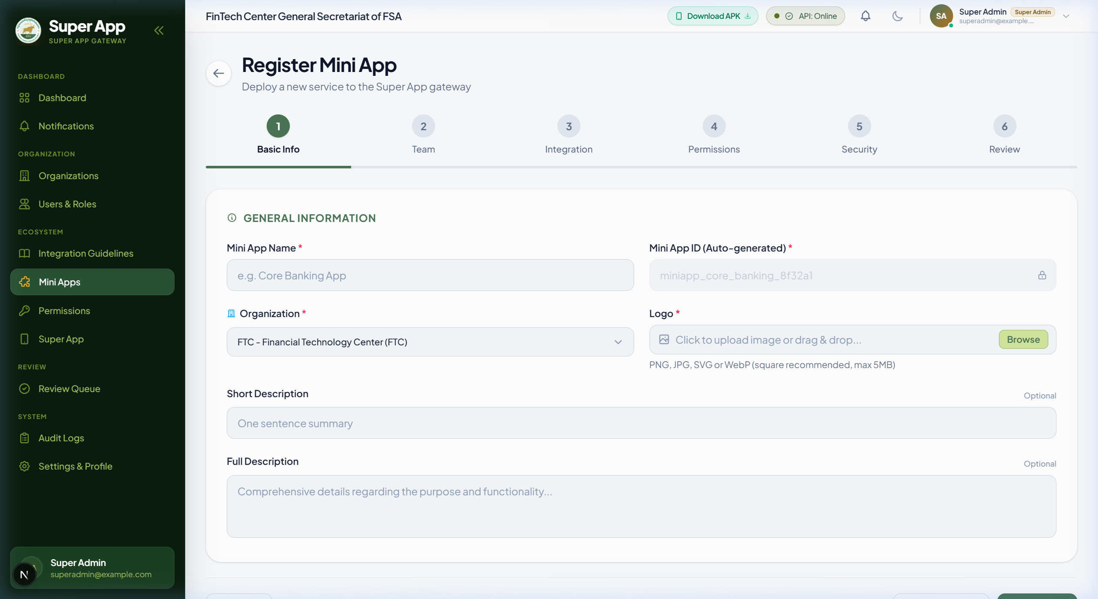
FINTECH CENTER • GENERAL SECRETARIAT OF FSA
3.1 PARTNER ONBOARDING
Partner Self-Service Portal & 6-Step Wizard
Accelerating partner onboarding from months to minutes while enforcing strict architectural and security requirements.
Structured 6-Step Developer Flow
• 01 Metadata Registration: Application name, ministry category, localized descriptions, and official icons.
• 02 Integration Tier Selection: Select architectural tier: WebView, Flutter Module, Native SDK, or Deep Link.
• 03 Repository & Branch Sync: Configure GitLab/GitHub repository URL, deployment branch, and webhook credentials.
• 04 Capability & Permission Grants: Request explicit access to native Camera, Location, Storage, and CamDigiKey SSO.
• 05 Endpoint Reachability Probes: Automated SSRF validation and DNS health probing of partner server endpoints.
• 06 Policy Disclosure & Sign-Off: Digital legal acceptance of FSA platform guidelines, queuing the submission for review.

Slide 8
FINTECH CENTER • GENERAL SECRETARIAT OF FSA
3.2 ENTERPRISE SECURITY
Multi-Layered Security Pipeline: 8 Pre-Flight Gates
Continuous automated vulnerability scanning and policy enforcement protecting the super app ecosystem before release.
Static Code & Network Scanners [GATES 01-04]
• Gate 01: SSRF & Network Endpoint Probe [PASS]
Validates endpoint reachability, blocks private RFC1918 subnets, and enforces HTTPS.
• Gate 02: Static AST Code Analysis [PASS]
Scans source code for unauthorized APIs, hardcoded credentials, and unsafe eval().
• Gate 03: SBOM & Dependency CVE Audit [PASS]
Audits all third-party libraries against national vulnerability registries and copyleft licenses.
• Gate 04: Capability & Manifest Alignment [PASS]
Ensures declared mini app permissions strictly match iOS Info.plist & Android manifest entries.
Runtime & Isolation Governance [GATES 05-08]
• Gate 05: Cryptographic Token Isolation [PASS]
Enforces HttpOnly SameSite=Strict cookies; strictly prohibits tokens in localStorage.
• Gate 06: Native MethodChannel Guard [PASS]
Validates payload schemas on all Flutter method channels to block injection attacks.
• Gate 07: Content Security Policy Enforcement [PASS]
Restricts WebView origins, script sources, and forbids framing by unauthorized domains.
• Gate 08: Immutable Regulatory Audit Log [PASS]
Records SHA-256 binary hash, operator approval, and gate logs in tamper-evident database.

Slide 9
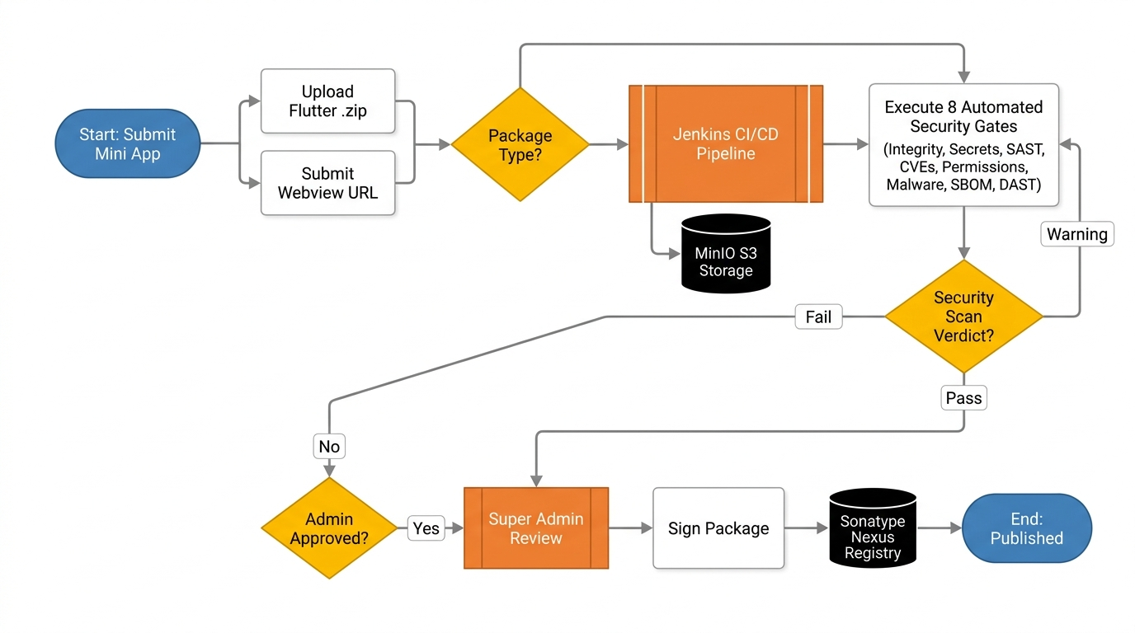
FINTECH CENTER • GENERAL SECRETARIAT OF FSA
4.1 CI/CD & NEXUS REGISTRY
CI/CD Codegen Assembly & Nexus Registry
Automating compilation, code generation, and package release in an air-gapped, verifiable DevOps pipeline.
• Zero Remote Code Loading
Strict regulatory policy: zero remote uncompiled Dart/JS loading over the air. All executable code is inspected, compiled, and pinned at build time.
• Nexus Enterprise Registry
Release bundles are versioned, signed, and hosted within a private Nexus CE repository, guaranteeing package authenticity and tamper evidence.
• Automated Jenkins CI/CD
Dynamic code generation, symbol obfuscation, ProGuard/R8 shrinking, and signed APK/AAB release generation without manual developer intervention.

Slide 10
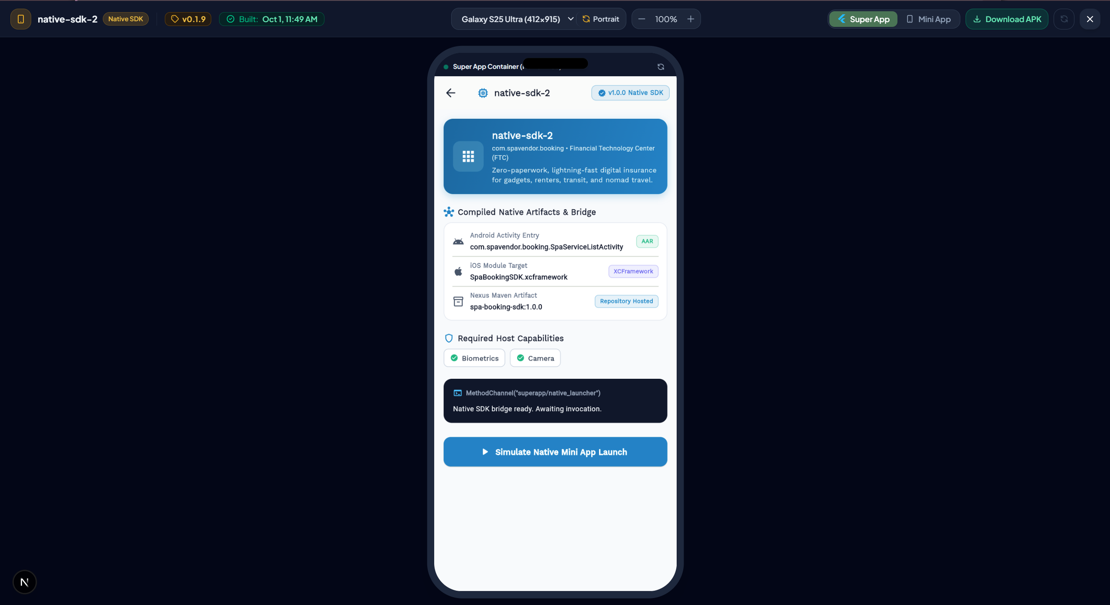
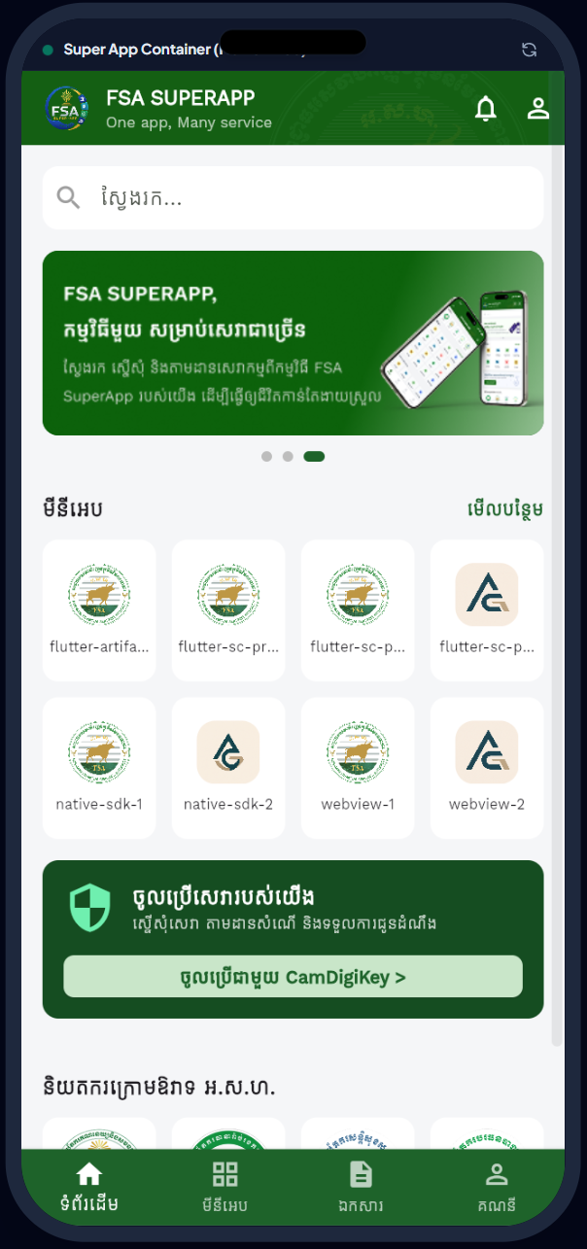
FINTECH CENTER • GENERAL SECRETARIAT OF FSA
4.2 DUAL-ENVIRONMENT QA
Dual-Environment Testing & QA Verification
Combining browser-based emulator agility with physical device hardware verification for zero-defect releases.
Environment 1: In-Browser Web Sandbox Preview
QA teams inspect UI layouts, touch response, and mock bridge APIs directly in Chrome/Edge without physical phones.
Environment 2: Physical Device Verification
Auditors scan dynamic backoffice QR codes to test live biometric scanning and physical performance.
• Dynamic QR Code Install
Instant over-the-air test builds on actual hardware.
• Live Biometric Auth
Tests real fingerprint & face scanners with host bridge.
• Camera & GPS Sensors
Validates hardware capture and geo-fencing policies.
• Fluid 60fps Experience
Verifies frame rates, thermal profiles and battery health.

Slide 11
FINTECH CENTER • GENERAL SECRETARIAT OF FSA
4.3 OPERATIONAL STATUS
Current Platform Milestones & Verification
Proven technical capabilities operating end-to-end across backend microservices, backoffice portal, and mobile runtime.
100% OPERATIONAL
4 Tiers Fully Verified
• Comprehensive Verification
WebView, Flutter Mini App, Native Android SDK, and Deep Link schemes have all completed end-to-end integration testing.
• Bridge Protocol Stability
JavaScript bridge postMessage and native Flutter MethodChannels operating with sub-millisecond response latency.
ZERO-TRUST ACTIVE
8-Gate Security Pipeline
• Automated Pre-Flight Audits
AST code parser, SSRF network probe, and SBOM vulnerability checks fully integrated into backoffice submission queue.
• Zero Hardcoded Capabilities
Dynamic capability registry synchronized with native iOS Info.plist and AndroidManifest files.
TIER-1 ARCHITECTURE
Production Stack Ready
• Modular Enterprise Core
Next.js 16 Backoffice BFF, NestJS Microservices, TypeORM transaction safety, and PostgreSQL containerized.
• Scale-Ready Foundation
Built according to national regulatory standards to support dozens of ministry mini apps concurrently.

Slide 12
FINTECH CENTER • GENERAL SECRETARIAT OF FSA
4.4 STRATEGIC ROADMAP
Next Integrations & Strategic Roadmap
Expanding ecosystem capabilities with national identity, enterprise administration, and automated synchronization.
HORIZON 01 • Q1 2027
CamDigiKey National SSO
• Single Digital Citizen Identity
Seamless integration with Cambodia's national identity authentication system for instant login across all mini apps.
• Biometric Authorization
Enables citizens to digitally sign financial and administrative documents using verified cryptographic keys.
HORIZON 02 • Q2 2027
Flagship Enterprise HR App
• First Internal Ministry Mini App
Flagship showcase featuring employee profile management, digital attendance tracking, and leave workflow approval.
• Flutter Riverpod Blueprint
Establishes the gold-standard architectural template for all subsequent enterprise ministry applications.
HORIZON 03 • Q3 2027
Automated Capability Sync
• Automated Manifest Discovery
CI/CD crawler automatically discovers new native iOS/Android capabilities from mobile core and updates the backoffice registry.
• Zero Hardcoded Configuration
Maintains total zero-hardcode compliance by dynamically generating permission selectors and bridge adapters.

Slide 13
FINTECH CENTER • GENERAL SECRETARIAT OF FSA
SYSTEM DEMO
Live Platform Demonstration
Walkthrough of the partner onboarding wizard, automated pre-flight security scan, and live mobile execution.
STAGE 01
1. Partner Onboarding
• Rapid Configuration
Registering a new ministry service, configuring GitLab repository hooks, and requesting camera and location permissions.
• Live Probing
Observing real-time SSRF and DNS endpoint validation before saving the partner profile.
STAGE 02
2. Pre-Flight Security
• Instant Vulnerability Scan
Executing the 8 security scanners against the partner codebase and generating the executive compliance report.
• Operator Sign-Off
Regulatory review in the live web sandbox emulator and promoting the build to staging.
STAGE 03
3. Mobile Runtime
• Seamless Launch
Scanning the dynamic QR code on a physical mobile device and launching the Flutter mini app with zero perceptible latency.
• Native Bridge Execution
Testing real camera scanning, biometric authorization, and secure session management.

Slide 14
FINTECH CENTER OF GENERAL SECRETARIAT OF FSA
Super App & Mini App Platform
Open for Strategic Guidance, Architectural Questions & Executive Direction
SOVEREIGN SECURITY • ARCHITECTURAL AGILITY • REGULATORY GOVERNANCE
Non-Bank Financial Services Authority (FSA) • Core Engineering POC

