Slide 1

DIGITAL PUBLIC SERVICE PLATFORM
Super App & Mini App Platform
A unified, enterprise-grade mobile container and partner integration gateway powering secure digital public services.
Non-Bank Financial Services Authority (FSA)

Slide 2
FINTECH CENTER • NON-BANK FINANCIAL SERVICES AUTHORITY (FSA)
AGENDA
Table of Contents
Comprehensive overview of architecture, security checkpoints, and operational milestones.
01
Strategic Vision
The Challenge of Fragmentation vs. Unified Super App Ecosystem
05
Security Scan Flow
Release Builds, Dynamic Codegen & Mainline Git Isolation
02
4 Flexible Integration Tiers
WebView, Flutter Package, Native SDK, Deep Link Schemes
06
Dual-Environment Testing Engine
Flutter Web Sandbox + Physical Android Device Verification
03
Partner Self-Service Portal
Backoffice Onboarding Wizard & Real-time Probes
07
Current Operational Milestones
Working Prototypes, Production Readiness & Architecture Integrity
04
8 Multi-Layered Security Gates
Automated Security Scanners Orchestrated by CI/CD Pipeline
08
Next Integrations
CamDigiKey SSO, HR Enterprise Mini App, SA Capability Generator

Slide 3
FINTECH CENTER • NON-BANK FINANCIAL SERVICES AUTHORITY (FSA)
STRATEGIC VISION
The Challenge & The Solution
Transforming fragmented citizen applications into a unified digital public service ecosystem.
⚠️ The Fragmented Dilemma
✨ The Unified Super App Solution
✕ Citizens forced to download dozens of separate standalone government and financial applications.
✓ One App for All Services: High-performance Flutter container hosting dynamic on-demand Mini Apps.
✕ Inconsistent authentication, variable security postures, and fragmented citizen profiles across services.
✓ Automated Security Gates: Strict network isolation, domain verification, and 8-stage SAST/DAST compliance.
✕ Slow partner onboarding with high engineering costs, duplicated infrastructure, and tedious release reviews.
✓ Self-Service Backoffice: Instant registration wizard, live reachability checks, and version governance.
✕ Heavy maintenance burden for government authorities with unstandardized mobile deployment pipelines.
✓ Zero Mobile Git Mutation: Codegen and Nexus artifact hosting ensure sovereign, clean continuous deployment.

Slide 4
FINTECH CENTER • NON-BANK FINANCIAL SERVICES AUTHORITY (FSA)
ARCHITECTURE
4 Flexible Integration Tiers
Supporting any partner technology stack with zero manual host application modification.
WebView Mini Apps (H5 / Web)
INSTANT WEB DEPLOY
Flutter Package (Git / Nexus)
HIGH PERFORMANCE
Interactive responsive web applications running in a sandboxed Web container with bidirectional SuperAppJSBridge and native hardware capability access (camera, location, storage).
High-performance in-app micro-apps integrated via Git repository source OR hosted Dart Pub artifacts from Sonatype Nexus CE with offline caching and native 120 FPS transitions.
Native SDK Frameworks (.aar / .xcframework)
ENTERPRISE BINARY
Deep Link & App Links (OS Scheme)
EXTERNAL ECOSYSTEM
Platform-specific binary modules integrated automatically via Native SDK Codegen and Universal Native Launcher without manual mobile codebase edits.
Seamless OS-level URL scheme delegation (e.g. cambodia-tax://) to external standalone applications with automated App Store / Play Store fallback routing.

Slide 5
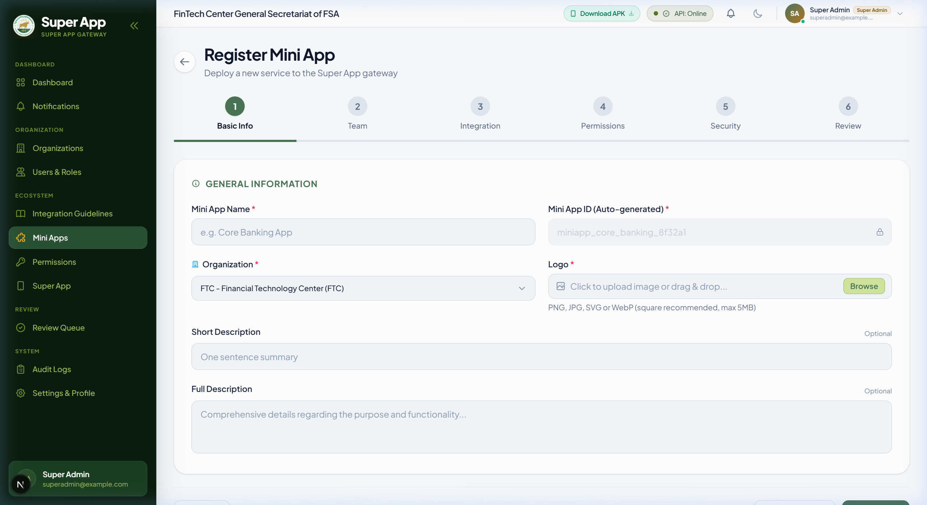
FINTECH CENTER • NON-BANK FINANCIAL SERVICES AUTHORITY (FSA)
DEVELOPER EXPERIENCE
Partner Self-Service & Developer Portal
Next.js Backoffice Admin Portal with live URL reachability, capability proposals, and regulatory vetting.
📋 6-Step Onboarding Wizard
Guided step-by-step registration capturing app metadata, identity branding logos, technical integration endpoints, and ownership credentials.
⚡ Live URL Reachability Probes
Real-time debounced HTTP & TCP probes verifying production URLs, privacy policy endpoints, and store fallbacks during data entry.
🛡️ Flexible Policy Disclosures
Supports live HTTPS regulatory URLs or self-contained offline Markdown policy documents with built-in compliance templates.

Slide 6
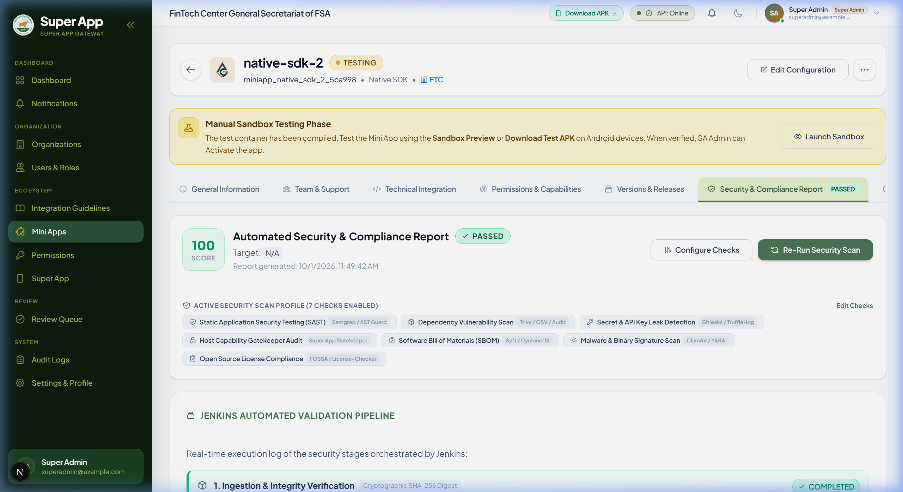
FINTECH CENTER • NON-BANK FINANCIAL SERVICES AUTHORITY (FSA)
ENTERPRISE SECURITY • STRICT
8 Automated Security Scanners & Gates
Multi-layered validation pipeline executed automatically by Jenkins CI/CD on every package submission.
01. Cryptographic SHA-256 [PASS ✓]
02. Gitleaks Secret [PASS ✓]
03. Semgrep & AST Guard (SAST) [PASS ✓]
04. Trivy & OSV Database (SCA/CVE) [PASS ✓]
05. Super App Gatekeeper [PASS ✓]
06. Syft CycloneDX (SBOM) [PASS ✓]
07. License Compliance Scanner [PASS ✓]
08. ClamAV & YARA Malware Scan [PASS ✓]

Slide 7
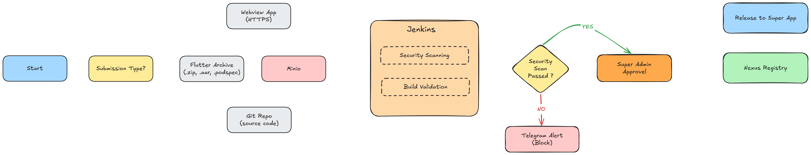
FINTECH CENTER • NON-BANK FINANCIAL SERVICES AUTHORITY (FSA)
AUTOMATED ASSEMBLY
Security Scan Flow
Release-mode compilation with Jenkins, Sonatype Nexus Repository CE, and automated SDK codegen.

Slide 8
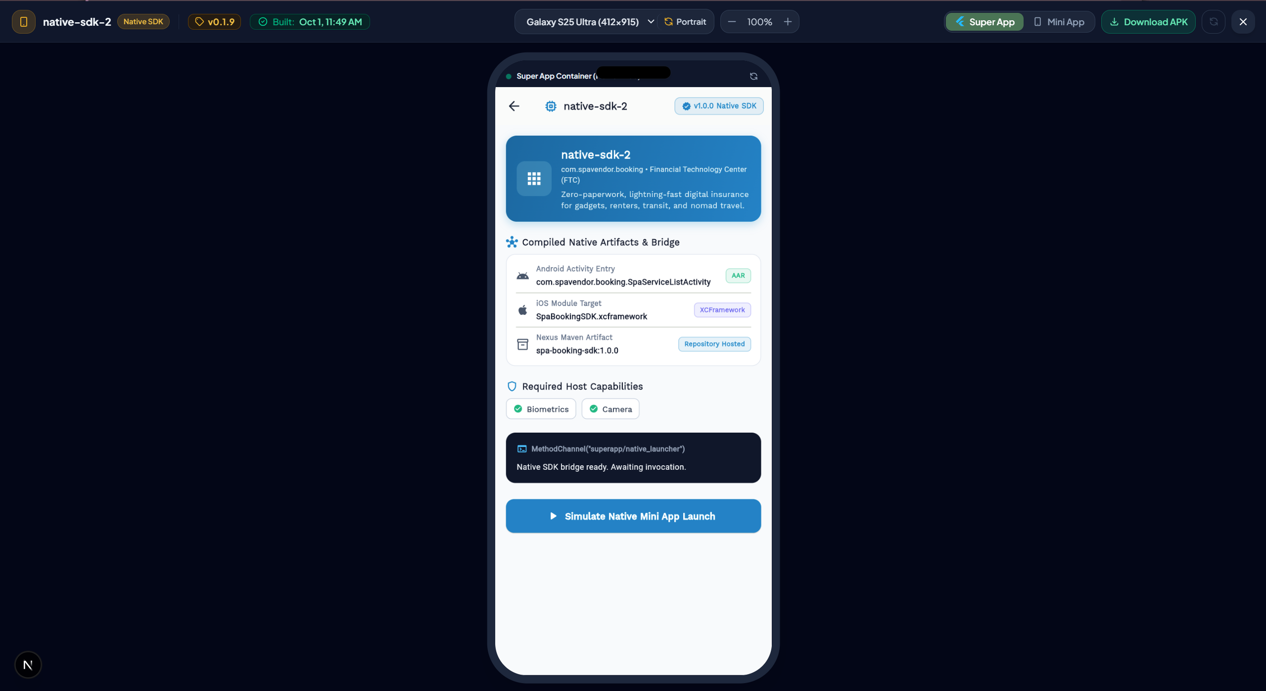
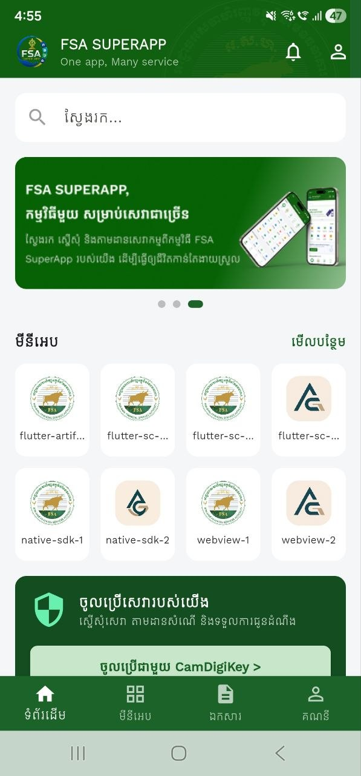
FINTECH CENTER • NON-BANK FINANCIAL SERVICES AUTHORITY (FSA)
TESTING & VERIFICATION
Dual-Environment Testing & QA Engine
Instant in-browser Flutter Web simulation combined with physical Android device verification.
Web:
Mobile:

Slide 9
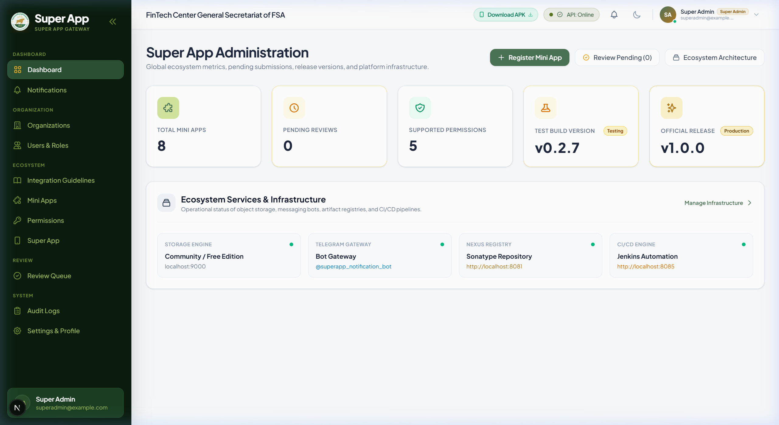
FINTECH CENTER • NON-BANK FINANCIAL SERVICES AUTHORITY (FSA)
STATUS & ACHIEVEMENTS
Current Milestones & Operational Status
Working prototype and governance infrastructure fully validated end-to-end.
4 Tiers Verified (90%)
WebView Mini App, Flutter Package, Native SDK, and Deep Link validated end-to-end with live sample services.
2-Stage Automated CI/CD
Jenkins compilation pipelines & Sonatype Nexus CE repository operational with automated release packaging.
Production Infrastructure
Consolidated database schema, real-time Socket.IO notifications, and high-reliability Docker containers published.

Slide 10
FINTECH CENTER • NON-BANK FINANCIAL SERVICES AUTHORITY (FSA)
STRATEGIC ROADMAP
Next Integrations
Upcoming high-impact integrations and enterprise ecosystem expansion.
🏢 HR Mini App
⚙️ SA Capability Generator
🆔 CamDigiKey Integration

Slide 11
DEMO
Non-Bank Financial Services Authority (FSA) • Core Engineering Team

Slide 12
🤝 Q&A / THANK YOU
Thank You!
Empowering national-scale digital public services and partner ecosystems through a unified, secure Super App platform.
Non-Bank Financial Services Authority (FSA) • Core Engineering Team

