Slide 1
MODERN OPERATING SYSTEMS
Third Edition
ANDREW S. TANENBAUM
Орчин үеийн үйлдлийн системүүд
Tanenbaum, Modern Operating Systems 3 e, (c) 2008 Prentice-Hall, Inc. All rights reserved. 0-13-6006639

Slide 2
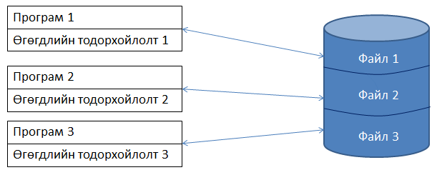
- Дээхнэ үед програмууд өгөгдлийг энгийн файлуудад хадгалдаг байсан.
- Програм бүр өөрийн өгөгдөлтэй
  – өртөг ихтэй
  – алдаа ихтэй
Tanenbaum, Modern Operating Systems 3 e, (c) 2008 Prentice-Hall, Inc. All rights reserved. 0-13-6006639

Slide 3
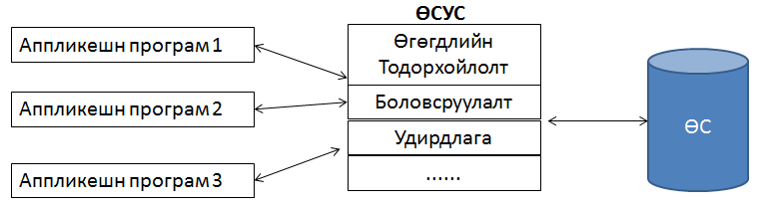
- Өгөгдлийн хандалт болон удирдлага төвлөрсөн
- Аппликешн нь файлын физик болон логик зохион байгуулалтаас тусгаар болсон.
Tanenbaum, Modern Operating Systems 3 e, (c) 2008 Prentice-Hall, Inc. All rights reserved. 0-13-6006639

Slide 4
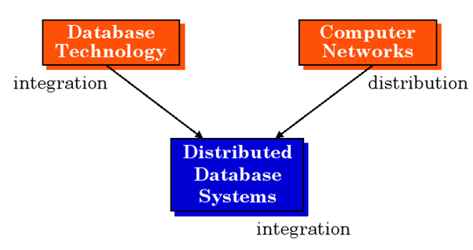
Tanenbaum, Modern Operating Systems 3 e, (c) 2008 Prentice-Hall, Inc. All rights reserved. 0-13-6006639

Slide 5
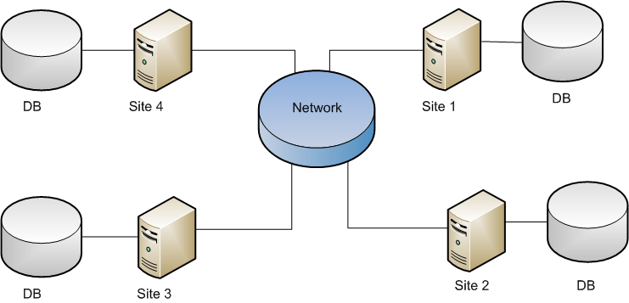
Tanenbaum, Modern Operating Systems 3 e, (c) 2008 Prentice-Hall, Inc. All rights reserved. 0-13-6006639

Slide 6
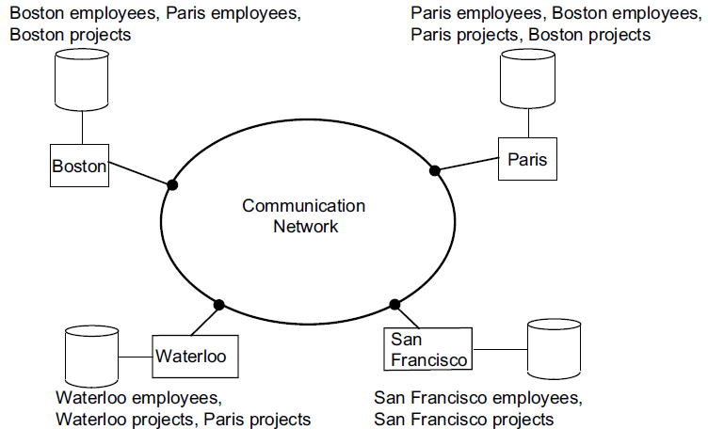
Tanenbaum, Modern Operating Systems 3 e, (c) 2008 Prentice-Hall, Inc. All rights reserved. 0-13-6006639

Slide 7
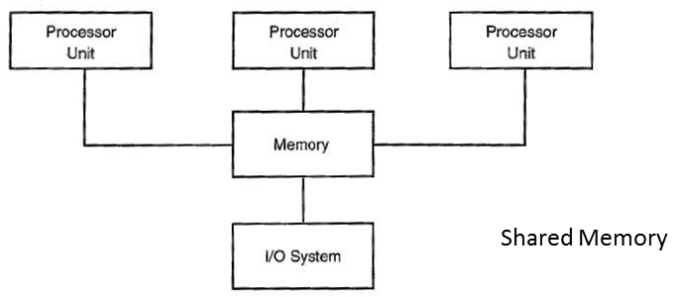
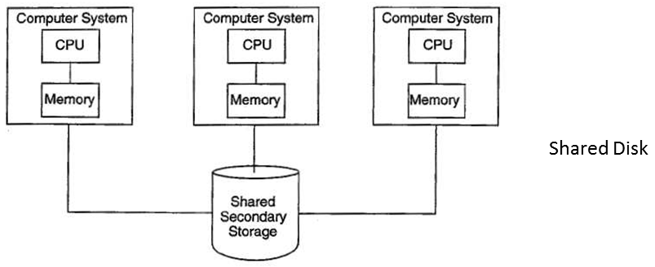
Tanenbaum, Modern Operating Systems 3 e, (c) 2008 Prentice-Hall, Inc. All rights reserved. 0-13-6006639

Slide 8
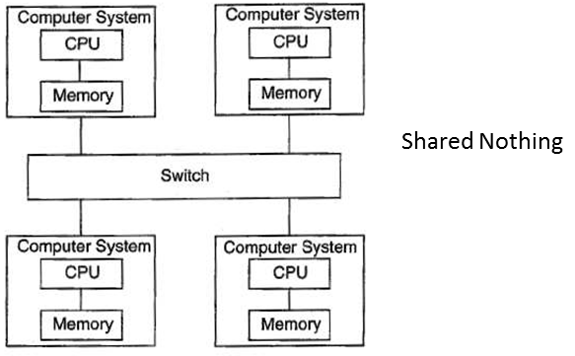
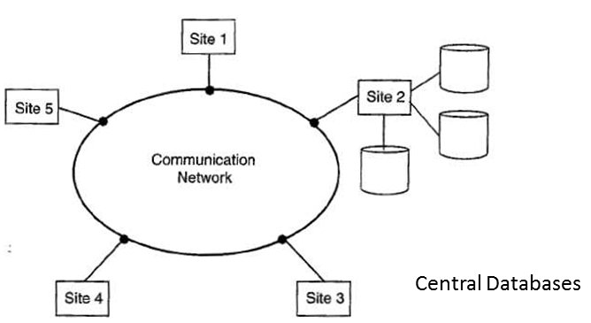
Tanenbaum, Modern Operating Systems 3 e, (c) 2008 Prentice-Hall, Inc. All rights reserved. 0-13-6006639

Slide 9
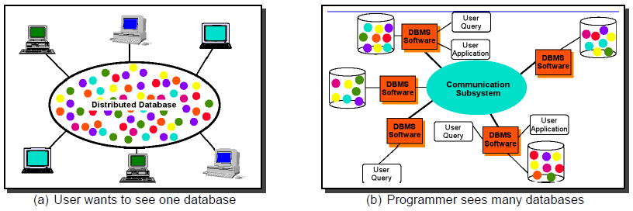
Tanenbaum, Modern Operating Systems 3 e, (c) 2008 Prentice-Hall, Inc. All rights reserved. 0-13-6006639

Slide 10
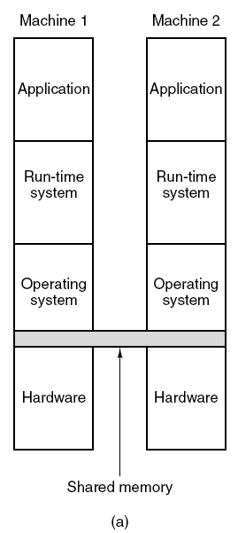
Хуваарилагдсан Shared Memory (1)
Зураг 8-21. Олон түвшингүүд –санах ойг хамтран эзэмшиж байгаа байдал.
(a) Техник хангамж.
Tanenbaum, Modern Operating Systems 3 e, (c) 2008 Prentice-Hall, Inc. All rights reserved. 0-13-6006639

Slide 11
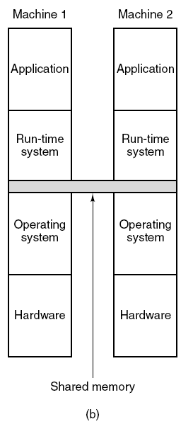
Хуваарилагдсан Shared Memory (2)
Figure 8-21. Олон түвшингүүд –санах ойг хамтран эзэмшиж байгаа байдал.
(b) Үйлдлийн систем.
Tanenbaum, Modern Operating Systems 3 e, (c) 2008 Prentice-Hall, Inc. All rights reserved. 0-13-6006639

Slide 12
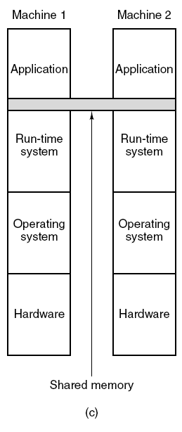
Хуваарилагдсан Shared Memory (3)
Figure 8-21. Олон түвшингүүд –санах ойг хамтран эзэмшиж байгаа байдал.
(c) Хэрэглэгчийн түвшний программ хангамж.
Tanenbaum, Modern Operating Systems 3 e, (c) 2008 Prentice-Hall, Inc. All rights reserved. 0-13-6006639

Slide 13
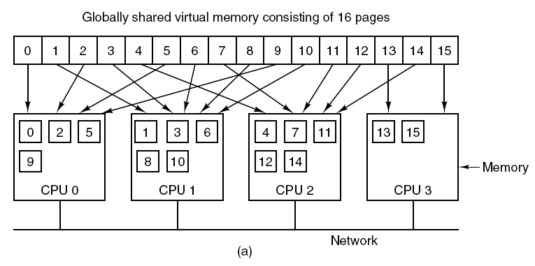
Хуваарилагдсан Shared Memory (4)
Зураг 8-22. (a) 4 CPU –ны хооронд хаягийн орон зай дахь хуудаснуудыг хуваарилсан байдал.
Tanenbaum, Modern Operating Systems 3 e, (c) 2008 Prentice-Hall, Inc. All rights reserved. 0-13-6006639

Slide 14
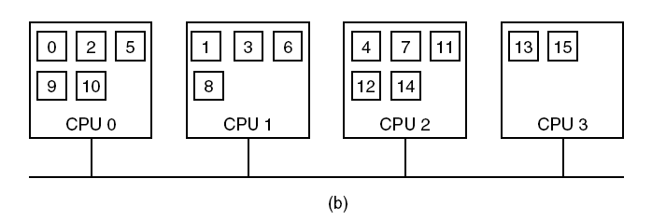
Хуваарилагдсан Shared Memory (5)
Зураг 8-22. (b) CPU 1 хуудас 10 –г гүйцэтгэсний дараа устана.
Tanenbaum, Modern Operating Systems 3 e, (c) 2008 Prentice-Hall, Inc. All rights reserved. 0-13-6006639

Slide 15
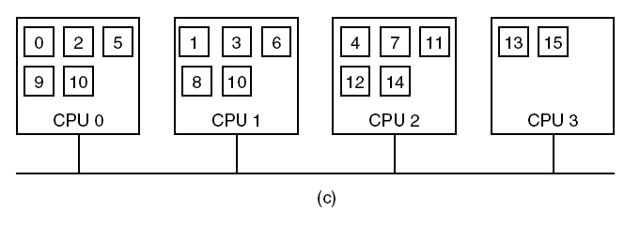
Хуваарилагдсан Shared Memory (6)
Figure 8-22. (c) Хэрэв хуудас 10 зөвхөн унших,олшуулагдаж байгаа бол.
Tanenbaum, Modern Operating Systems 3 e, (c) 2008 Prentice-Hall, Inc. All rights reserved. 0-13-6006639

Slide 16
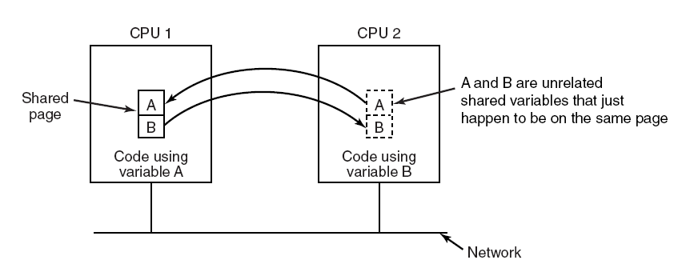
False Sharing
Зураг 8-23. 2 харилцан хамааралгүй хувьсагчуудыг агуулж байгаа хуудасны худал хамтран эзэмшилт (False sharing).
Tanenbaum, Modern Operating Systems 3 e, (c) 2008 Prentice-Hall, Inc. All rights reserved. 0-13-6006639

Slide 17
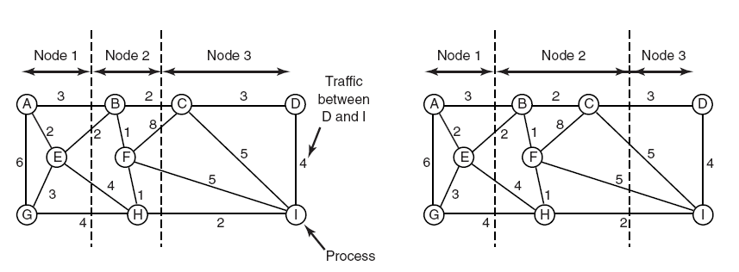
Графын онол- Deterministic алгоритм
Зураг 8-24. 9 процессыг 3 зангилаанд хуваарилах
2 арга.
Tanenbaum, Modern Operating Systems 3 e, (c) 2008 Prentice-Hall, Inc. All rights reserved. 0-13-6006639

Slide 18
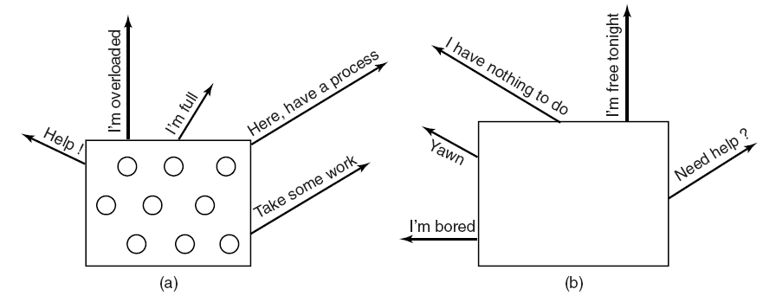
A Sender-Initiated Distributed
Heuristic Algorithm
Figure 8-25. (a) An overloaded node looking for a
lightly loaded node to hand off processes to.
(b) An empty node looking for work to do.
Tanenbaum, Modern Operating Systems 3 e, (c) 2008 Prentice-Hall, Inc. All rights reserved. 0-13-6006639

Slide 19
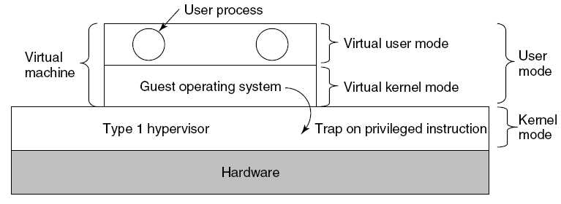
Type 1 Hypervisors
Figure 8-26. When the operating system in a virtual machine executes a kernel-only instruction, it traps to the hypervisor if virtualization technology is present.
Tanenbaum, Modern Operating Systems 3 e, (c) 2008 Prentice-Hall, Inc. All rights reserved. 0-13-6006639

Slide 20
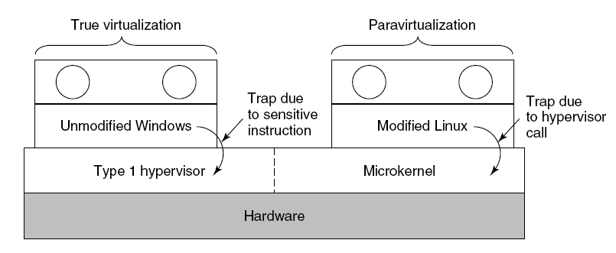
Paravirtualization (1)
Figure 8-27. A hypervisor supporting both true
virtualization and paravirtualization.
Tanenbaum, Modern Operating Systems 3 e, (c) 2008 Prentice-Hall, Inc. All rights reserved. 0-13-6006639

Slide 21
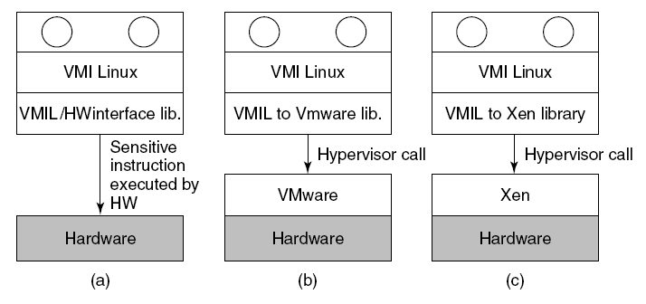
Paravirtualization (2)
Figure 8-28. VMI Linux running on (a) the bare hardware
(b) VMware (c) Xen.
Tanenbaum, Modern Operating Systems 3 e, (c) 2008 Prentice-Hall, Inc. All rights reserved. 0-13-6006639

Slide 22
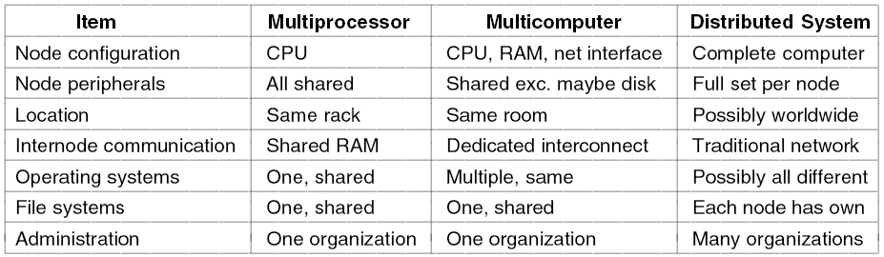
Хуваарилагдсан системүүд (1)
Зураг 8-29. Олон CPU –тэй 3 төрлийн системийг харьцуулсан байдал.
Tanenbaum, Modern Operating Systems 3 e, (c) 2008 Prentice-Hall, Inc. All rights reserved. 0-13-6006639

Slide 23
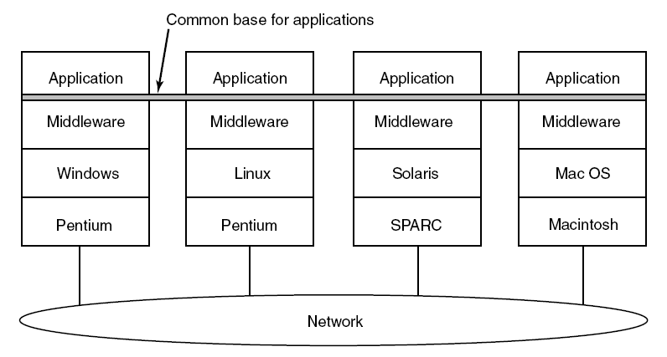
Хуваарилагдсан системүүд(2)
Зураг 8-30. Хуваарилагдсан систем дэх дундын/холбогч программ.
Tanenbaum, Modern Operating Systems 3 e, (c) 2008 Prentice-Hall, Inc. All rights reserved. 0-13-6006639

