Slide 1
MODERN OPERATING SYSTEMS
Third Edition
ANDREW S. TANENBAUM
Бүлэг 8
Олон процессорын систем
Tanenbaum, Modern Operating Systems 3 e, (c) 2008 Prentice-Hall, Inc. All rights reserved. 0-13-6006639

Slide 2
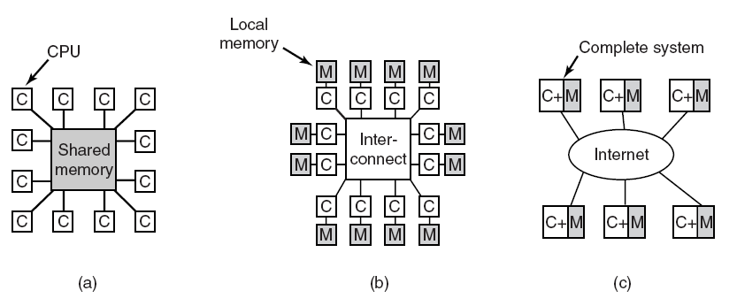
Олон процессорын системүүд
Figure 8-1. (a) A shared-memory multiprocessor. (b) A message-passing multicomputer. (c) A wide area distributed system.
Tanenbaum, Modern Operating Systems 3 e, (c) 2008 Prentice-Hall, Inc. All rights reserved. 0-13-6006639

Slide 3
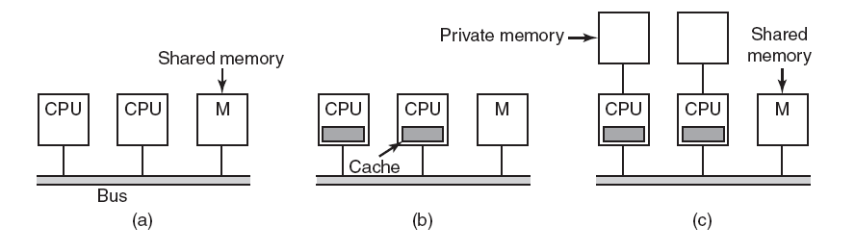
Шугам –д үндэслэгдсэн бүтэцтэй UMA олон процессорууд
Figure 8-2. Three bus-based multiprocessors. (a) Without caching. (b) With caching. (c) With caching and private memories.
Tanenbaum, Modern Operating Systems 3 e, (c) 2008 Prentice-Hall, Inc. All rights reserved. 0-13-6006639

Slide 4
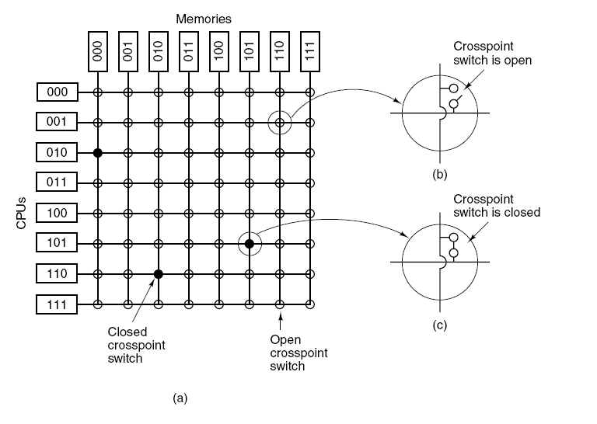
UMA олон процессорууд
(Crossbar Switches)
Figure 8-3. (a) An 8 × 8 crossbar switch. (b) An open crosspoint. (c) A closed crosspoint.
Tanenbaum, Modern Operating Systems 3 e, (c) 2008 Prentice-Hall, Inc. All rights reserved. 0-13-6006639

Slide 5
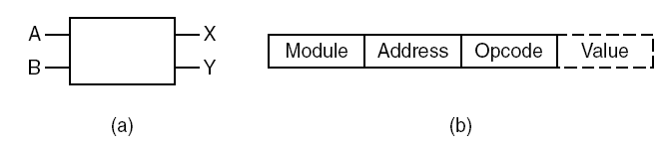
UMA олон процессорууд – олон шатлалт Switching сүлжээнүүд (1)
Figure 8-4. (a) A 2 × 2 switch with two input lines, A and B, and two output lines, X and Y. (b) A message format.
Tanenbaum, Modern Operating Systems 3 e, (c) 2008 Prentice-Hall, Inc. All rights reserved. 0-13-6006639

Slide 6
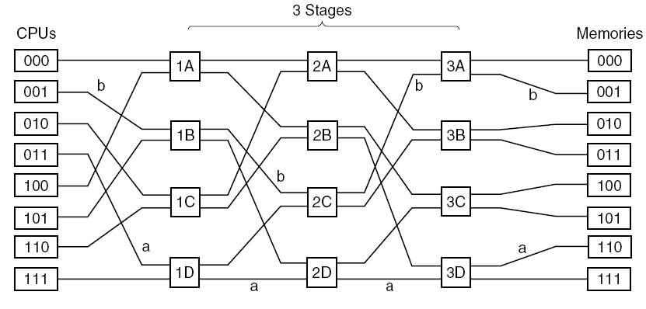
UMA олон процессорууд – олон шатлалт Switching сүлжээнүүд (2)
Зураг 8-5. omega сэлгэн залгалтын сүлжээ.
Tanenbaum, Modern Operating Systems 3 e, (c) 2008 Prentice-Hall, Inc. All rights reserved. 0-13-6006639

Slide 7
NUMA олон процессорууд (1)
Characteristics of NUMA machines:
There is a single address space visible to all CPUs.
Access to remote memory is via LOAD and STORE instructions.
Access to remote memory is slower than access to local memory.
Tanenbaum, Modern Operating Systems 3 e, (c) 2008 Prentice-Hall, Inc. All rights reserved. 0-13-6006639

Slide 8
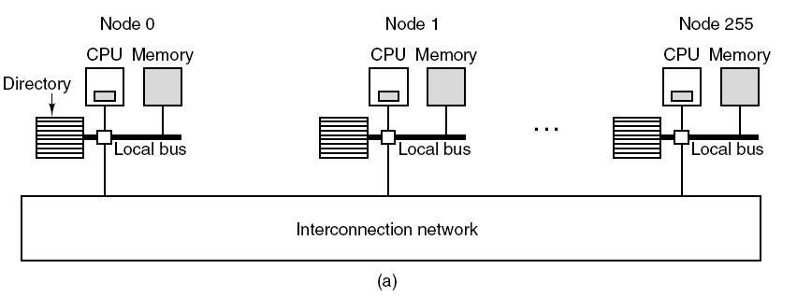
NUMA олон процессорууд (2)
Figure 8-6. (a) A 256-node directory-based multiprocessor.
Tanenbaum, Modern Operating Systems 3 e, (c) 2008 Prentice-Hall, Inc. All rights reserved. 0-13-6006639

Slide 9
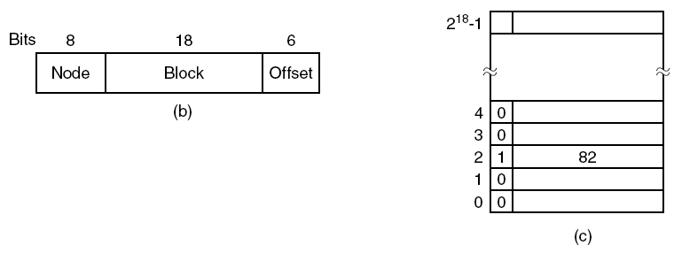
NUMA олон процессорууд (3)
Figure 8-6. (b) Division of a 32-bit memory address into fields.
(c) The directory at node 36.
Tanenbaum, Modern Operating Systems 3 e, (c) 2008 Prentice-Hall, Inc. All rights reserved. 0-13-6006639

Slide 10
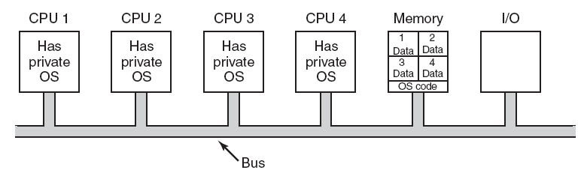
CPU бүр өөрийн үйлдлийн системтэй
Figure 8-7. Partitioning multiprocessor memory among four CPUs, but sharing a single copy of the operating system code.
The boxes marked Data are the operating
system’s private data for each CPU.
Tanenbaum, Modern Operating Systems 3 e, (c) 2008 Prentice-Hall, Inc. All rights reserved. 0-13-6006639

Slide 11
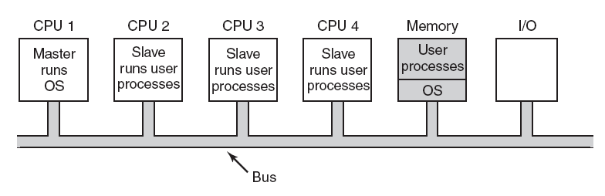
Master-Slave олон процессорууд
Зураг 8-8. A master-slave олон процессорын загвар.
Tanenbaum, Modern Operating Systems 3 e, (c) 2008 Prentice-Hall, Inc. All rights reserved. 0-13-6006639

Slide 12
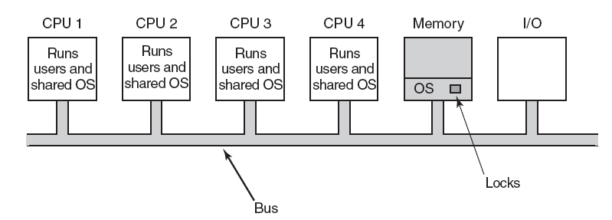
Тэгш хэмт (Symmetric) олон процессорууд
Зураг 8-9. SMP олон процессорын загвар.
Tanenbaum, Modern Operating Systems 3 e, (c) 2008 Prentice-Hall, Inc. All rights reserved. 0-13-6006639

Slide 13
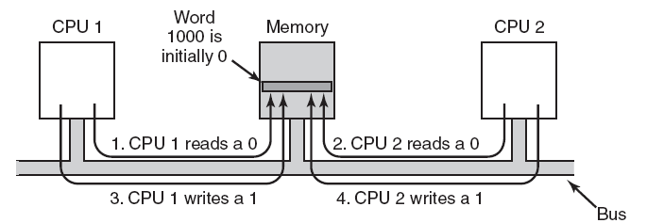
Олон процессорын синхрончлол (1)
Figure 8-10. The TSL instruction can fail if the bus cannot be locked. These four steps show a sequence of events where the failure is demonstrated.
Tanenbaum, Modern Operating Systems 3 e, (c) 2008 Prentice-Hall, Inc. All rights reserved. 0-13-6006639

Slide 14
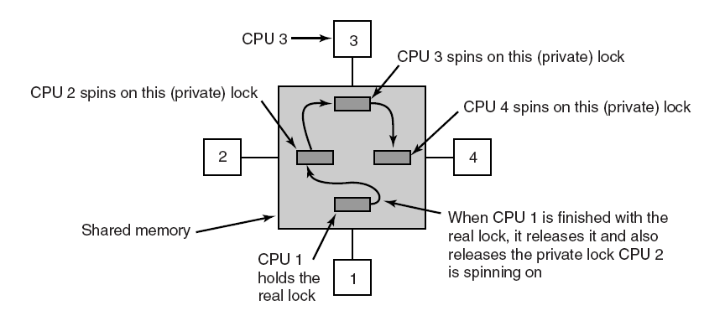
Олон процессорын синхрончлол (2)
Figure 8-11. Use of multiple locks to avoid cache thrashing.
Tanenbaum, Modern Operating Systems 3 e, (c) 2008 Prentice-Hall, Inc. All rights reserved. 0-13-6006639

Slide 15
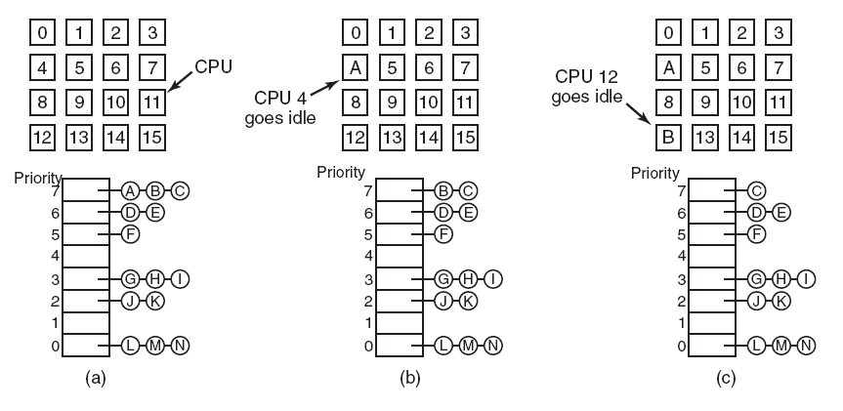
Timesharing
Figure 8-12. Using a single data structure for scheduling a multiprocessor.
Tanenbaum, Modern Operating Systems 3 e, (c) 2008 Prentice-Hall, Inc. All rights reserved. 0-13-6006639

Slide 16
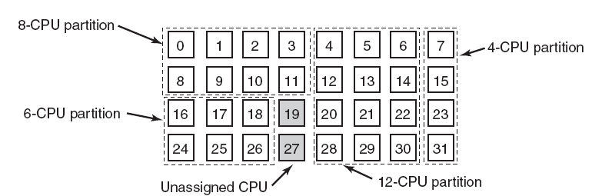
Space Sharing
Figure 8-13. A set of 32 CPUs split into four partitions,
with two CPUs available.
Tanenbaum, Modern Operating Systems 3 e, (c) 2008 Prentice-Hall, Inc. All rights reserved. 0-13-6006639

Slide 17
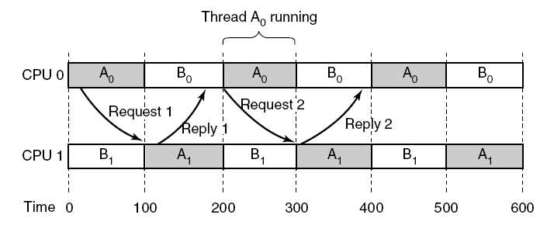
Gang хуваарилалт (1)
Figure 8-14. Communication between two threads belonging to thread A that are running out of phase.
Tanenbaum, Modern Operating Systems 3 e, (c) 2008 Prentice-Hall, Inc. All rights reserved. 0-13-6006639

Slide 18
Gang хуваарилалт (2)
The three parts of gang scheduling:
Groups of related threads are scheduled as a unit, a gang.
All members of a gang run simultaneously, on different timeshared CPUs.
All gang members start and end their time slices together.
Tanenbaum, Modern Operating Systems 3 e, (c) 2008 Prentice-Hall, Inc. All rights reserved. 0-13-6006639

Slide 19
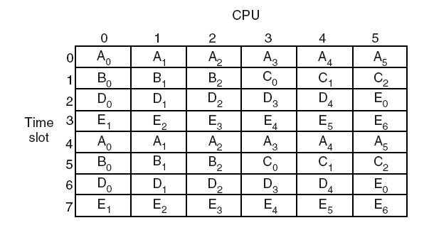
Gang хуваарилалт (3)
Figure 8-15. Gang scheduling.
Tanenbaum, Modern Operating Systems 3 e, (c) 2008 Prentice-Hall, Inc. All rights reserved. 0-13-6006639

Slide 20
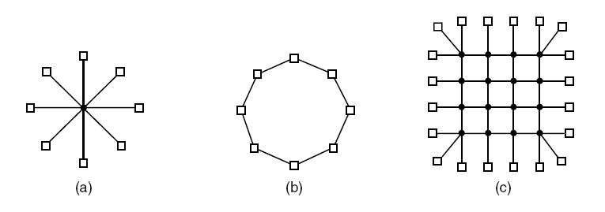
Харилцан холболтын технологи (1)
Figure 8-16. Various interconnect topologies.
(a) A single switch. (b) A ring. (c) A grid.
Tanenbaum, Modern Operating Systems 3 e, (c) 2008 Prentice-Hall, Inc. All rights reserved. 0-13-6006639

Slide 21
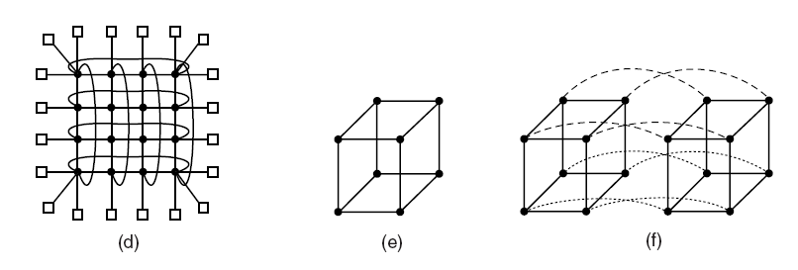
Харилцан холболтын технологи (2)
Figure 8-16. Various interconnect topologies.
(d) A double torus. (e) A cube. (f) A 4D hypercube.
Tanenbaum, Modern Operating Systems 3 e, (c) 2008 Prentice-Hall, Inc. All rights reserved. 0-13-6006639

Slide 22
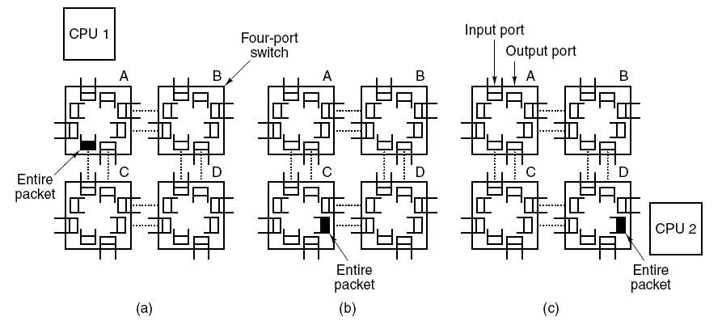
Харилцан холболтын технологи (3)
Figure 8-17. Store-and-forward packet switching.
Tanenbaum, Modern Operating Systems 3 e, (c) 2008 Prentice-Hall, Inc. All rights reserved. 0-13-6006639

Slide 23
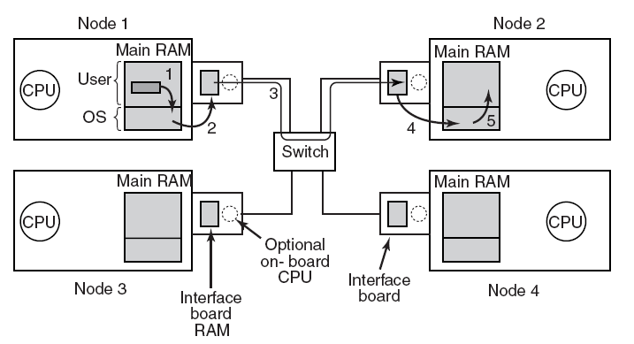
Сүлжээний интерфэйс
Зураг 8-18. Олон компьютер дах сүлжээний интерфэйсийн хавтангийн байрлал.
Tanenbaum, Modern Operating Systems 3 e, (c) 2008 Prentice-Hall, Inc. All rights reserved. 0-13-6006639

Slide 24
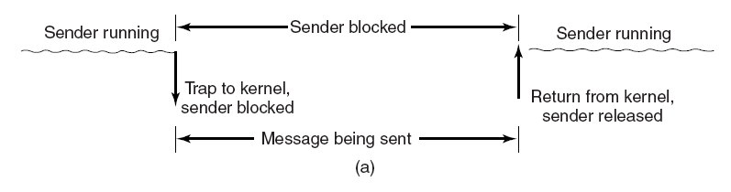
Blocking versus Nonblocking Calls (1)
Зураг 8-19. (a) A blocking send call.
Tanenbaum, Modern Operating Systems 3 e, (c) 2008 Prentice-Hall, Inc. All rights reserved. 0-13-6006639

Slide 25
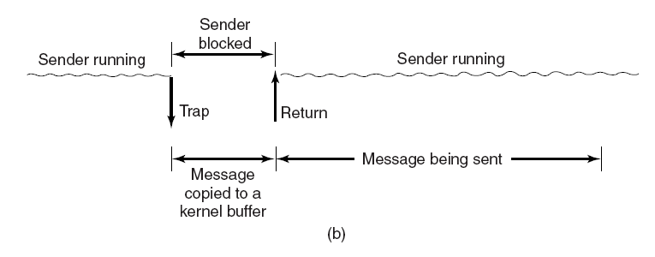
Blocking versus Nonblocking Calls (2)
Figure 8-19. (b) A nonblocking send call.
Tanenbaum, Modern Operating Systems 3 e, (c) 2008 Prentice-Hall, Inc. All rights reserved. 0-13-6006639

Slide 26
Blocking versus Nonblocking Calls (3)
Choices on the sending side:
Blocking send (CPU idle during message transmission).
Nonblocking send with copy (CPU time wasted for the extra copy).
Nonblocking send with interrupt (makes programming difficult).
Copy on write (extra copy probably needed eventually).
Tanenbaum, Modern Operating Systems 3 e, (c) 2008 Prentice-Hall, Inc. All rights reserved. 0-13-6006639

Slide 27
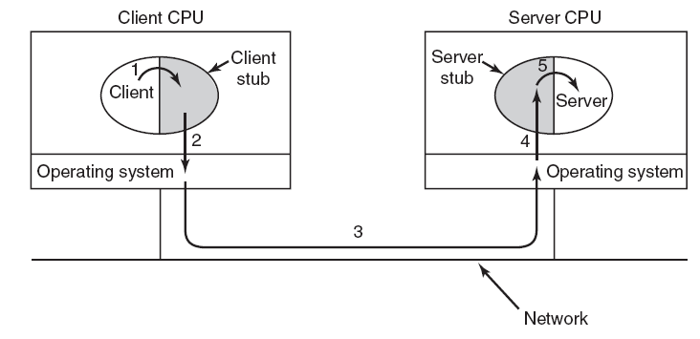
Алсын үйл ажиллагааны дуудлага
Зураг 8-20. Алсын үйл ажиллагааны дуудлага хийх алхамууд.
Tanenbaum, Modern Operating Systems 3 e, (c) 2008 Prentice-Hall, Inc. All rights reserved. 0-13-6006639

