Slide 1
Файл системүүд
Tanenbaum, Modern Operating Systems 3 e, (c) 2008 Prentice-Hall, Inc. All rights reserved. 0-13-6006639

Slide 2
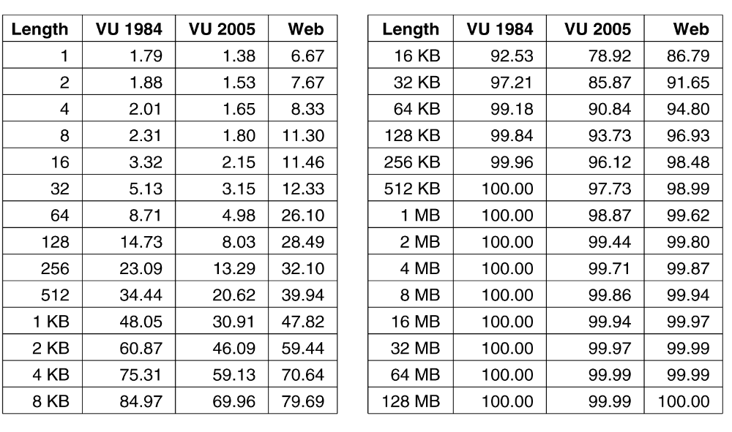
Дискны зайн удирдлагын блокын хэмжээ
Figure 4-20. Өгөгдсөн хэмжээнээс бага файлын % (байт).
Tanenbaum, Modern Operating Systems 3 e, (c) 2008 Prentice-Hall, Inc. All rights reserved. 0-13-6006639

Slide 3
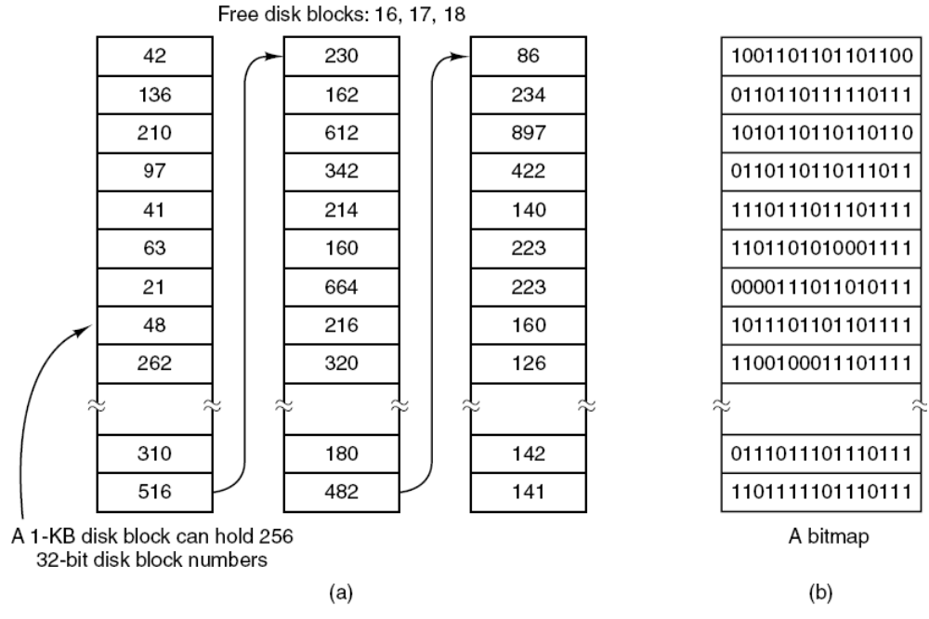
Хоосон блокуудыг хадгалах
Figure 4-22. (a) Storing the free list on a linked list. (b) A bitmap.
Tanenbaum, Modern Operating Systems 3 e, (c) 2008 Prentice-Hall, Inc. All rights reserved. 0-13-6006639

Slide 4
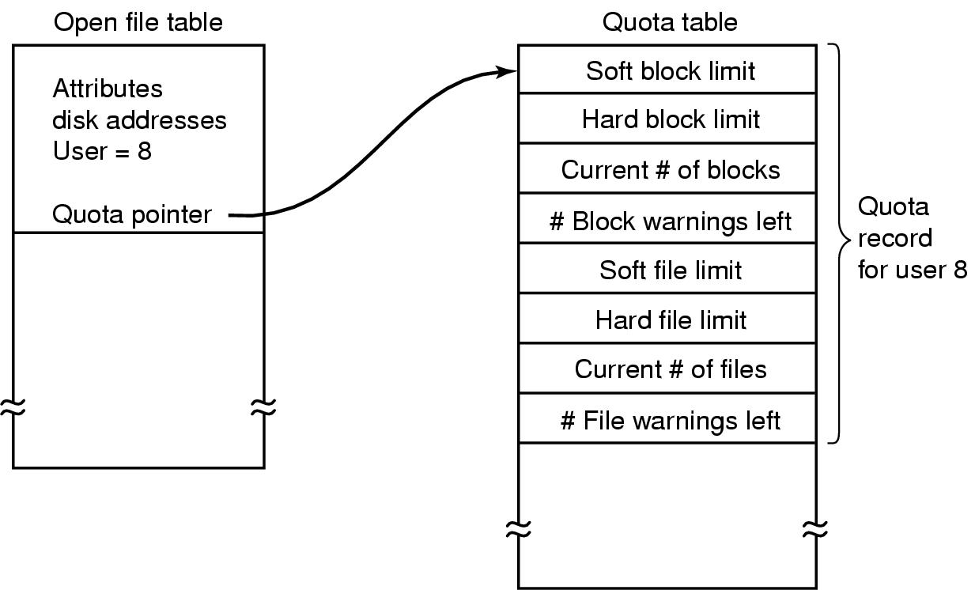
Дискны квот (Disk Quotas)
Figure 4-24. Quotas are kept track of on a per-user basis
in a quota table.
Tanenbaum, Modern Operating Systems 3 e, (c) 2008 Prentice-Hall, Inc. All rights reserved. 0-13-6006639

Slide 5

Дискны гарын хөдөлгөөнийг багасгах
Figure 4-29. (a) I-nodes placed at the start of the disk.
(b) Disk divided into cylinder groups, each with its own blocks and i-nodes.
Tanenbaum, Modern Operating Systems 3 e, (c) 2008 Prentice-Hall, Inc. All rights reserved. 0-13-6006639

Slide 6

In-Memory File System Structures

Slide 7

Үргэлжилсэн хуваарилалт

Slide 8

Холбоост хуваарилалт

Slide 9

File-Allocation Table

Slide 10

Индексэн хуваарилалт

Slide 11
Хоосон зайн удирдлага
Bit map requires extra space
  Example:
block size = 4KB = 2¹² bytes
disk size = 2⁴⁰ bytes (1 terabyte)
n = 2⁴⁰/2¹² = 2²⁸ bits (or 32MB)
if clusters of 4 blocks -> 8MB of memory
Easy to get contiguous files

Slide 12

Дискэн дээрх хоосон зайн холбоосууд
Linked list (free list)
  Cannot get contiguous space easily
  No waste of space
  No need to traverse the entire list (if # free blocks recorded)

Slide 13

Ердийн Файл системийн зохион байгуулалт

Slide 14

Нэг түвшинт хавтас
A single directory for all users
Naming problem
Grouping problem

Slide 15

2 түвшинт хавтас
Separate directory for each user
Path name
Can have the same file name for different user
Efficient searching
No grouping capability

Slide 16

Модон бүтэцтэй хавтас

