Slide 1
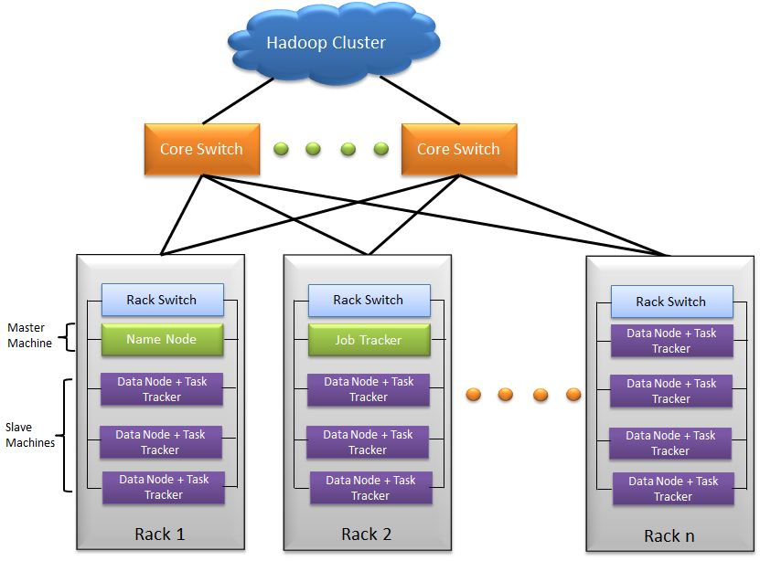
Network Bandwidth between two nodes in
the same rack

Slide 2
Network Bandwidth between two nodes in
the different rack

Slide 3
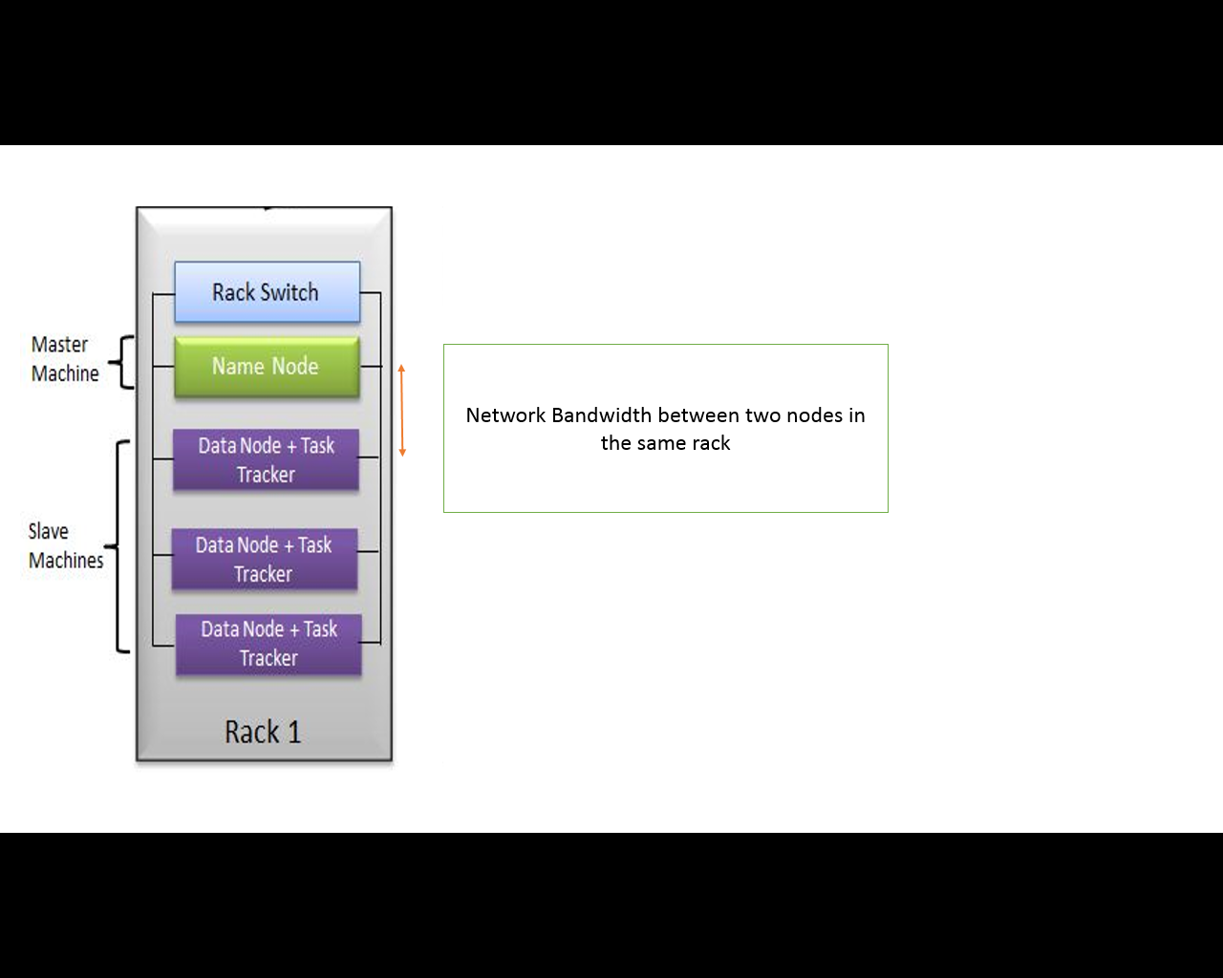
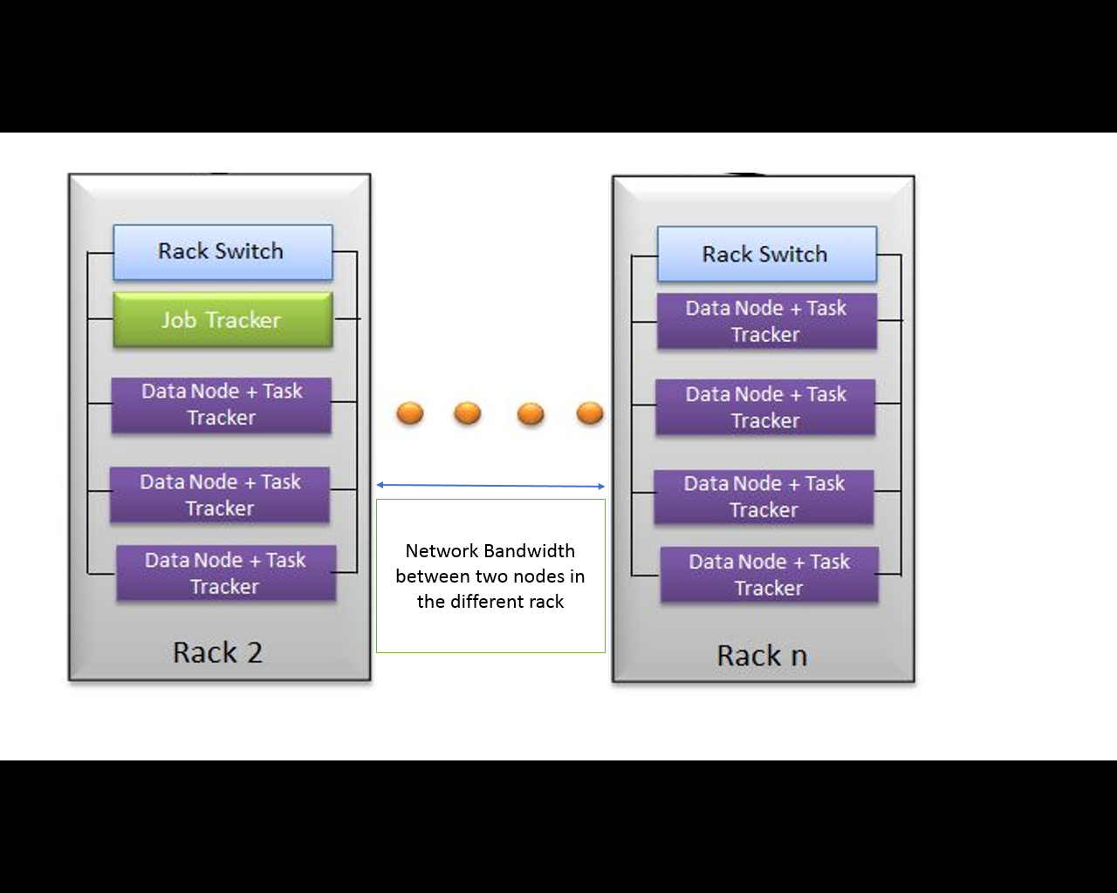
> >
> > means greater than

