Slide 1


COS711 Assignment 3
[Names + Student Numbers of all team members]

Slide 2
Data Preparation
Discuss all data preparation steps taken
Bullets
Bullets
Bullets
Bullets
Bullets

Slide 3
Experimental Setup
Briefly discuss all libraries and tools that you have used. What hardware did you use to run experiments?
Bullets
Bullets
Bullets
Bullets
Bullets

Slide 4
Methodology
Clearly specify how you have formulated the problem, and what sub-problems were addressed in your project.
Bullets
Bullets
Bullets
Bullets

Slide 5
Results: Classification
How well did your classifier do on the various classes? Were some classes handled better than others?
Bullets
Bullets
Bullets
Bullets

Slide 6
Results: Classification Enhancement
How did pseudo-labelling and other methods applied affect the labelling?
Bullets
Bullets
Bullets
Bullets
Bullets

Slide 7
Qualitative Analysis:
Automatically Labelled Sample
Show a sample of previously unlabelled images together with the labels assigned by your model, and discuss if the labels seem viable.

Slide 8
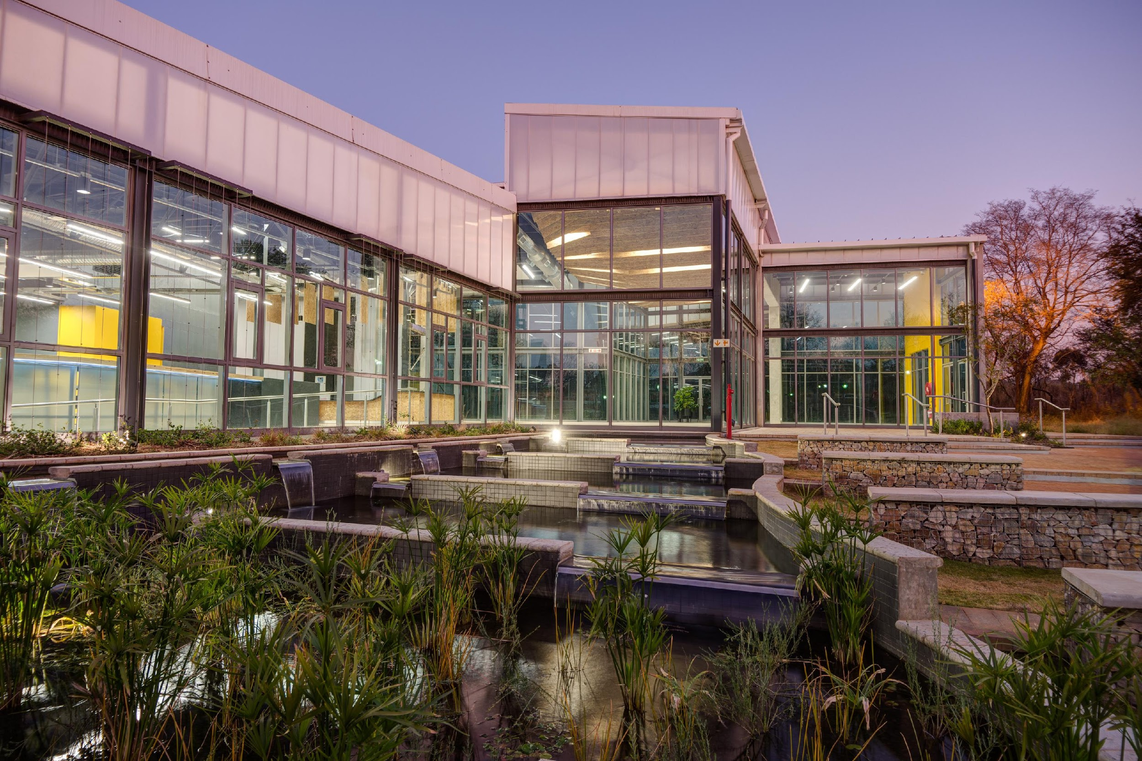
Conclusions
Very general conclusions about the assignment that you have done.
This section ``answers'' the questions and issues that you have raised and investigated.
This section is, in general, a summary of what you have done, what the results were, and finally what you concluded from these results

Slide 9
Bibliography
Paper 1
Paper 2
Website 3

