Slide 1
Capstone: Find the best neighborhood in Toronto to open a Restaurant
Applied Data Science Capstone
IBM Data Science Professional Certificate

Slide 2
Introduction:
A friend of mine who runs a leading Restaurant Supply Store has found out that I am studying data science and has asked for help in trying to determine which neighborhood in Toronto he should open his new store in. Example Company: http://www.bramainc.com/about-brama I begin with an interview with my friend to determine the requirements.

Slide 3
Problem Description:
Which neighborhood should you open his new Restaurant in Toronto?

Slide 4
Data:
Data Wrangling
A lot of hard work went into creating the working data set. I had to combine the following disparate data sources. The order of events went like this
1. Load all the Data from all the various sources.
1.1 Toronto neighborhoods broken down by postal code
https://en.wikipedia.org/wiki/List_of_postal_codes_of_Canada:_M Here I used BeautifulSoup to scrape the wiki page to extract a working list of Toronto Neighborhoods sorted by postal code.
1.1.1 Load Toronto geospatial coordinates and merge to Toronto Postal Code Data
http://cocl.us/Geospatial_data Next, I joined geo spatial to the Toronto Data.

Slide 5
Data cont’d:
Toronto list of Restaurants or Venues that could potentially use Restaurant Equipment
4SQUARE API https://api.foursquare.com
1.5.1 Get all the Venues in Toronto.
1.5.2 Only add Restaurants as Venue Categories
Use this list to Extract Restaurants and only include Restaurants in our Data Set.
1.5.3 OneHot encode and count restaurants
Prepare the data for clustering

Slide 6
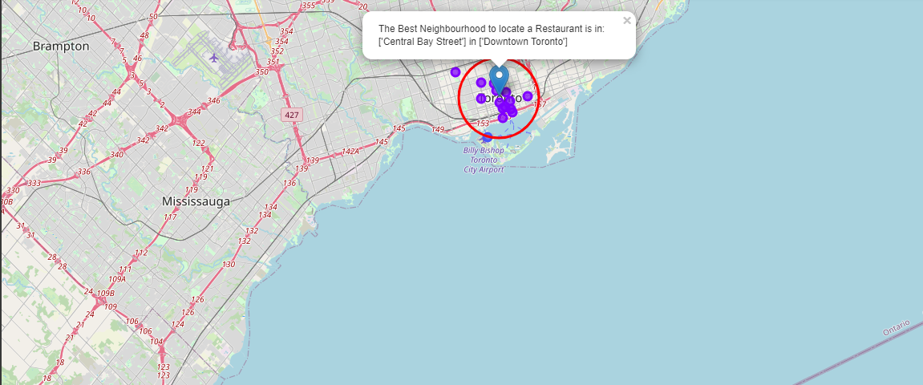
Results:
4.1 Plot the clusters on a Map of the Toronto and Super Impose the best location of a Store

Slide 7
Results Cont’d:
4.2 Exact Address of desired Location
Based on a reverse Lookup The exact Address to locate would be:Toronto, ON M5G 2J5, Canada',
'lat': 43.6533092, 'lng': -79.3848698

