Slide 1
Liu Crew Finale
Nolan Khounborin, Tyler Zwolenik,
Peter Schumacher, Dominic Benintendi

Slide 2
What? Where?Why?
We have created a website that pulls from the Johns Hopkins University Covid-19 statistics.
One is able to view our website on the following slide
We created this website with the intent of showing statistics with different views of the data. That way people can view the disparity between different statistics. The results MAY be shocking.

Slide 3
DEMO

Slide 4
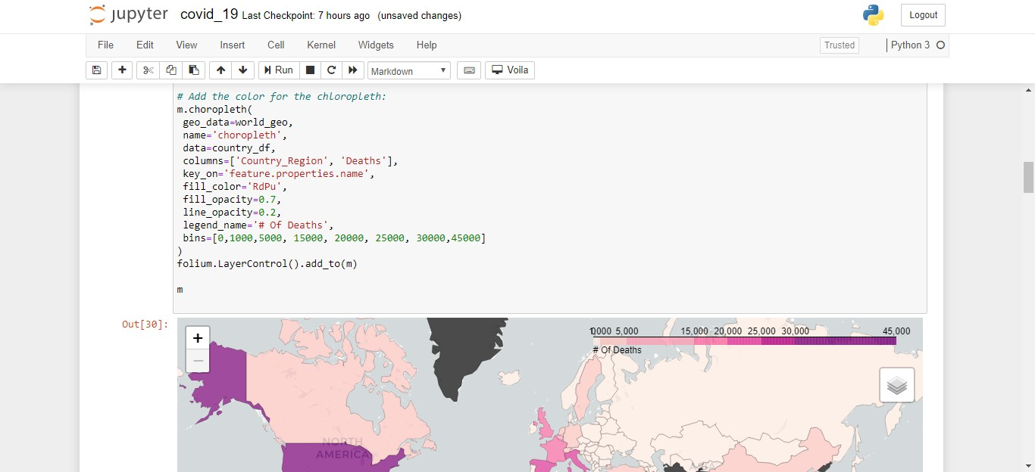
Tools We Used and Their Effectiveness
Jupyter Notebook:
Our main editor
Provided local source control by having checkpoints
Discord/Snapchat:
Our sources for communication

Slide 5
Tools We Used and Their Effectiveness
Voila:
Python dashboarding dependency
Converts Jupyter Notebooks into locally hosted web applications
Works well paired with Heroku
Github:
Became even more important for this project
Main source of file sharing and source control
Displays Jupyter Notebooks very well

Slide 6
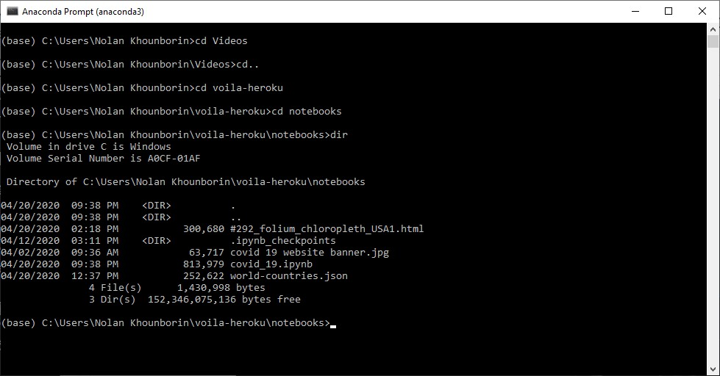
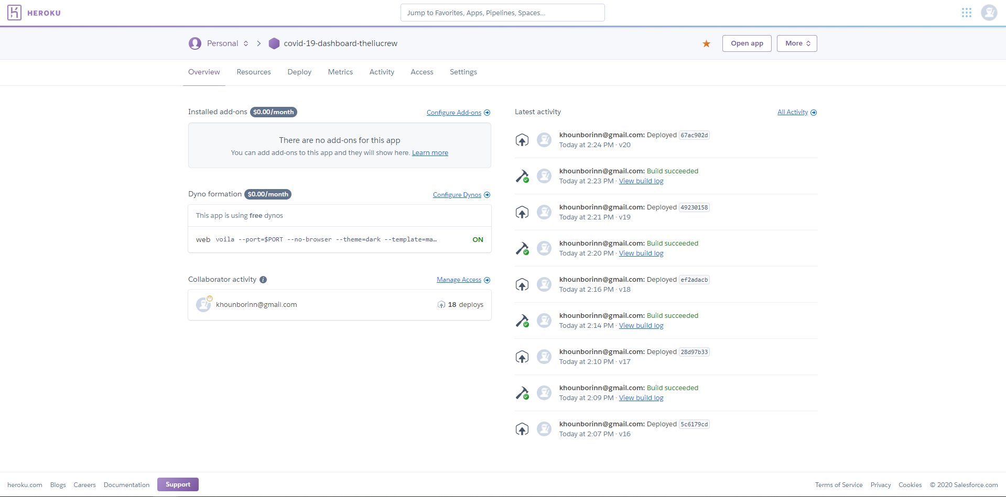
Tools We Used and Their Effectiveness
Anaconda Terminal:
Terminal ran well with Python code as well as automatically installed Jupyter Notebook
Heroku:
Where we hosted our website
Free and easily usable
Shows version builds

Slide 7
Tool Reflection
Voila was not the strongest web tool we could have used
Could have looked into Flask or Django, but needed more time
Some functionalities did not work (Heatmap code conversion)
Other tools worked perfectly fine, would use them again

Slide 8

Languages We Learned
Python 3.7.5:
Had to pip/conda install some dependencies
Syntax took time to get used to after learning C++
Was not too difficult to learn other than trying to see what has already been done through dependencies

Slide 9
Individual Contributions
Nolan:
Initially found the capabilities of Voila for this project
Found the necessary Python dependencies needed in order for the project to be hosted on the internet
Added small formatting details to the website to provide easier user experience

Slide 10
Individual Contributions
Tyler:
Learned and used the necessary python dependencies
Created the deaths pie chart on the covid-19 website

Slide 11
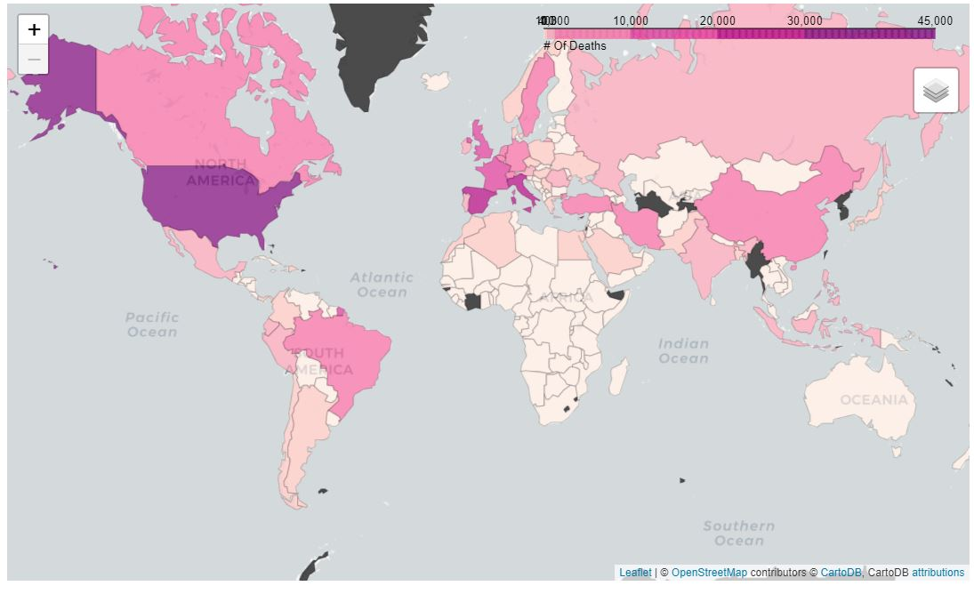
Individual Contributions
Peter:
Created the choropleth map that took account for the amount of deaths per company. The darker zones being where more casualties occured
Used Jupyter notebook and made the map using the Folium package in Python

Slide 12
Individual Contributions
Dominic:
Came Up with the Initial Idea surrounding the COVID-19 Pandemic
Communications Leader

Slide 13
Overall Team Contributions
Nolan took charge organizing how the group would function after classes became online
Created smaller plans on what needed to be done
Everyone took the time to learn different parts of Python
Created individual Jupyter Notebooks to showcase 1 feature

Slide 14
Reflection of Team Contributions
Communication could have been stronger
Still had meetings, but in between we struggled
More specific roles
A lot of roles we made for each other were vague
Some roles were more difficult than others

