Slide 1
A Millimeter-Wave Concurrent LNA in 45-nm CMos on 5G Applications
By:2100040045-M.Sai Khoushik
2100040161-N.Harshitha
Under the supervision of Dr.Vamsee Krishna.S

Slide 2
OUTLINE
Abstract
Introduction
Literature Survey
Proposed Design
Simulation
Applications
References

Slide 3
ABSTRACT
This project introduces a concurrent dual-band low-noise amplifier (LNA) proposed for 5G mm-wave bands in a 45-nm CMOS technology. The proposed design operates between 23.3-30.3 GHz and 38-44.7 GHz, it employs a three-stage Cascade design with a notch circuit for enhanced rejection. The LNA features digitally controlled gain and high-pass filtering for rejection below 13 GHz. This design targeted for a gain of 25 dB at 24 GHz and 20 dB at 40.5 GHz. This design is targeted for low power and low area which is suitable for 5G applications.

Slide 4
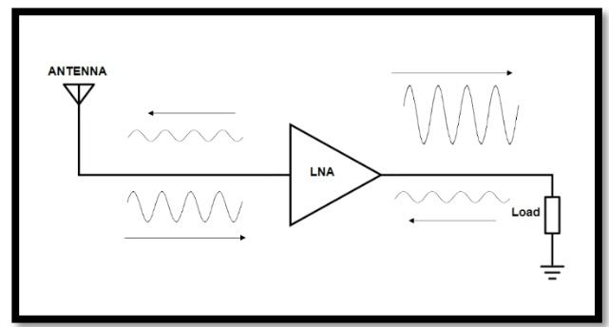
INTRODUCTION
A Low Noise Amplifier (LNA) is a fundamental electronic device designed to amplify weak signals while introducing minimal additional noise. As an essential component in various applications such as communication systems, radar, and scientific instruments, the LNA plays a critical role in enhancing the overall sensitivity and performance of these systems. By strategically placed at the front end of a receiver chain, the LNA ensures that signals are boosted without significant degradation in signal-to-noise ratio, making it indispensable in scenarios where accurate and reliable signal reception is paramount.

Slide 5
LITERATURE SURVEY
Design of an Ultra Low Power Low Noise Amplifier for 5-GHz band
----Low Noise Amplifier (LNA) with techniques used forward-body bias and Current-reuse DC power dissipation is reduced. Capacitive Coupling is used for gain boosting.
A 180-GHz Low-Noise Amplifier With RecursiveZ-Embedding Technique in 40nm CMOS
-----The equivalent noise resistance is proved to dominate the noise figure deterioration due to the Z-embedding network. The interstage networks are designed to achieve the optimal noise figure.
A SiGe HBT D-Band LNA With Butterworth Response and Noise Reduction Technique
-----A shunt inductor that is used at the intermediate node of the cascade topology to reduce the noise contribution of the common base transistor is analyzed and employed for the first time for the SiGe HBT technology.

Slide 6
A Packaged Noise-Canceling High-Gain Wideban Low Noise Amplifier
---Packaged single-ended wideband (LNA) module for high-sensitivity receivers. by using gate-source inductors assisted impedance-matching, current reuse feed-forward noise cancellation technique, and integrated shunt peaking output buffer.
A Novel Current Density Based Design Approach of Low-Noise Amplifiers
---A Novel Current Density Based Design Approach of Low-Noise Amplifiers
Designing a Low-Power LNA and Filter for Portable EEG Acquisition Applications
---A low-noise amplifier and a Gm-C ultra-low-power filter is proposed in this paper for portable EEG acquisition applications.
Design of Low-Power Sub-2.4 dB Mean NF 5G LNAs Using Forward Body Bias
in 22 nm FDSOI
---Design of Low-Power Sub-2.4 dB Mean NF 5G LNAs Using Forward Body Bias in 22 nm FDSOI

Slide 7
A 33-GHz LNA for 5G Wireless Systems in 28-nm Bulk CMOS
---Design procedure of a compact 33-GHz low noise amplifier (LNA) for 5G applications realized in 28-nm LP CMOS. Based on the unique set of challenges presented by advanced nanoscale CMOS,
A 27-31 GHz CMOS LNA for 5G Application via Improved Noise Cancellation Technique and Gain Boosting
---The first stage of this two-stage LNA is designed with a noise cancelation approach to decrease the noise figure of the system. To improve the design method, we utilize negative feedback by implementing a couple of inductors with a transformer connection.
Design of CMOS Low Noise Amplifier for 5G Applications Using 45nm Technology
---The amplifier is implemented using a two-stage Cascade configuration and shunt series peaking. A comparative study of designed Cascade configuration with feedforward technique, current bleeding technique, and differential configuration.

Slide 8
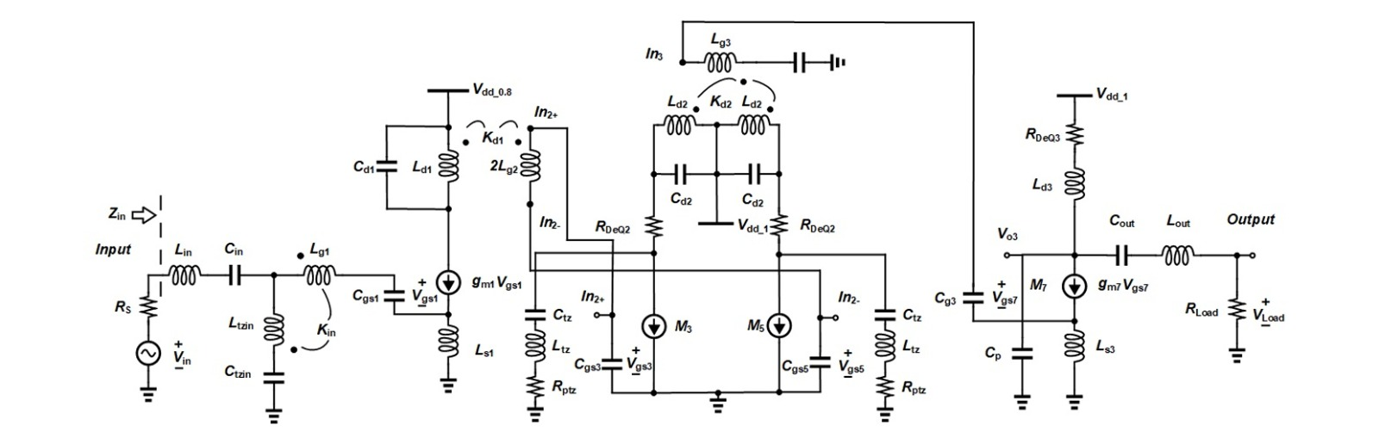
Proposed Design

Slide 9
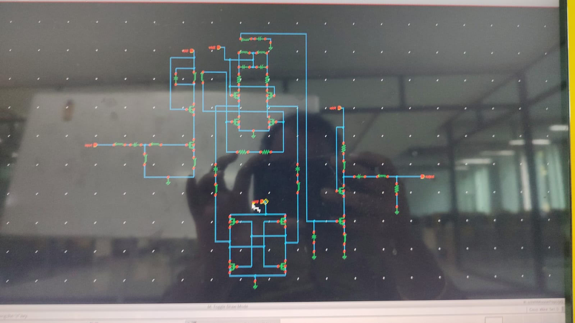
SIMULATION

Slide 10
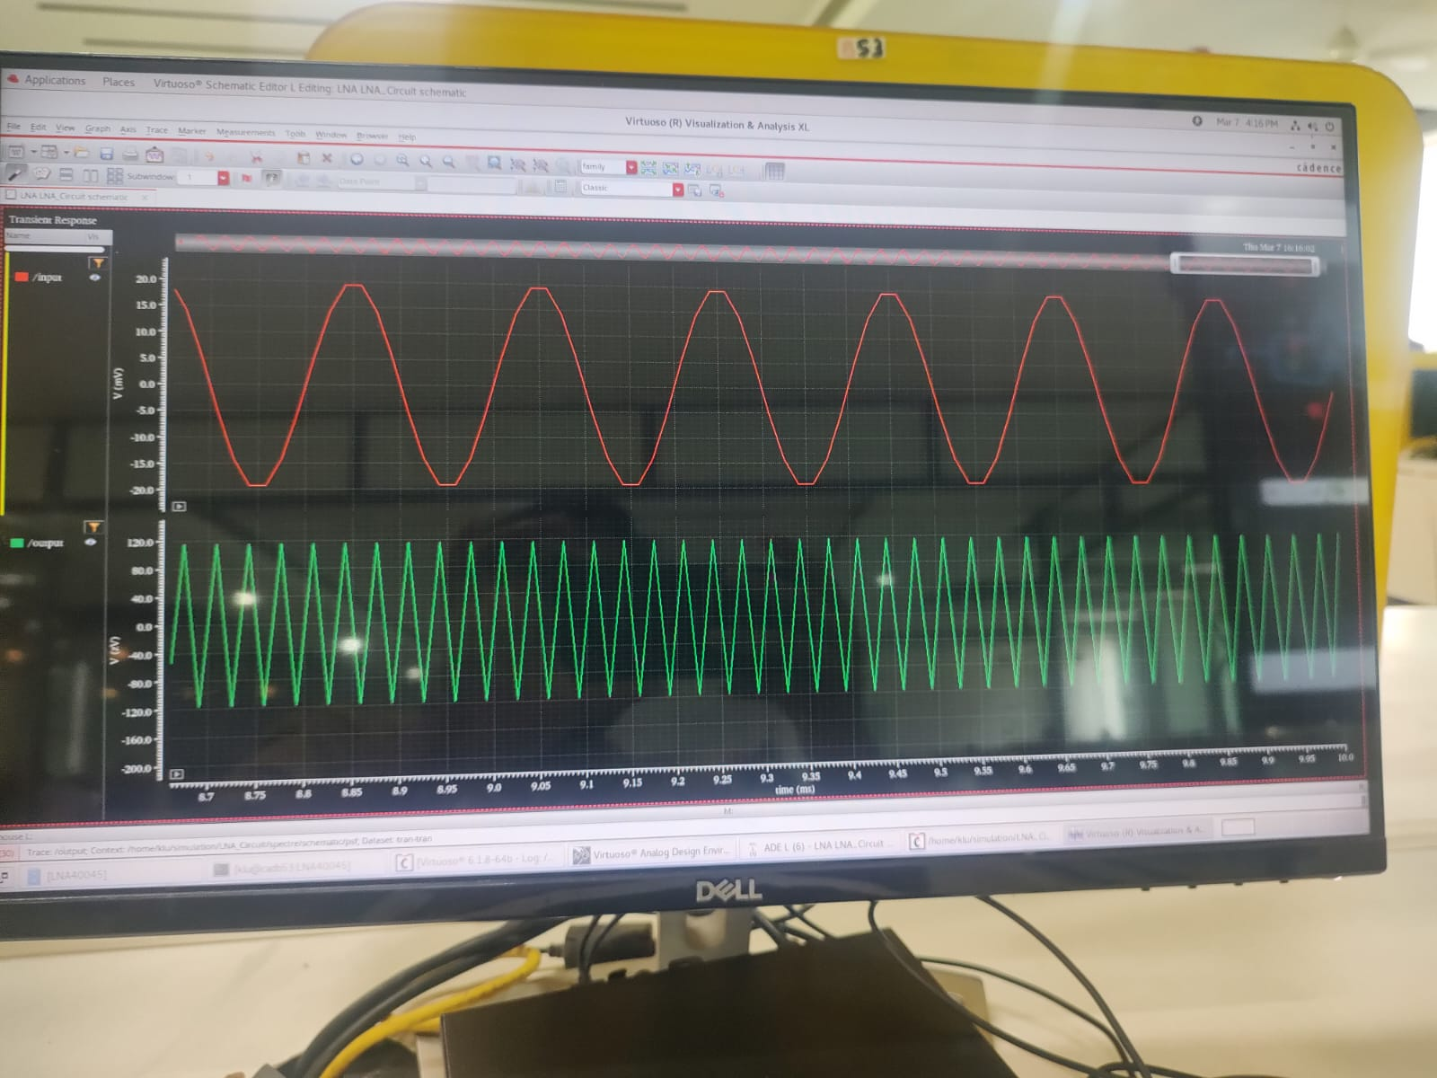
Results

Slide 11
APPLICATIONS
Radio telescopes,
Cellular telephones,
GPS receivers,
Wireless LANs (WiFi)
Satellite communications.

Slide 12
REFERENCES
M. El-Noza, E. Sanchez-Sinencio, and K. Entesari, “A millimeter-wave (23–32 GHz) wideband BiCMOS low-noise amplifier,” IEEE J. SolidState Circuits, vol. 45, no. 2, pp. 289–299, Feb. 2010.
H.-C. Yeh, Z.-Y. Liao, and H. Wang, “Analysis and design of millimeterwave low-power CMOS LNA with transformer-multicascode topology,” IEEE Trans. Microw. Theory Techn., vol. 59, no. 12, pp. 3441–3454, Dec. 2011.
P. Qin and Q. Xue, “Compact wideband LNA with gain and input matching bandwidth extensions by transformer,” IEEE Microw. Wireless Compon. Lett., vol. 27, no. 7, pp. 657–659, Jul. 2017.
V. Chauhan and B. Floyd, “A 24–44 GHz UWB LNA for 5G cellular frequency bands,” in Proc. Global Symp. Millim. Wave, May 2018, pp. 1–3
L. Gao and G. M. Rebeiz, “A 24–43 GHz LNA with 3.1–3.7 dB noise figure and embedded 3-pole elliptic high-pass response for 5G applications in 22 nm FDSOI,” in Proc. IEEE Radio Freq. Integr. Circuits Symp. (RFIC), Jun. 2019, pp. 239–242.

Slide 13
R. Singh, S. Mondal, and J. Paramesh, “A millimeter-wave receiver using a wideband low-noise amplifier with one-port coupled resonator loads,” IEEE Trans. Microw. Theory Techn., vol. 68, no. 9, pp. 3794–3803, Sep. 2020.
Z. Wang et al., “A Ka-band switchable LNA with 2.4-dB NF employing a varactor-based tunable network,” IEEE Microw. Wireless Compon. Lett., vol. 31, no. 4, pp. 385–388, Apr. 2021.
R. A. Shaheen, T. Rahkonen, and A. Parssinen, “Millimeter-wave frequency reconfigurable low noise amplifiers for 5G,” IEEE Trans. Circuits Syst. II, Exp. Briefs, vol. 68, no. 2, pp. 642–646, Feb. 2021.
A. A. Nawaz, J. D. Albrecht, and A. C. Ulusoy, “A Ka/V band switchable LNA with 2.8/3.4 dB noise figure,” IEEE Microw. Wireless Compon. Lett., vol. 29, no. 10, pp. 662–664, Oct. 2019.
R. Singh, S. Mondal, and J. Paramesh, “A millimeter-wave receiver using a wideband low-noise amplifier with one-port coupled resonator loads,” IEEE Trans. Microw. Theory Techn., vol. 68, no. 9, pp. 3794–3803, Sep. 2020

Slide 14


