Slide 1
Introduction to Classes and Objects

Slide 2
Course General Information
Professor: Sharof Suvanov
Office: Room 512
Email: s.suvanov@inha.uz
Office hours Wednesday and Friday: 16:00 p.m to 18:00 p.m
Course managing style:
Lecture & Lab class: covered by me

Slide 3
Course General Information
Evaluation Criteria | (Attendance) | 10% | Quiz | 10% | Project | 10% | Practical Assignment | 10%
 | Class Participation |  | (Midterm exam) | 30% | (Final Exam) | 30% | Total = 100 %
Methods of Evaluation | Assessment will be made based on the midterm exam (30%), final exam (30%), practical Assignment (10%), Quizzes (10%), Class Attendance (10%) and Project(10%)

Slide 4
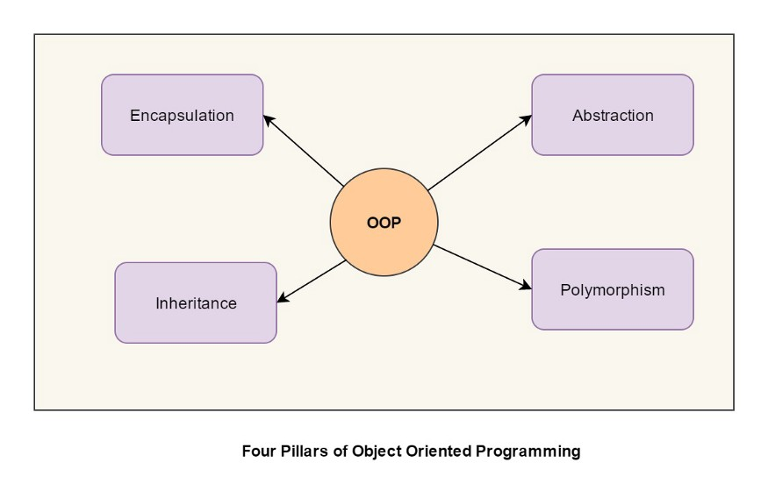
Four Basic Properties of Object Oriented Programming

Slide 5

Class
Abstraction of an object
Define real world (object) with data and functionality
Encapsulation
characteristic 1. four legs (data)
characteristic 2. length of nose is about 5 meters (data)
characteristic 3. weight is over 1 tone (data)
characteristic 4. can shower using nose (functionality)
characteristic 5. can pick up a thing (functionality)

Slide 6
Classes in C++
A class definition begins with the keyword class.
The body of the class is contained within a set of braces, { } ; (notice the semi-colon).
class class_name
{
….
….
….
};
Any valid identifier
Class body (data member + methods)

Slide 7
Basics for Class
The class body contains the declaration of variables and functions.
These functions and variables collectively called class members.
They are usually grouped under two sections , namely private and public to denote which of the members are private and which of them are public.
The keyword private and public are known as visibility labels.
Note that these keywords are followed by a colon.

Slide 8
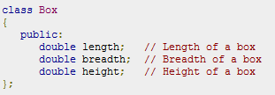
C++ Class Definitions:
When you define a class, you define a blueprint for a data type. This doesn't actually define any data, but it does define what the class name means, that is, what an object of the class will consist of and what operations can be performed on such an object.
For example, we defined the Box data type using the keyword class as follows:

Slide 9

Define C++ Objects:
A class provides the blueprints for objects, so basically an object is created from a class. We declare objects of a class with exactly the same sort of declaration that we declare variables of basic types. Following statements declare two objects of class Box:
Both of the objects Box1 and Box2 will have their own copy of data members.

Slide 10
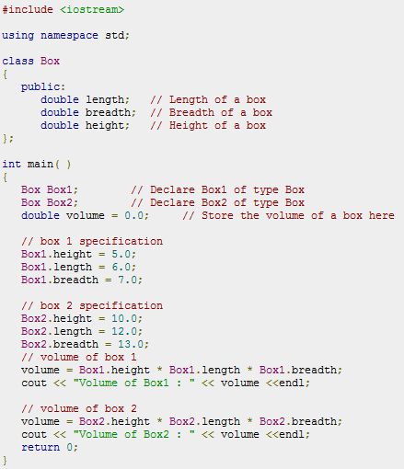

Slide 11
Private and Public Visibility Labels
The class members that have been declared as private can be accessed only from within the class
Public members can be accessed from outside the class also.
The data hiding(using private declaration)is the key feature of OOP.
The use of keyword private is optional.
By default , the members of class are private.
The variables declared inside the class are known as data members and functions are known as member functions.
Only the member functions can have access to the private class members.
However, the public members(both data and functions) can be accessed from outside the class.

Slide 12
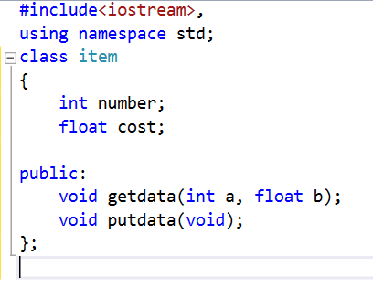

Slide 13
Defining Member Functions
Member functions can be defined in two places:
Outside the class definition
Inside the class definition

Slide 14
Outside the Class Definition
An important difference between a member function and a normal function is that a member function incorporates a membership ‘identity label’ in the header.
This label tells the compiler which class the function belongs to.
Return-type class-name :: function-name (argument declaration)
{
Function Body
}

Slide 15
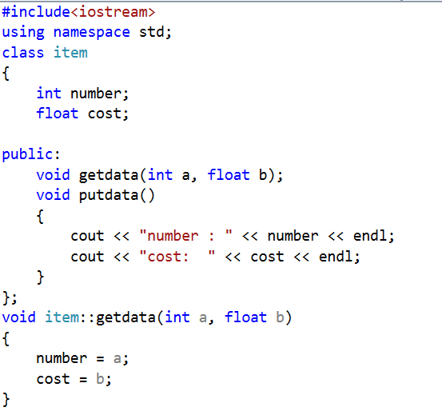
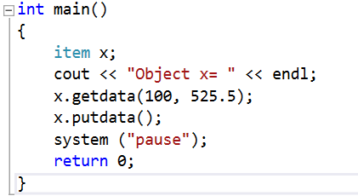
A C++ Program with Class

Slide 16
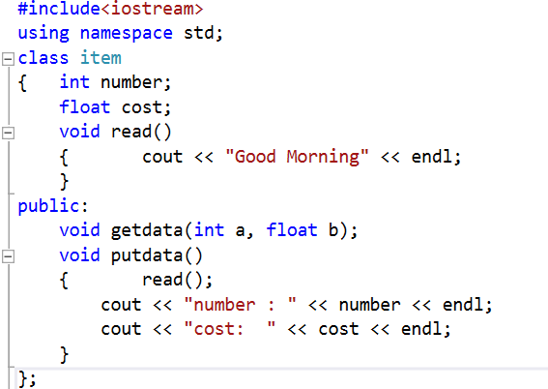
Private Member Function
A private member function can only be called by another function that is a member of its class. Even an object cannot invoke a private function using dot operator.

Slide 17
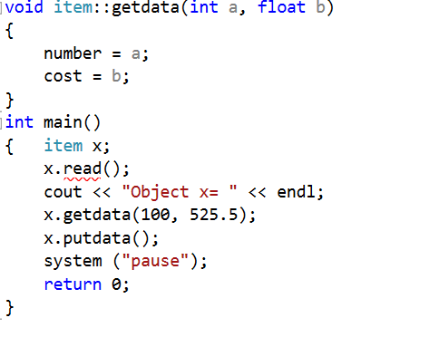

Slide 18
set Functions and get Functions
Software engineering with set and get functions
public member functions that allow clients of a class to set or get the values of private data members
set functions sometimes called mutators and get functions sometimes called accessors
Allows the creator of the class to control how clients access private data
Should also be used by other member functions of the same class

Slide 19
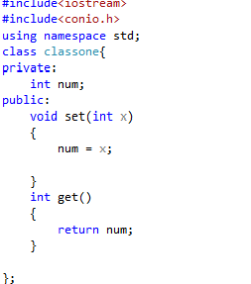
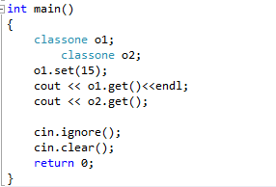
Accessor and Mutator Function

Slide 20

UML Diagram
Indicating the return type of an operation
Place a colon and the return type after the parentheses following the operation name
Minus sign used to indicate private members

Slide 21
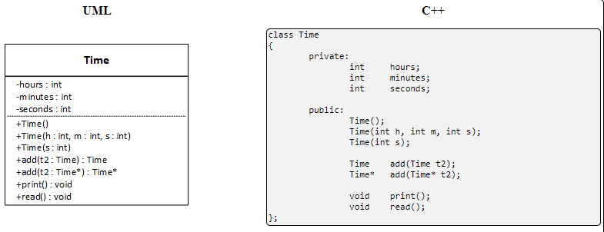
UML Diagram

