Slide 1



RUN HES-SO, RUN !
David Crittin
Albain Dufils
Louise Bretz

Slide 2
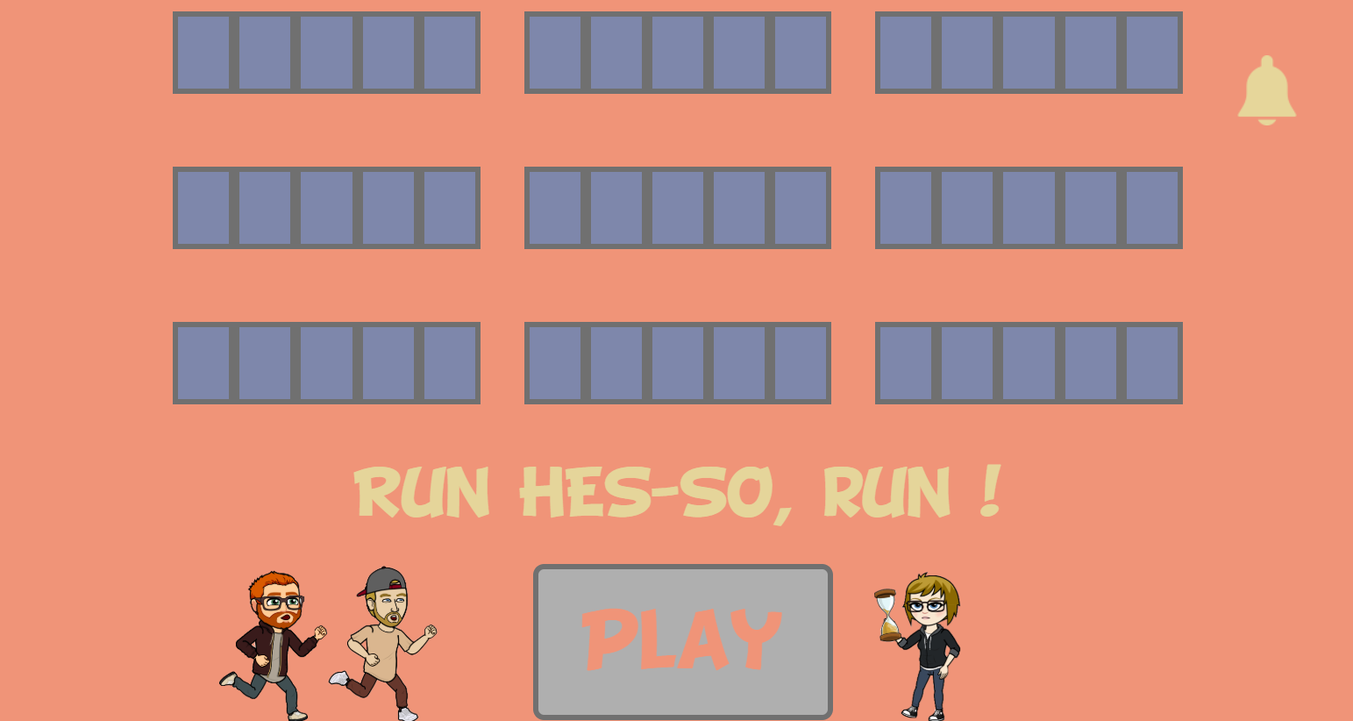
Notre jeu

Slide 3
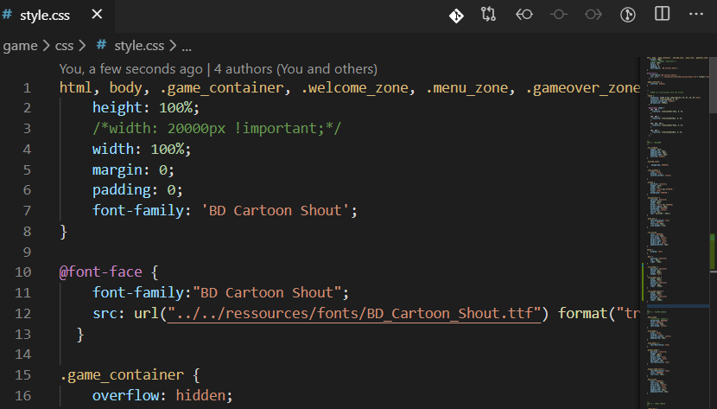
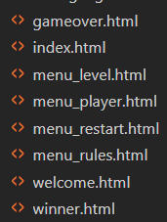
HTML / CSS

Slide 4
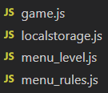
Javascript

Slide 5
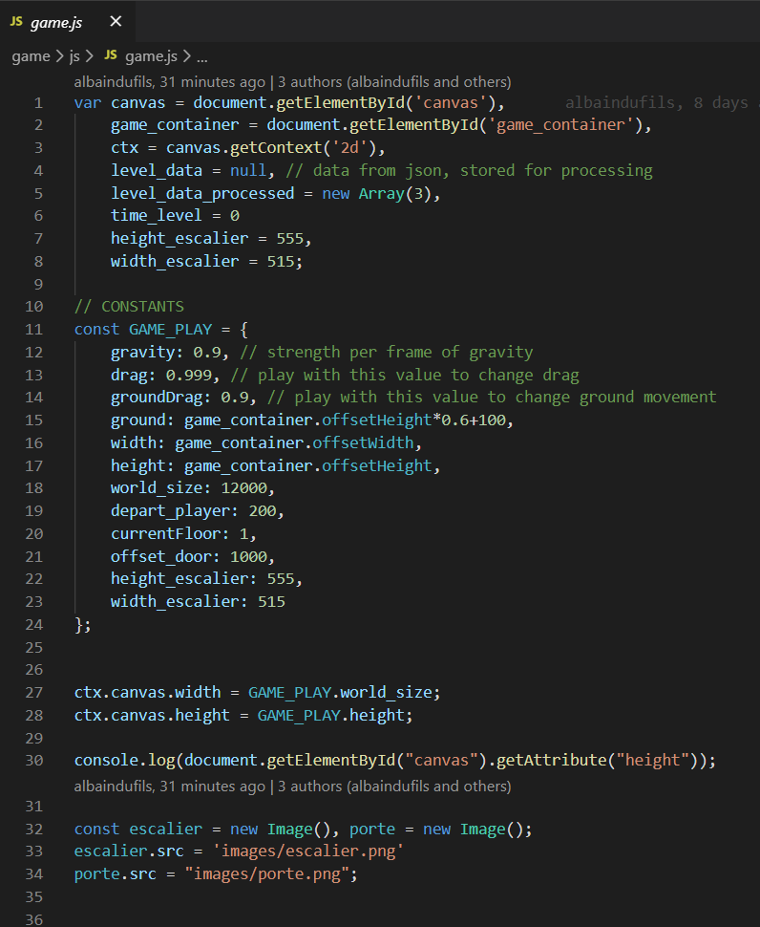
game.js

Slide 6

Differentes classes

Slide 7
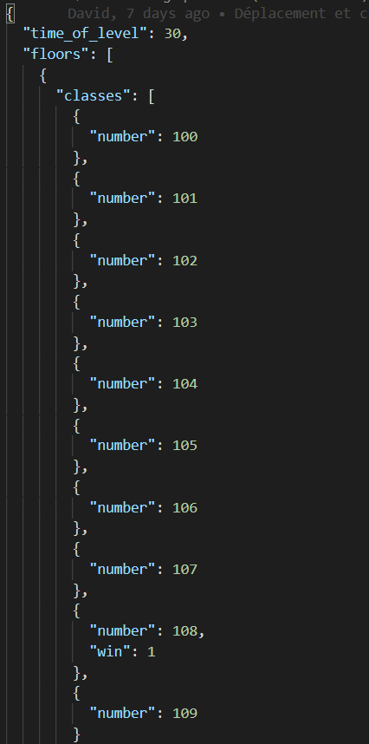
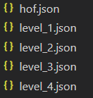
JSON

Slide 8
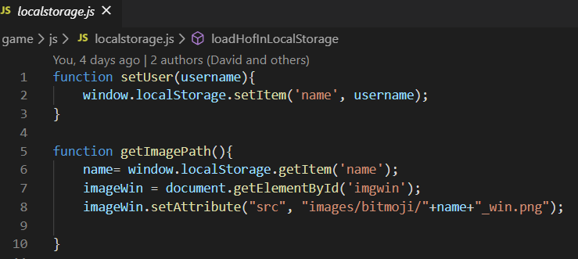
Localstorage

Slide 9
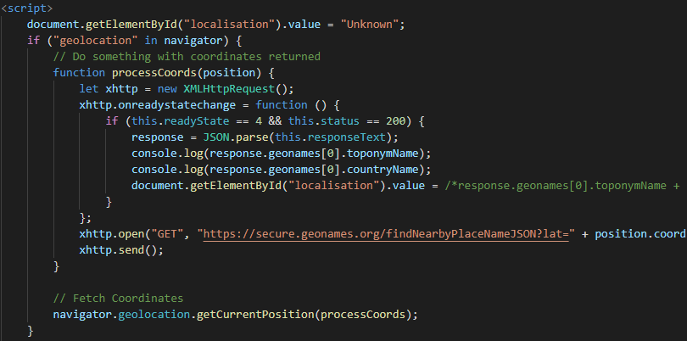
localisation

Slide 10
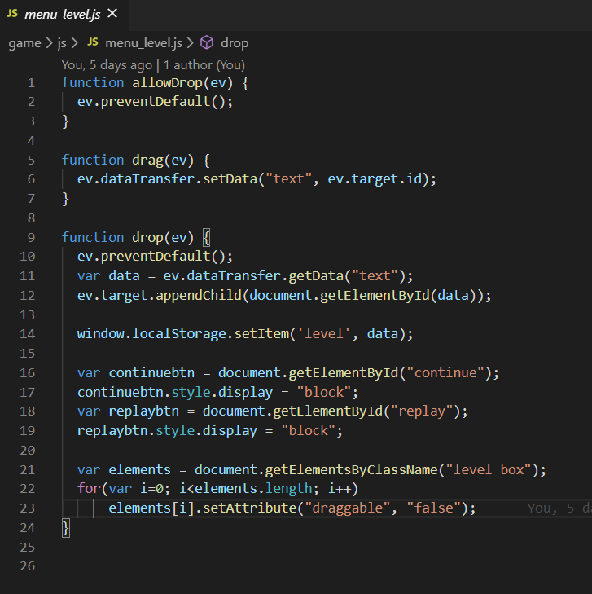

Drag and drop

Slide 11











design

Slide 12
Questions ?

