Slide 1

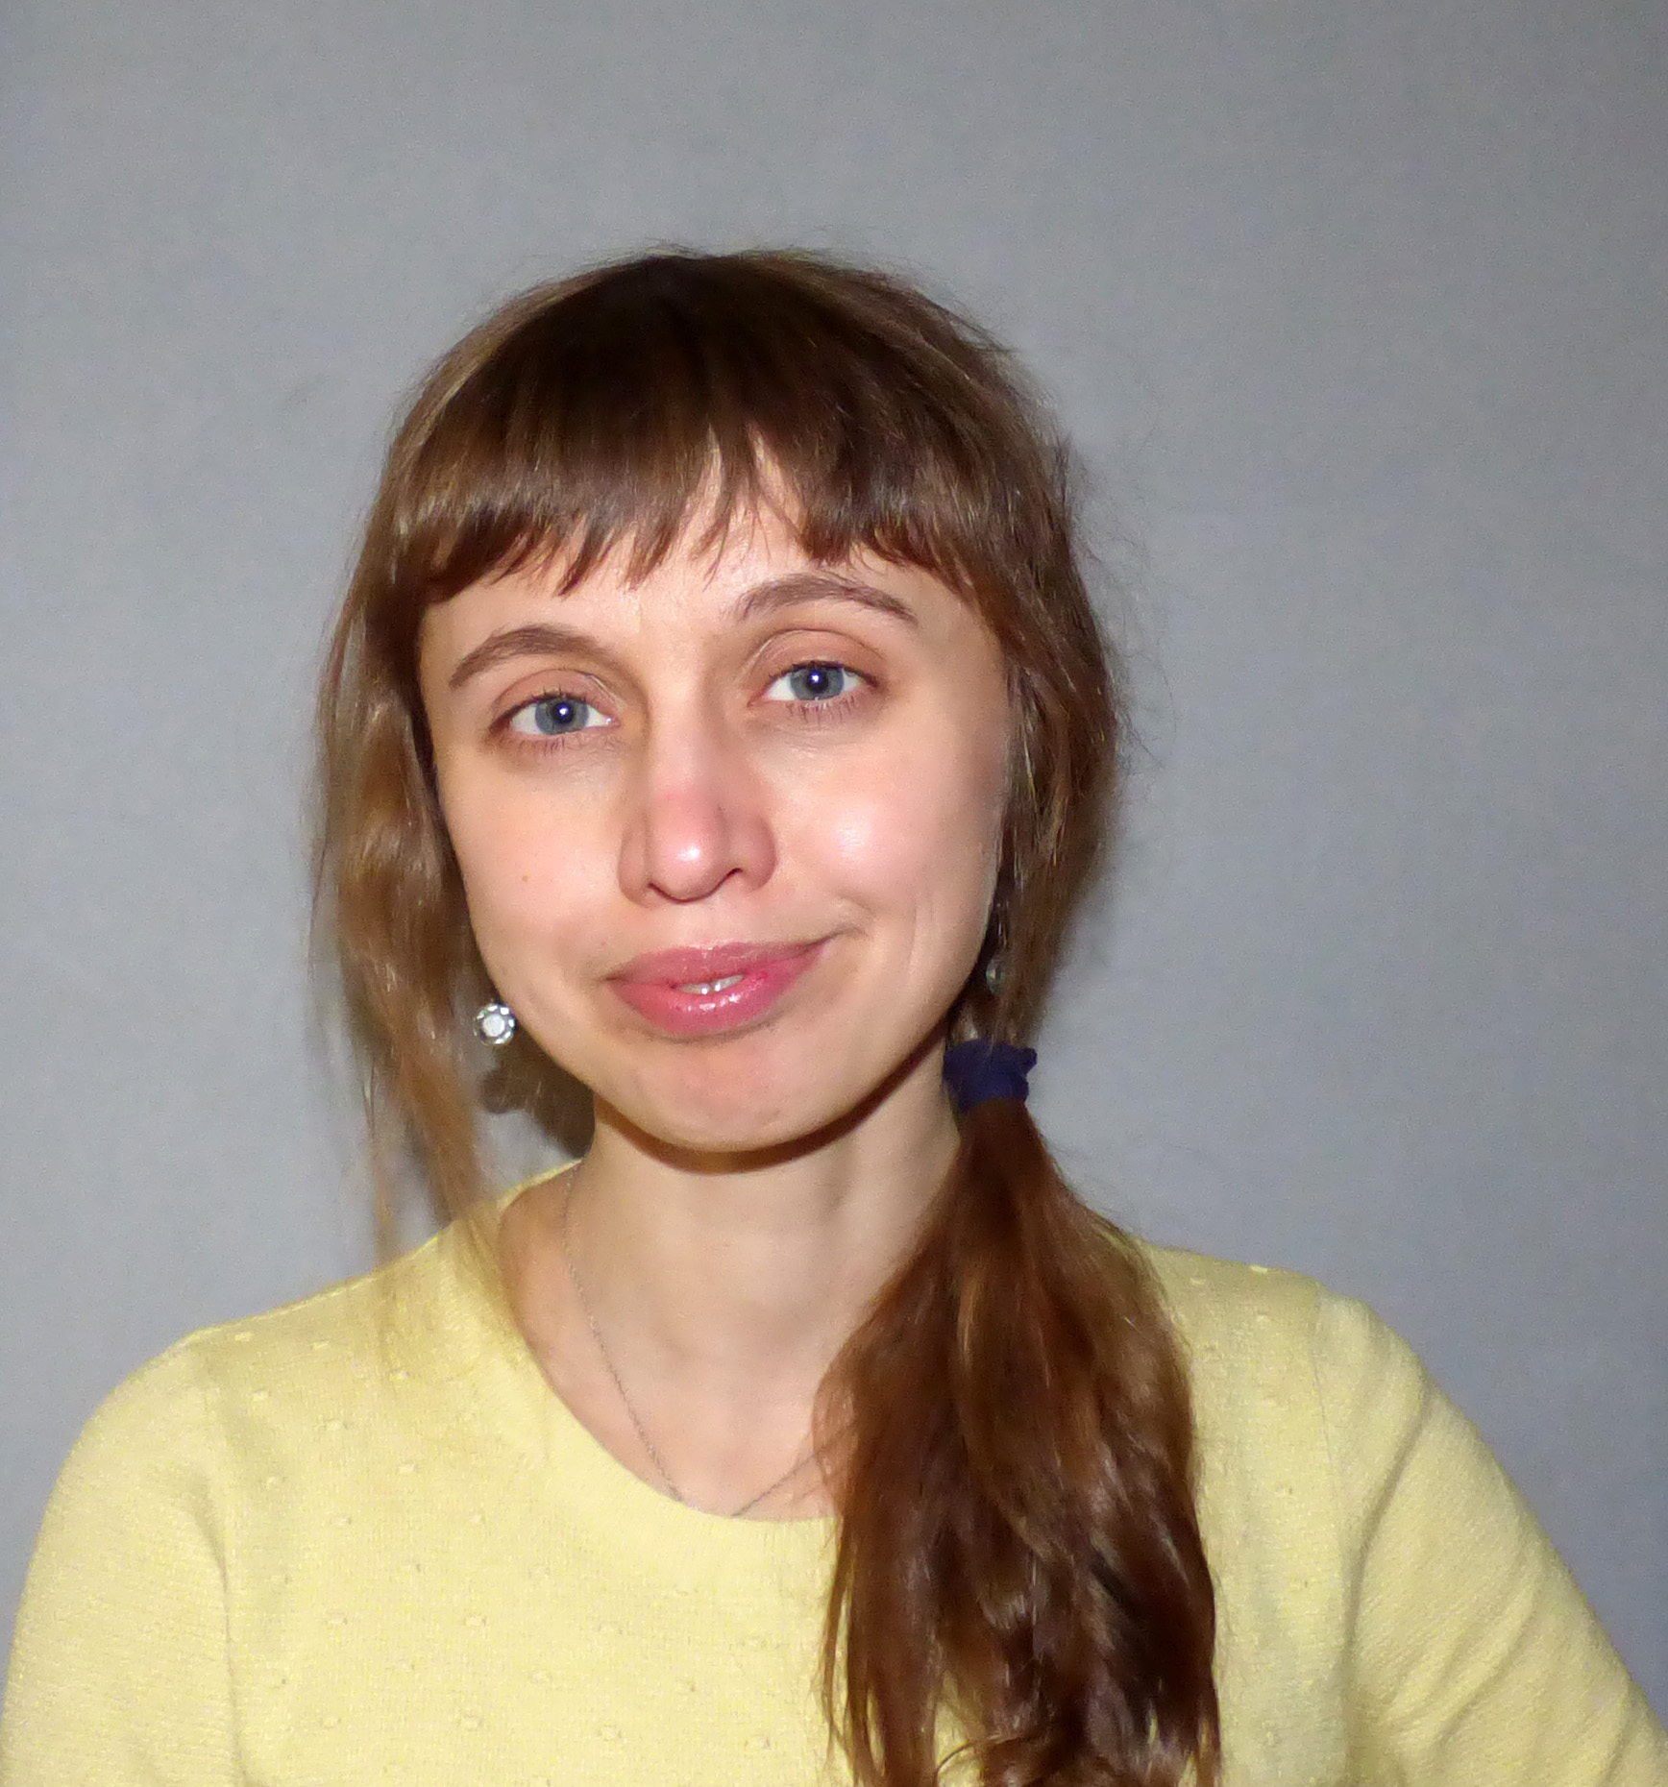

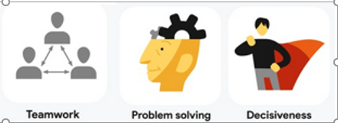
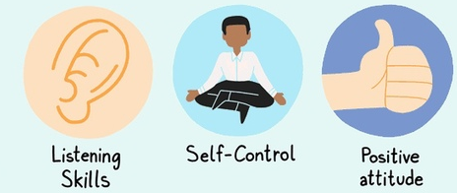
About me:)
Divchur Khrystyna
Business analyst (+QA,QC, support-manager, project manager)
Work for Ukrainian company (CUBP), that provides, supports services and developing 1C Accounting software.
Why I’m here!? I want to grow up as a specialist and catch this opportunity for development.
*** Projects are always interesting to experience and investigation. There is something that I like the most – during cooperation, in that or different time, we can create something new and “magic” for customers, company and ourselves). This energy force to keep going.

Slide 2







Project structure: | Goals
Project Name: website “Food lover”
Project goal: create a website with different sections for restaurant.
The site must be:
*a user-friendly Interface,
*style through simplicity,
*attractive for people.
Main goal for stakeholders:
- be available in the internet
- attract more clients,
to be competitive in the market
became popular and well-known – chance to grow up
increase the gain
AWS instance
Apache2
AWS S3 bucket
Terraform
creator
Main Developer 1
GitHub
AWS S3 bucket
Jenkins Pipeline
Copy
production
Copy
artifacts

Slide 3


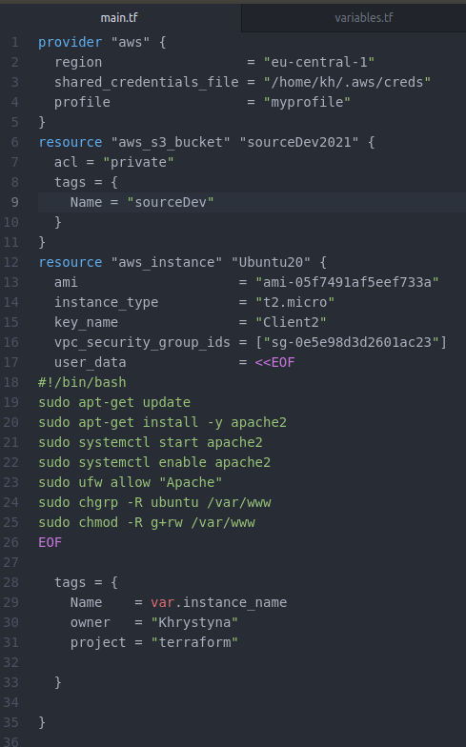
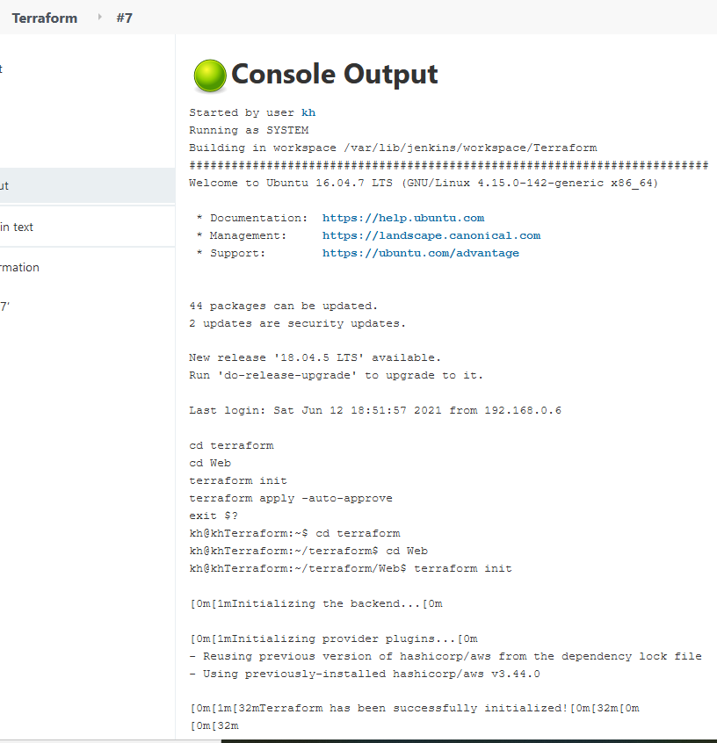


Main.tf

Slide 4


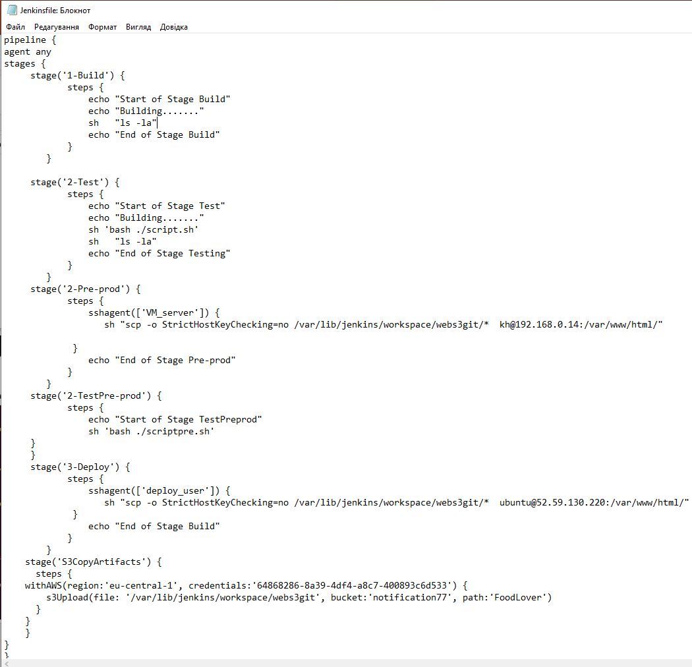



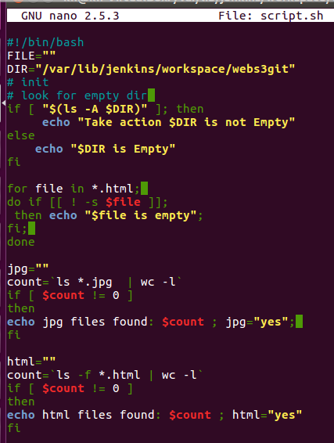
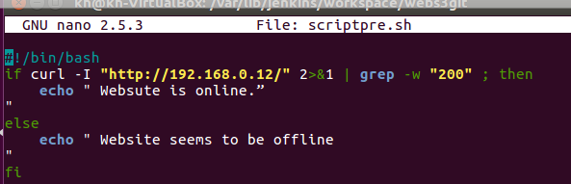
Jenkins pipeline
Integration
Test script -bash

Slide 5









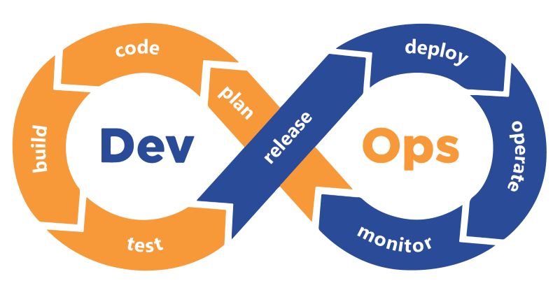







Devops technology are used:
…

Slide 6
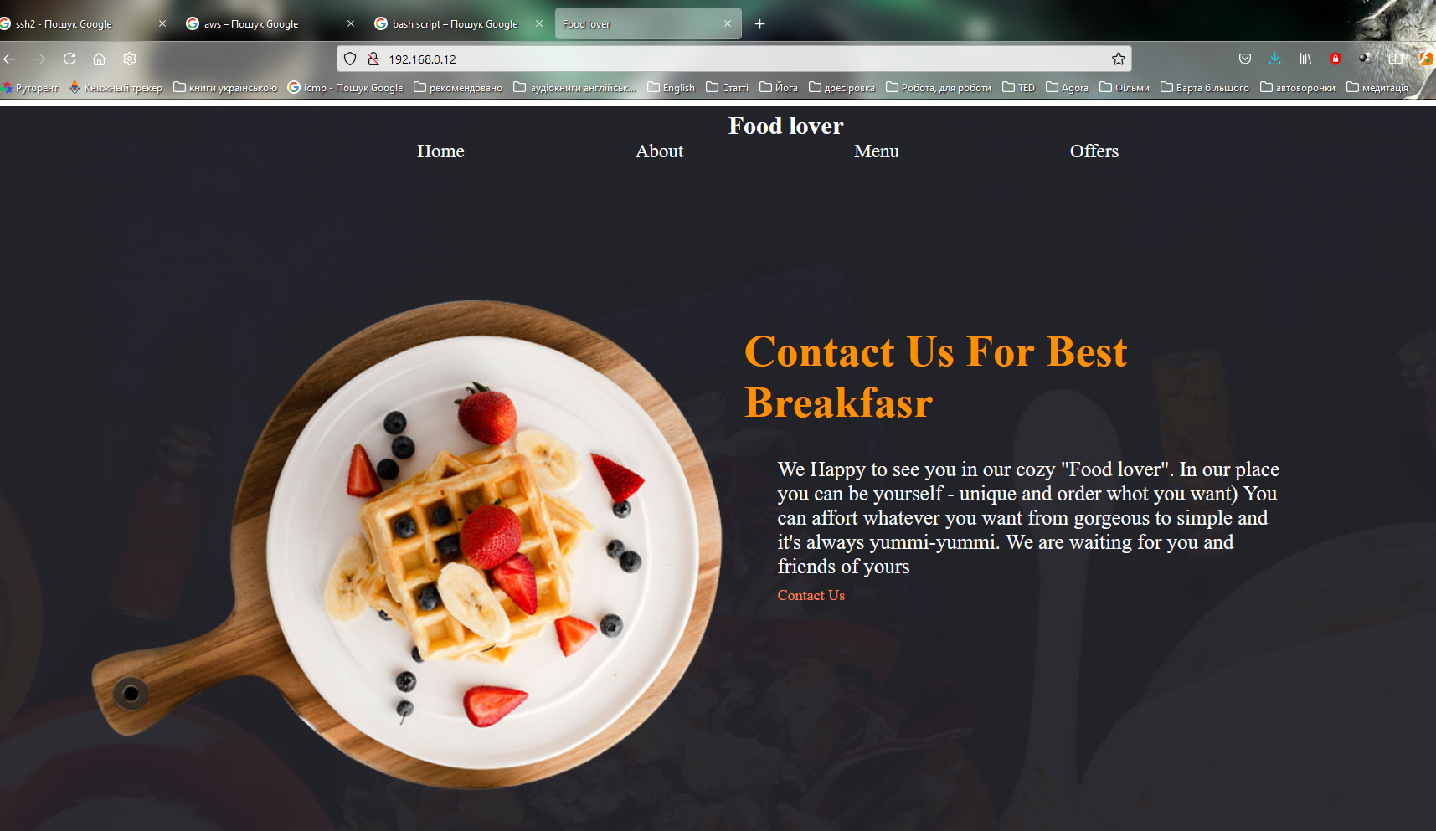
Result

Slide 7


What next ?
Next, we should offer our customer to extend the site and services , for example:
Provide service “Order online”
Provide service “Order online”
Add pictures at the menu and automatically changed prices, integrate with the 1c program in order to have actual prices
Pay attention to extra services, maybe book a restaurant for same important events(wedding, parties, meetings) and light this on the web pages
…
Thank your for your attention ☺

