Slide 1
Chapter 6
Registers and Counters
Digital System
數位系統
Ping-Liang Lai (賴秉樑)

Slide 2
Outline of Chapter 6
6.1 Registers
6.2 Shift Registers
6.3 Ripple Counters
6.4 Synchronous Counters
6.5 Other Counters
6.6 HDL for Registers and Counters

Slide 3
6.1 Registers (暫存器)
Clocked sequential circuits
  A group of flip-flops and combinational gates.
  Connected to form a feedback path.
  Flip-flops + Combinational gates
  (essential) (optional)
Register (暫存器)
  A group of flip-flops.
  Gates that determine how the information is transferred into the register.
Counter (計數器)
  A register that goes through a predetermined sequence of states.

Slide 4
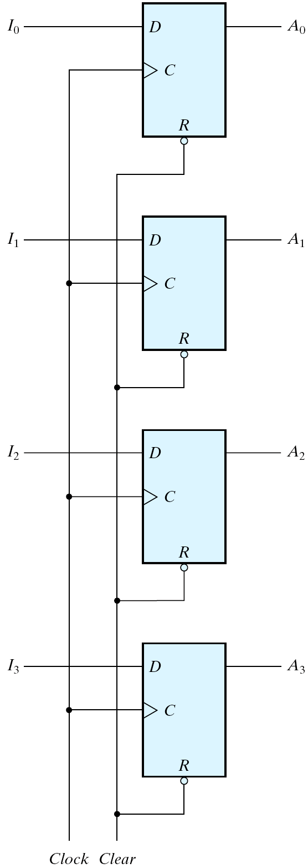
6-1 Registers
A n-bit register
  n flip-flops capable of storing n bits of binary information.
  4-bit register is shown in Fig. 6.1.
Clear =0 (active low); A_{x} = 0
Clock= ↑; A_{x}=I_{x}
Normal Operation; Clear =1
Fig. 6.1 Four-bit register

Slide 5
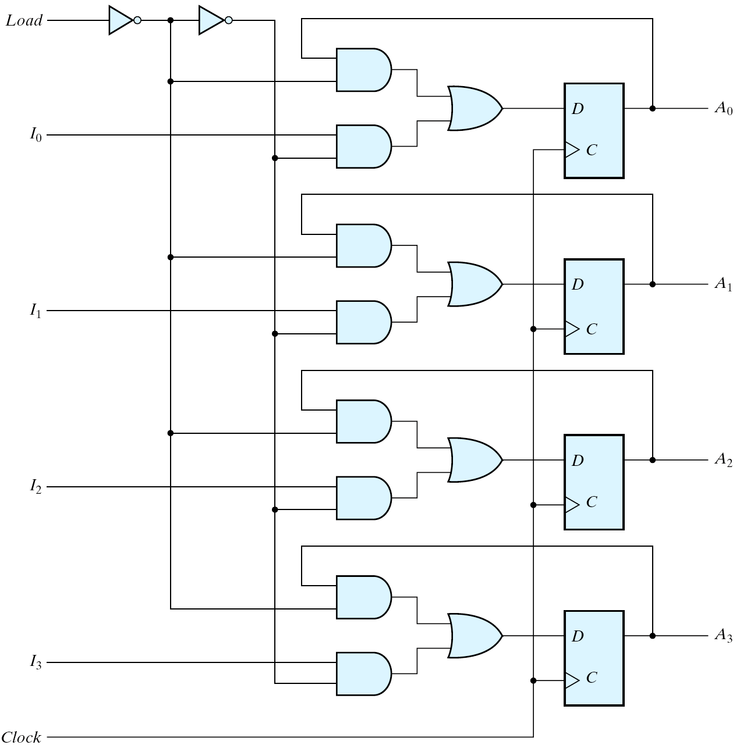
4-bit Register with Parallel Load
1/0
0/1
1/0
load'
load
0/1
1/0
1: Parallel load
0: No change
Fig. 6.2 Four-bit register with parallel load

Slide 6
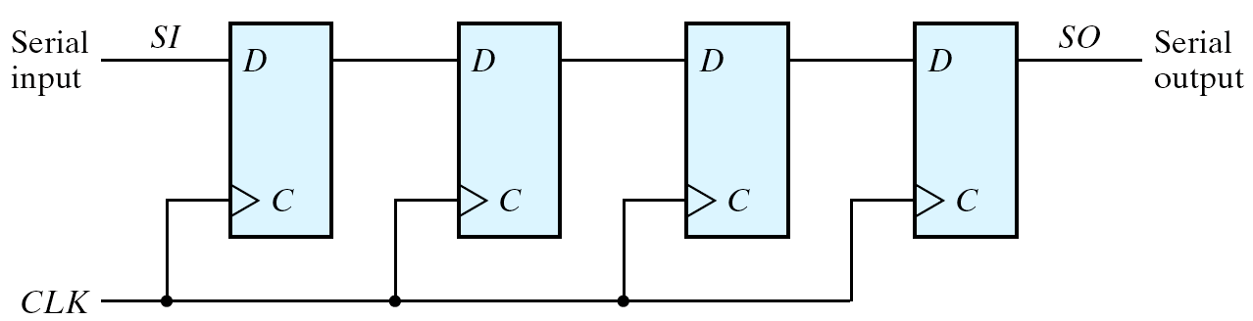
6-2 Shift Registers
Shift register (移位暫存器)
  A register capable of shifting its binary information in one or both directions.
Simplest shift register
1
0
1
1
0
1
1
0
1
1
Fig. 6.3 Four-bit shift register

Slide 7
Data Transfer
Serial transfer (串列轉移) vs. Parallel transfer (並列轉移)
  Serial transfer
    Information is transferred one bit at a time.
    Shifts the bits out of the source register into the destination register.
  Parallel transfer
    All the bits of the register are transferred at the same time.

Slide 8
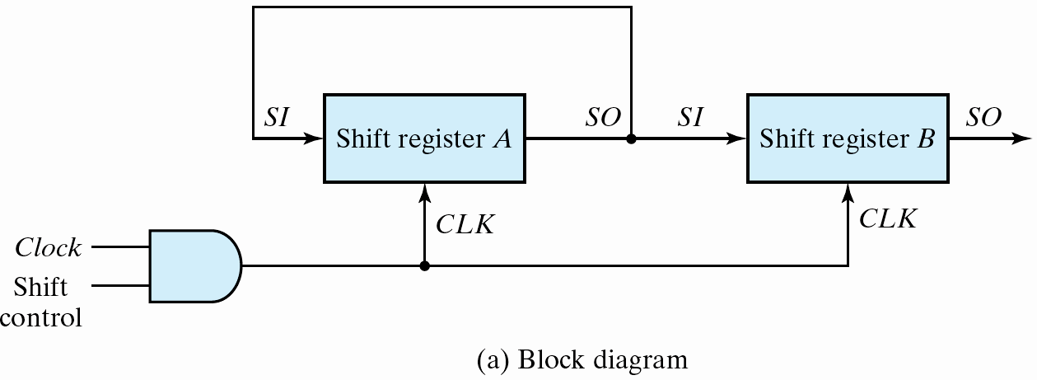
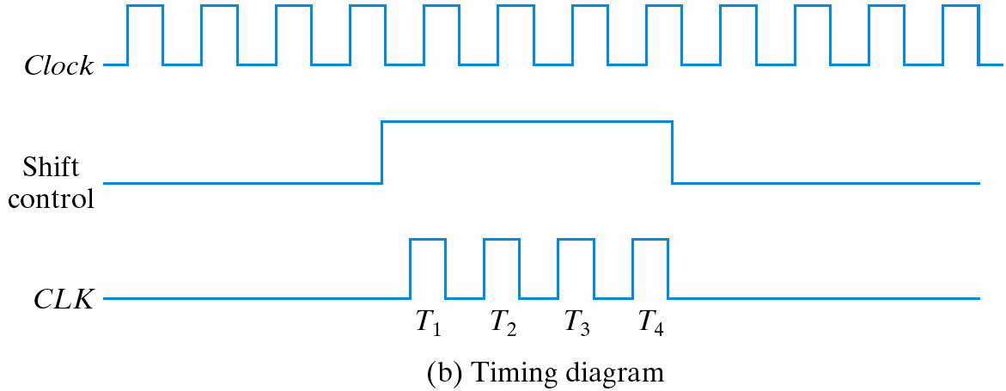
Serial Transfer (1/2)
Example: Serial transfer from reg A to reg B
Synchronous
Fig. 6.4 Serial transfer from register A to register B

Slide 9
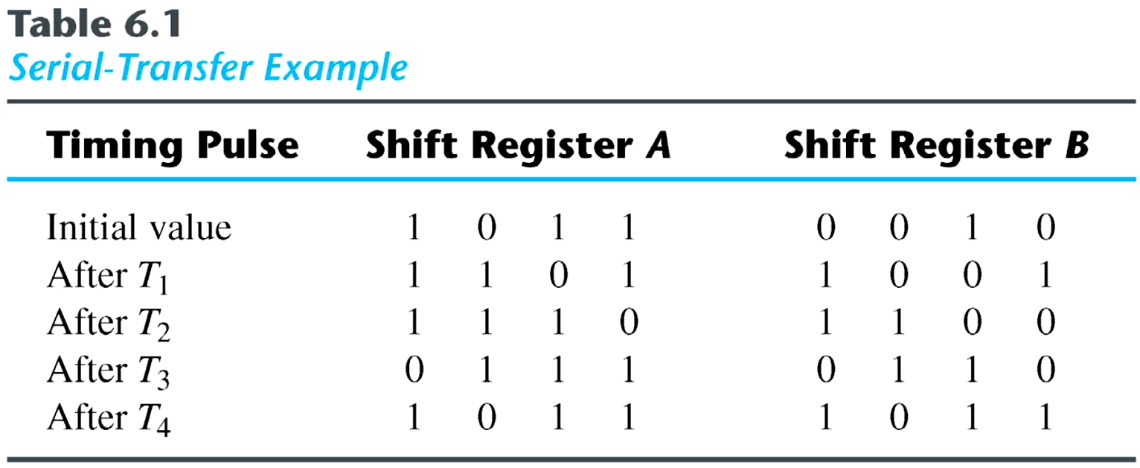
Serial Transfer (2/2)
Example: Serial transfer from reg A to reg B.
serial-transfer

Slide 10
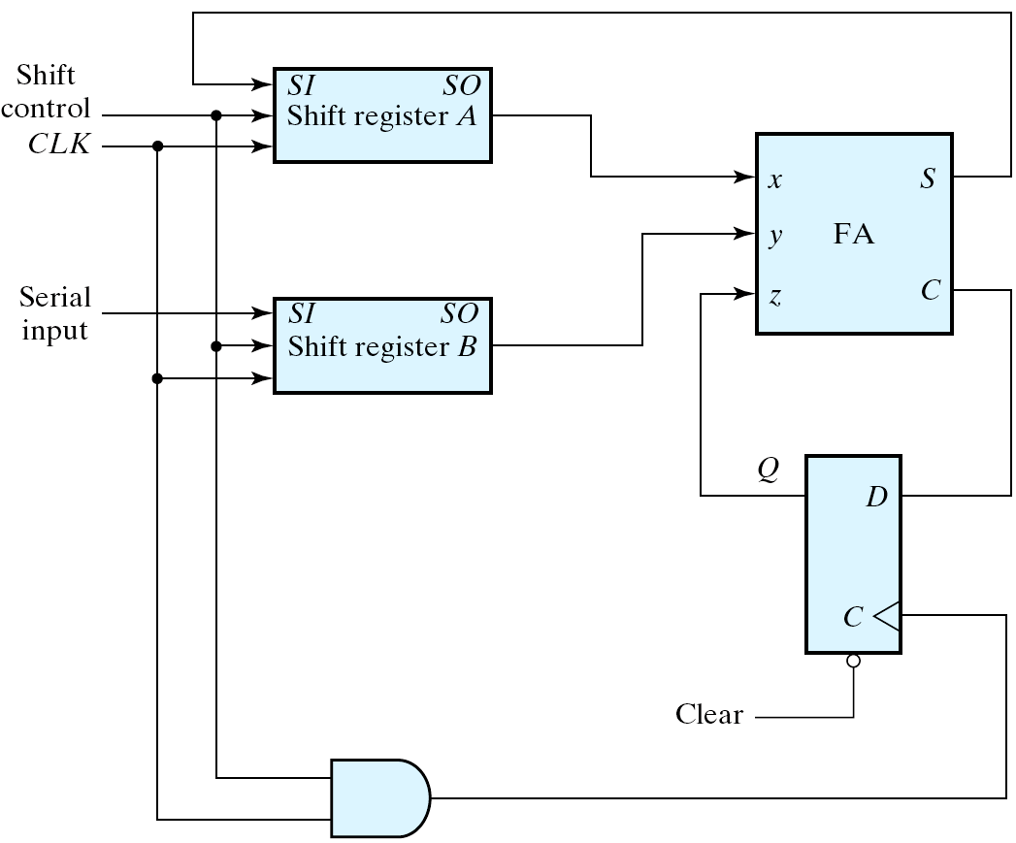
Serial Addition using D Flip-Flops
被加數
1
0
0101
0
0
0010
加數
1
1
0
1
1
1
0011
?001
Fig. 6.5 Serial adder (串列加法器)

Slide 11
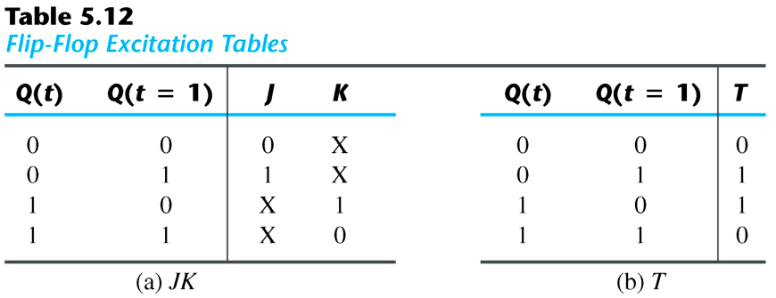
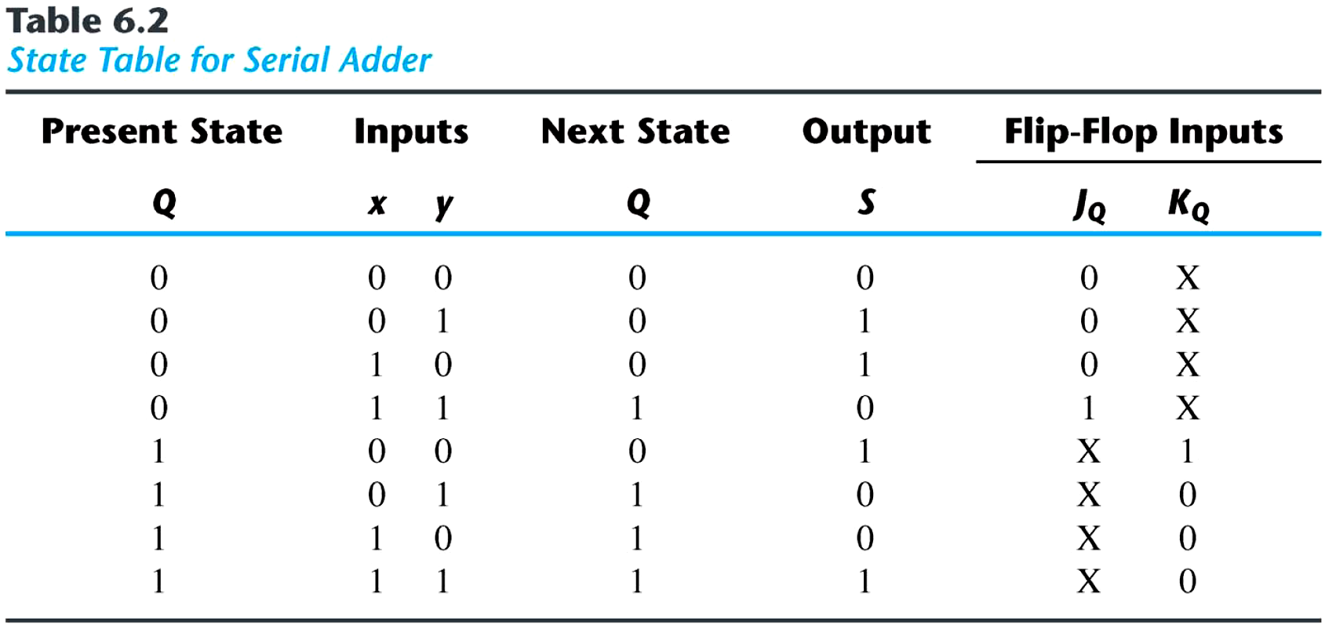
Serial Adder using JK FFs (1/2)
Serial adder using JK flip-flops

Slide 12
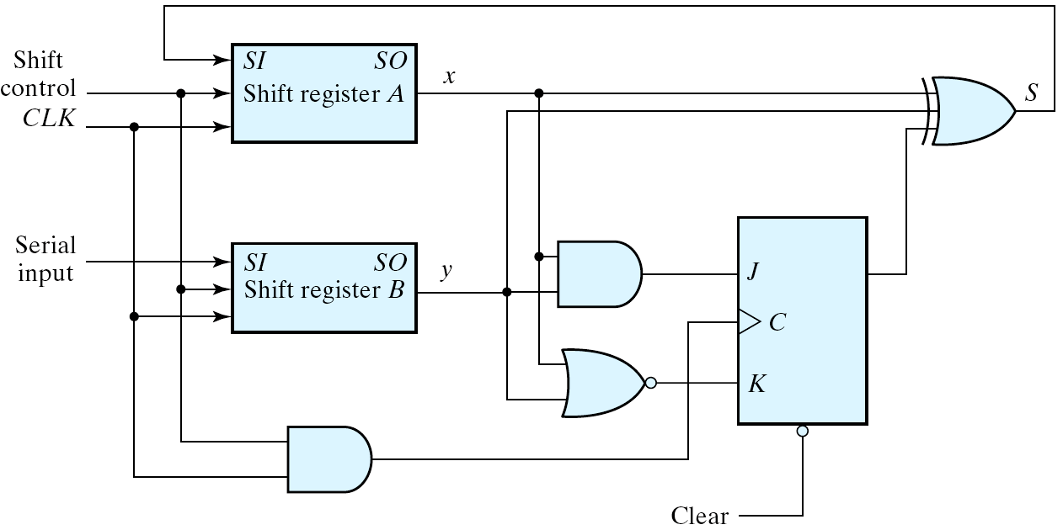
Serial Adder using JK FFs (2/2)
Circuit diagram
  J_{Q} = xy
  K_{Q} = x′y′ = (x+y)′
  S = x ⊕ y ⊕ Q
C_{i}
Fig. 6.6 Second form of serial adder

Slide 13
Universal Shift Register
Three types of shift register
  Unidirectional shift register (單向移位暫存器，如左移或右移暫存器)
    A register capable of shifting in one direction.
  Bidirectional shift register (雙向移位暫存器，如左/右移暫存器)
    A register can shift in both directions.
  Universal shift register (通用移位暫存器)
    Has both direction shifts & parallel load/out capabilities.

Slide 14
Universal Shift Register (1/4)
Capability of a universal shift register:
  A clear control to clear the register to 0 (一個清除控制將暫存器清除為 0);
  A clock input to synchronize the operations (一個時脈輸入使所有操作同步化);
  A shift-right control to enable the shift right operation and the serial input and output lines associated w/ the shift right (一個右移控制用以啟動向右移位操作，以及串列輸入及輸出線配合成可向右移位);
  A shift-left control to enable the shift left operation and the serial input and output lines associated w/ the shift left (一個左移控制用以啟動向左移位操作，以及串列輸入及輸出線配合成可向左移位);
  A parallel-load control to enable a parallel transfer and the n parallel input lines associated w/ the parallel transfer (一個並列載入控制，以啟動並列轉移，及有n 條輸入線配合提供並列轉移);
  n parallel output lines (n 條的並列輸出線);
  A control state that leaves the information in the register unchanged in the presence of the clock (在時脈不斷供應下，有一個控制狀態可使暫存器內的資訊維持不變)。

Slide 15
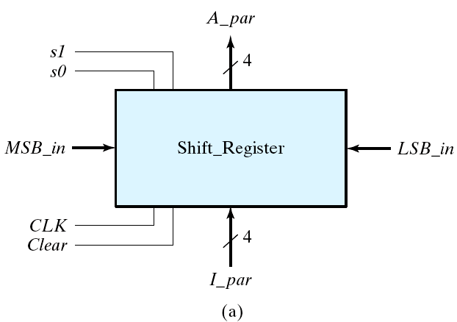
Universal Shift Register (2/4)
Example: 4-bit universal shift register
Fig. 6.7 Four-bit universal shift register

Slide 16
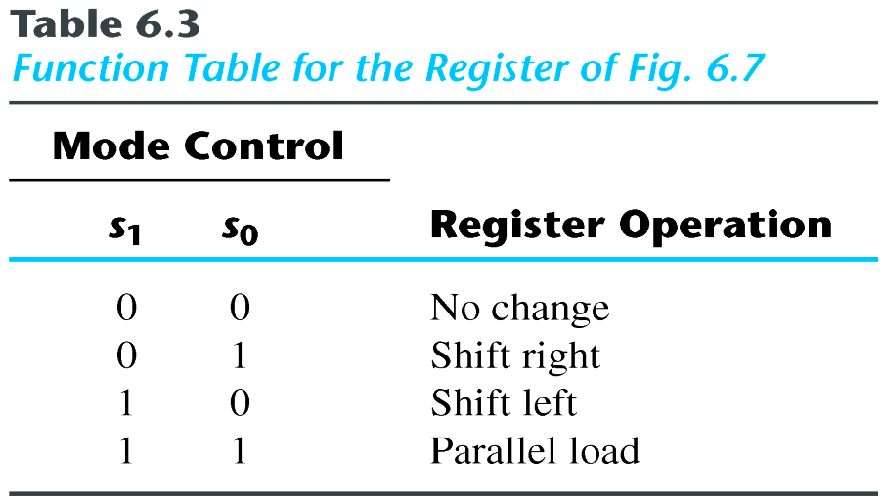
Universal Shift Register (3/4)
Function Table
Clear | S1 | S0 | A3+ | A2+ | A1+ | A0+ | (operation)
0 | × | × | 0 | 0 | 0 | 0 | Clear
1 | 0 | 0 | A3 | A2 | A1 | A0 | No change
1 | 0 | 1 | sri | A3 | A2 | A1 | Shift right
1 | 1 | 0 | A2 | A1 | A0 | sli | Shift left
1 | 1 | 1 | I3 | I2 | I1 | I0 | Parallel load

Slide 17
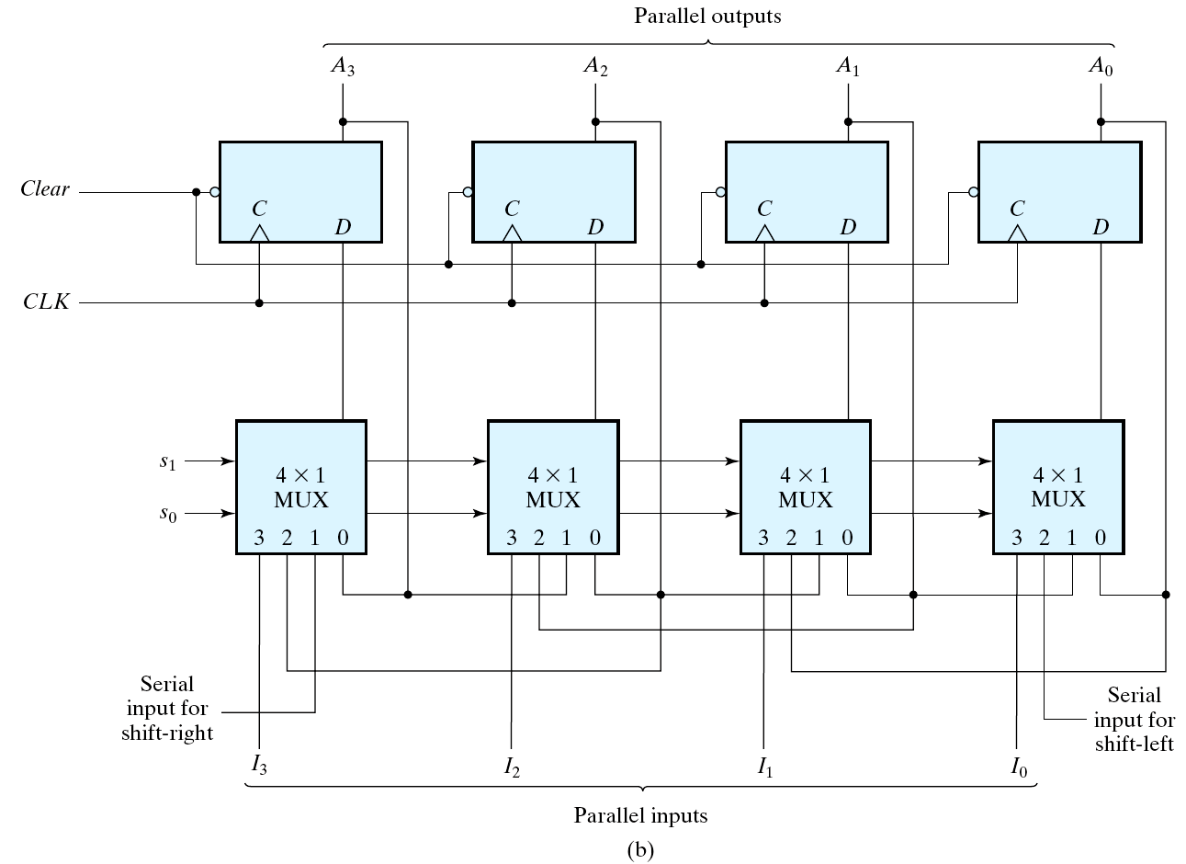
Universal Shift Register (4/4)
A₁
A₂
A₀
Fig. 6.7 Four-bit universal shift register

Slide 18
6-3 Ripple Counters
Counter (計數器)
  A register that goes through a prescribed sequence of states.
  Upon the application of input pulses
    Input pulses: may be clock pulses or originate from some external source.
    The sequence of states: may follow the binary number sequence (⇒ Binary counter) or any other sequence of states.
    A n-bit binary counter → n FFs → count from 0 to 2^{n}-1.

Slide 19
Categories of counters
  Ripple counters (漣波計數器)
    The flip-flop output transition serves as a source for triggering other flip-flop.
    ⇒ no common clock pulse (not synchronous).
  Synchronous counters (同步計數器)
    The CLK inputs of all flip-flops receive a common clock.

Slide 20
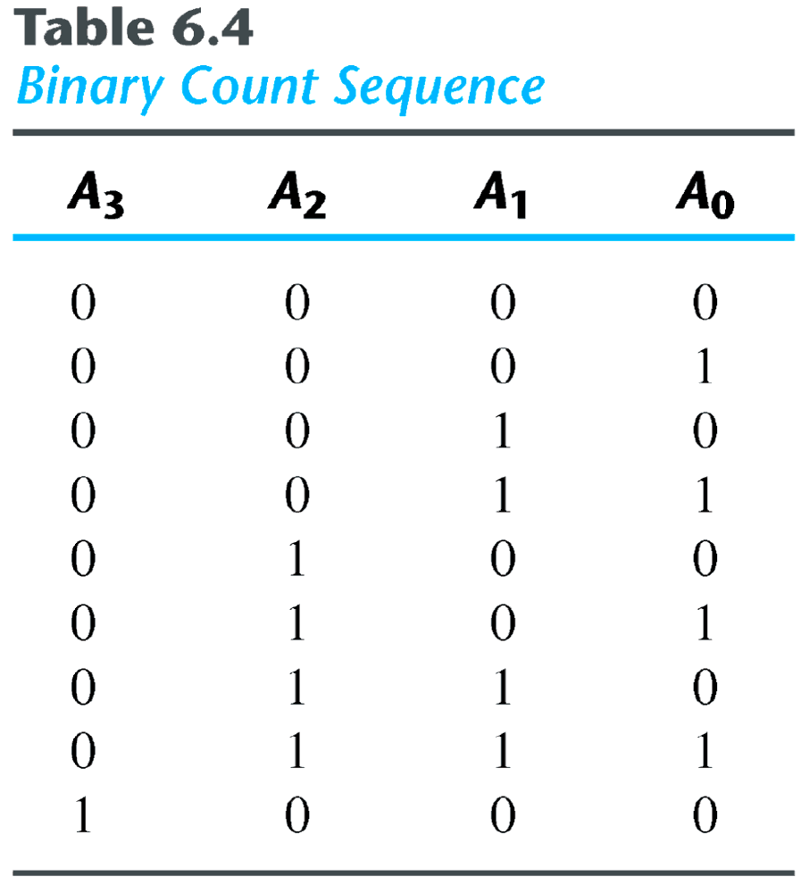
Example: 4-bit binary ripple counter
  Binary count sequence: 4-bit

Slide 21
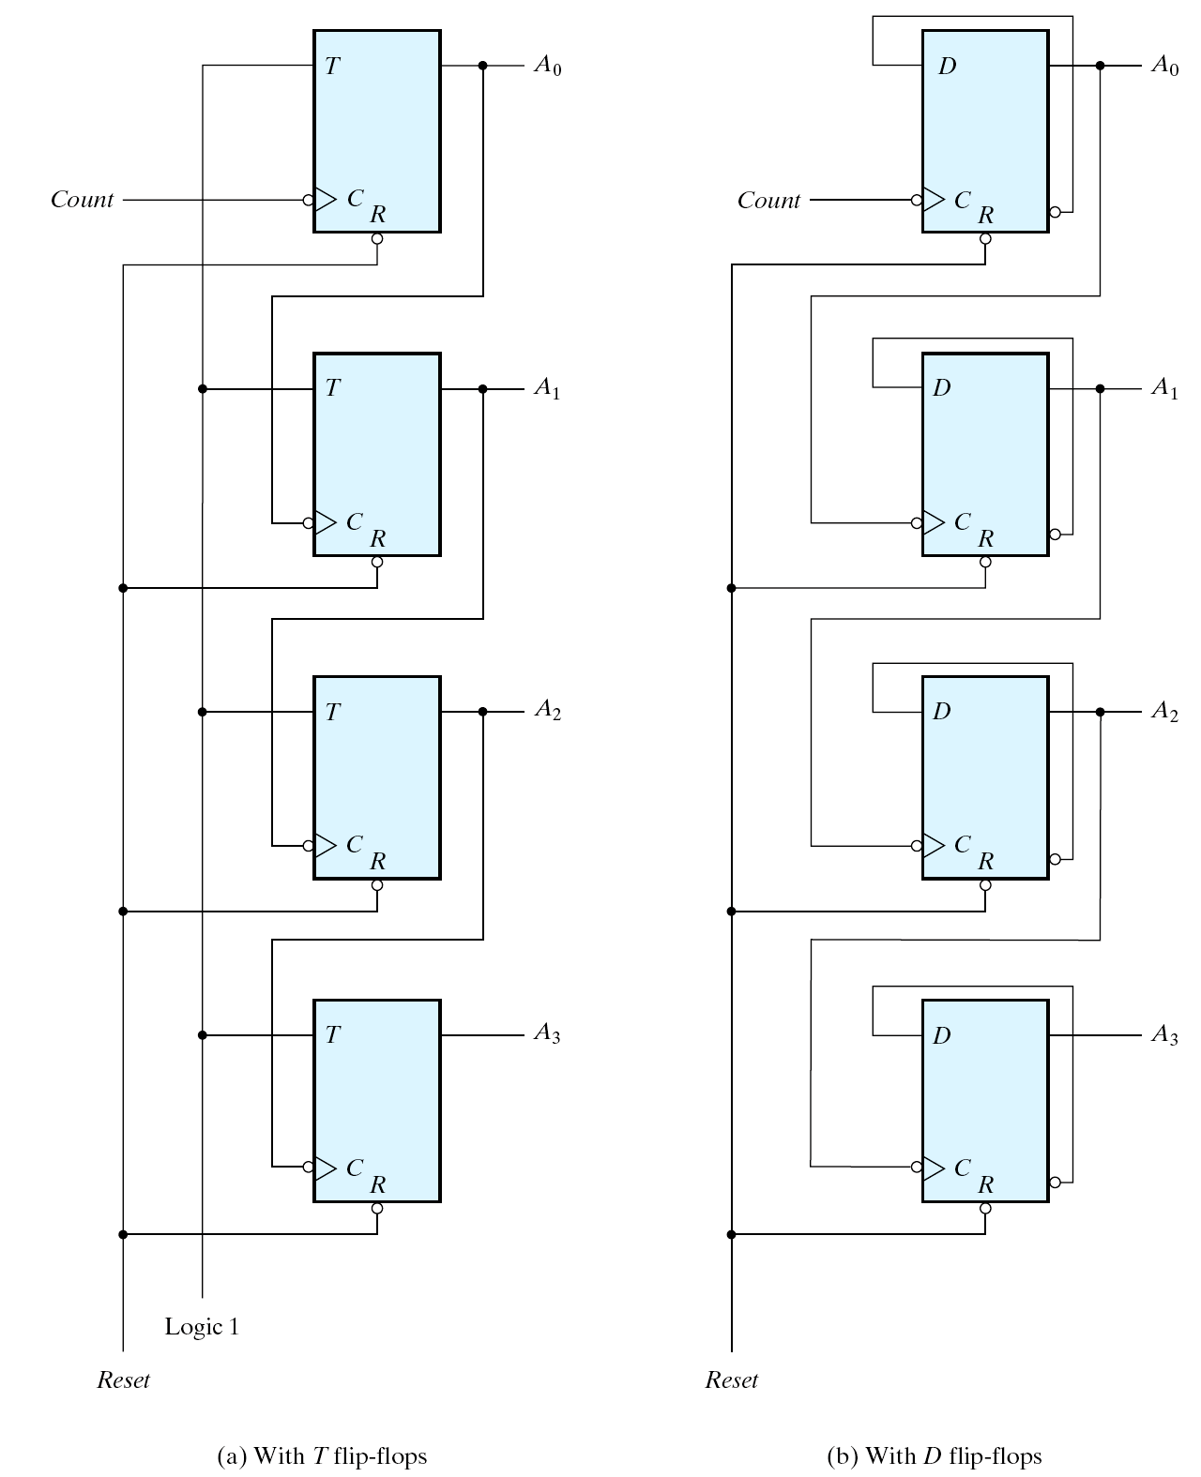
Ripple Counter
A₃ | A₂ | A₁ | A₀
0 | 0 | 0 | 0
0 | 0 | 0 | 1
0 | 0 | 1 | 0
0 | 0 | 1 | 1
0 | 1 | 0 | 0
0 | 1 | 0 | 1
0 | 1 | 1 | 0
0 | 1 | 1 | 1
1 | 0 | 0 | 0
Ripper propagation
Ripper propagation
Fig. 6.8 Four-bit binary ripple counter

Slide 22
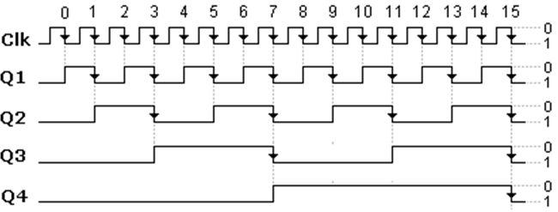

Slide 23
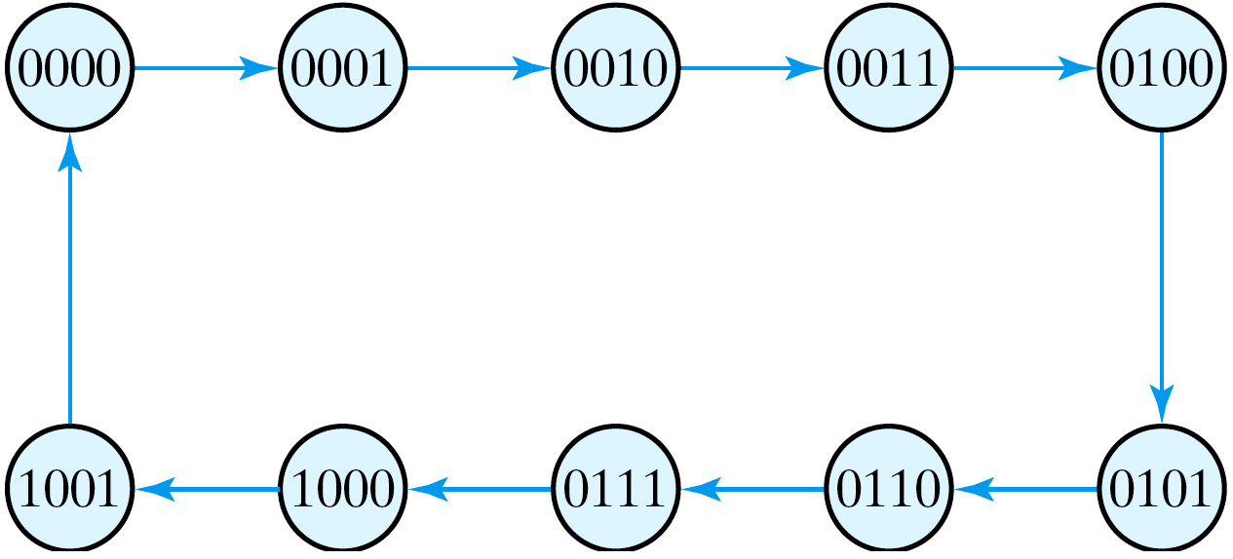
BCD Ripple Counter
Fig. 6.9 State diagram of a decimal BCD counter

Slide 24
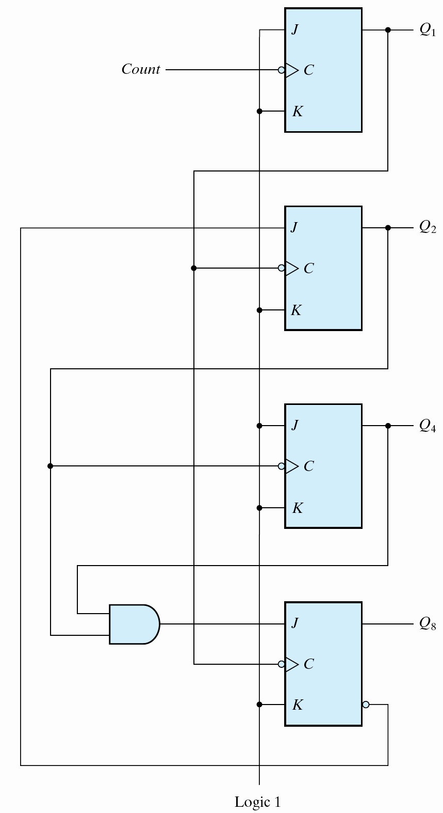
BCD Ripple Counter
Q₈ | Q₄ | Q₂ | Q₁
0 | 0 | 0 | 0
0 | 0 | 0 | 1
0 | 0 | 1 | 0
0 | 0 | 1 | 1
0 | 1 | 0 | 0
0 | 1 | 0 | 1
0 | 1 | 1 | 0
0 | 1 | 1 | 1
1 | 0 | 0 | 0
1 | 0 | 0 | 1
Fig. 6.10 BCD ripple counter

Slide 25
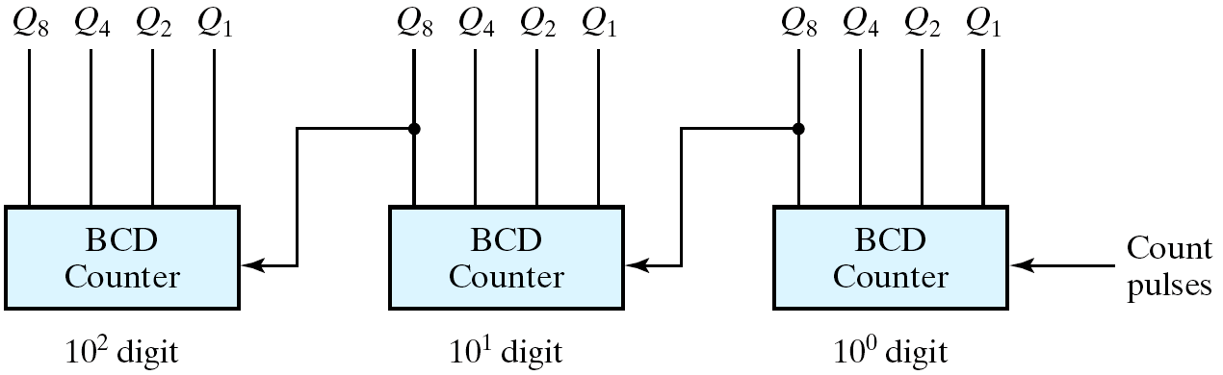
Three-decade BCD counter
Fig. 6.11 Block diagram of a three-decade decimal BCD counter

Slide 26
6-4 Synchronous Counters
Review of counters
  Ripple counters (漣波計數器)
    The flip-flop output transition serves as a source for triggering other flip-flop.
    ⇒ No common clock pulse (not synchronous).
  Synchronous counters (同步計數器)
    The CLK inputs of all flip-flops receive a common clock.

Slide 27
6-4 Synchronous Counters
Sync counter (同步計數器)
  A common clock triggers all flip-flops simultaneously.
Design procedure
  Apply the same procedure of sync seq ckts.
  Sync counter is simpler than general sync seq ckts.
T and JK FFs
  T=0 or J=K=0, no change;
  T=1 or J=K=1, complement.

Slide 28
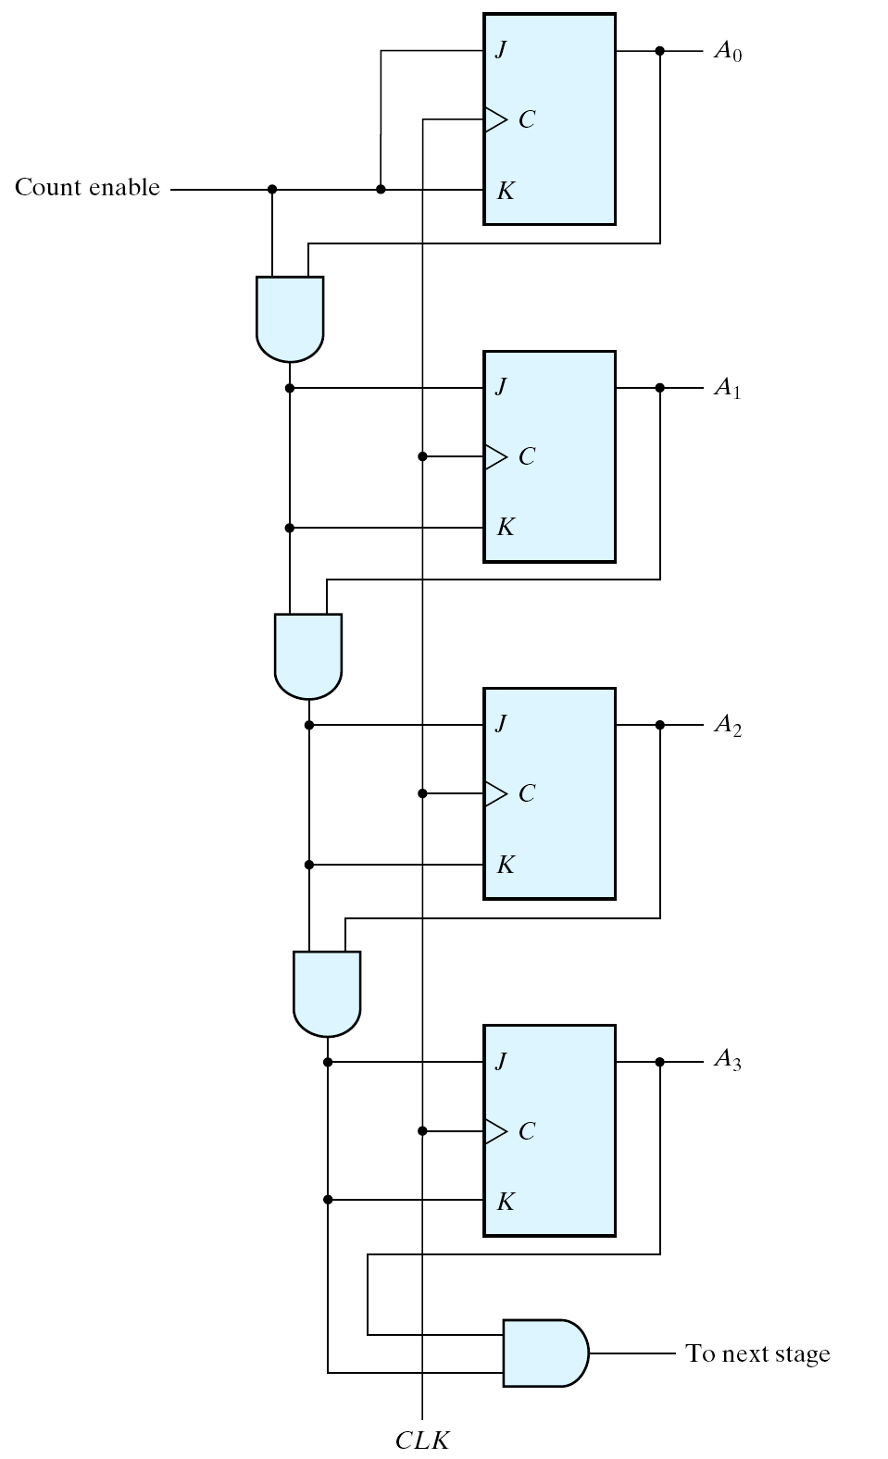
Sync Counters using JK FFs
4-bit binary counter
A₃ | A₂ | A₁ | A₀
0 | 0 | 0 | 0
0 | 0 | 0 | 1
0 | 0 | 1 | 0
0 | 0 | 1 | 1
0 | 1 | 0 | 0
0 | 1 | 0 | 1
0 | 1 | 1 | 0
0 | 1 | 1 | 1
1 | 0 | 0 | 0
1 | 0 | 0 | 1
1 | 0 | 1 | 0
1 | 0 | 1 | 1
1 | 1 | 0 | 0
1 | 1 | 0 | 1
1 | 1 | 1 | 0
1 | 1 | 1 | 1
C_en A₀
C_en A₀ A₁
C_en A₀ A₁ A₂
Fig. 6.12 Four-bit synchronous binary counter

Slide 29
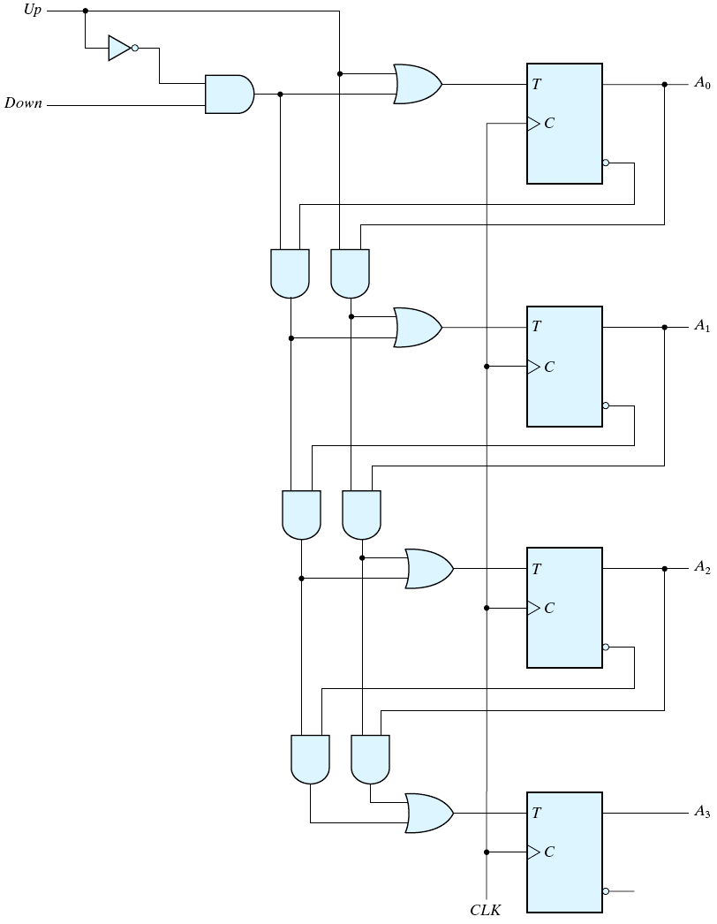
4-bit Up/Down Binary Counter
Up | Down | Function
0 | 0 | No change
0 | 1 | Down Count
1 | 0 | Up Count
1 | 1 | Up Count
down
up
A₃ | A₂ | A₁ | A₀
0 | 0 | 0 | 0
0 | 0 | 0 | 1
0 | 0 | 1 | 0
0 | 0 | 1 | 1
0 | 1 | 0 | 0
0 | 1 | 0 | 1
0 | 1 | 1 | 0
0 | 1 | 1 | 1
1 | 0 | 0 | 0
1 | 0 | 0 | 1
1 | 0 | 1 | 0
1 | 0 | 1 | 1
1 | 1 | 0 | 0
1 | 1 | 0 | 1
1 | 1 | 1 | 0
1 | 1 | 1 | 1
down A'₀
up A₀
down A'₀ A'₁
up A₀ A₁
down A'₀ A'₁ A'₂
up A₀ A₁ A₂
Fig. 6.13 Four-bit up-down binary counter

Slide 30
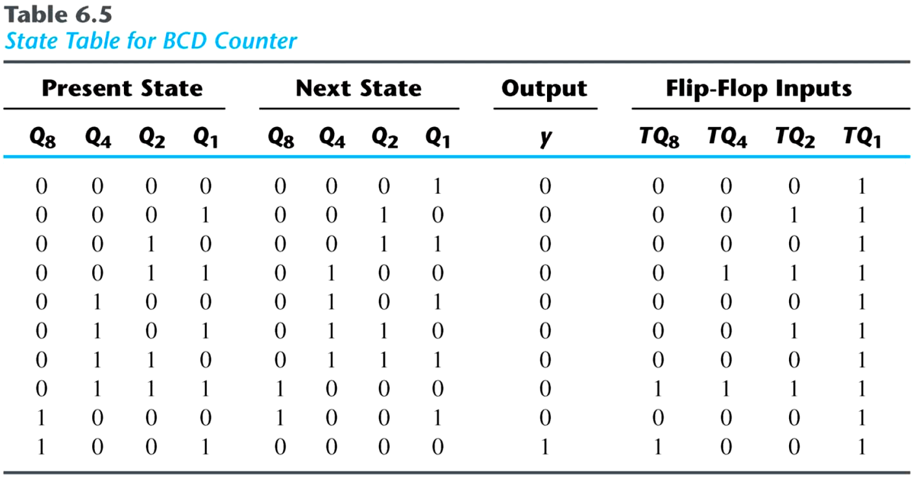

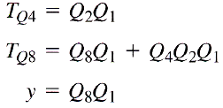
BCD Counters
Simplified functions

Slide 31
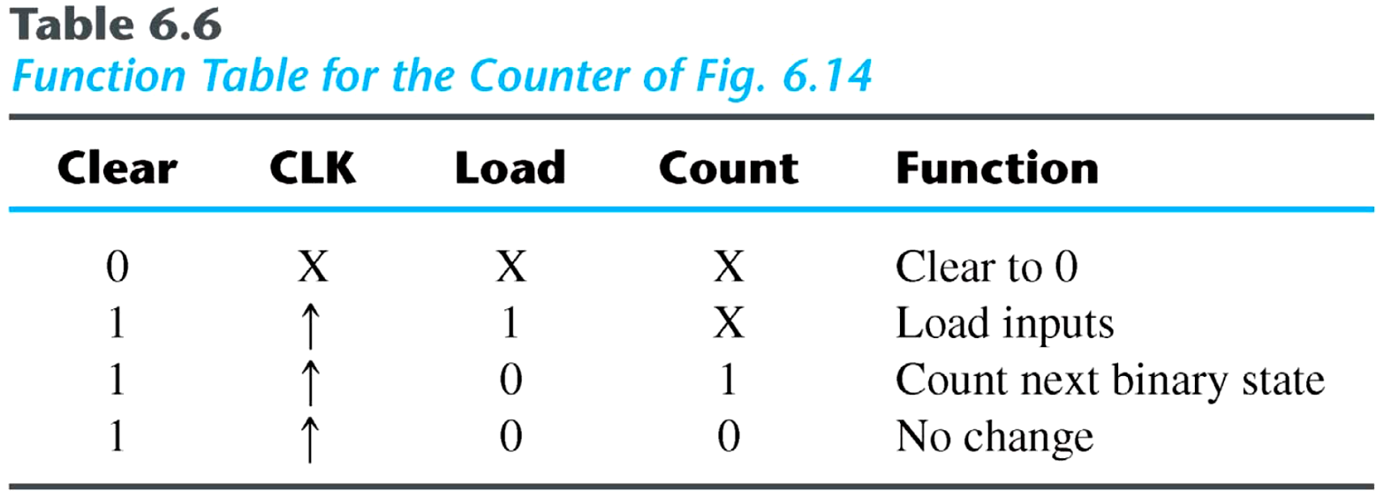
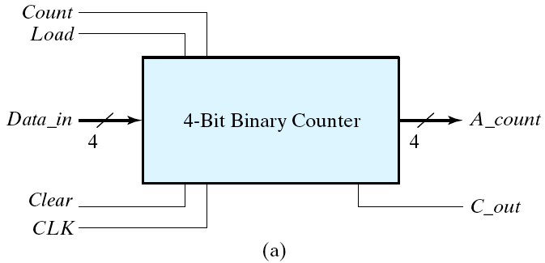
4-bit binary counter with parallel load
Fig. 6.14 Four-bit binary counter with parallel load

Slide 32
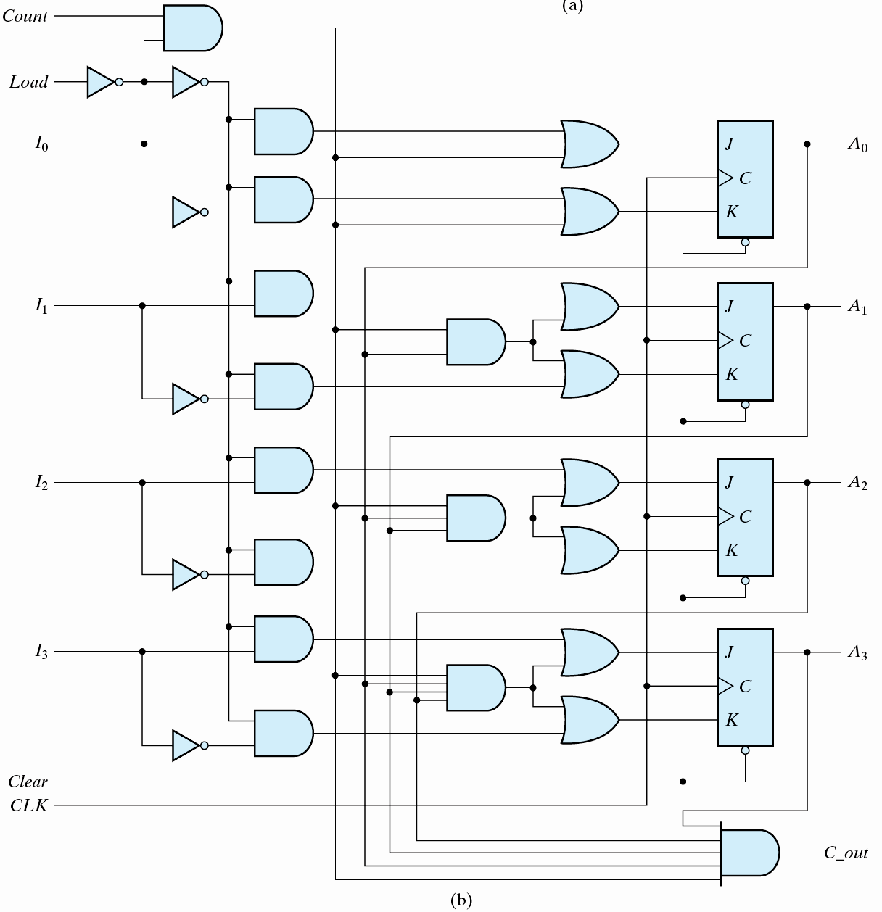
count load'
load
c_en
c_en A₀
async
Fig. 6.14
Four-bit binary counter with parallel load (cont.)

Slide 33
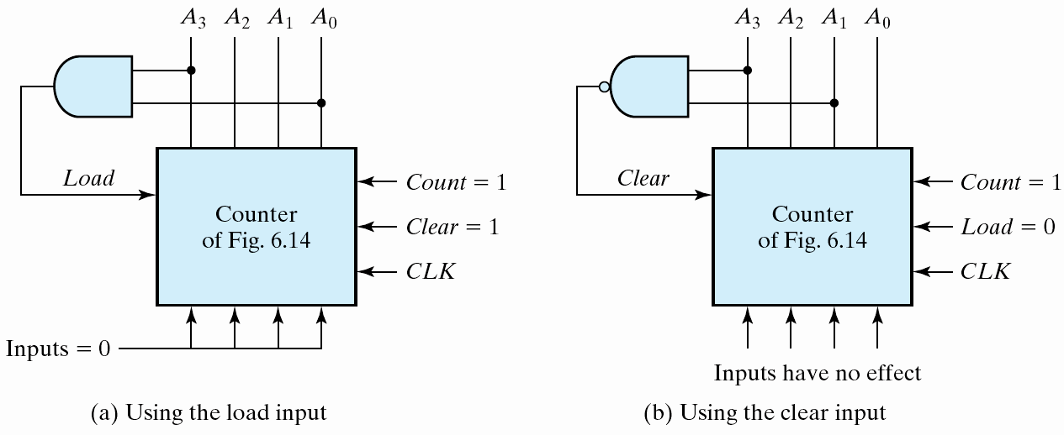
Generate any count sequence
  E.g.: BCD counter ⇐ Counter with parallel load
Fig. 6.15 Two ways to achieve a BCD counter using a counter with parallel load

Slide 34
6-5 Other Counters
Counters
  Can be designed to generate any desired sequence of states.
Divide-by-N counter (modulo-N counter)
  A counter that goes through a repeated sequence of N states.
  The sequence may follow the binary count or may be any other arbitrary sequence.

Slide 35
n flip-flops ⇒ 2^{n} binary states
Unused states
  States that are not used in specifying the FSM.
  May be treated as don’t-care conditions or may be assigned specific next states.
Self-correcting counter (自我校正計數器)
  Ensure that when a ckt enter one of its unused states, it eventually goes into one of the valid states after one or more clock pulses so it can resume normal operation.
  ⇒ Analyze the ckt to determine the next state from an unused state after it is designed.

Slide 36
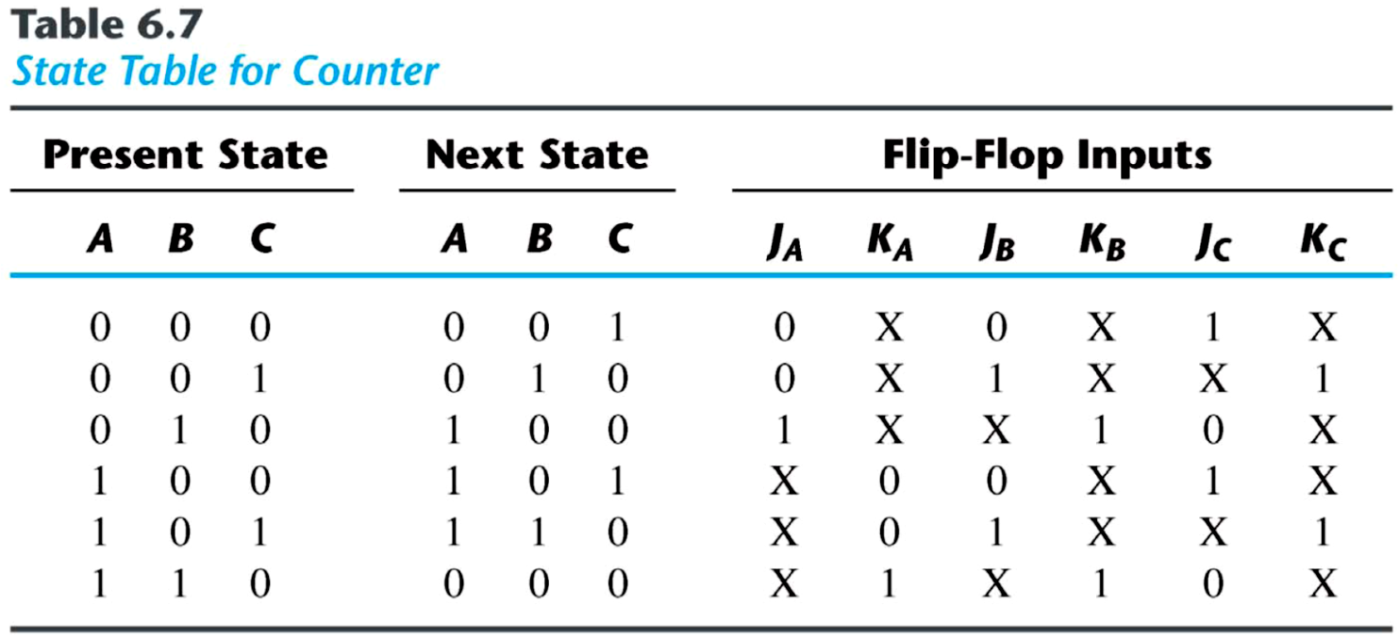
An example
  Two unused states: 011 & 111
  The simplified flip-flop input equations:
    J_{A} = B, K_{A} = B
    J_{B} = C, K_{B} = 1
    J_{C} = B′, K_{C} = 1

Slide 37
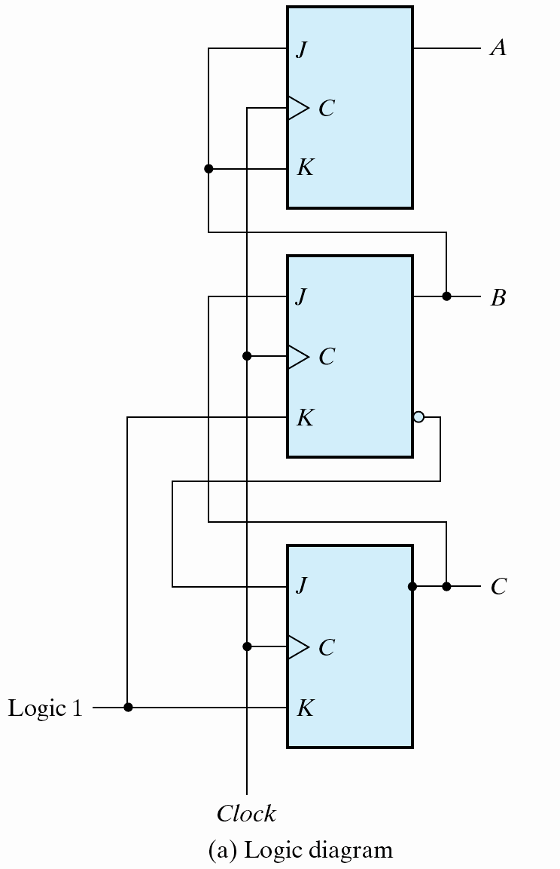
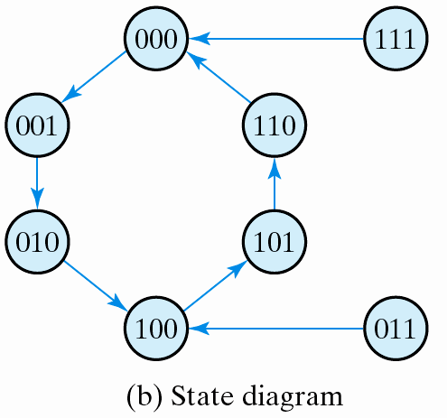
The logic diagram & state diagram of the ckt
The simplified flip-flop input equations:
J_{A} = B, K_{A} = B
J_{B} = C, K_{B} = 1
J_{C} = B′, K_{C} = 1
Fig. 6.16 Counter with unsigned states

Slide 38
Ring counter (環型計數器)
  A circular shift register with only one flip-flop being set at any particular time, all others are cleared (initial value = 1 0 0 … 0 ).
  The single bit is shifted from one flip-flop to the next to produce the sequence of timing signals.

Slide 39
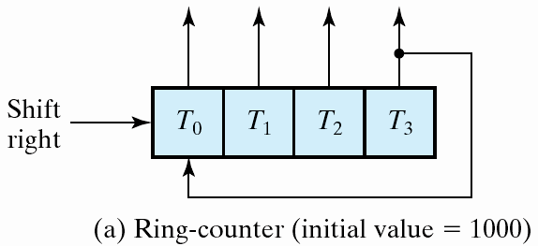
A 4-bit ring counter
A3 | A2 | A1 | A0
1 | 0 | 0 | 0
0 | 1 | 0 | 0
0 | 0 | 1 | 0
0 | 0 | 0 | 1
1 | 0 | 0 | 0
Fig. 6.17 Generation of timing signals

Slide 40
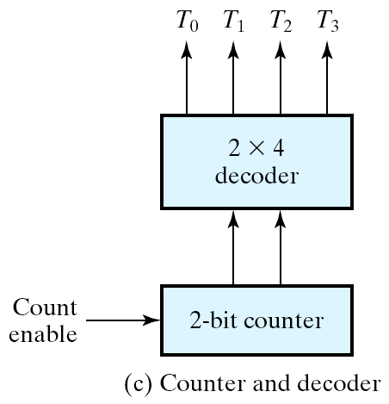
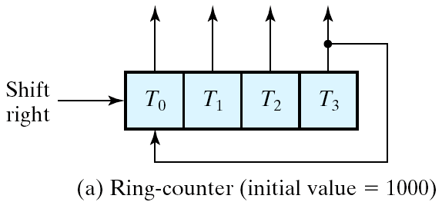
Application of counters
  Counters may be used to generate timing signals to control the sequence of operations in a digital system.
Approaches for generation of 2^{n} timing signals
  1. A shift register with 2^{n} flip-flops
  2. An n-bit binary counter together with an n-to-2^{n}-line decoder
Fig. 6.17 Generation of timing signals

Slide 41
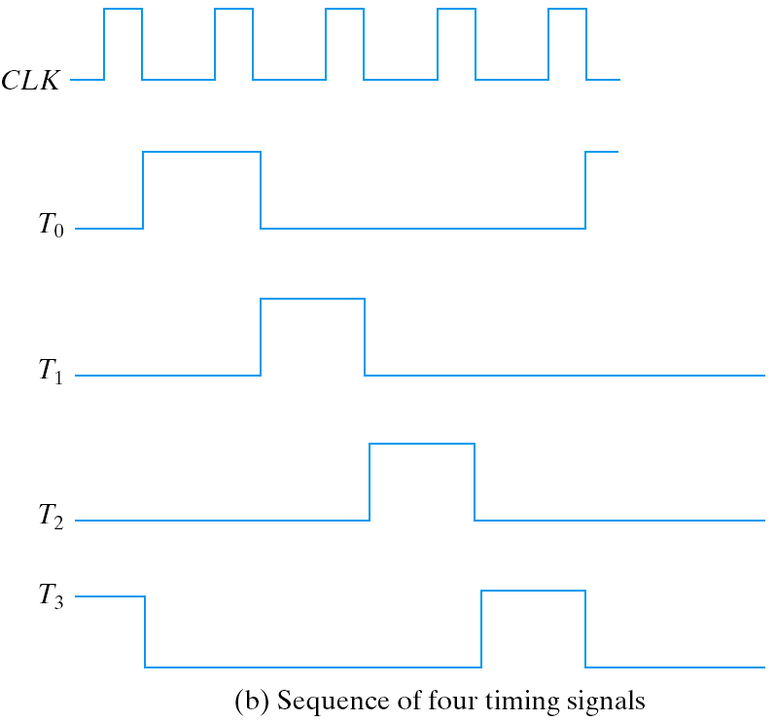
Fig. 6.17 Generation of timing signals

Slide 42
Johnson Counter (詹森計數器)
Ring counter vs. Switch-tail ring counter
  Ring counter
    A k-bit ring counter circulates a single bit among the flip-flops to provide k distinguishable states.
  Switch-tail ring counter (切換-尾端環型計數器)
    It is a circular shift register with the complement output of the last flip-flop connected to the input of the first flip-flop.
    A k-bit switch-tail ring counter will go through a sequence of 2k distinguishable states. (initial value = 0 0 … 0).

Slide 43
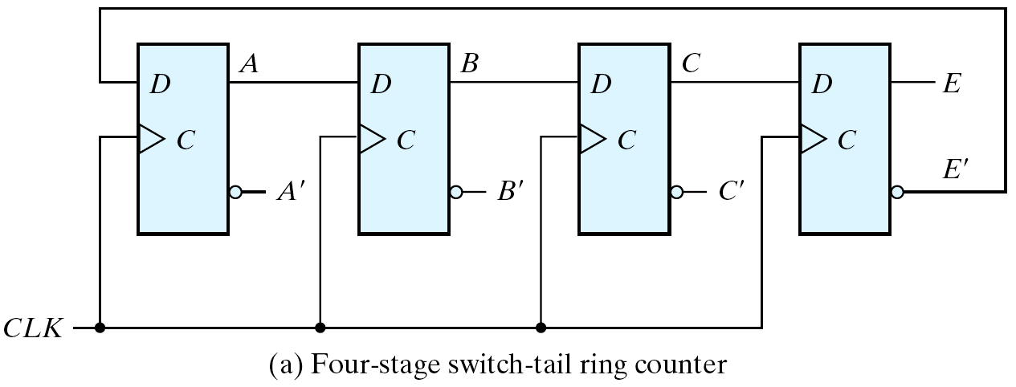
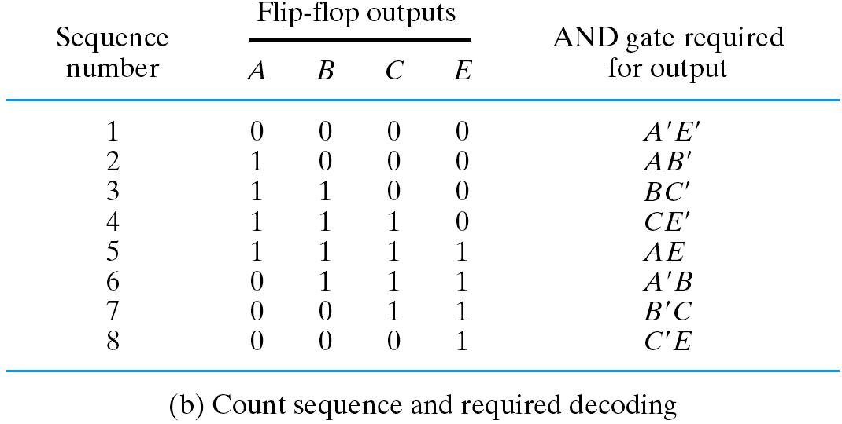
An example: Switch-tail ring counter
Fig. 6.18 Construction of a Johnson counter

Slide 44
Johnson counter (詹森計數器)
  A k-bit switch-tail ring counter + 2k decoding gates
  Provide outputs for 2k timing signals
    E.g.: 4-bit Johnson counter
  The decoding follows a regular pattern
    2 inputs per decoding gate

Slide 45
Summary
Disadvantage of the switch-tail ring counter
  If it finds itself in an unused state, it will persist to circulate in the invalid states and never find its way to a valid state.
  One correcting procedure: D_{C} = (A + C) B
Summary
  Johnson counters can be constructed for any number of timing sequences
    Number of flip-flops = 1/2 (the number of timing signals).
    Number of decoding gates = number of timing signals 2-input per gate.

