Slide 1
Digital Image Processing
OpenCV Python Program to analyze an image using Histogram

Slide 2

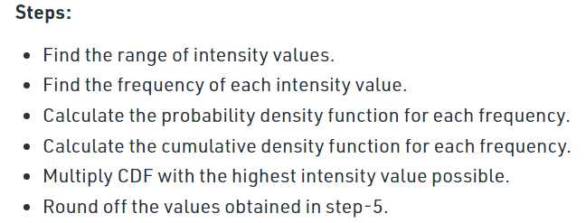
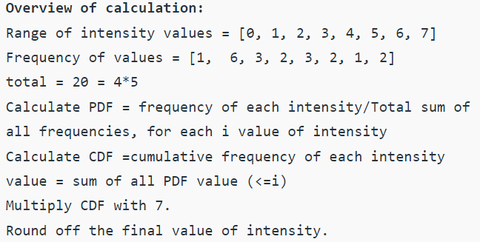
Histogram Equalization

Slide 3
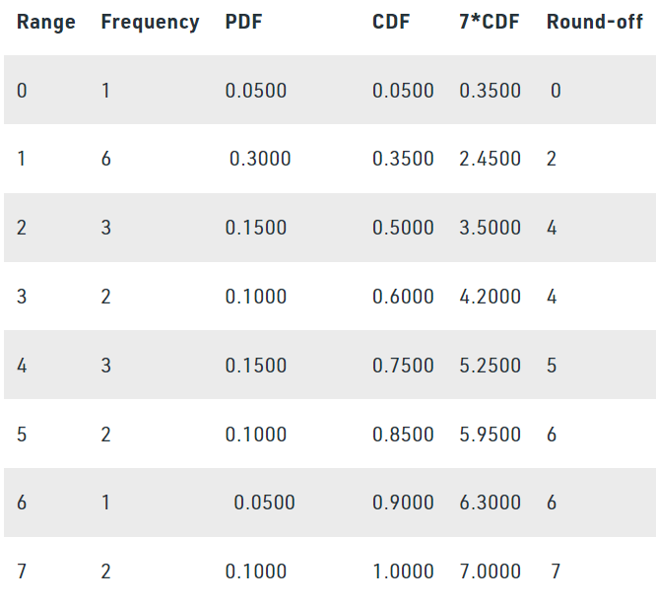
Histogram Equalization

Slide 4
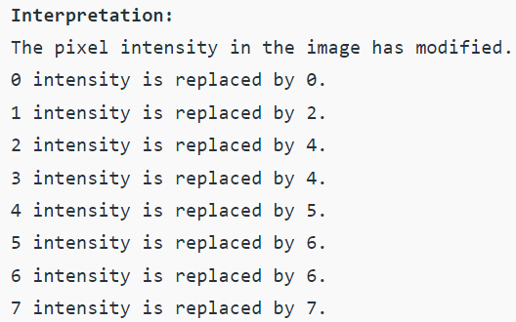
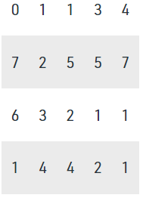

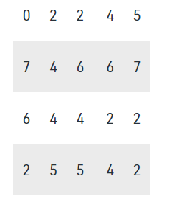
Histogram Equalization

Slide 5
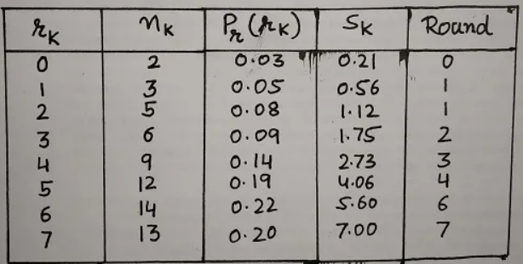
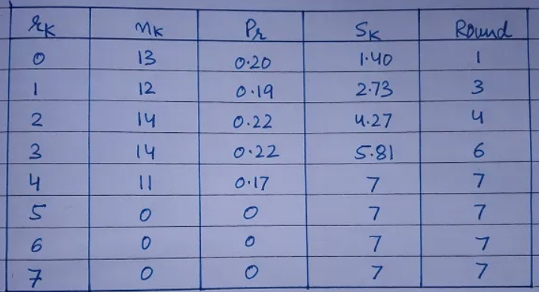
Histogram Matching

Slide 6
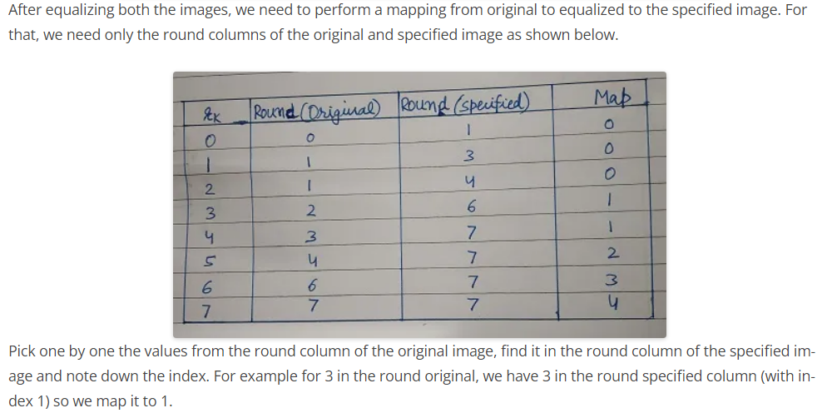
Histogram Matching

Slide 7
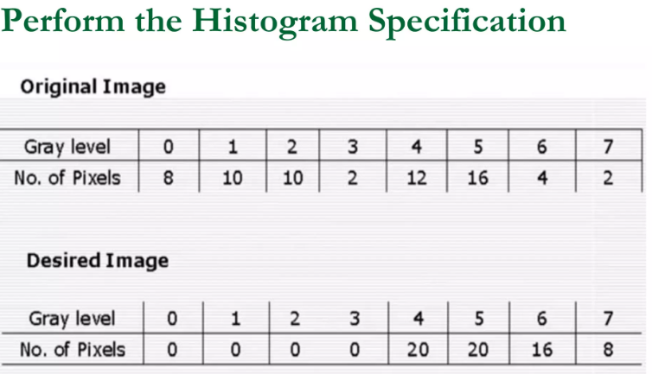
Histogram Matching

Slide 8
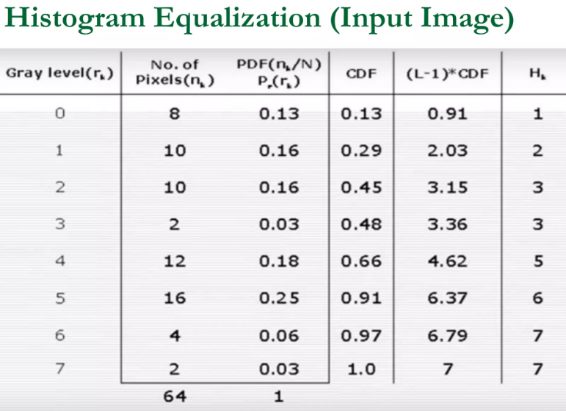
Histogram Matching

Slide 9
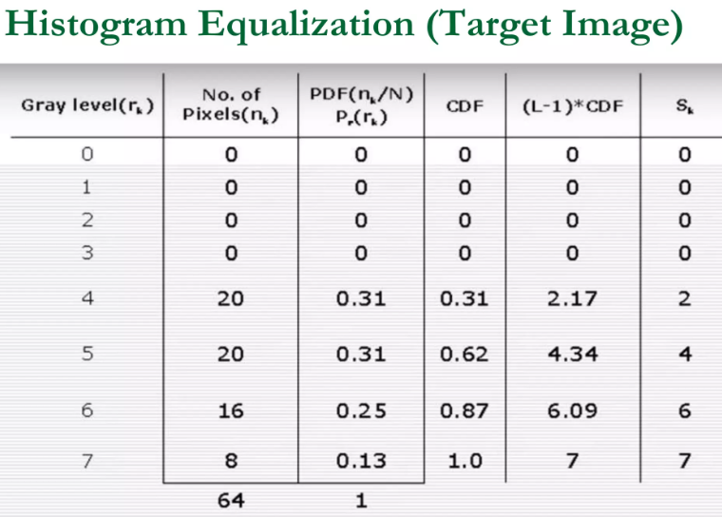
Histogram Matching

Slide 10
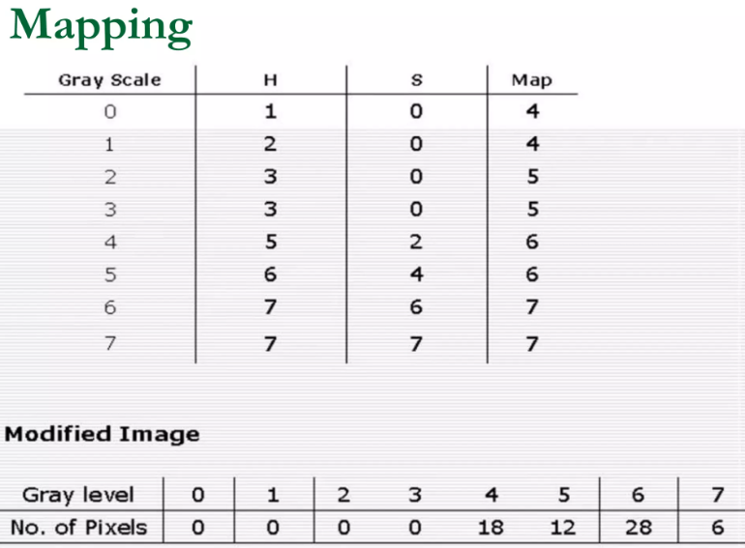
Histogram Matching

Slide 11


Codes Related to Histogram

Slide 12
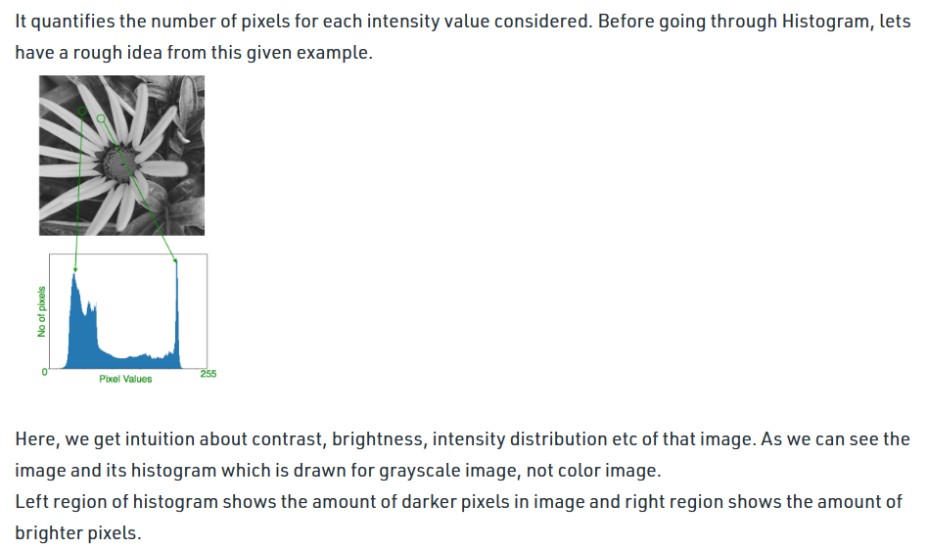
Codes Related to Histogram

Slide 13
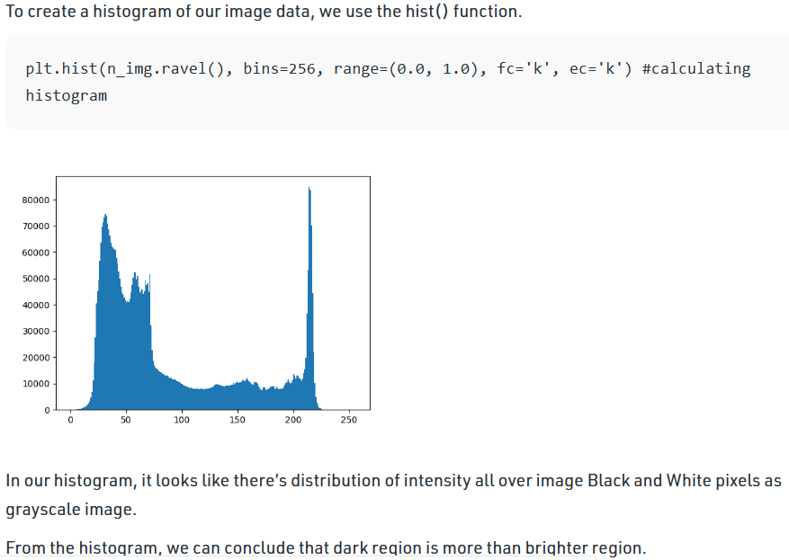
Codes Related to Histogram
fc= facecolor
ec=edgecolor
The ravel() function in NumPy is used to create a contiguous flattened array.

Slide 14
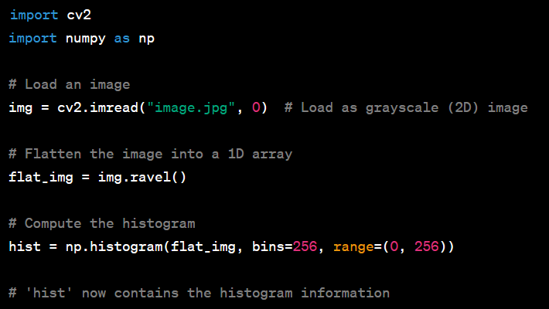
Codes Related to Histogram

Slide 15


Codes Related to Histogram

Slide 16
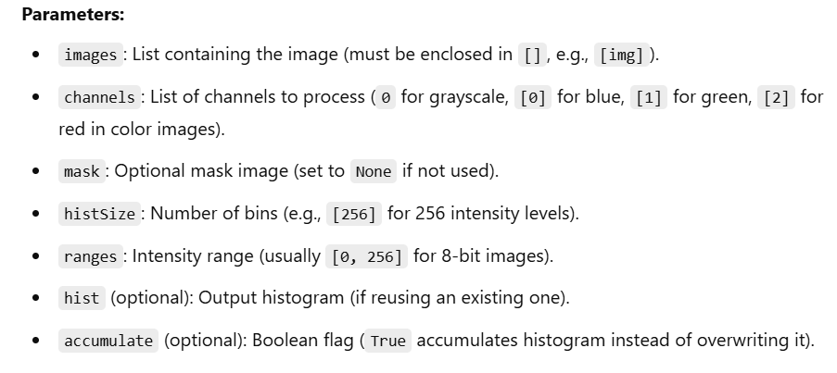
Codes Related to Histogram

Slide 17

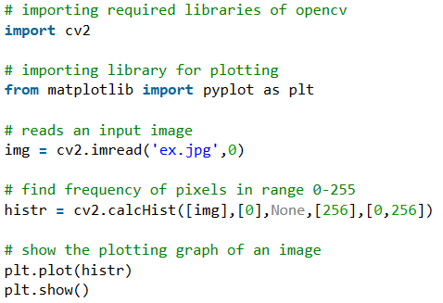
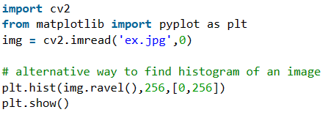
Codes Related to Histogram

Slide 18



Codes Related to Histogram

Slide 19
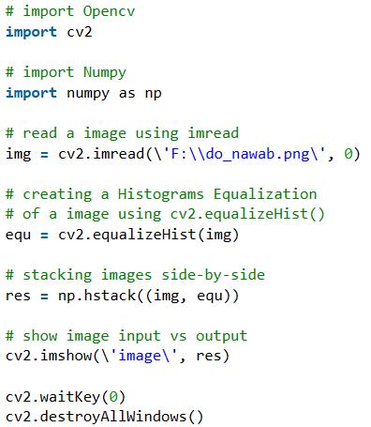
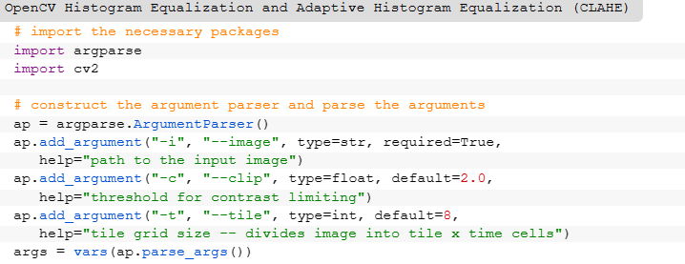
Codes Related to Histogram

Slide 20
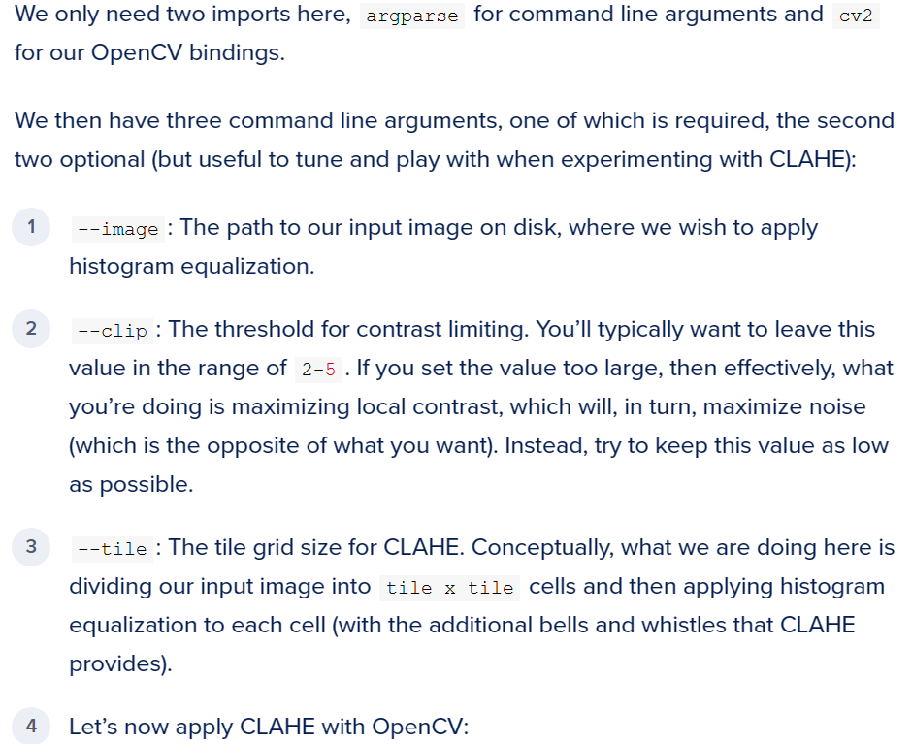
Codes Related to Histogram

Slide 21

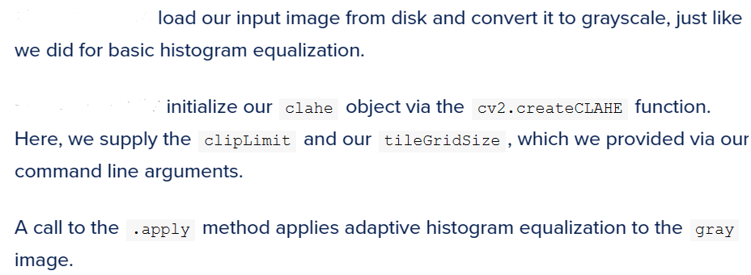

Codes Related to Histogram

Slide 22
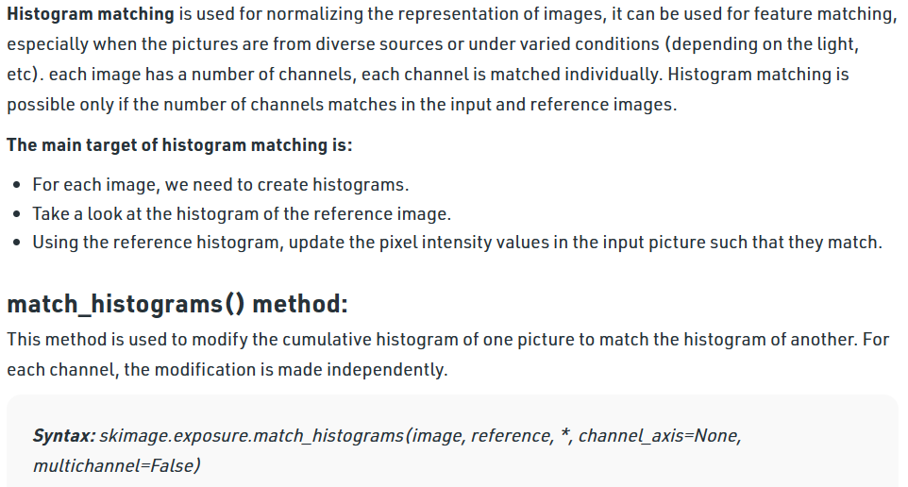
Codes Related to Histogram

Slide 23

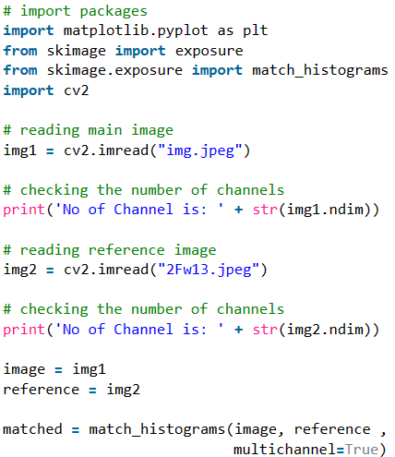

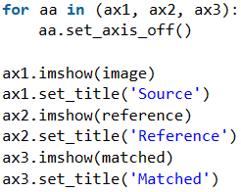
Codes Related to Histogram

Slide 24
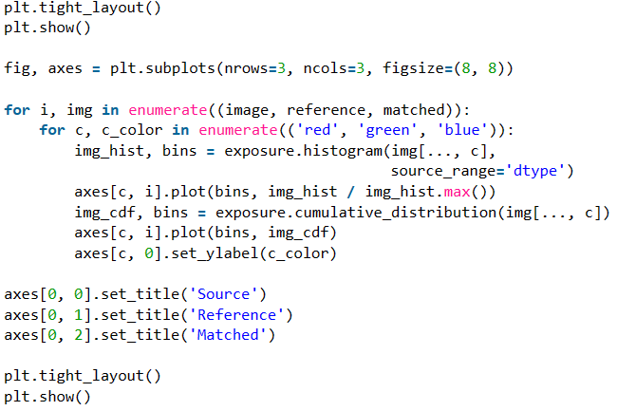
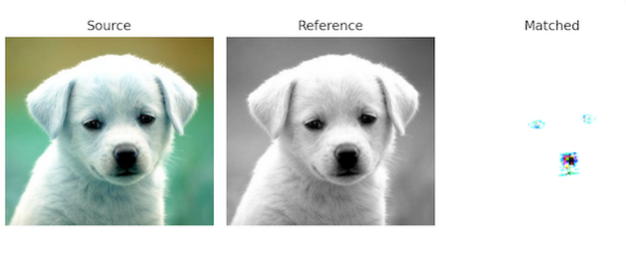
Codes Related to Histogram

Slide 25
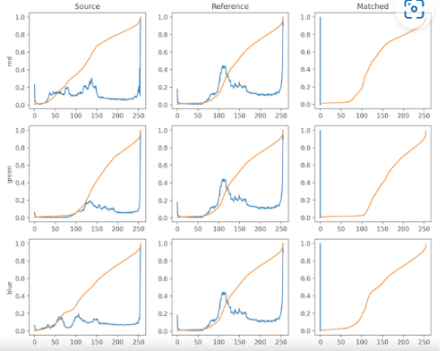
Codes Related to Histogram

Slide 26
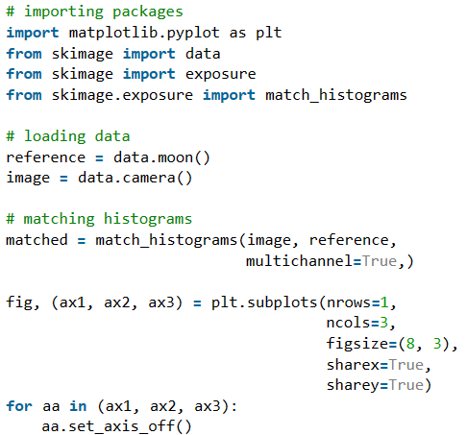
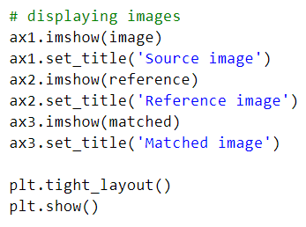
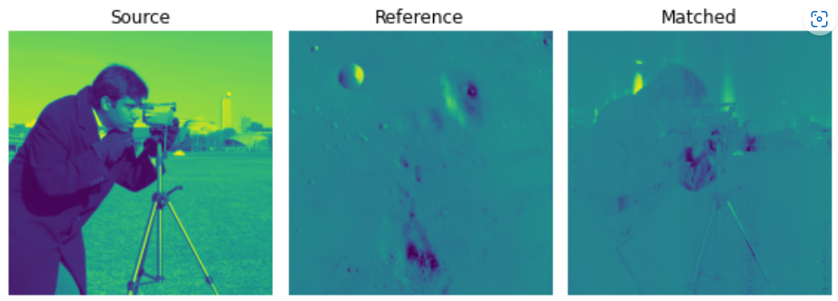
Codes Related to Histogram

Slide 27
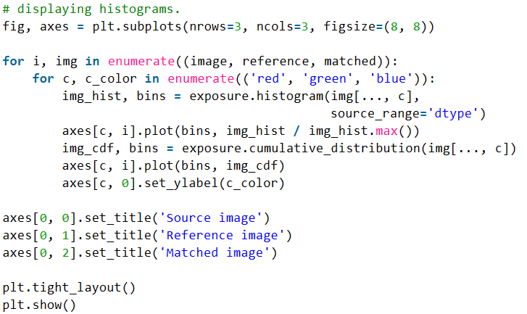
Codes Related to Histogram

Slide 28
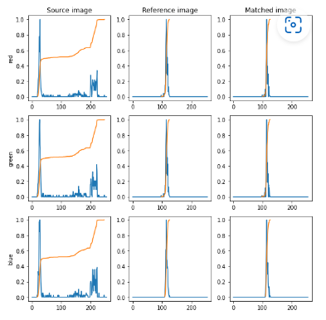
Codes Related to Histogram

Slide 29
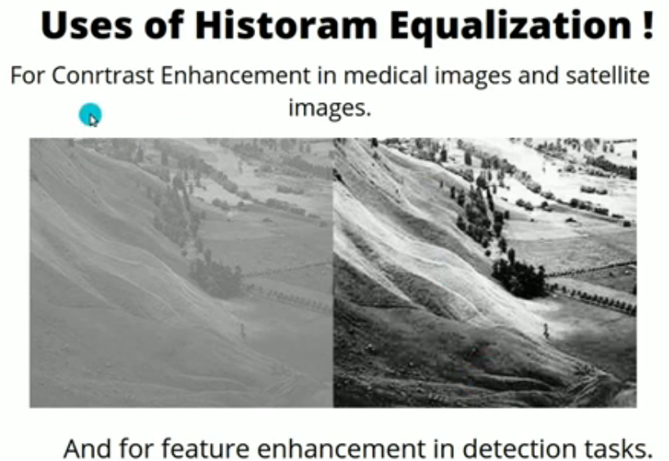
Codes Related to Histogram

