Slide 1

Pancreatic cancer detection based on CT images using deep learning
Presenter: Nguyen Ngoc Tram
Authors and Co-Authors: Hoang Quang Huy
Ngo Tien Dat
Dinh Nghia Hiep
Tran Anh Vu

Slide 2

Contents
Introduction
Dataset
Pre-Processing
Proposed Method
Model Evaluation
Results
Conclusion

Slide 3
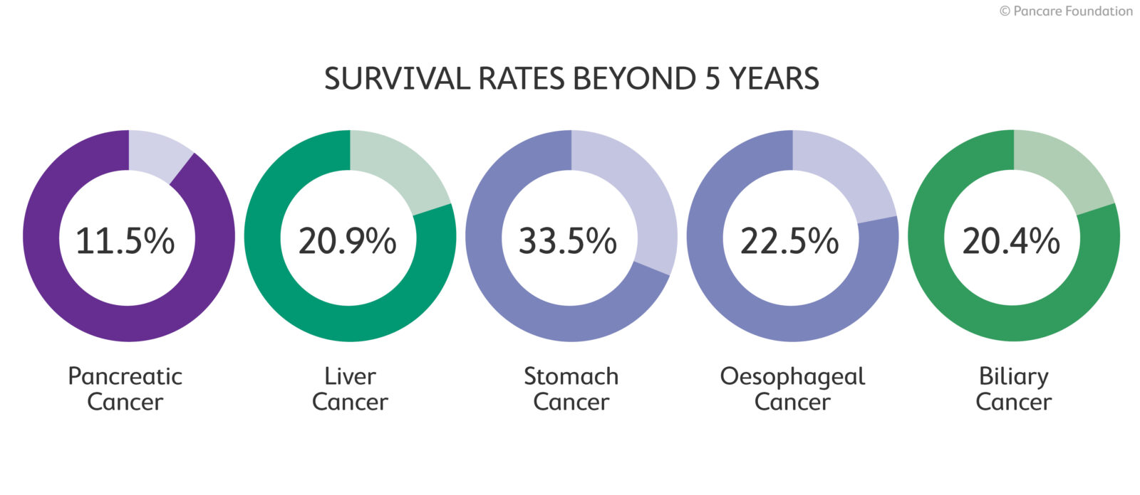
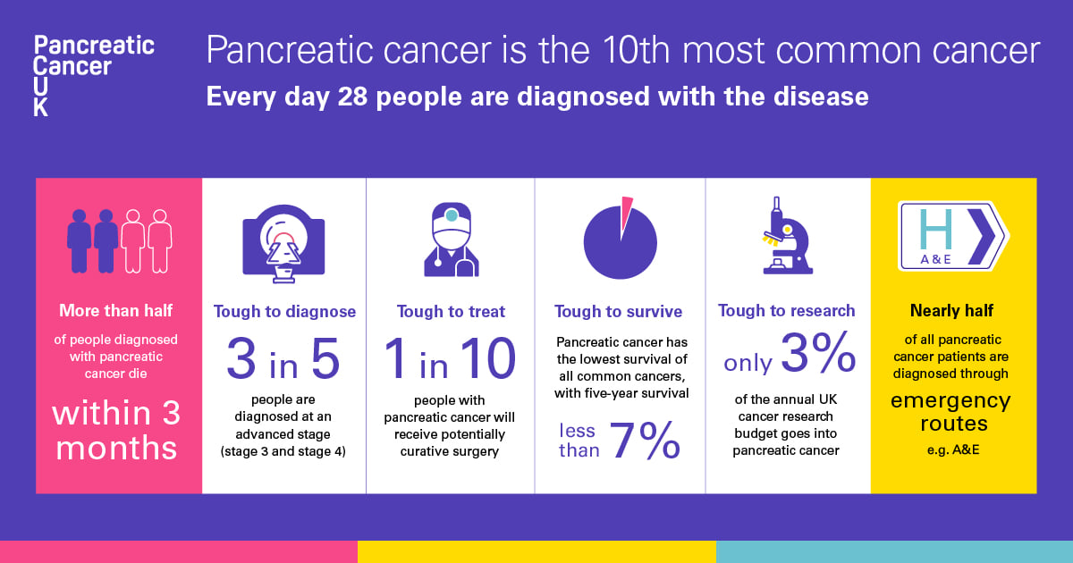
Introduction
Pancreatic cancer : a leading cause of fatality in the United States & the world, with only 4% of patients having a survival rate of 5 years
An estimated 31,270 out of 31,860 patients would die from the disease (2006)
Number surged to an estimation of 37,390 patients in 2012
Early detection of pancreatic cancer is difficult due to its metastasis and few undruggable genes
approximately 40% of tumors smaller than 2cm evade CT scan
distant metastasis present in more than one-half of the cases
elimination of local therapies such as surgery and radiation
few mutated genes currently undruggable
KRAS, CDKN2A (p16), TP53, and SMAD4

Slide 4
Introduction
Manual diagnosis: prone to inaccuracy due to lengthy procedure and human error
Recent research has shown superior results in applying Artificial Intelligence techniques in predicting potential pancreatic cancer
In this project, we propose a CNN-based model detect pancreatic cancer on clinical CT scans

Slide 5
Dataset
Two publicly available datasets:
The Cancer Imaging Archive (TCIA)
The Medical Segmentation Decathlon (MSD)
In total, we analyzed 363 CT scans from the TCIA and MSD datasets
163 scans from patients with pancreatic cancer
200 from control patients
The TCIA dataset
82 patients with pancreatic ductal adenocarcinoma
The MSD dataset
280 patients with pancreatic cancer
7983 portal-venous phase CT scans
100 control patients
DICOM format
~ 512 x 512 pixels
slice thickness between 1.5 − 2.5 mm
Provided by the National Institutes of Health Clinical Center in 2016
DICOM format
~ 512 x 512 pixels
Provided by the Memorial Sloan Kettering Cancer Center, New York, US

Slide 6
Dataset
Origin data:
280 patients with pancreatic cancer (15000 images)
82 patients with normal pancreas
(18942 images)
Total 9676 images:
3812 images with pancreatic cancer (label 1)
5864 images with normal pancreas (label 0)
Training set:
(6400 images) 2400 image pancreatic cancer and 4000 images normal pancreas
Validation set:
(1698 images) 699 image pancreatic cancer and 999 images normal pancreas
Testing set:
(1574 images) 711 image pancreatic cancer and 863 images normal pancreas :
Images are labeled as “0” for non-cancerous and “1” for cancerous patients
Patients are randomly placed into validation, test, and training sets
20% of the patients into the validation set
20% into the test set
Remaining 60% into the training set
Training set with a mini-batch size of 32

Slide 7
Pre-Processing
The proposed image conversion steps are as follows:
Image extraction: CT scans are extracted from the DICOM file dataset and converted into 2D JPG images.
Dilation operations: 3x3 matrix is used to dilate the image, focusing on the pancreas and tumor area.
Image contour: "find contour" algorithm based on upper, lower, left, and right extremes parameters to remove redundant parts.
Result: Unwanted noise is removed through denoising, contrast, and brightness adjustment, followed by resizing for optimal image conditions.

Slide 8
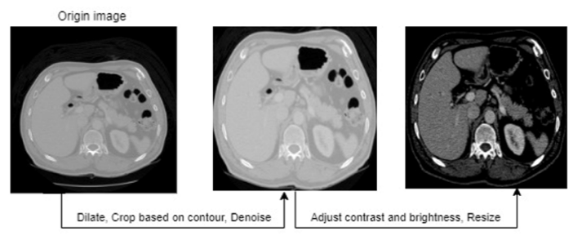
Pre-Processing
After pre-processing, the CT images are filtered through a mask, leaving only images representing the ROI

Slide 9
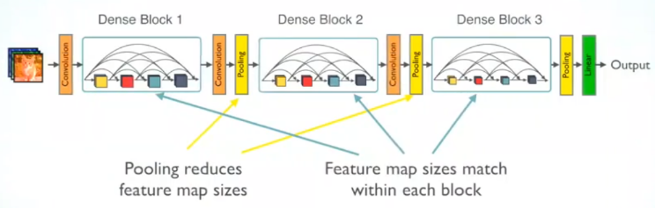
Proposed Method
Densely Connected Convolutional Network (DenseNet)
Based on the CNN framework
Cross-connects multiple layers in the network
Feature maps iterate through the network
Encouraging information flow and recycling features
For each layer, the feature maps of all the preceding layers are used as inputs, and their own feature maps are used as input for each subsequent layer
For L layers, there are L(L+1)/2 direct connections
Block sequence of the DenseNet model

Slide 10
Model Evaluation
The model was trained for 15 epochs
A 10-fold cross-validation process
6 used for training
2 for validation
1 for testing
The process was repeated 10 times
Each fold used as the test set once
Record average performance
The effectiveness of the CNN model was evaluated on the test sets in terms of:
Accuracy: proportion of true positives and true negatives to the total number of cases
Confusing matrix: shows the classification results in a tabular form
Predicted values
True Neg
834
52.99%
False Pos
29
1.84%
False Neg
12
0.76%
True Pos
699
44.41%
Seaborn Confusion Matrix

Slide 11
Results
Author/Year | Method | Accuracy | Sensitivity | Specificity | Balanced accuracy
Han Ma et al. / 2020 | CNN | 95.47% | 91.57% | 98.27% | 94.92%
Kao-Lang Liu et al. / 2020 | CNN (VGG) | 86.7% | 91.2% | 85.8% | 88.5%
Our result | CNN (DenseNet) | 97.4%. | 98.3% | 96.6% | 97.5%

Slide 12
Results
Model | MobileNet | DenseNet | EfficientNet
Training accuracy | 0.941 (0.770 to 0.988) | 0.923 (0.803 to 0.951) | 0.969 (0.869 to 0.987)
Testing accuracy | 0.948 | 0.974 | 0.945
Compare the performance of the DenseNet model with another model

Slide 13
Conclusion
Has shown superior performance in classifying pancreatic cancerous tissues
Solved the issue of redundancy by adding a modified pre-processing step of image dilation and contour to remove unwanted noise
Achieved an average:
accuracy of 97.4%
sensitivity of 98.3%
specificity of 96.6%

Slide 14
THANK YOU !

