Slide 1
Automate & Chill
Sit back, relax, and automate your existence.
Notes:
Terribly sorry for this awful name. For the day that’s in it I was trying to go with a Valentine’s theme and, well, I failed quite miserably. A more appropriate name for this talk would be “How you can automate yourself out of a job”, or something just well… better.
Today I’m going to skim over what automation is. Along with this we will dive ino why you should automate more, what you can actually automate, what is considered overkill, and then some examples of what Redbrick committee members have automated

Slide 2
Automation
Method of operating or controlling a process while reducing human intervention.
Redbrick likes to automate stuff.
Notes:
So what is Automation. Basically, it’s the way you control a process while reducing human intervention.
In short, you’re finding a way to be as lazy as possible while still carrying out your more repetitive and tedious day-to-day tasks. And that’s okay, being lazy is perfectly acceptable, in fact it’s not even comparable to being lazy, it’s not like procrastinating, in fact, you’re just being more efficient with your time. It’s all about prioritisation, what needs your attention directly, and what doesn’t
Rebrick automate quite a bit, for exactly this reason. Some things require more attention than others. We need a way to sift through what’s worth investing more time into and what isn’t.

Slide 3
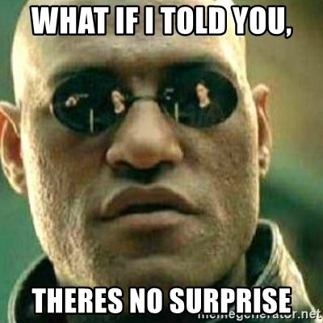

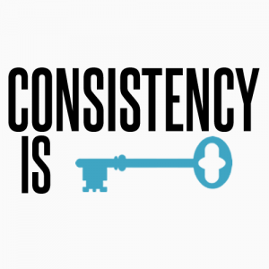
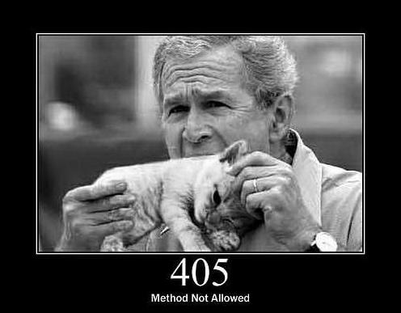
Why automate?
Faster
Consistent output
Predictable
Less room for human error
Notes:
Why should you automate things? Why should you change and move away from societal norms? Well there’s a few reasons. A few pretty reasonable reasons even.
So… quite naturally, if you automate something it tends to be faster. Think of it like this: what’s the fastest way to change the tv channel. It’s a remote control. You could get up and change it manually, but it would take longer and be less efficient timewise.
Pretty self explanatory. There’s only a set amount of what can happen if done properly, there’s no outside factors other than what you’ve programmed it to carry out.
This next point is somewhat inexplicably linked to my previous point. When the output is consistent, it becomes increasingly predictable. This means that the range of general errors that can occur are reduced greatly as there is only a set number of outcomes. When done properly, automation can make your daily tasks very predictable in their outcomes. When done properly.
You absolutely cannot idiot-proof anything in this world. You can however, hope to god that reducing the level of human interaction results in less things going wrong. Automating a task means there’s less of a chance of going wrong due to people directly. It doesn’t remove the possibility of it going wrong, like I said, you cannot idiot proof anything. People will always find a way to break something.
These a pretty general reasons as to why people automate things. In fairness, you will see reasons such as “reduces the cost of labour” and what not, and often that is a good reason, but in Redbrick we don’t get paid, so it;s not really a reason to automate.

Slide 4
What you can automate?
Social Media
Emails
Download notes
Backups
Notes:
What can you automate? Well in short, everything and anything. People tend to automate the strangest things, I’ll give some examples after we go through a brief explanation of what students often automate.
Social Media is one we are going to focus on today for a bit using something called IFTTT. More on that later. Automating social media isn’t just a student thing it’s pretty universal at this stage, for entrepreneurs and businesses alike. I can understand why, while everyone uses Facebook, no one really likes having to actually use it.
Emailing is pretty easy to automate to. In your time in DCU you’re bound to get auto-generated responses. At the start of the year I found myself automating emails most weekends when it came to room bookings. So yeah, it’s a pretty done thing.
I’ve even seen some students download or just in most cases scrape their notes off loop on a weekly basis. Pretty nifty idea, easy implement, and it saves you from having to actually go and use loop.
Back-ups. Back-ups are really important, and in turn, so is scheduling back-ups. I don’t see all that many students doing this kind of thing and they really should, it’s important and honestly it’s super simple to do. Probably going to have a talk on BASH next week that includes a BASH backup script. Come along to that, it’ll be pretty good.

Slide 5
Odd things to automate
Notes:
So when I said everything and anything, I really meant it. People go from doing the really good to the really odd. There are many many examples out there, like I’m sure if you pop over to Reddit you’ll find hundreds of odd automations.
There’s two in particular I highlighted as being worth a little mention here. This is more to see the extent to what can be automated more than anything.
This first one is quite clever.
“Some years ago we had a python chatbot in the company that would monitor power consumption. If it saw a power spike of 8 min or so it would figure out that coffee has been brewed and consequently alert everyone in the chat room about the freshly available coffee.”
Every office in the world could actually do with this. Pretty odd but good idea.
The next one is, quite odd, but again, should serve as an example of what you’re able to do.
“ My brother in law has a "habit" of going to jail. All. The. Time. My wife wants to know when it happens, so I setup a script to poll the local jail inmate rosters, and send me an email when his name shows up. It works pretty well.”

Slide 6

IFTTT
If This Then That
Creates chains of simple conditional statements.
No scripting.
Notes:
IFTTT IS A FREE WEB BASED SERVICE
MEANS YOU CAN LINK YOUR FACEBOOK AND TWITTER TOGETHER, INSTAGRAM AND TWITTER (NATIVE TWITTER IMAGE ETC).

Slide 7

Node-Red
Didn’t discover until this week.
Painless, next level IFTTT.
Can be used to capture IFTTT triggers.
Check out at https://github.com/node-red/node-red
Notes:
IFTTT IS A FREE WEB BASED SERVICE
MEANS YOU CAN LINK YOUR FACEBOOK AND TWITTER TOGETHER, INSTAGRAM AND TWITTER (NATIVE TWITTER IMAGE ETC).

Slide 8
What we have automated
User Registration and Management
Student Registration
Room Booking
Voting
Notes:
As I said earlier, We have automated quite a bit. I’m going to show you a little of what we have done now. It ranges from quite good to quite bad and hacky, but it works so…
User Reg and the management of RB memberships is a big part of the admin job, they get asked about getting a username change or creating a new user at least once a month, or thats what it seems like.
You have to register all you members with the SU in September/October I believe and when you have as many active memberships as we do this could end up being a job that takes well over 4 hours.
Room Booking and room lookup. I can talk more about this because this is my thing that I made. This stuff was all born out of having to book rooms and a hatred of moving because of labs.
Finally, voting. Does anyone know what a single transferable vote is? I hope someone does. Works like our general election here in fact. Peoples votes are shared out when they are eliminated. It’s really handy, and we are going to probably develop it into a web app at some point. Probably.

Slide 9
useradm
Helps us manage Redbrick’s membership.
Creates new users, renews accounts.
Check it out at - https://github.com/redbrick/useradm
Notes:
DO not ask any questions about useradm. I know what it does, I know how it works, but I cannot answer questions on it. MOst of committee are probably in that boat too. It’s like, not that bad, but it’s not great. It works, and it does what we need it to do. When I say It helps us manage RB memberships, I mean stuff like creating new users, and renewing users. It does quite a bit but those two things are some of the most important to know of.
BY all means check it out, if you want to trudge your way through the README go for it, I can’t say youll be any the better for it in all honesty.

Slide 10
Student Register
Written in NodeJS.
Uses puppeteer and reads a csv.
Submits the info on our membership.
Much faster than the alternative.

Slide 11
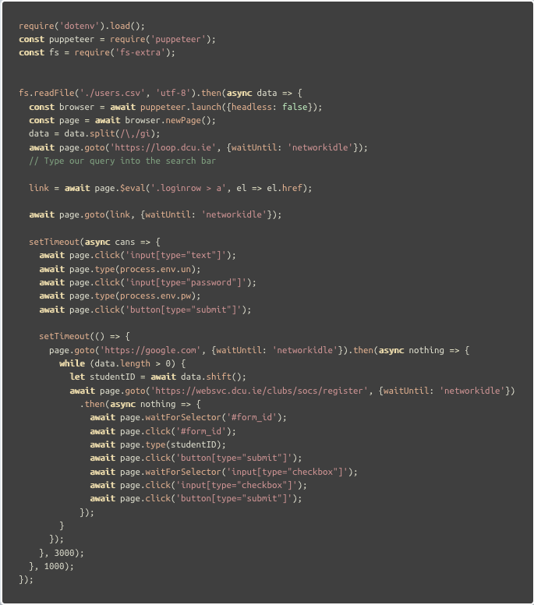
Reads a csv of student numbers.
Launches a headless browser using puppeteer.
Yes that does say “async cans”
Logs in and goes to registry page.
Enters student number one by one.
Logs in and goes to registry page.

Slide 12
good_stv
Yes there was a bad_stv.
Fast and quite robust in my opinion.
good_stv is written in Rust.

Slide 13
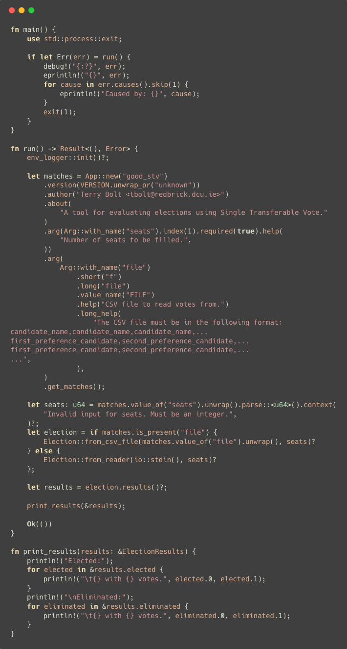
This is just some of the main.rs script.
Takes in a csv file and number of seats to be filled.
Handles almost anything you throw at it.

Slide 14
Room Booking and Lookup
I wrote this. It is not good.
Looks up and books rooms
Uses BeautifulSoup, and MechanicalSoup
I have automated myself out of a job.
Notes:
I wrote this, it like useradm uses python. It’s bascially a command line tool, it does the job for what I use it for. That said, I cannot consider it very good at all.

Slide 15
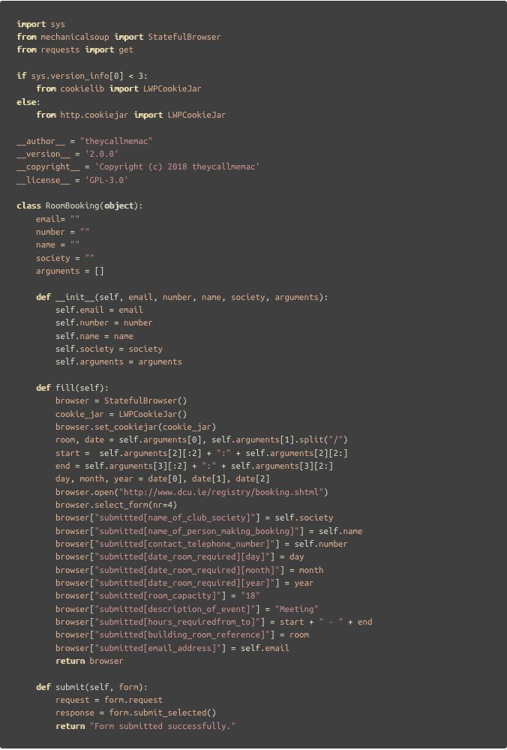
Lab Booking object from my room booking program.
Yes, the __init__ takes too many variables
“fill” interacts directly with https://www.dcu.ie/registry/booking.shtml
“submit” just confirms submission of the form.
Notes:
Here’s just a sample of some bad code from my room lookup and booking program. This is a Lab Booking object with a few methods.
Please ignore the init for now, it’ll get fixed soon.
The two methods here that can be focused on are the fill and submit functions. Fill works like this:
Sets up the Browser imported from MechanicalSoup, then sets the cookiejar from LWPCookieJar. From there it gets very hacky, slicing apart the attributes feed to it so as to conform the the form it has to fill in.
This line, where it says nr=4, means it’s filling in the fourth form on that page. MechanicalSoup is pretty cool in that way, you can navigate your way pretty easily based on tags found, just like BeautifulSoup really.
In the last month, has broken twice. For two completely different reasons. Firstly, they changed the link, and then, they changed the form number. Originally it was number 2, now it is the 4th on the page.

Slide 16
Questions? ( feedback )

